Slide 1
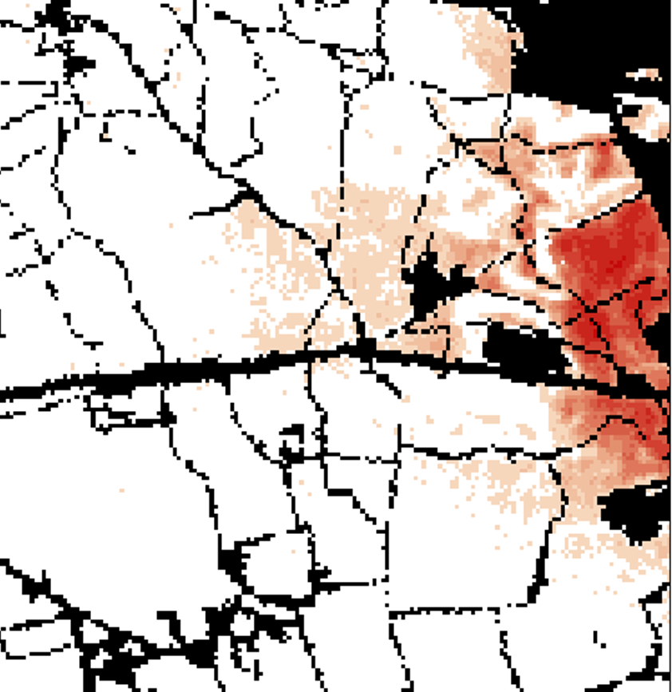

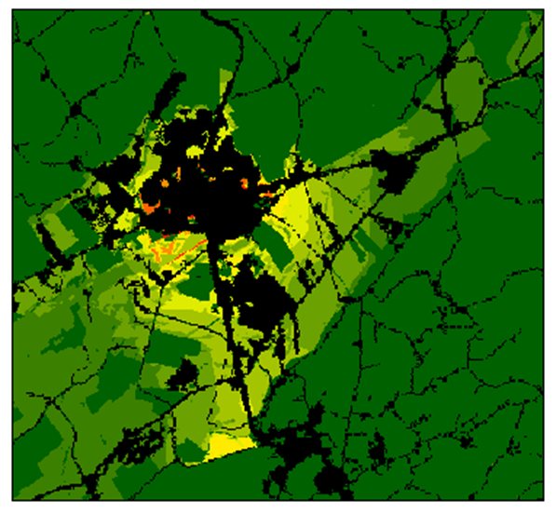




Modeling suitability for urban development in the Delaware River Basin
Mr. Alfonso Yáñez
Dr. Claire A. Jantz | Ms. Antonia Price
Dr. Scott Drzyzga | Mr. Joshua Barth
Dr. Dorlisa Minnick | Ms. Caitlin Lucas
Notes:
First, I’d like to thank in advance the presence of all of you here.
This presentation is going to show a part of a bigger project that aims to generate an urban development forecast for the Delaware River Basin up to 2070.

Slide 2
introduction
CA models, like SLEUTH (Clark, 2000), are becoming one of the most recurrent ways to simulate and forecast urban growth.
Suitability matrix
All land equal
Conversion rates
Multi-criteria Decision Analysis
Statistical Models
Hierarchical approaches
Area : 66.791 km²
Population:13.05 millions
(census 2010)
Notes:
Cellular Automata are broadly used to model city growth.
In our project, we are using SLEUTH, one of the most known and widespread models.
SLEUTH, like other Cellular Automata, uses a suitability map, that becomes a critical key for improving forecasts.
There are a different approaches for making that map.
The simplest one is to treat all available land as having equal value,
or we can apply more sophisticated methods that use a large number of different factors.
……
Here on the left, we have a map of the study are. (click)
It is a large extension and well populated. (click)
The North and in the South is more rural…
The north is forestall, the central region is agricultural…
There are cities, towns and suburbs….
Roads are not evenly distributed….
That complex reality has to be summarized in only one suitability matrix.

Slide 3
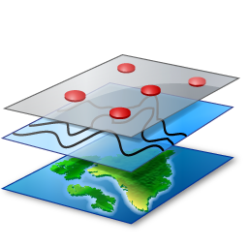
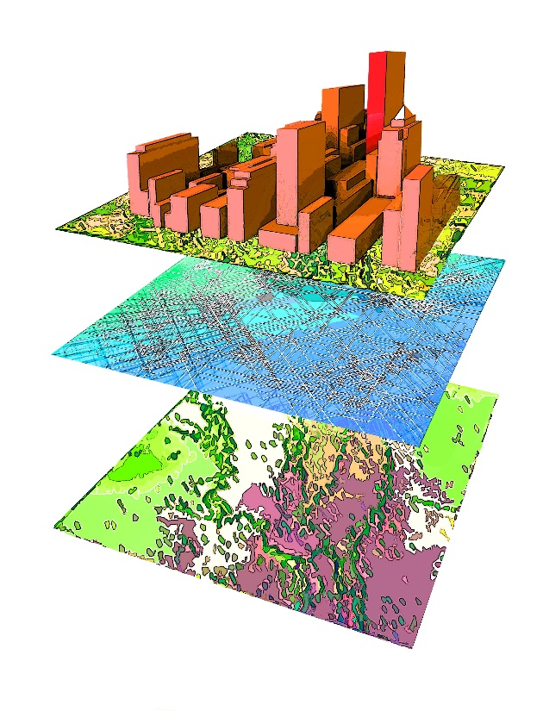
Factors
What can cause a terrain to be developed in the future?
  Physical factors
  Accessibility
  Demographics & Economy
  Limitations
Factors operate at different scales
Different importance
Non-stationary
Hierarchical approach
Notes:
So, in order to build that suitability matrix, we have to ask ourselves about the causes that lead to develop a portion of land.
The most common factors to address are: physical factors, those related to the access to resources, population and economy.
We must also add limitations that restrict or impede development, like those derived from planning processes.
However, we should highlight some aspects of the data.
Not all factors operate at the same scale.
Neither they have the same relevance.
We also should expect a different reaction to the same stimulus from one place to another.
All of that makes more reasonable to follow a hierarchical approach.

Slide 4
Factors
City Growth Theory (Storper & Scott, 2009):
  Human Capital drives city growth
  The cities offer the conditions to attract Human Capital
Amenities
Human Capital
City
Economy
Notes:
In the city growth theory, the rise and decline of cities depends on their ability to attract Human Capital.
There are two schools depending on what is the cause for that attraction: amenities or economy.
The arrows towards the left indicates that is city who offers, giving an active role to the city.
However, shifting the perspective, we can say that the action lays on the people, specifically in our ability to choose a destination.

Slide 5
Factors
Amenities
Human Capital
City
Economy
From the people perspective, This is a decision-making process to choose a place to live.
Sequential process: First opportunities and second place characteristics
Human Capital
Economy
Amenities
City
Population & Employment
Accessibility
Notes:
From that perspective, we consider in our model that both divers play a role, but the process of election is carried out sequentially, first driven by economy and later by amenities.
It accounts first to find opportunities, and then the election is narrowed down looking for a place that provides a better quality of life.
Finally, translating what economy and amenities means in relation with our factors…. (click)
Growth depends in firstly on the conditions given by population and employment and then is specified by the accessibility to services.

Slide 6
Physical factors
Notes:
We are going to treat group of factors in separate sub-models, and the order goes from those operating at smaller scales to a wider scales.
So we start first with the physical factors.

Slide 7
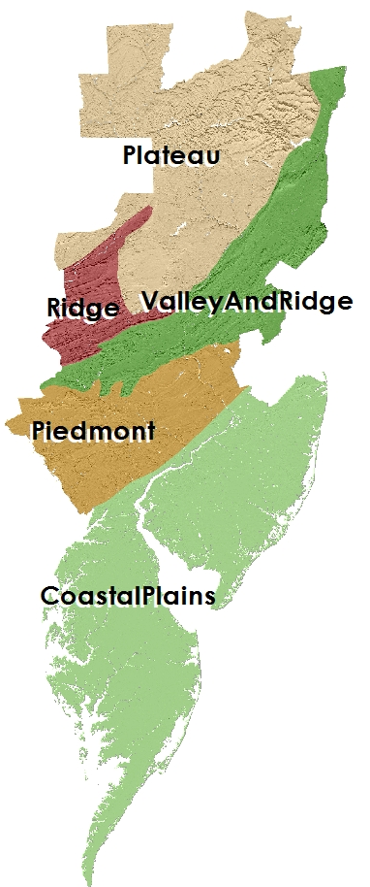
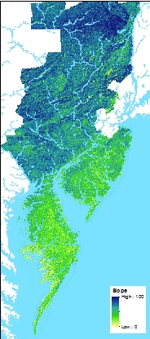
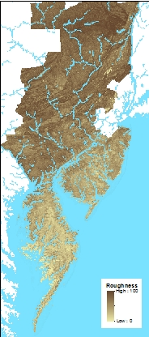
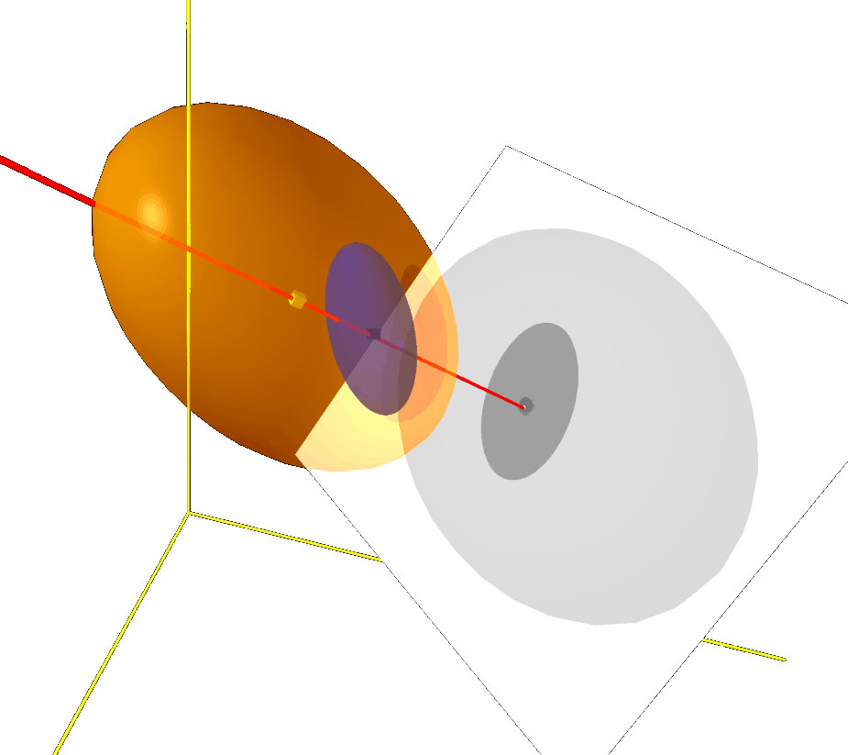
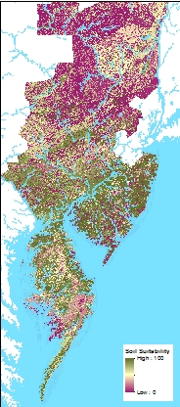
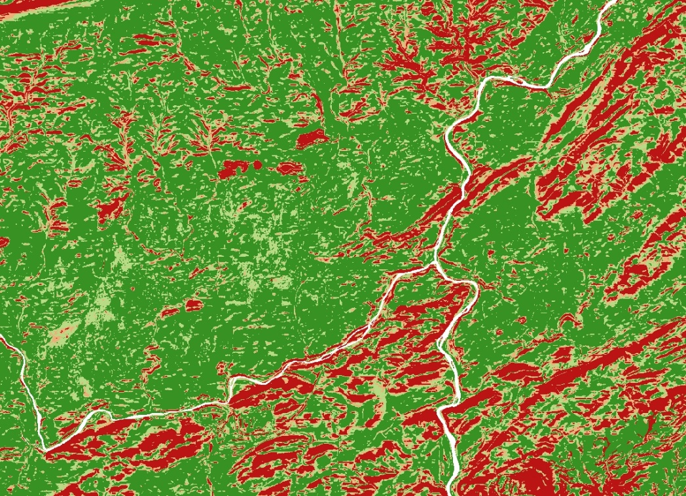
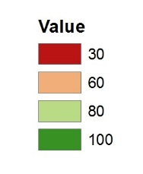
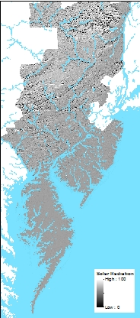
Physical Model
Quality of the land to be built
Slope
Regions
Roughness
Soil suitability
Ecological Niche Factor Analysis – ENFA. Hirzel et al., (2002)
Only needs presence data.
Used urban pixels not growth
Like PCA, ENFA summarizes variables into a few uncorrelated axis.
Solar hours
&
radiation
Data source: DEM USGS_NED (1 arc-second); SSURGO-NRCS
Notes:
The physical sub-model aims to classify the landscape based on the land’s suitability for building on it.
From the DEM and soil data, we obtained maps of slope, roughness, soil quality for building, and solar radiation and duration.
…And from those, an ENFA analysis was carried out in five physiographic regions.
ENFA is a methodology used to determine the potential distribution of species from their actual distribution. So, we treat development as a species and we try to identify its habitat.
Similar to multivariate analyses, like PCA, ENFA summarizes the variation of a number of factors into a smaller number which are subsequently combined in a unique index.
The graph shows that both, growth and all landscape cells, are distributed towards the high index scores.
That confirms, on one side, that the niche is well constructed and that, on the other hand, the landscape is mostly suitable for construction.
Using the ratio of the frequencies gives us a criterion to classify all landscape cells.

Slide 8
ACCESSIBILITY
Notes:
Next Accessibility which operates in medium-range scale.

Slide 9
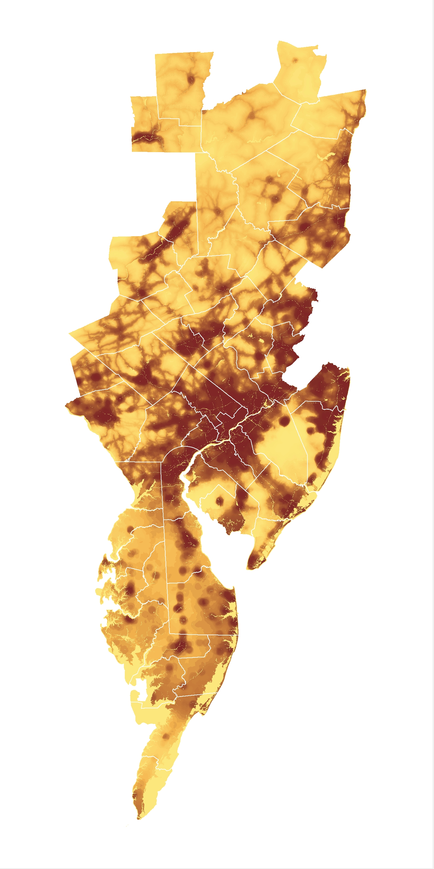
ACCESSIBILITY Model
The more suitable places are those where it is easier to reach a variety of resources to cover our needs.
Roads
Road | Country | Urban
Freeways | 70 mi/h
Highways | 60 mi/h
Main roads | 55 mi/h | 25 mi/h
Country roads | 45 mi/h | 20 mi/h
Ramps | 35 mi/h
Urban |  | 15 mi/h
Non-urban | 20 mi/h
Friction raster
Junctions to freeways
Main roads (except freeways)
Rail stations (Amtrak & SEPTA)
Water recreational resources
Federal and State forests
Distance measure as time (minutes) to the closest resource
Logistic Regression
Percentage development 5 km around each cell.
Land developed
Notes:
The accessibility sub-model tries to reflect the fact, that the decision-making process for choosing a place tends to value the places where there is easier access to a wider variety of amenities and entertainment.
Considering that the distance you can reach driving in them, and that many services are concentrated around them,
distance to the main transportation network is one of the most influential accessibility factors.
Because most of the services are in actual developed areas, we also can determine that, the more urban areas we have nearby a location, the greater probability of having more services.
And because tourism is an important activity in some regions, we incorporated accessibility to water and forest recreation resources as possible attractors.
A logistic regression was applied to obtain a probability map, where the chance of one cell to be developed depends on its situation respect of different sources.
As we can see in this map, the accessibility sub-model gives us a preference to areas surrounding actual urban centers and transportation corridors.

Slide 10
Demography & economy
Notes:
The last sub-model is the socioeconomic sub-model, the most important of all sub-models that make up our approach.

Slide 11
Individual perspective
Reasons for moving
11.7% of the US population changes residence in a year
Of them:
48.0% report house-related reasons
30.3% for family causes
19.4% for employment
23% other causes
D. Ihrle. 2014, Annual Social & Economic Supplement. Census Bureau
Notes:
Many people move every year, and almost half of them do so because of house-related reasons:
the need a bigger house, quieter neighborhood, etc.…

Slide 12
Individual perspective
Job related reasons increase with educational level
Bachelor: 28.3% Graduate: 35.2%
And with the distance
 | Family | Job | Housing | Total
Intracounty | 29.9 | 10.5 | 57.6 | 64.5%
Intercounty | 31.0 | 34.8 | 31.2 | 32.7%
<50 mi. | 33.4 | 22.7 | 41.5 | 13.1%
50-200 mi. | 29.6 | 34.3 | 32.1 | 6.8%
D. Ihrle. 2014, Annual Social & Economic Supplement. Census Bureau
Notes:
Distance plays also an important role, so the great majority of moves are inside the county, but when the distance increases, the job becomes more important in the decision.

Slide 13

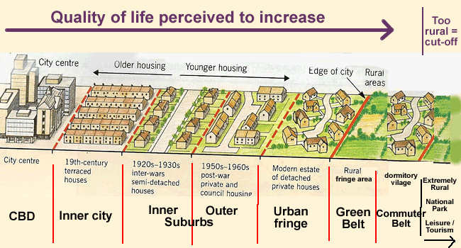
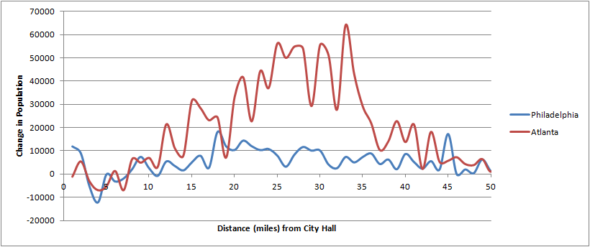
Urban Sprawl & local centers
Idealized landscape; monocentric model
Actual landscape; multiple local centers
US MSAs urban vs suburban growth (200-2010). SW Ontario Urbanist (in web).
Notes:
We must also note that the monocentric model of the city has changed into a reality where the city’s core lives together with multiple local centers.
All these aspects led us to develop a conceptual model; we have designed the analysis around it.

Slide 14
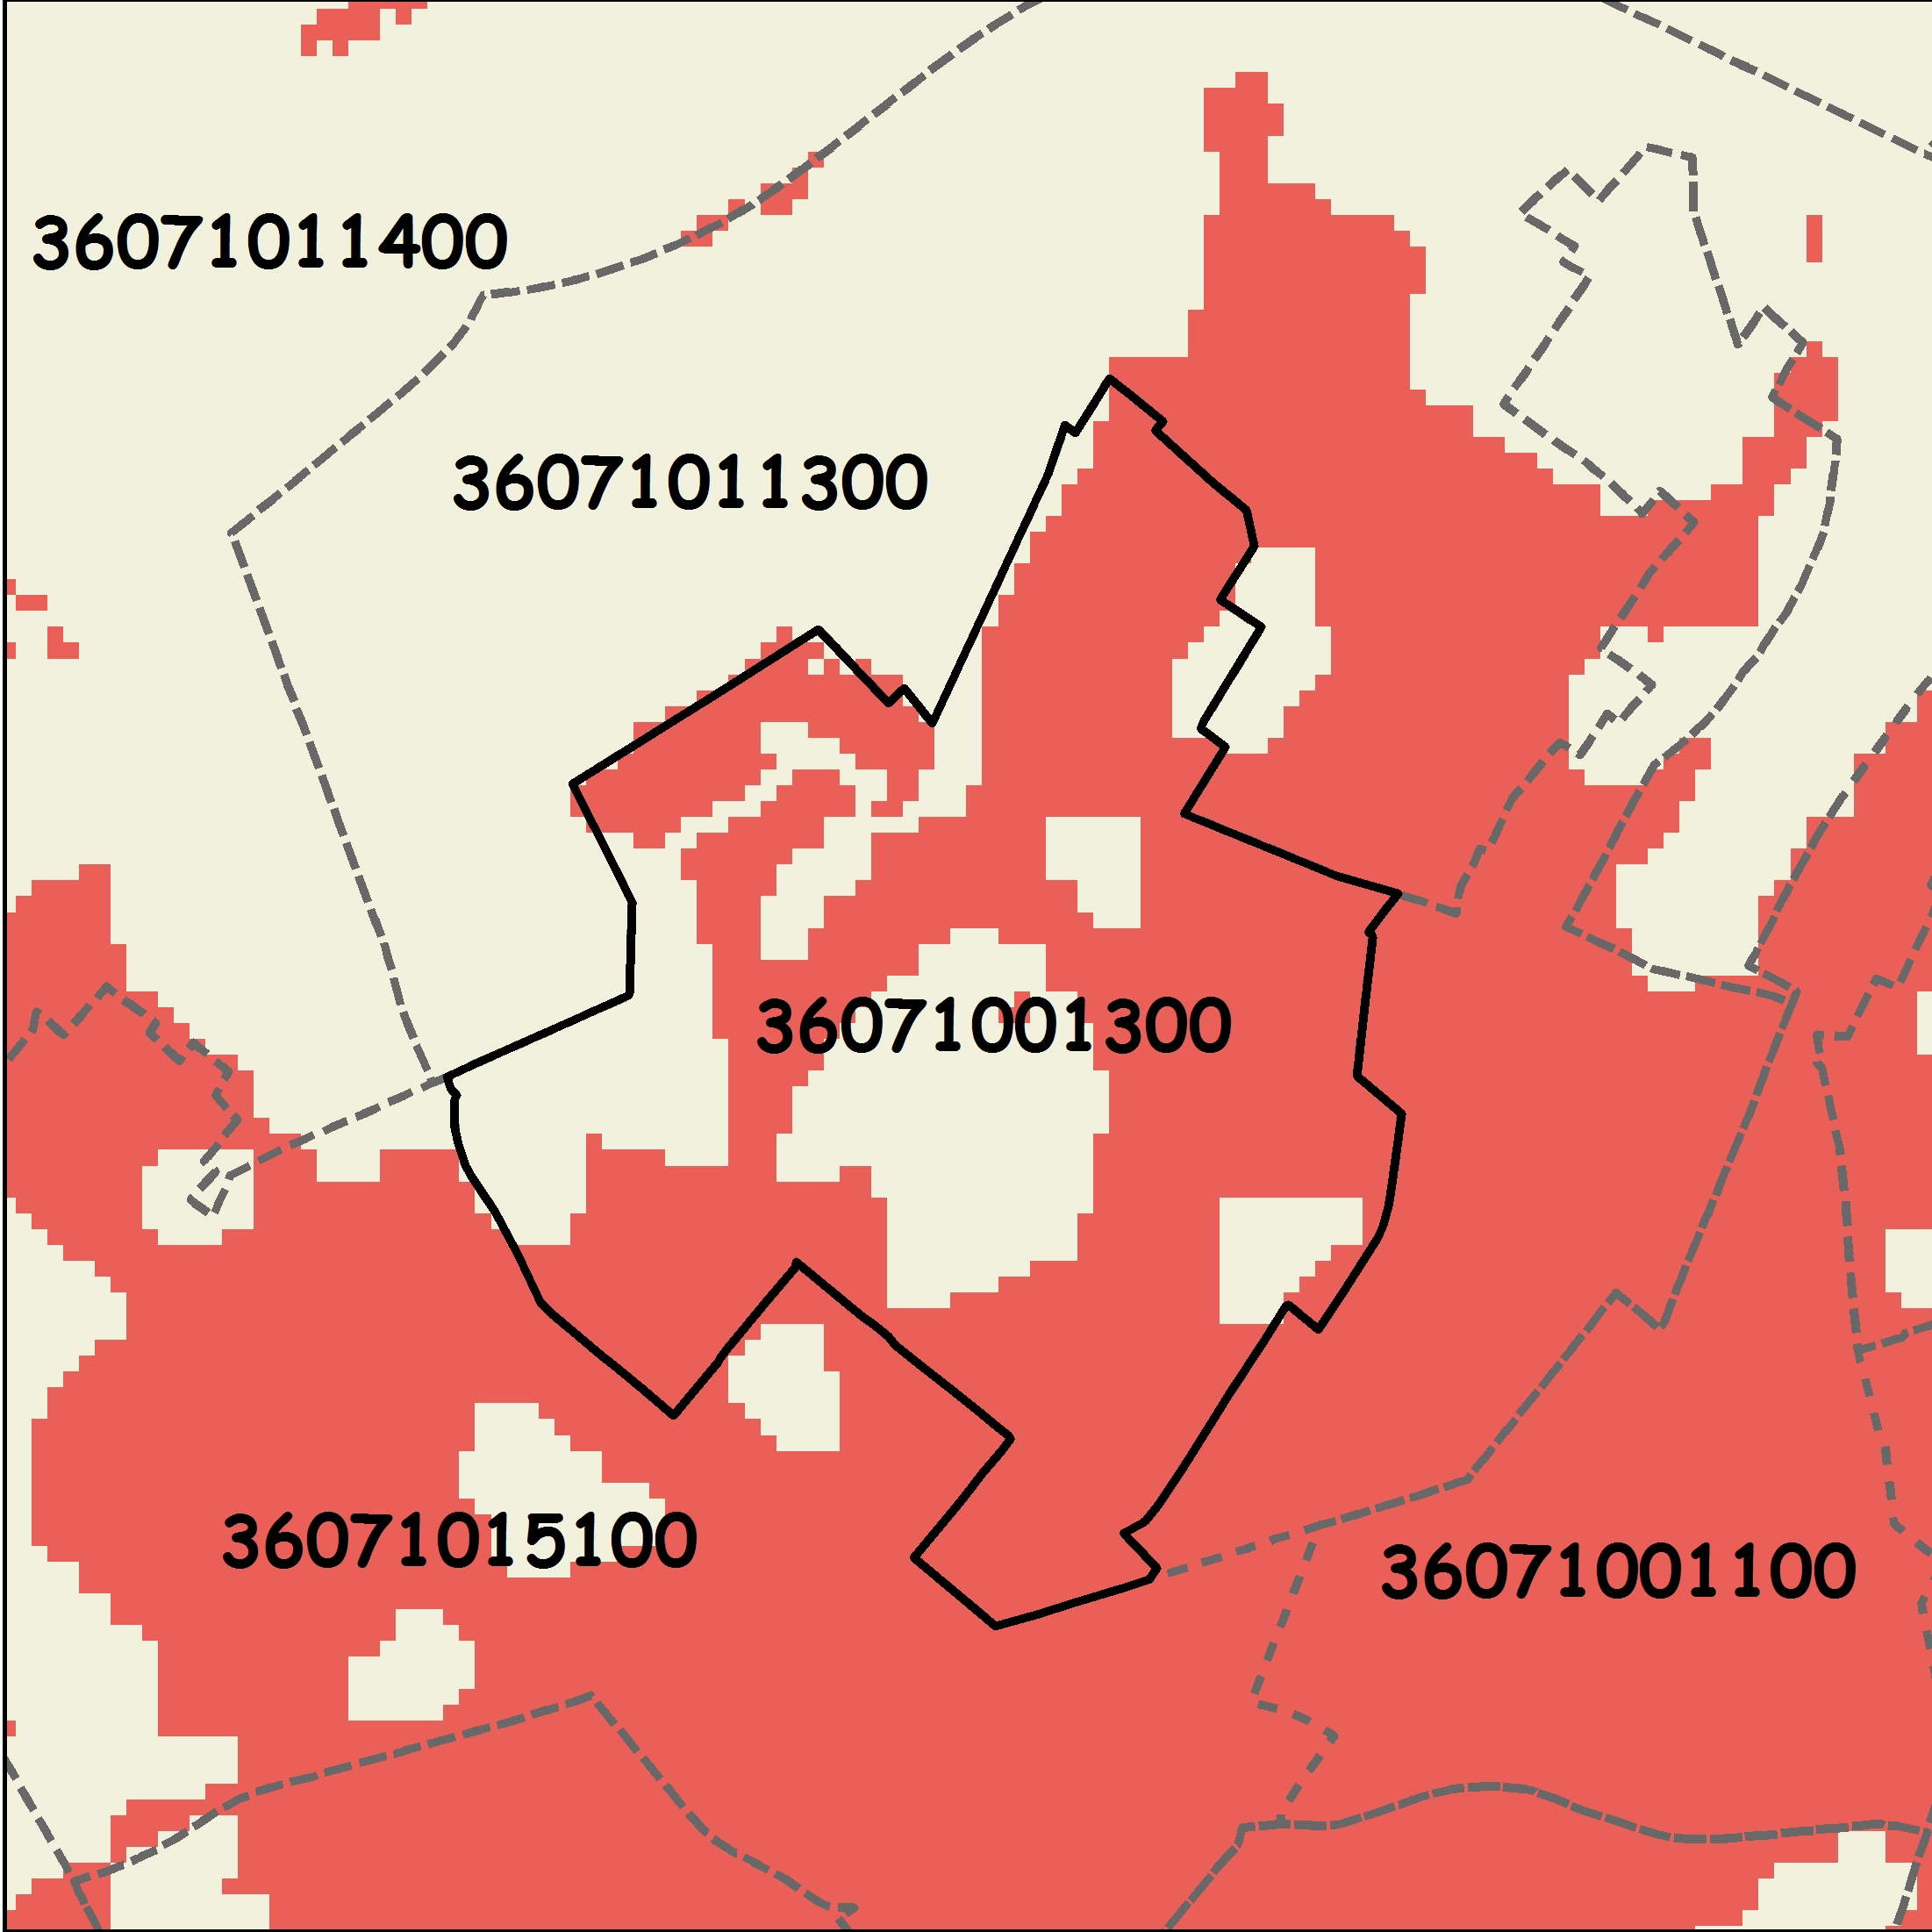
Conceptual Model
Tract
Notes:
We started with a spatial unit, for example, a census tract. The tract has developed a fraction of its surface.

Slide 15
Conceptual Model
Neighborhood (tract):
Population → Residential
Employment → Commercial
Population
Employment
Tract
Notes:
In first place, we can assume that the developed extension is a consequence of its demographical evolution and activities in it. Therefore, changes in population and employment will bring changes to the developed area.
We said before that people move, so there should be a pool of people interested in moving there.

Slide 16
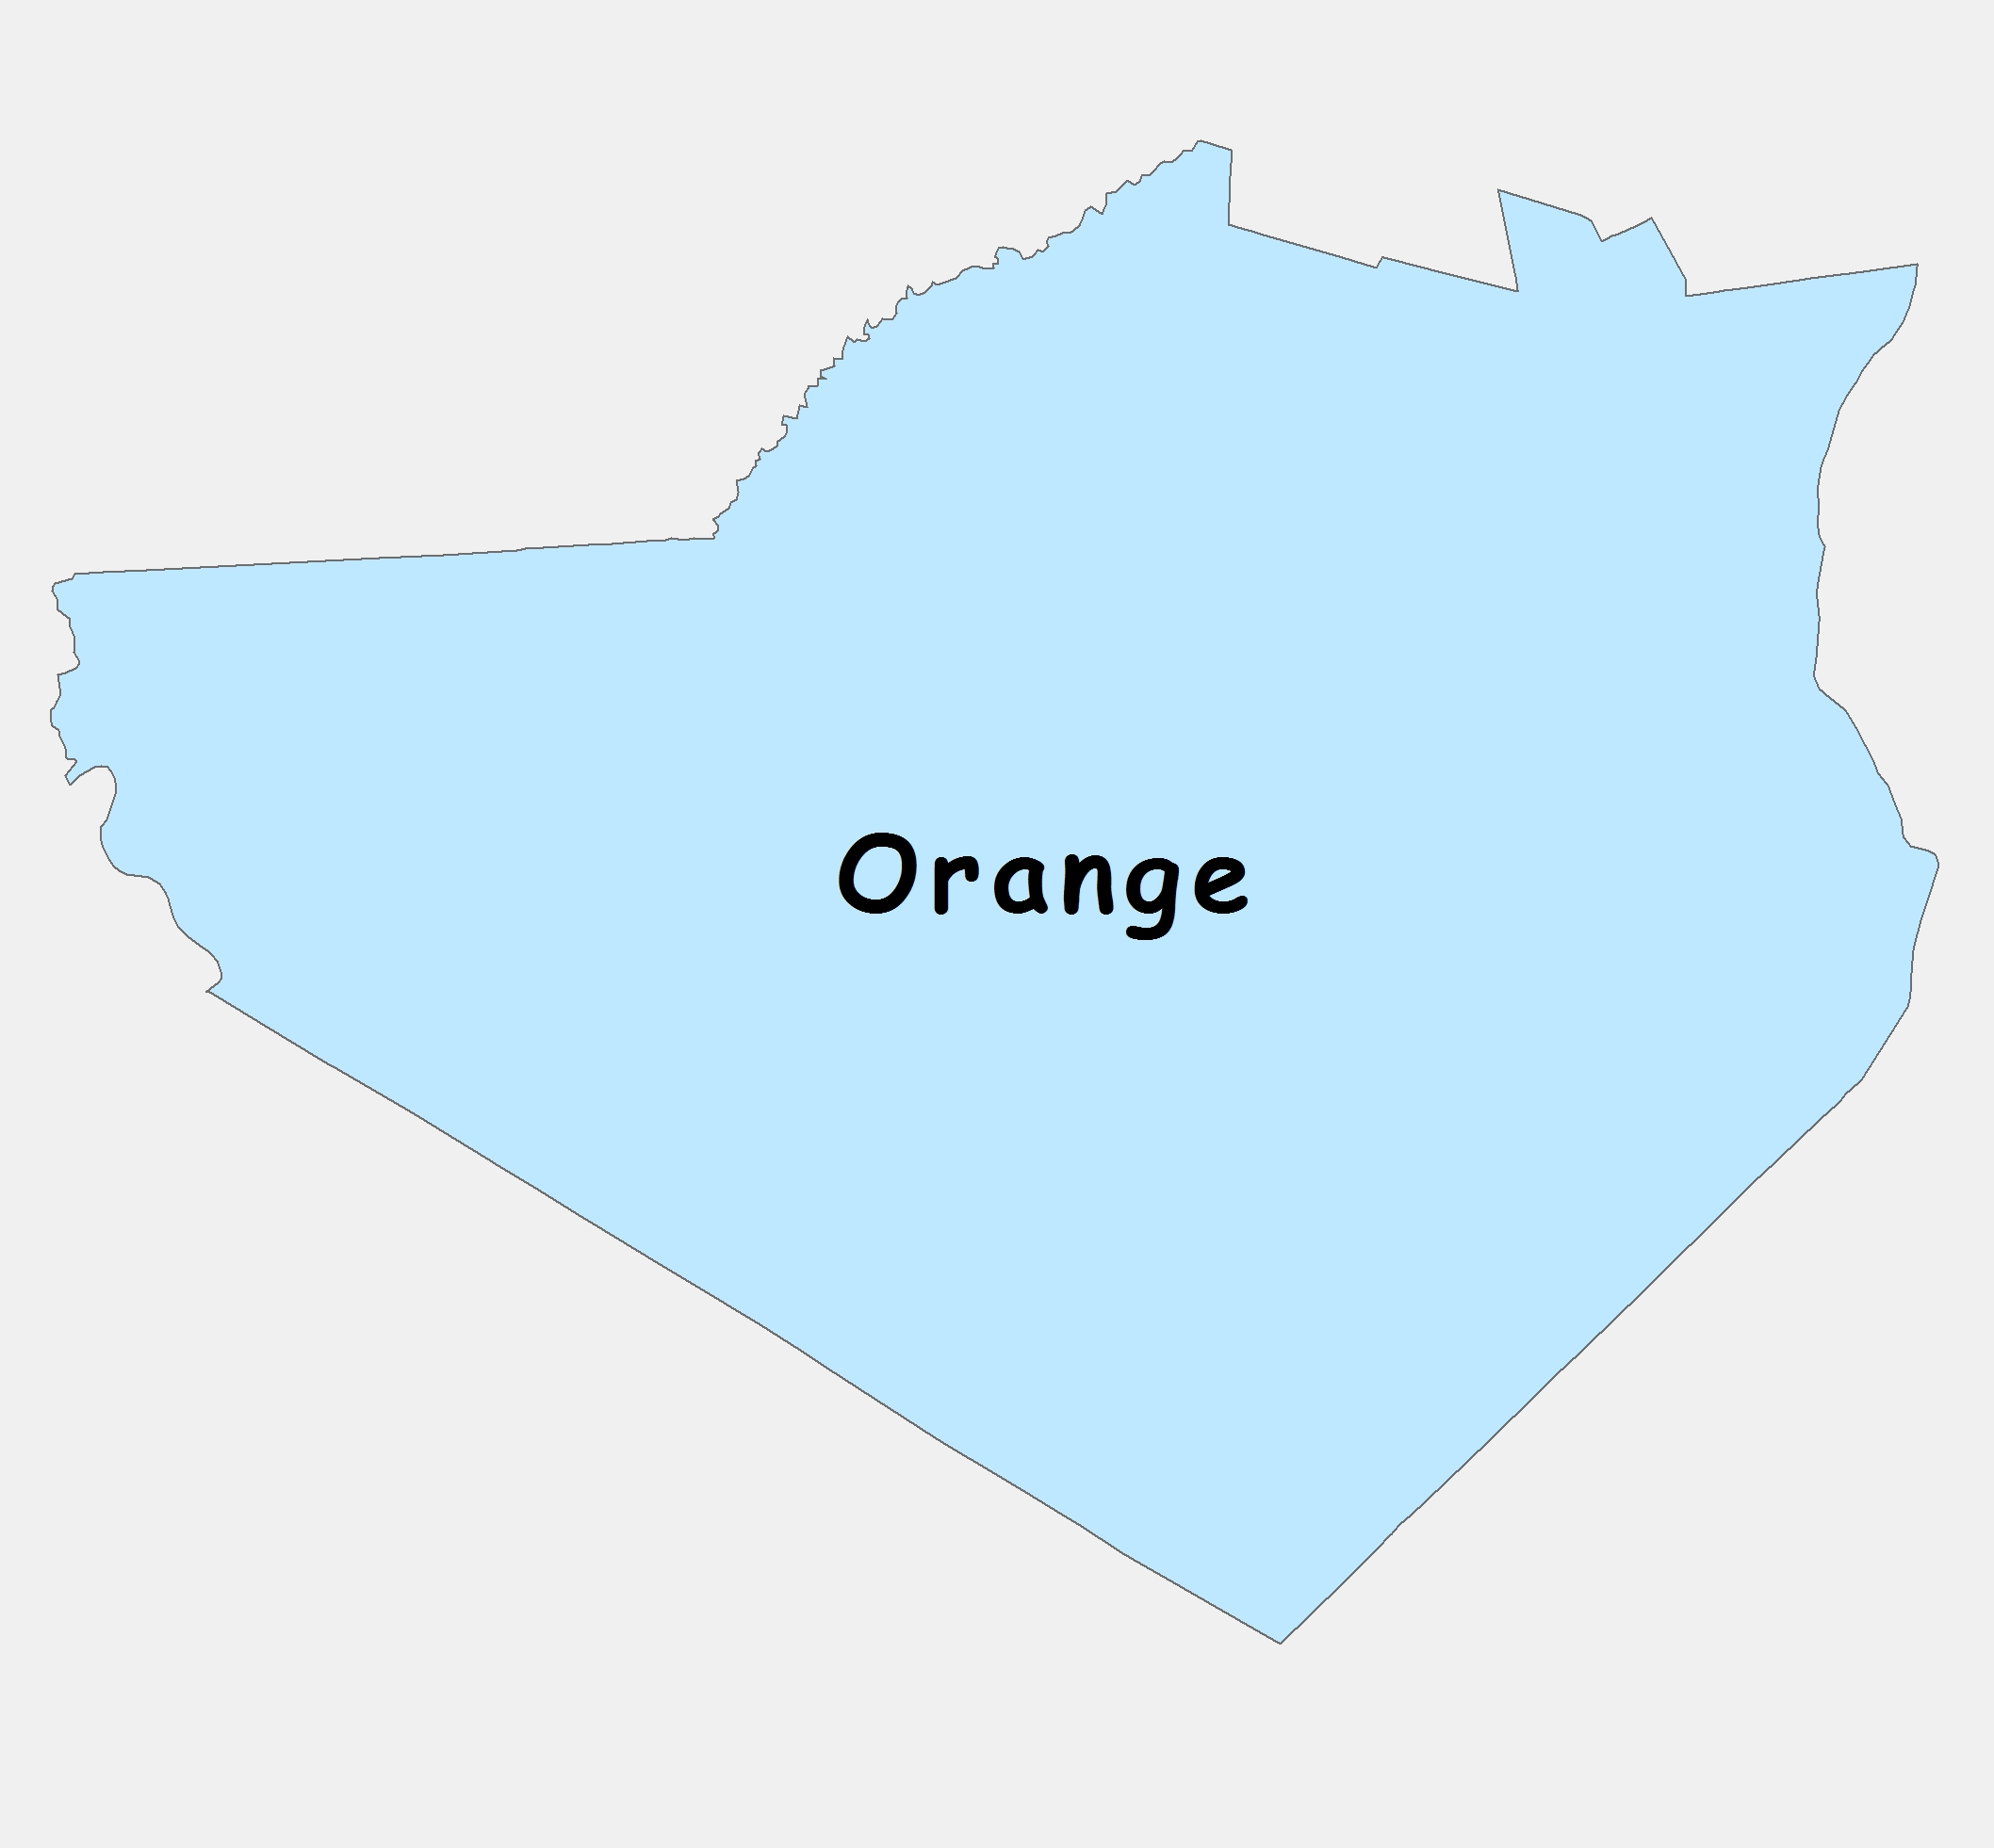

Conceptual Model
County
Neighborhood (tract):
Population → Residential
Employment → Commercial
County:
Relocation
City:
Migration to suburbs
Population
Population
Employment
Population
City
Tract
Notes:
…., and we also mentioned that most of the moves are inside the county.
On the other hand, it is well documented that one of the factors that in the last 60 years has contributed to urban sprawl is migration from the city core to the suburbs.
There are three important metropolitan cities that influence our study area: Philadelphia, which is part of the area, and New York City and Baltimore, both outside of it.

Slide 17
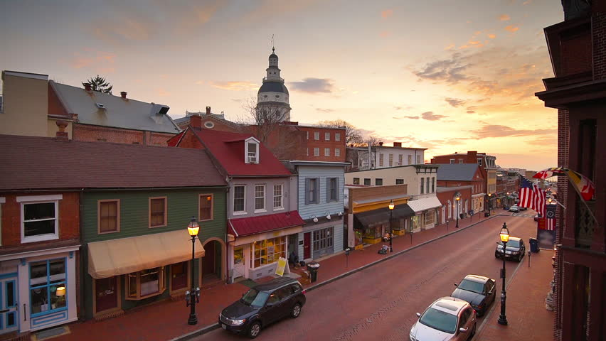
Conceptual Model
County
Neighborhood (tract):
Population → Residential
Employment → Commercial
County:
Relocation
City:
Migration to suburbs
Opportunities
Local-Regional Center:
Opportunities
Local Center
Population
Population
Employment
Population
City
Tract
Notes:
…. and lastly, metropolis and regional and local centers play a role revitalizing and catalyzing economic elements in their influence zones. This economic development is watched from the tract perspective as a series of opportunities and expectations that can drive employment creation and/or attract more people.

Slide 18
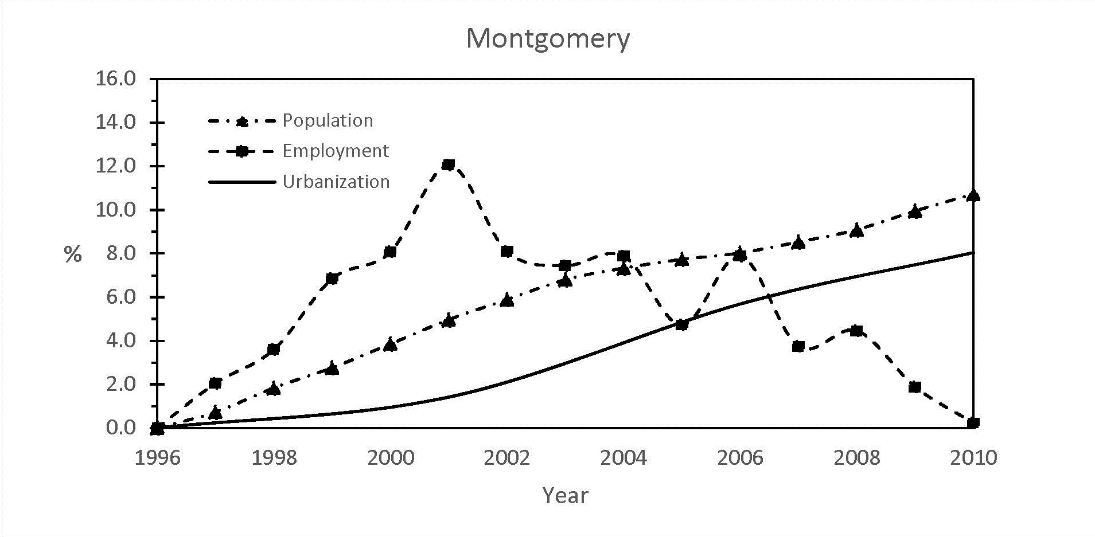
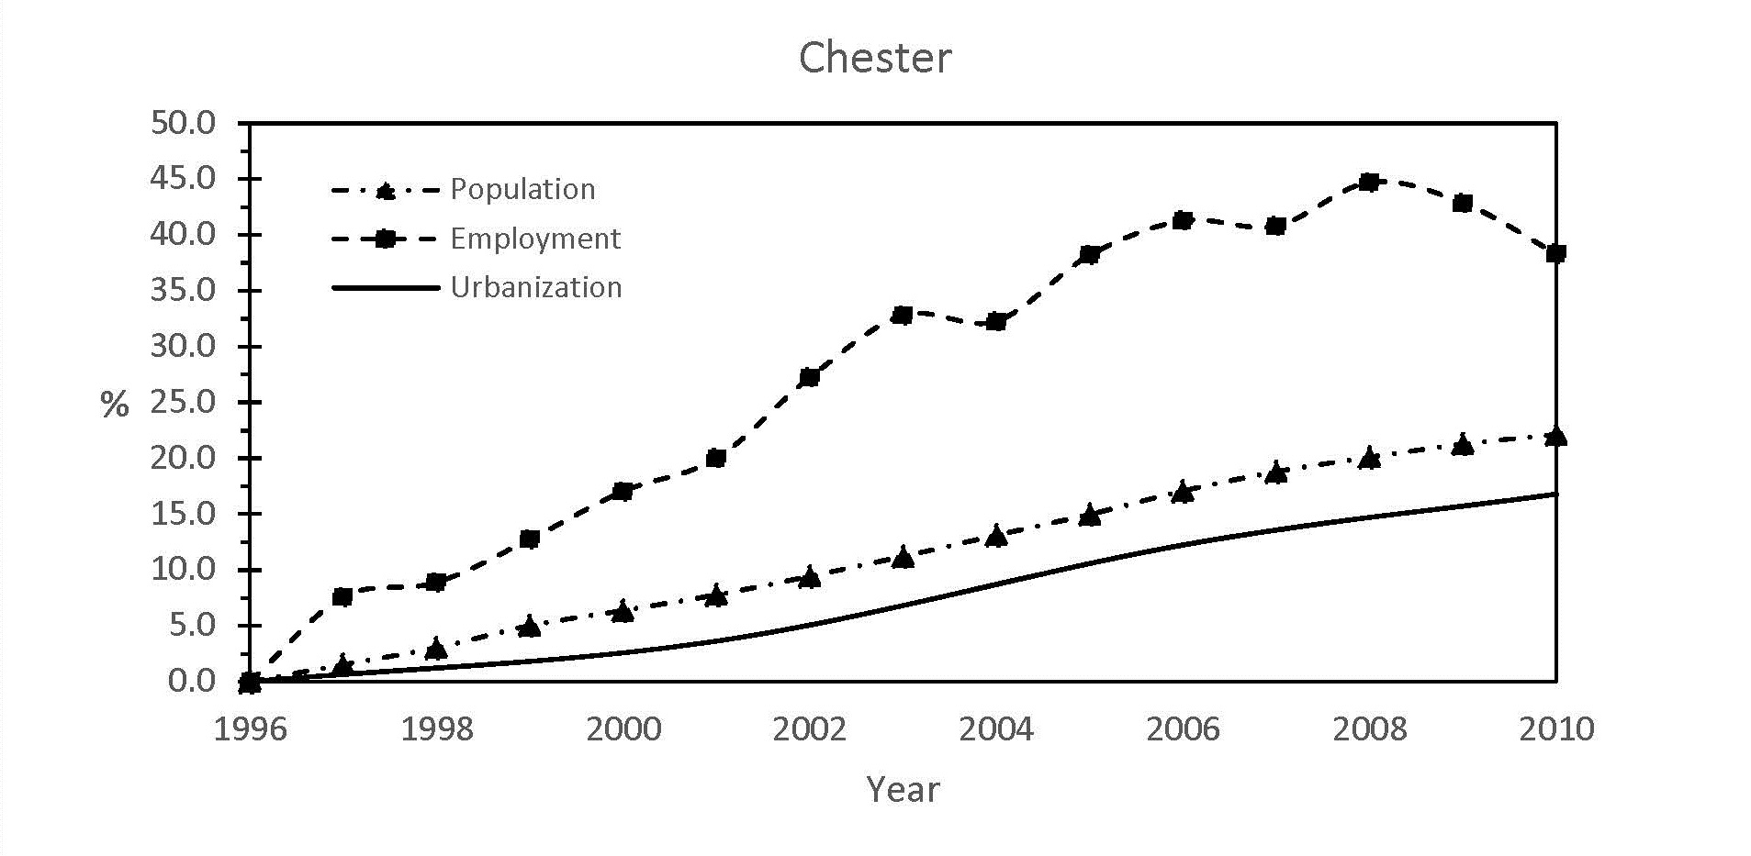
Socioeconomic Model
Is there a simple relationship between population, employment and urban growth ?
Notes:
Is there a simple relationship between changes in urban development, population, and employment?
The answer is probably negative.
It´s not easy to find a simple and unique relationship between urban growth and population and employment.
In these two charts, we can observe the evolution of growth, population and employment in two counties, Chester and Montgomery.
In Chester, we can easily see that the population curve matches the shape of the growth curve.
In Montgomery, neither the population nor the employment correlate to the evolution of growth.
This is an example of an issue we faced - the lack of a unique pattern of development drivers.

Slide 19
Socioeconomic Model
Population and employment are the drivers responsible for the intensity of the development.
Population and employment data organized in a hierarchical structure of tract-center-county and city
Population
Employment
&
Growth
GWR
G = f(p, e)
Each location is assigned to its centroid
Poisson model
Bi-square kernel
Bandwidth 60 points
Estimated averaged future conditions of population and employment
Estimated averaged annual urban development
Sources: State & EPA-ICLUS v.1 projections
GWR4.09 & R-package GModel
Notes:
If the physical sub-model shows the suitability of the land, and the accessibility sub-model shows its likelihood to be chosen, the socioeconomic sub-model determines the intensity of the development.
As a first step, we divided the study area into XXXX polygons based on the census tracts and the accessibility index, and after that, the location of each polygon was assigned to the coordinates of its centroid.
Next, we organized the population and employment data in a hierarchical structure of tract, center, county, and city.
Since the relationship of growth with population and employment is very specific to the location, as we see previously, we used a Geographical Weighted Regression analysis to obtain a way to translate future population projection into an expected future growth scenario.
The GWR performs a local regression fitted with the neighborhood values at each location.
And lastly, we used state population projections up to 2030 and an adjustment of the EPA´s ICLUS projections up to 2070 to generate a future growth scenario.

Slide 20
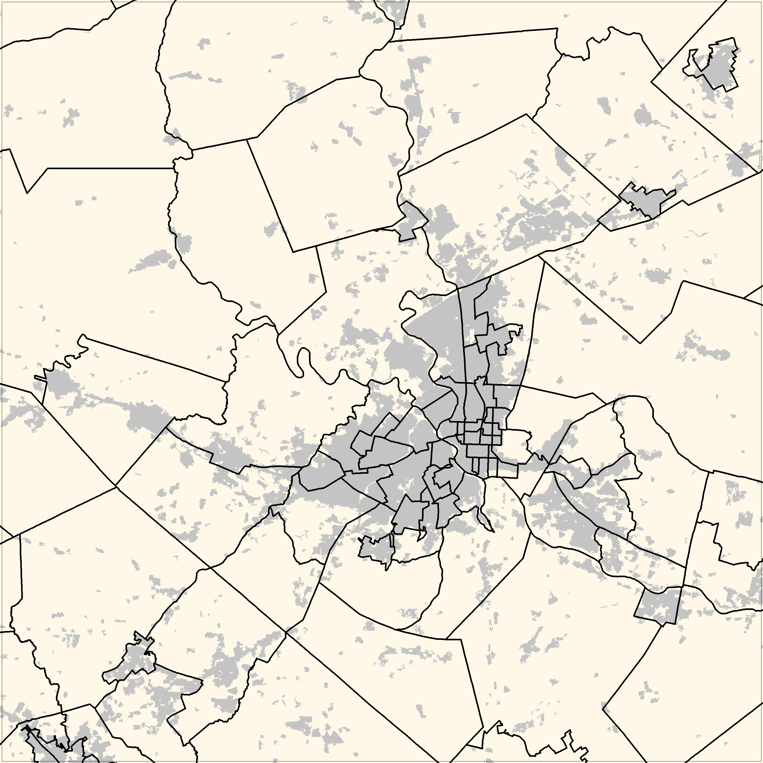
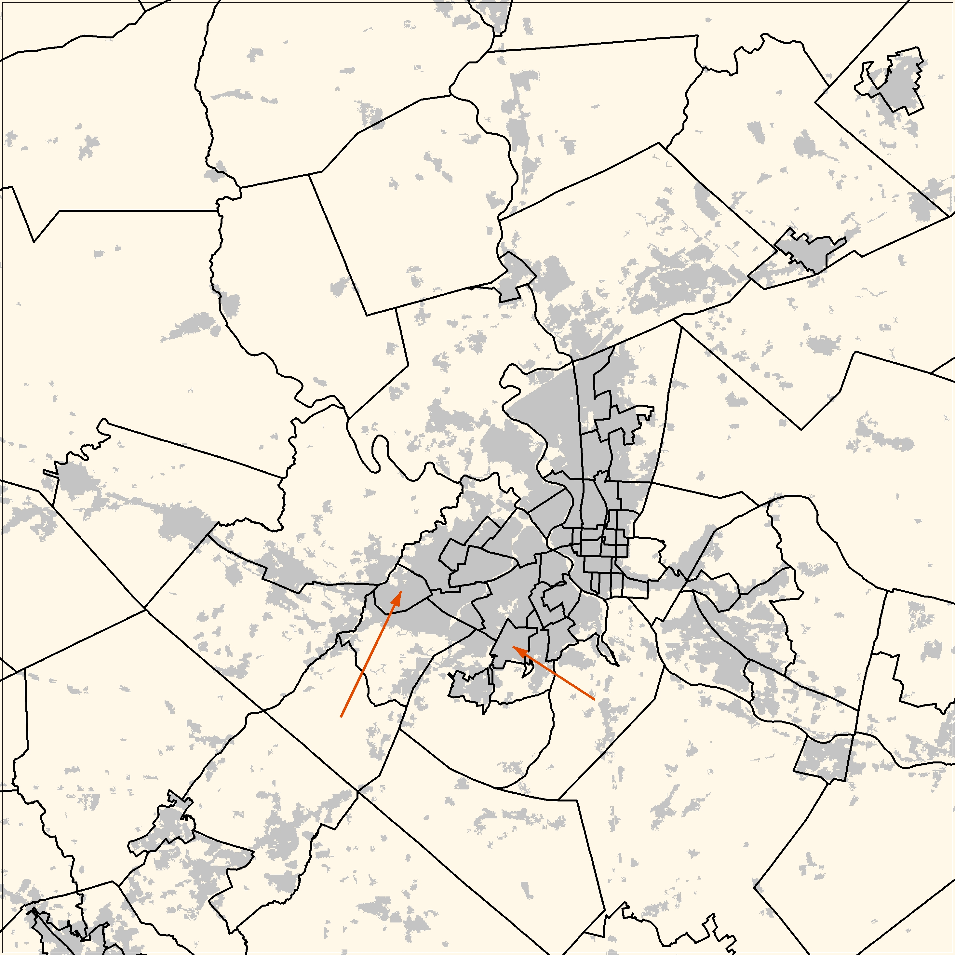
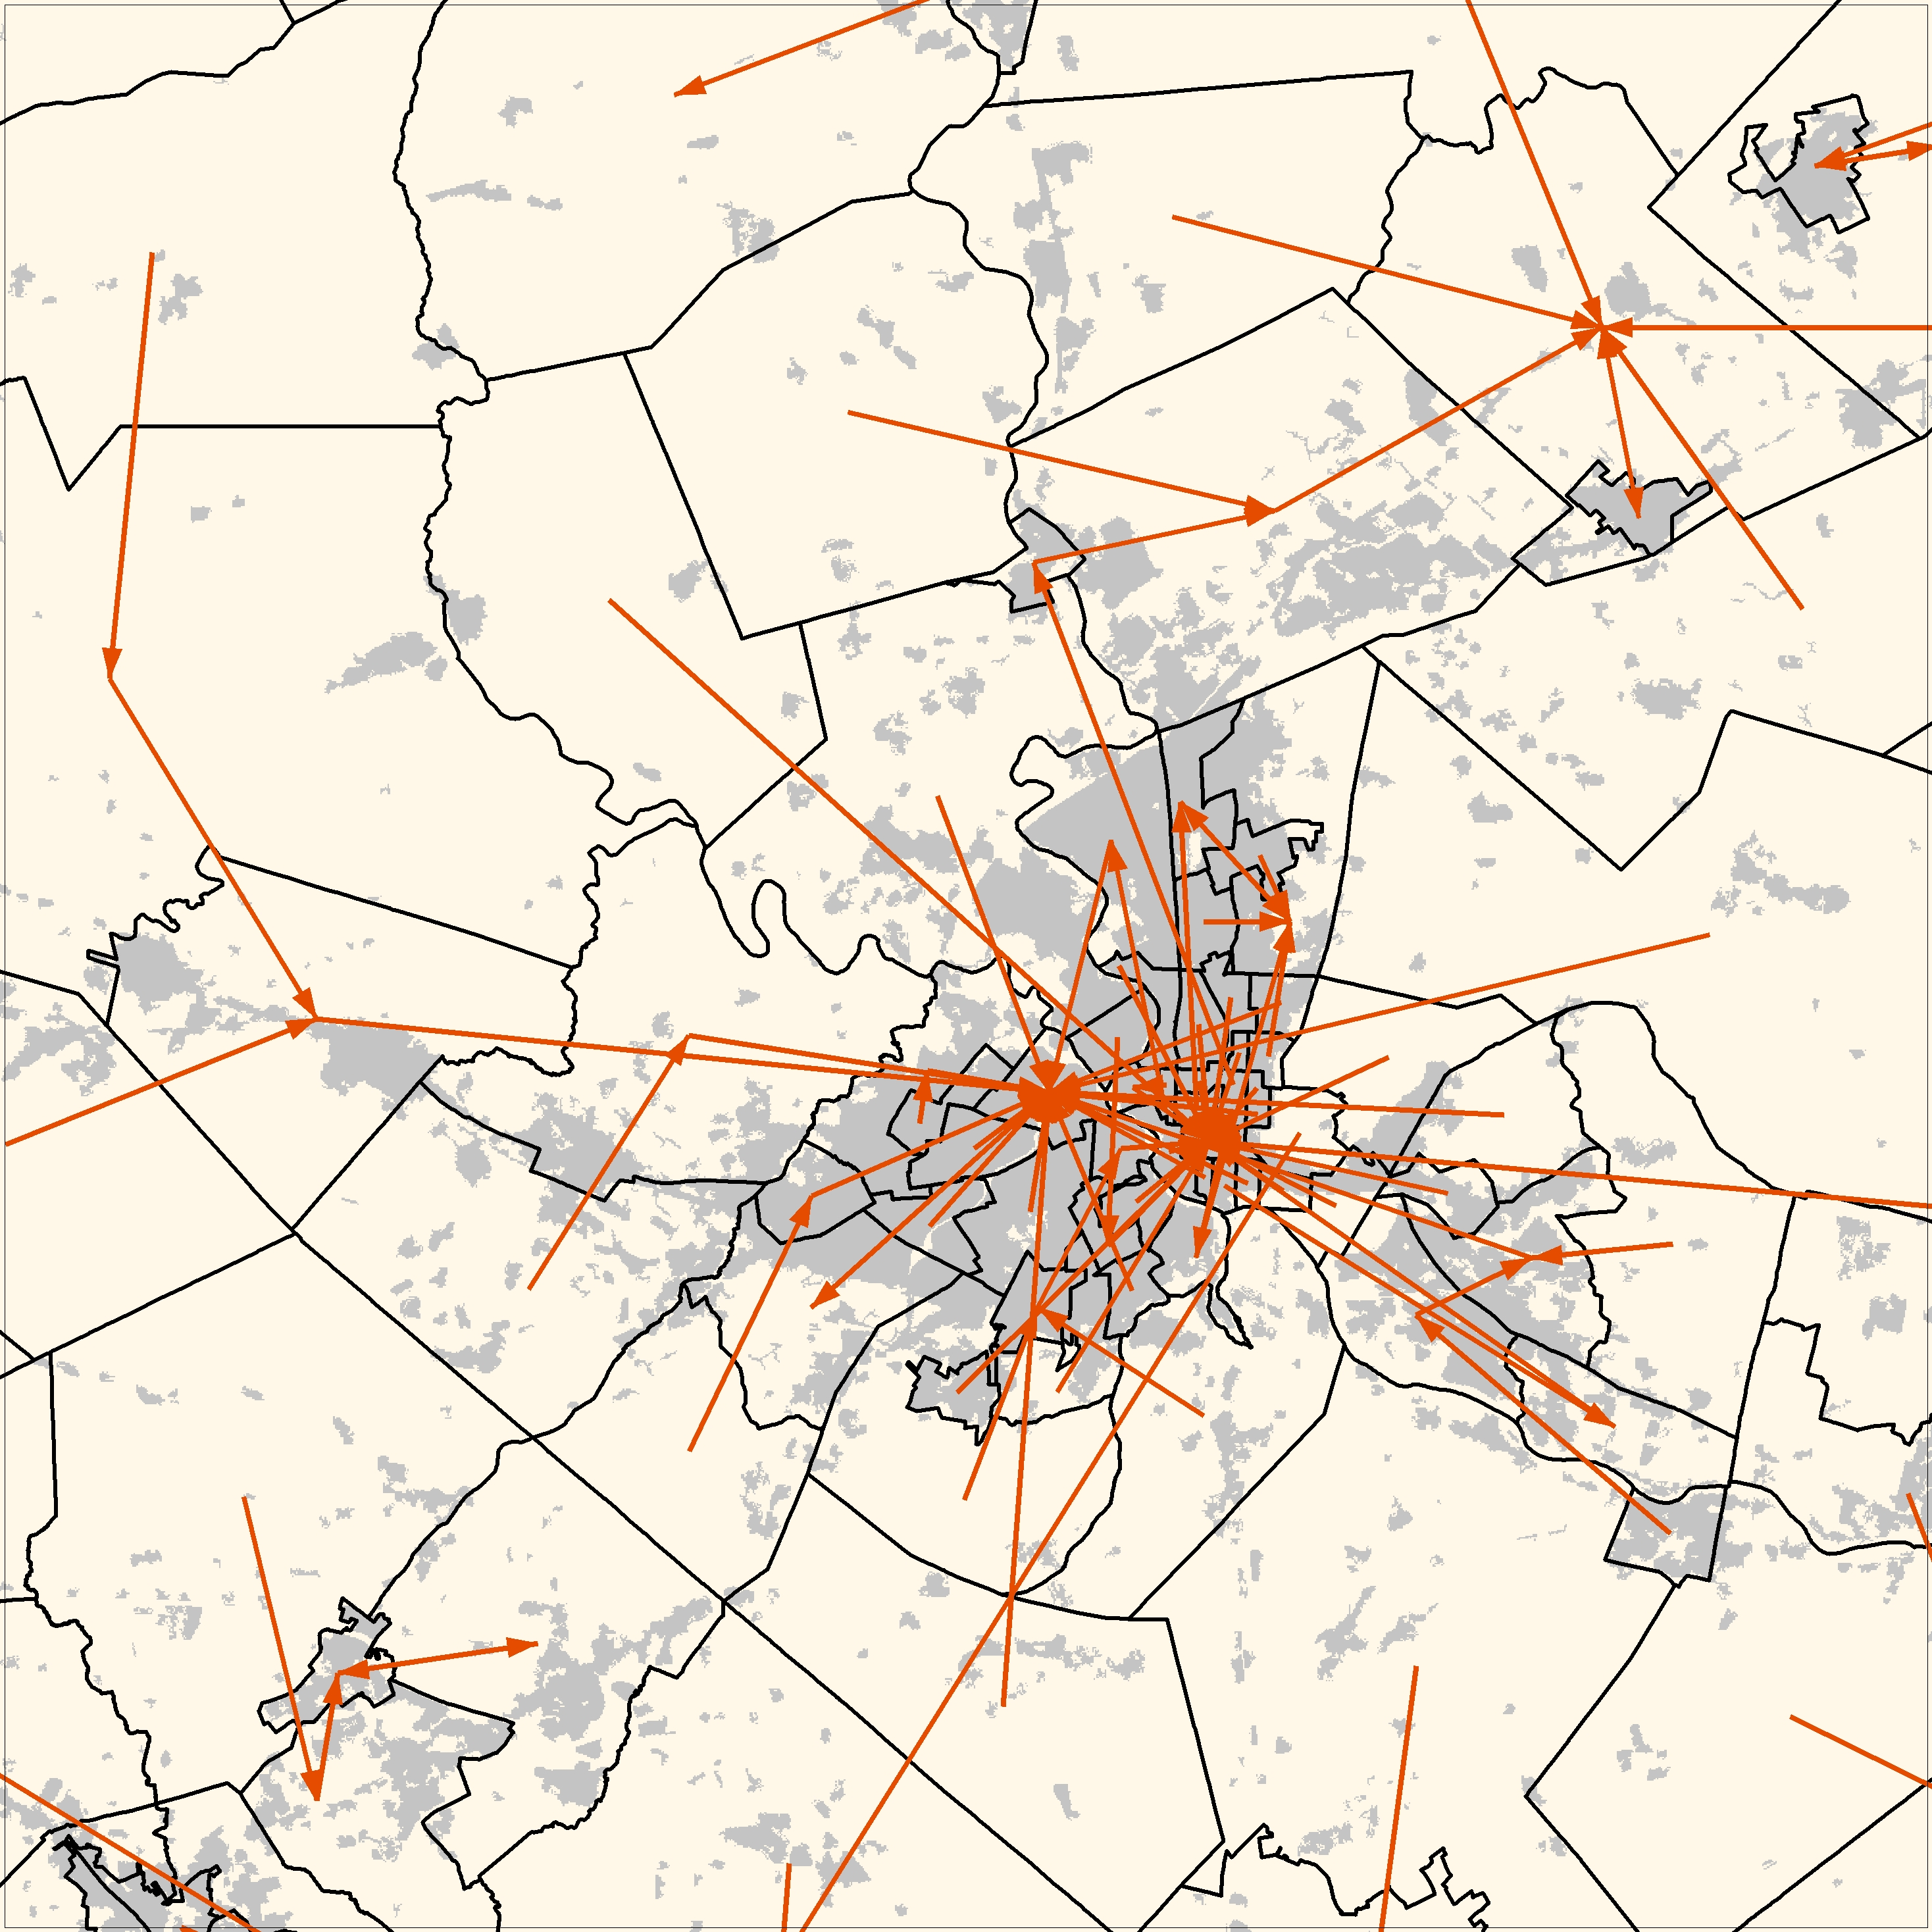
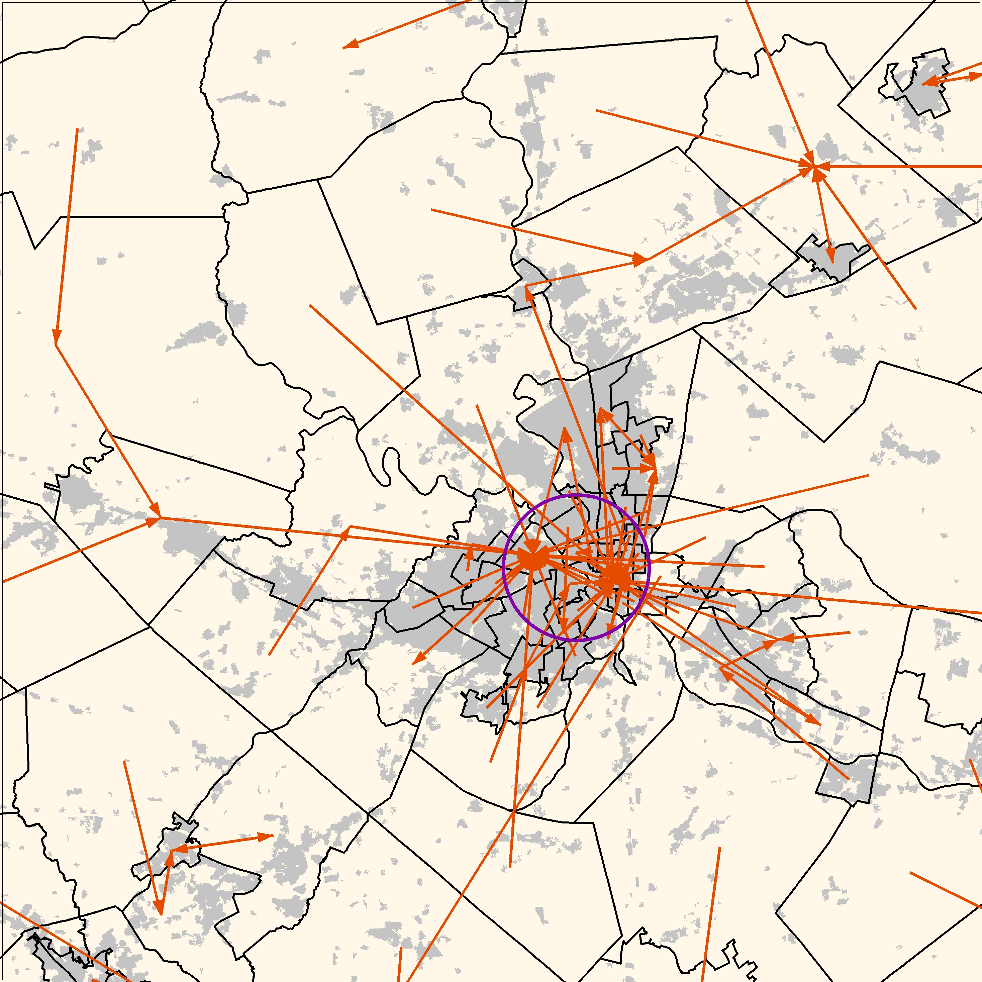
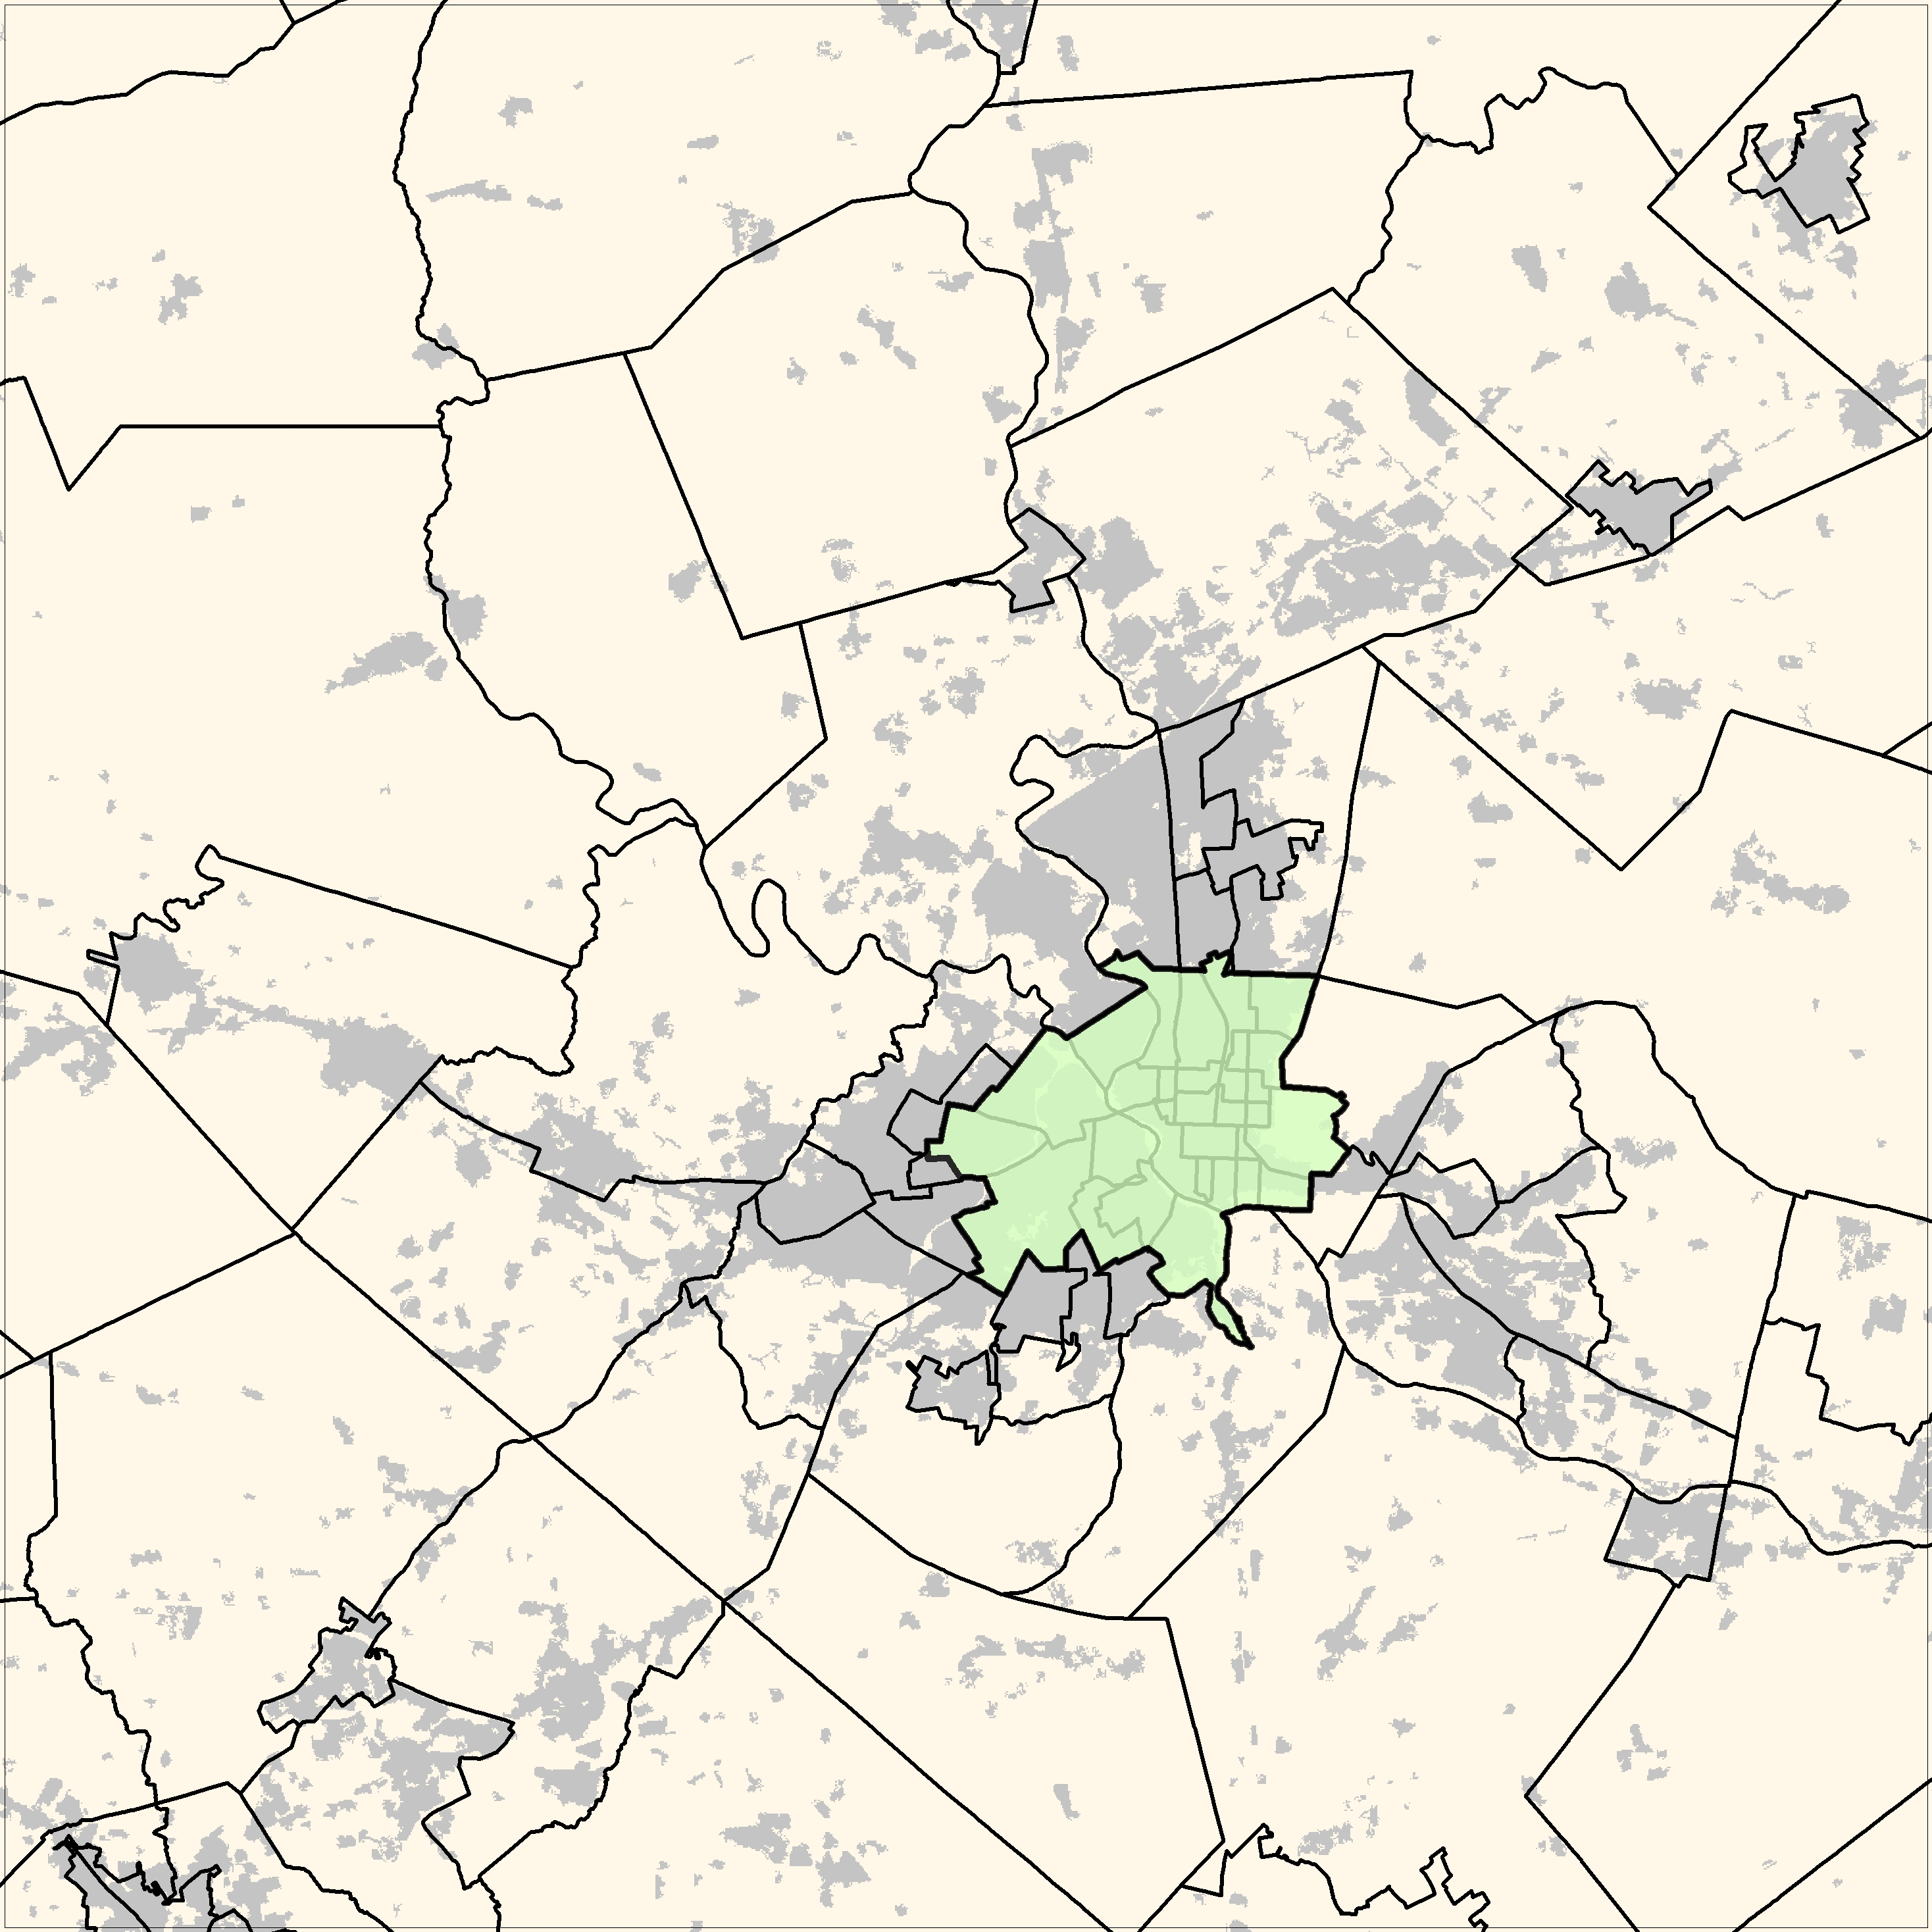
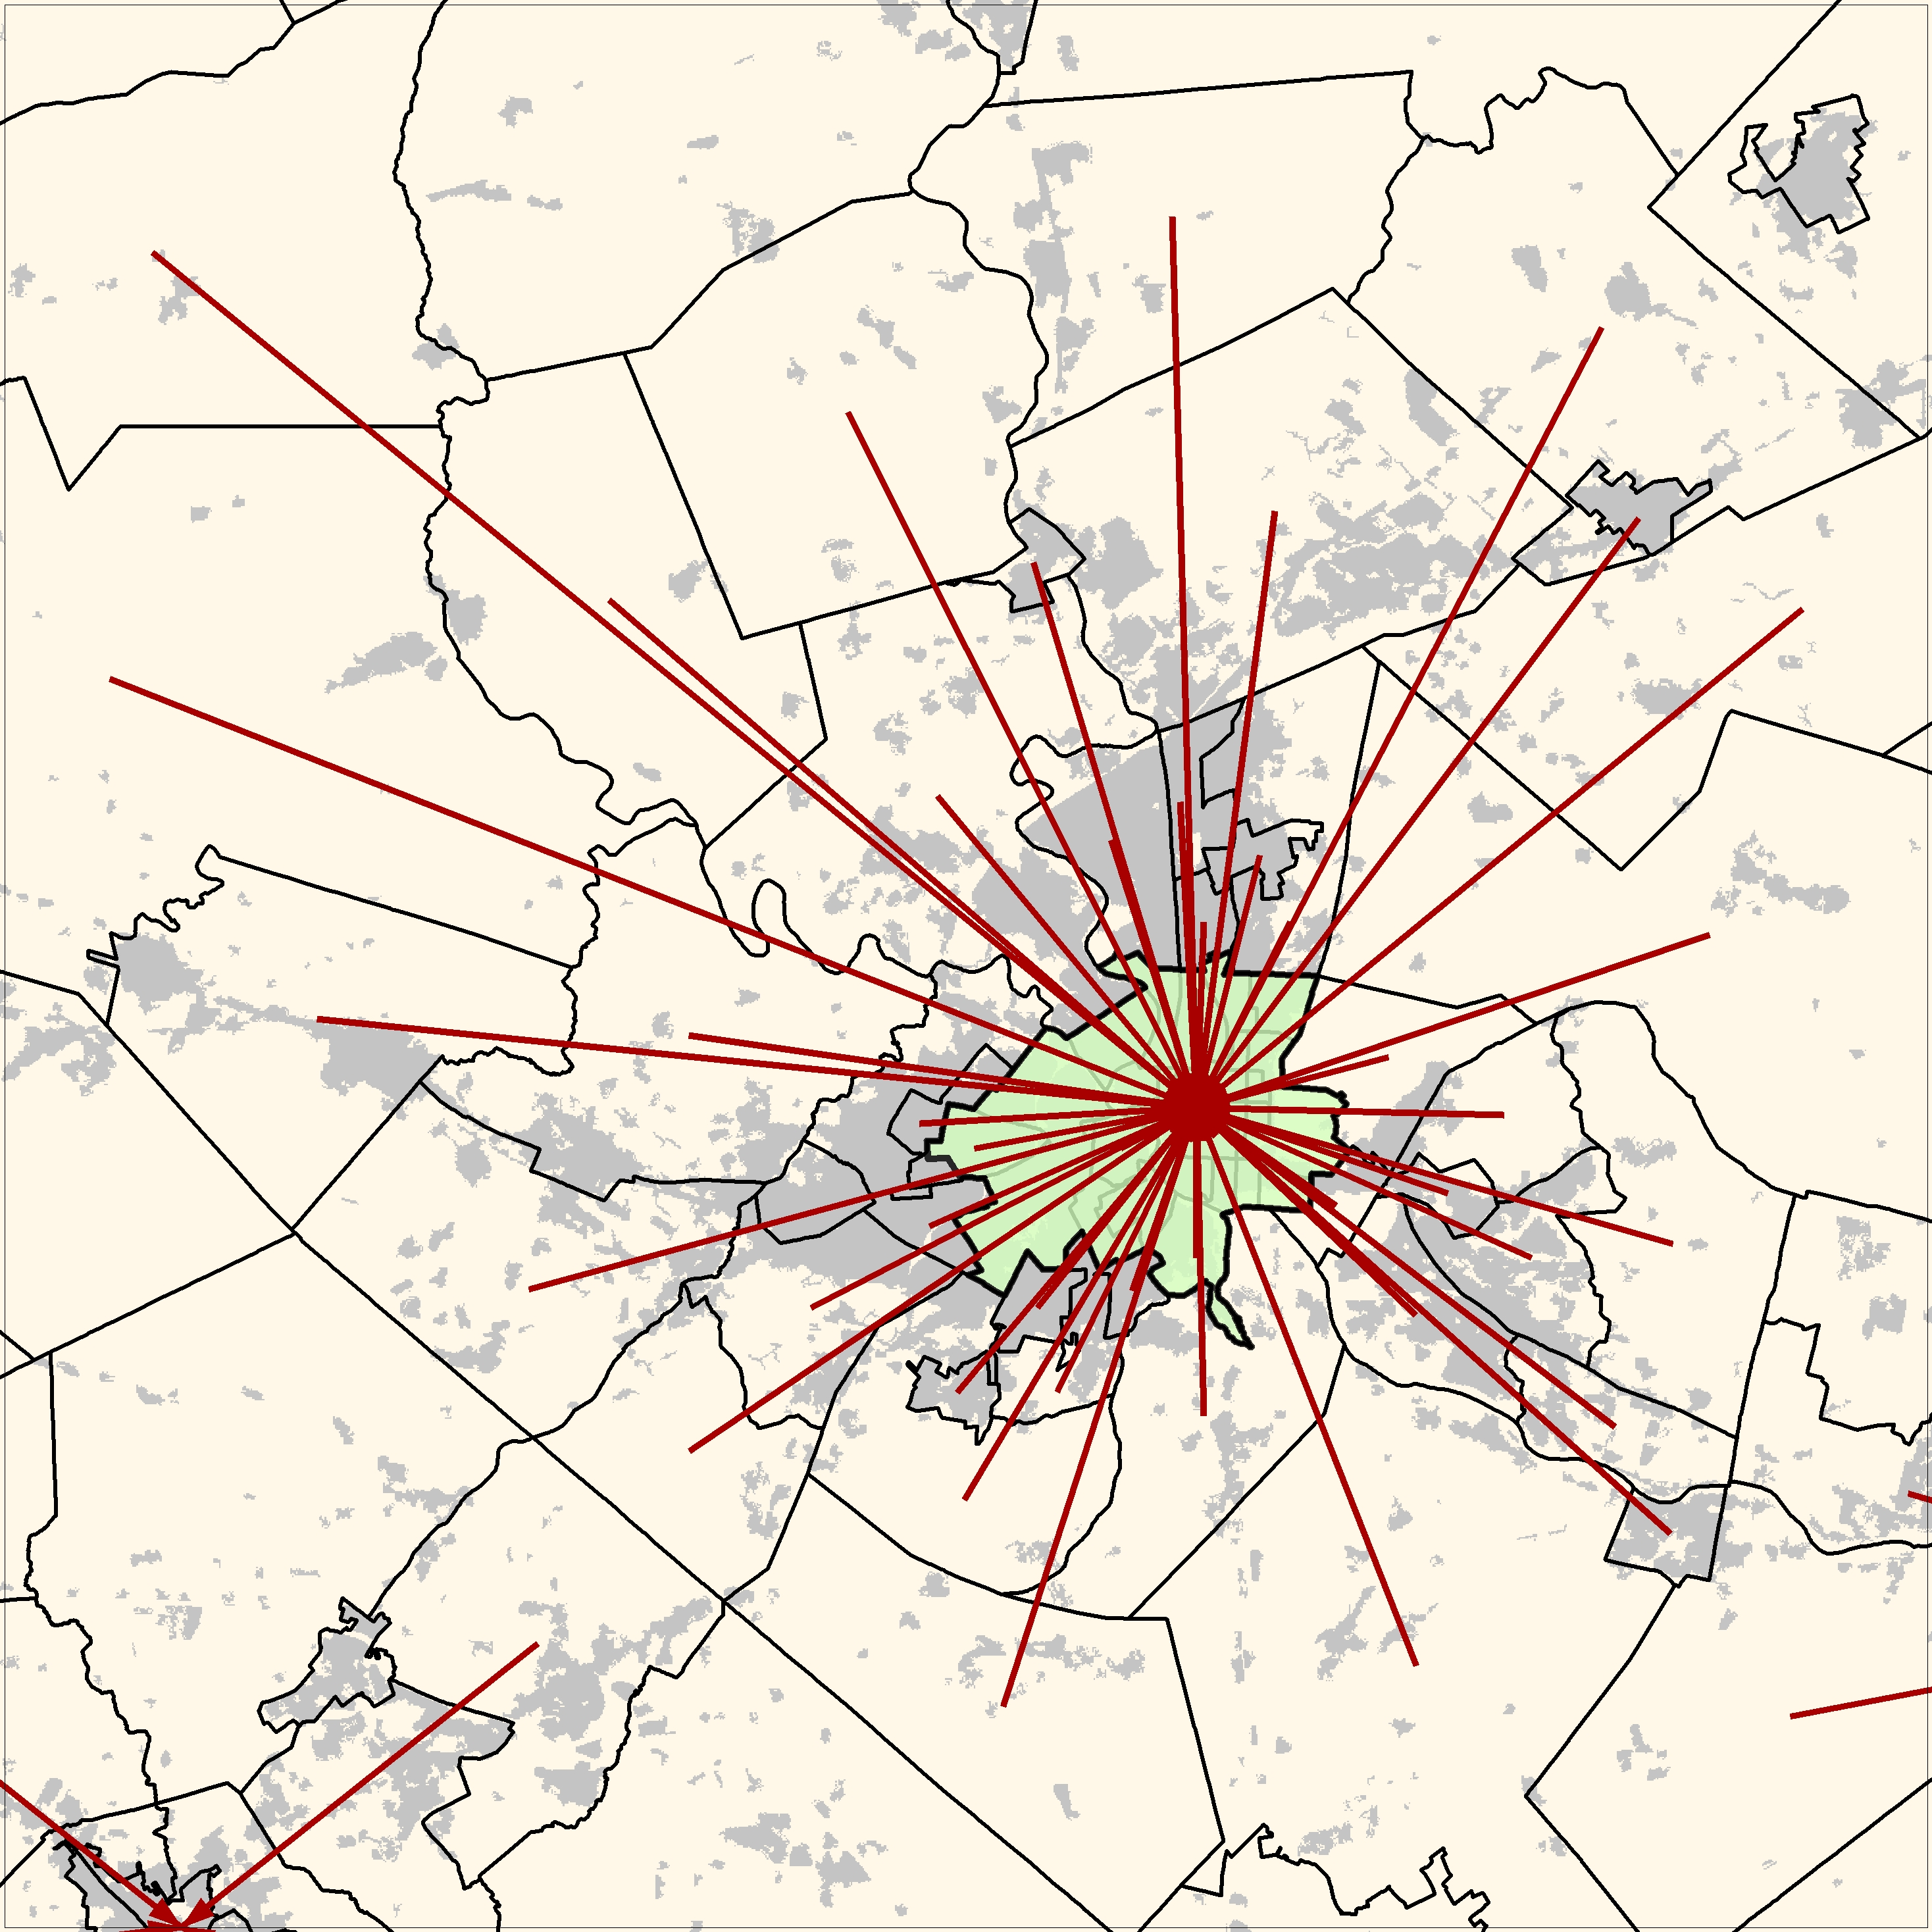
Local CENTERS DEFINITION
Data Source: Transportation Planning Products (CTPP) 2006-2009
Notes:
To identify local and regional centers we use CTPP’s commuting flows from tract to tract. (click)
That lets us to represent the links between a pair of tracts, the direction of the flow, and the intensity of the relationship. (click)
So, if we select the most frequent commute from each tract (click), we obtain something like this...
We can now note that some tracts accumulate significantly more flows than others (click), and sometimes they are very close together and belonging to the same urban entity.
Using county subdivisions (click) as a criterion to group those attraction poles, and selecting again the most frequent commute, we can simplify the commuting patterns to this (click).
With this method, we identified XXX local and regional centers in and around our study area.

Slide 21
Moving from concepts to numbers
Dependent variable – urban growth
Independent variables – population and employment
  1 year lag period.
  Only increments have influence.
Sources:
  Annual Estimates at County Subdivision level for NJ, NY and PA , and county level for DE, MD and VA.
  County Business Pattern 1990 – 2010
  3 periods (CCAP land cover data): 1996 – 2001, 2001 – 2006, 2006 – 2010.
Notes:
Summarizing our regression model, the dependent variable is urban growth calculated from the C-CAP Land cover impervious classes for the years: 1996, 2001, 2006, and 2010;
The independent variables are population and employment from census and department of labor datasets.
For practical reasons, we consider that only positive increments in population and employment have an effect on growth. With that, we try to avoid negative correlations where the loss of population and employment can take place with urban growth. A change of the conditions, with an increase in population and employment, would drop growth estimations, which is not reliable.

Slide 22
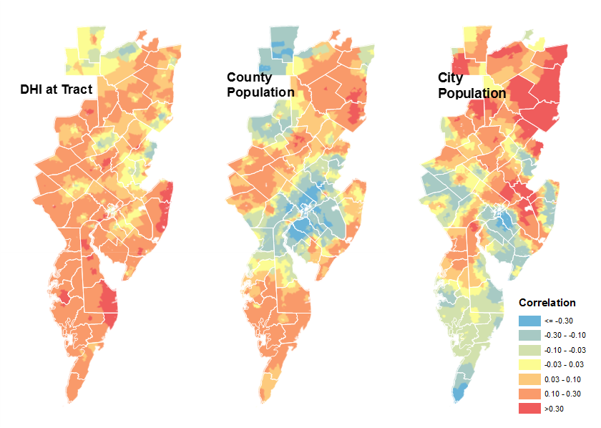

Moving from Concepts to numbers
Directed Pressures (DirPress):
We account for the fact that tract, county, or city population sources may have different influences (weight) on local urban development.
$${DirPress}_{i}=$$
$$w_{1}(i)×{DHI}_{i}+w_{2}(i)×{POP}_{co}+ w_{3}(i)×{POP}_{city}$$
Notes:
However, limiting the data to only the positive increases in the independent variables that have a relevant effect on growth is not enough.
The combination of recessions and the construction bubble might be behind the fact that in large areas there is a generalized opposite trend between growth and the independent variables, as we show with the blue tones in these maps.
To avoid those anomalous negative correlations, we decided to combine some factors into one, accounting for the fact that tract, county, or city population sources may have different influences on local urban development.

Slide 23
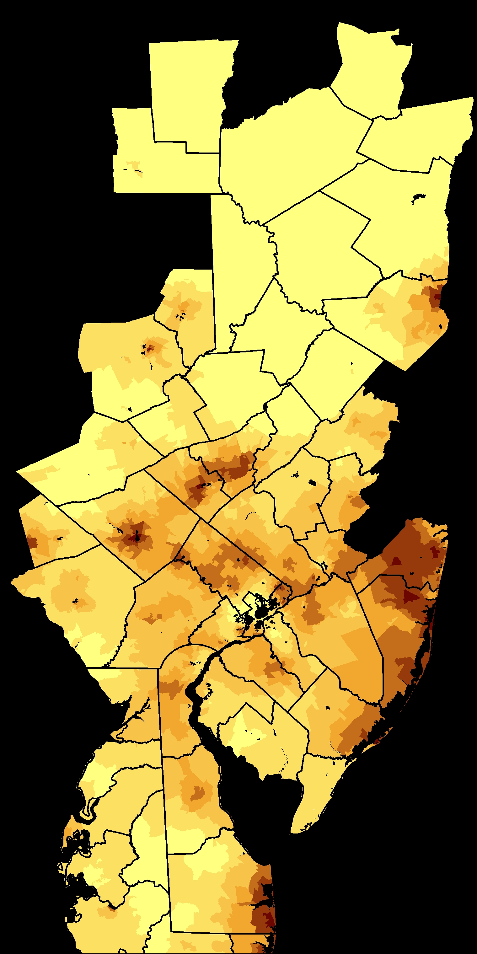
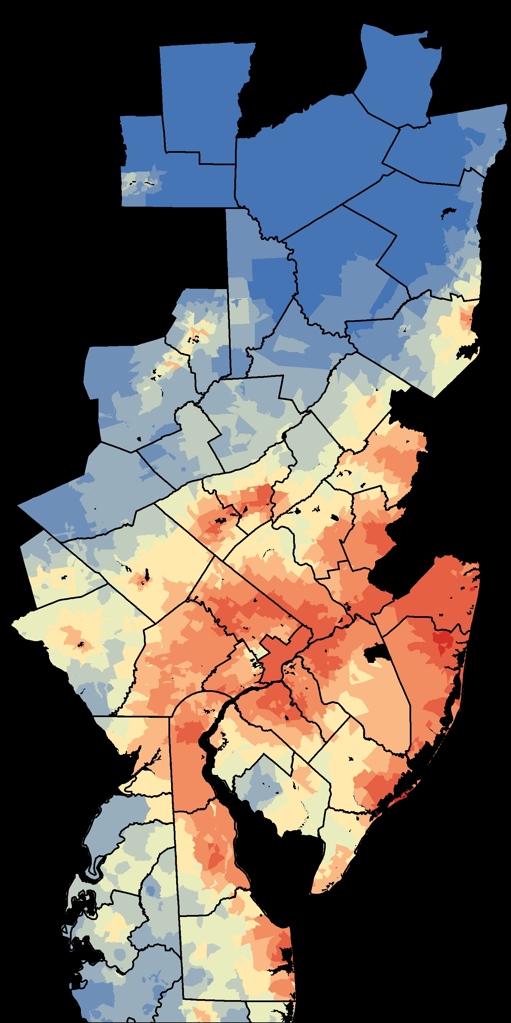
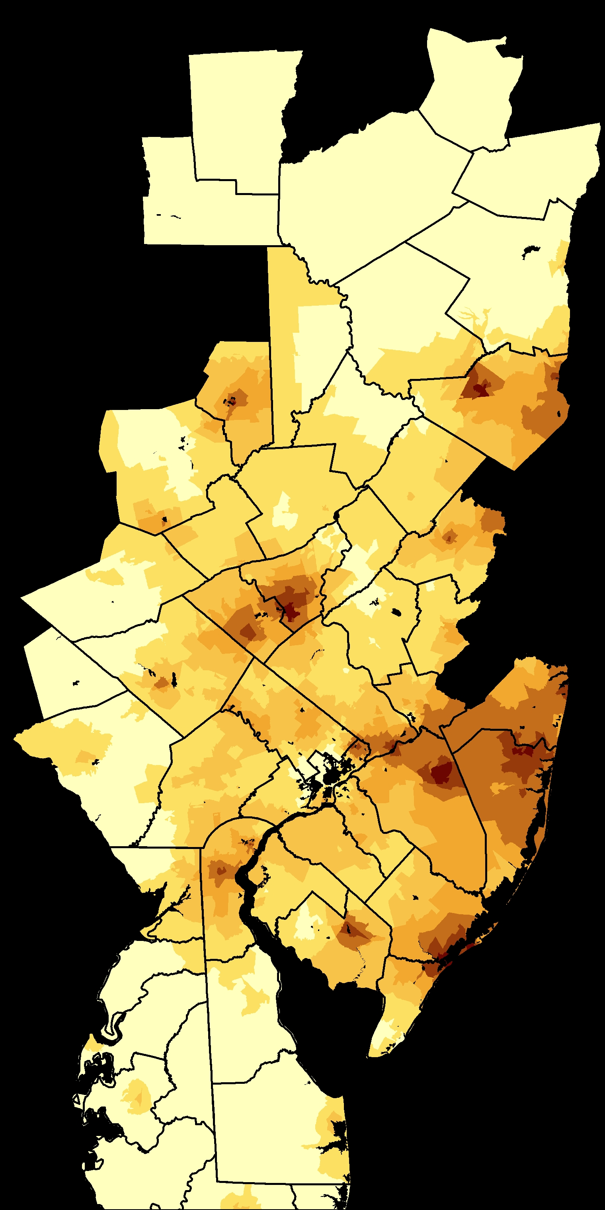
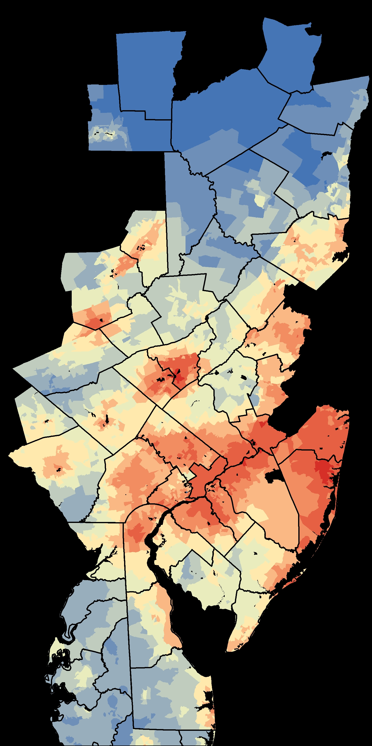
Model results
Growth intensity vs. Model Score
2001-2006
2006-2010
Notes:
We can compare the model results with the urban growth observed.
In general the model behave well, showing the highest scores in the areas where growth was more intense

Slide 24
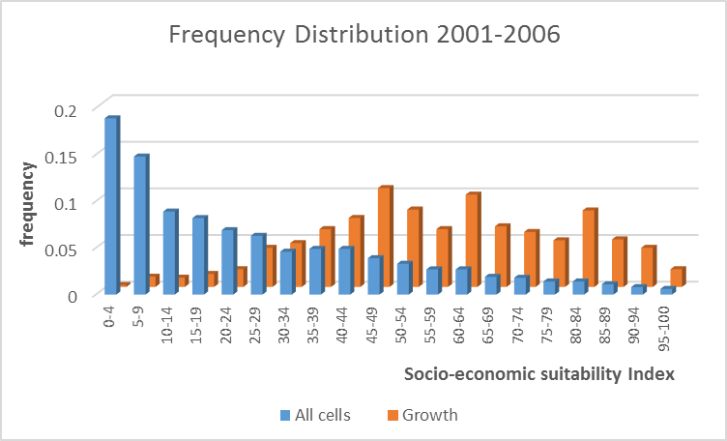
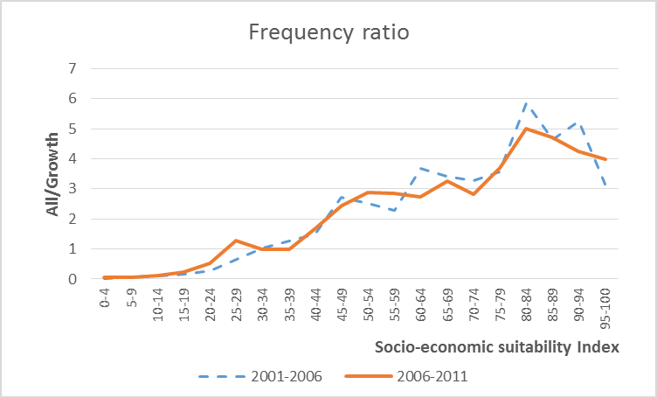
Validation

Slide 25
Future Scenarios
COUNTY LEVEL
TRACT LEVEL
VARIABLE
County Population
EPA-ICLUS Population Projections
Tract Weights
Population
DHI
Resident Work Force
Employment projections
Local Center Employment
Tract Weights
Work Force at place
Comm. Flows
(CTPP)
City Employment

Slide 26
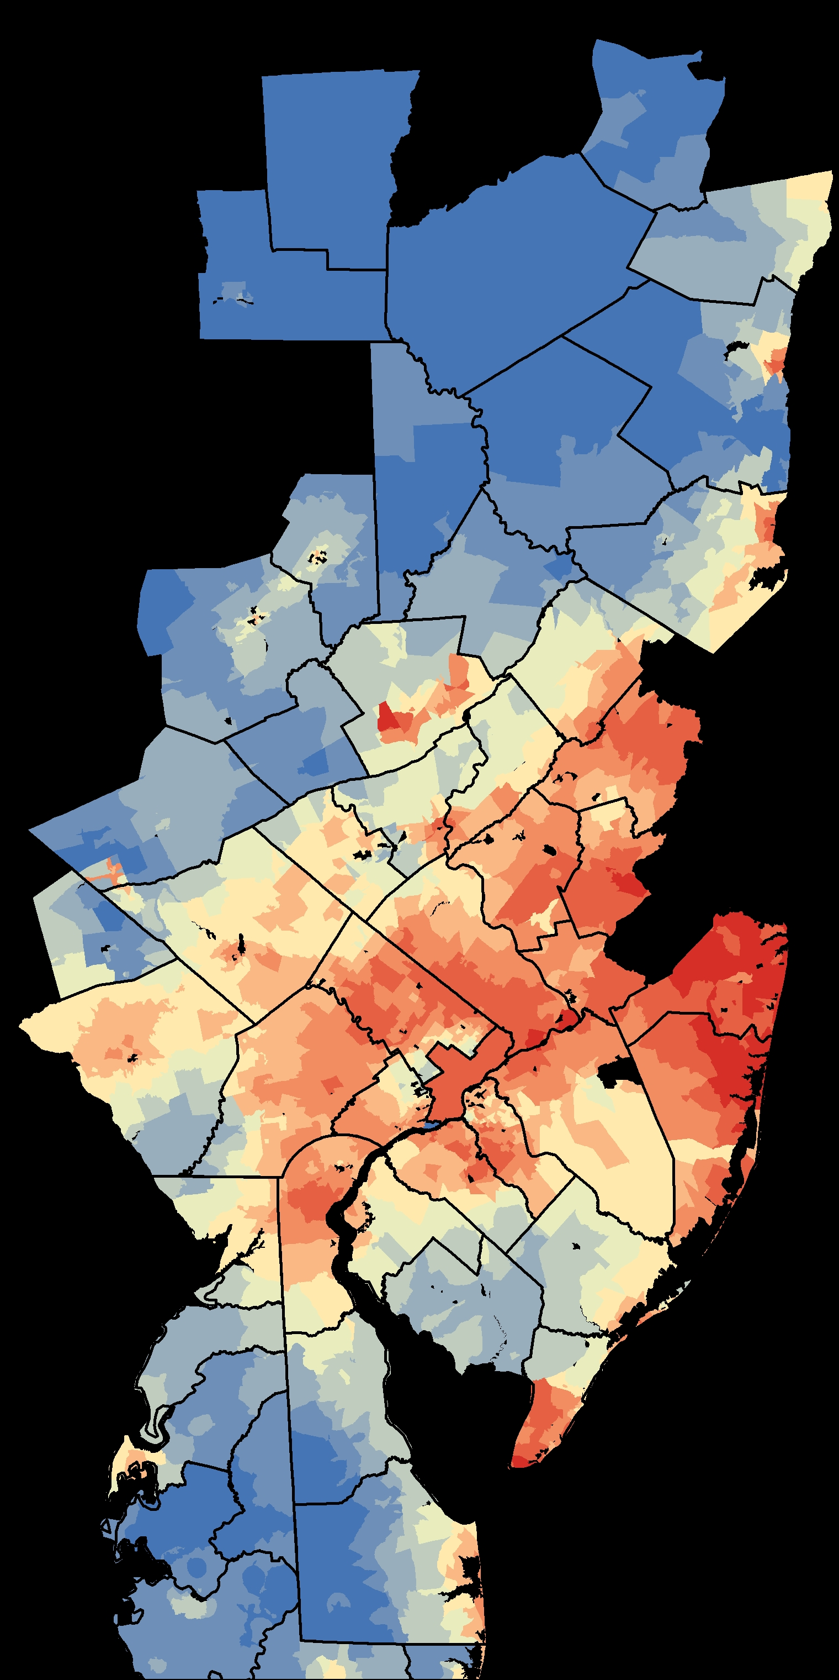
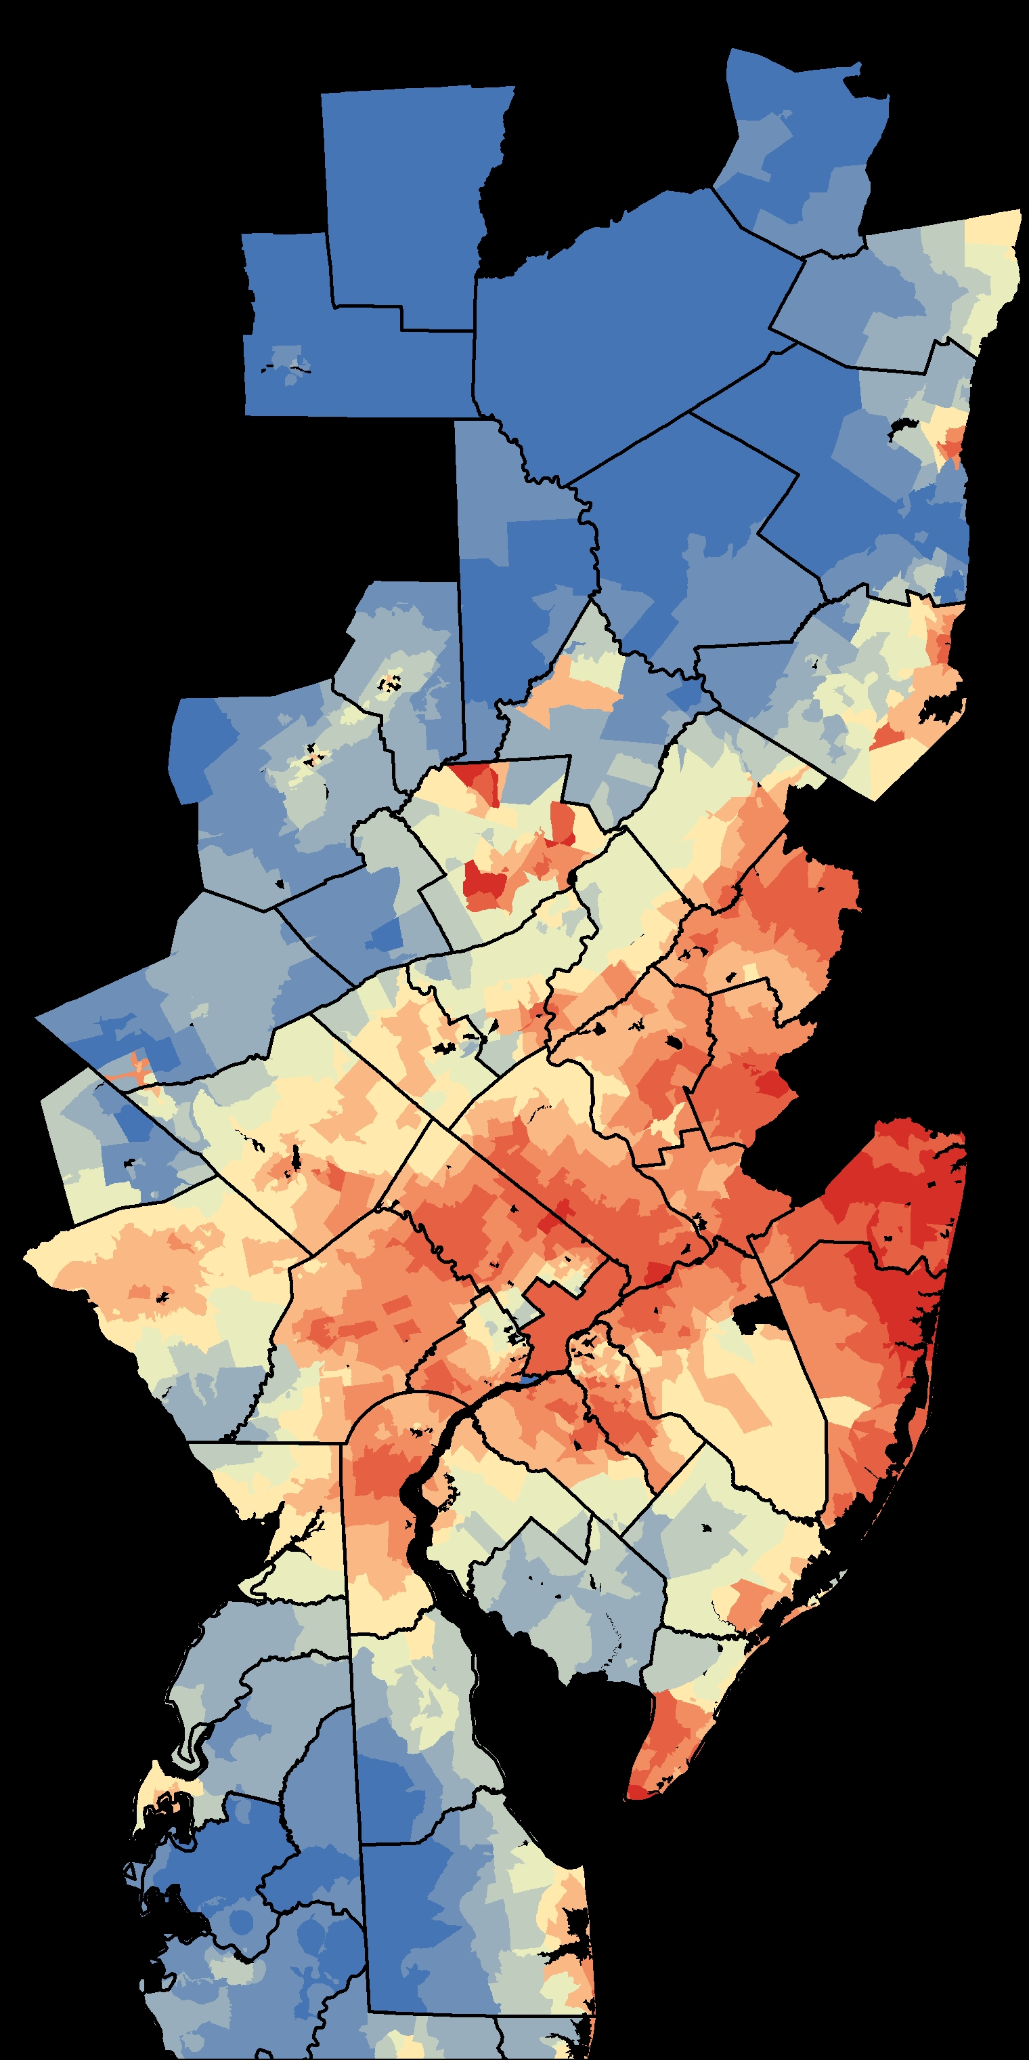
Future Scenarios
ICLUS. BC Scenario
ICLUS. Alt1 Scenario
Notes:
A number of models were run using several combinations of the variables.
From the figures on the table, we can note that the GWR obtains a much better adjustment than the global regression, indicating a clear non-stationary of the data.
The models with better adjustment are in yellow.
To select the final model, we compared its predictions obtained from the ICLUS data to assess whether the model creates anomalous estimations.
Model 01b has a location with a growth of more than 25,000 cells, a completely irrational value. That issue would mean not only that this individual location would rise to the top of the index range, but also that it would significantly reduce the rest of the locations, especially if there are more cases like that one.
(click)
Model 02b was selected. It clearly remains very close to the limits of twice of the maximum input growth.

Slide 27
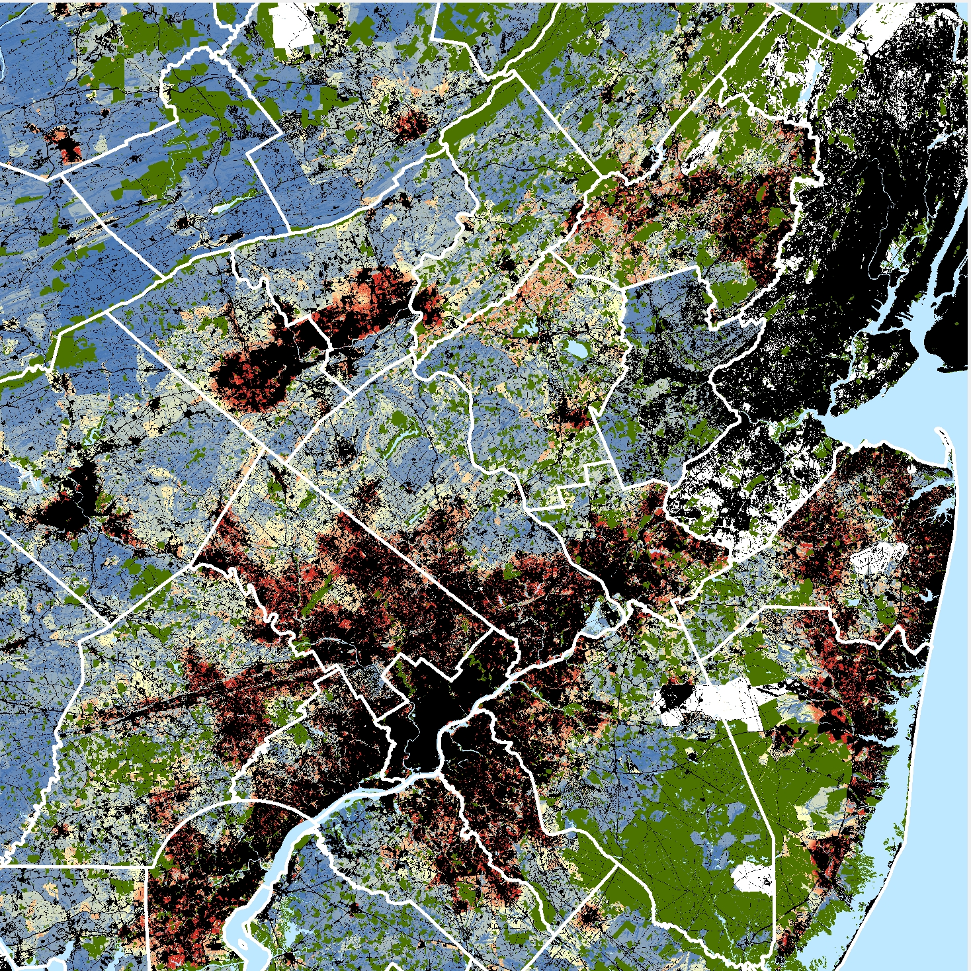
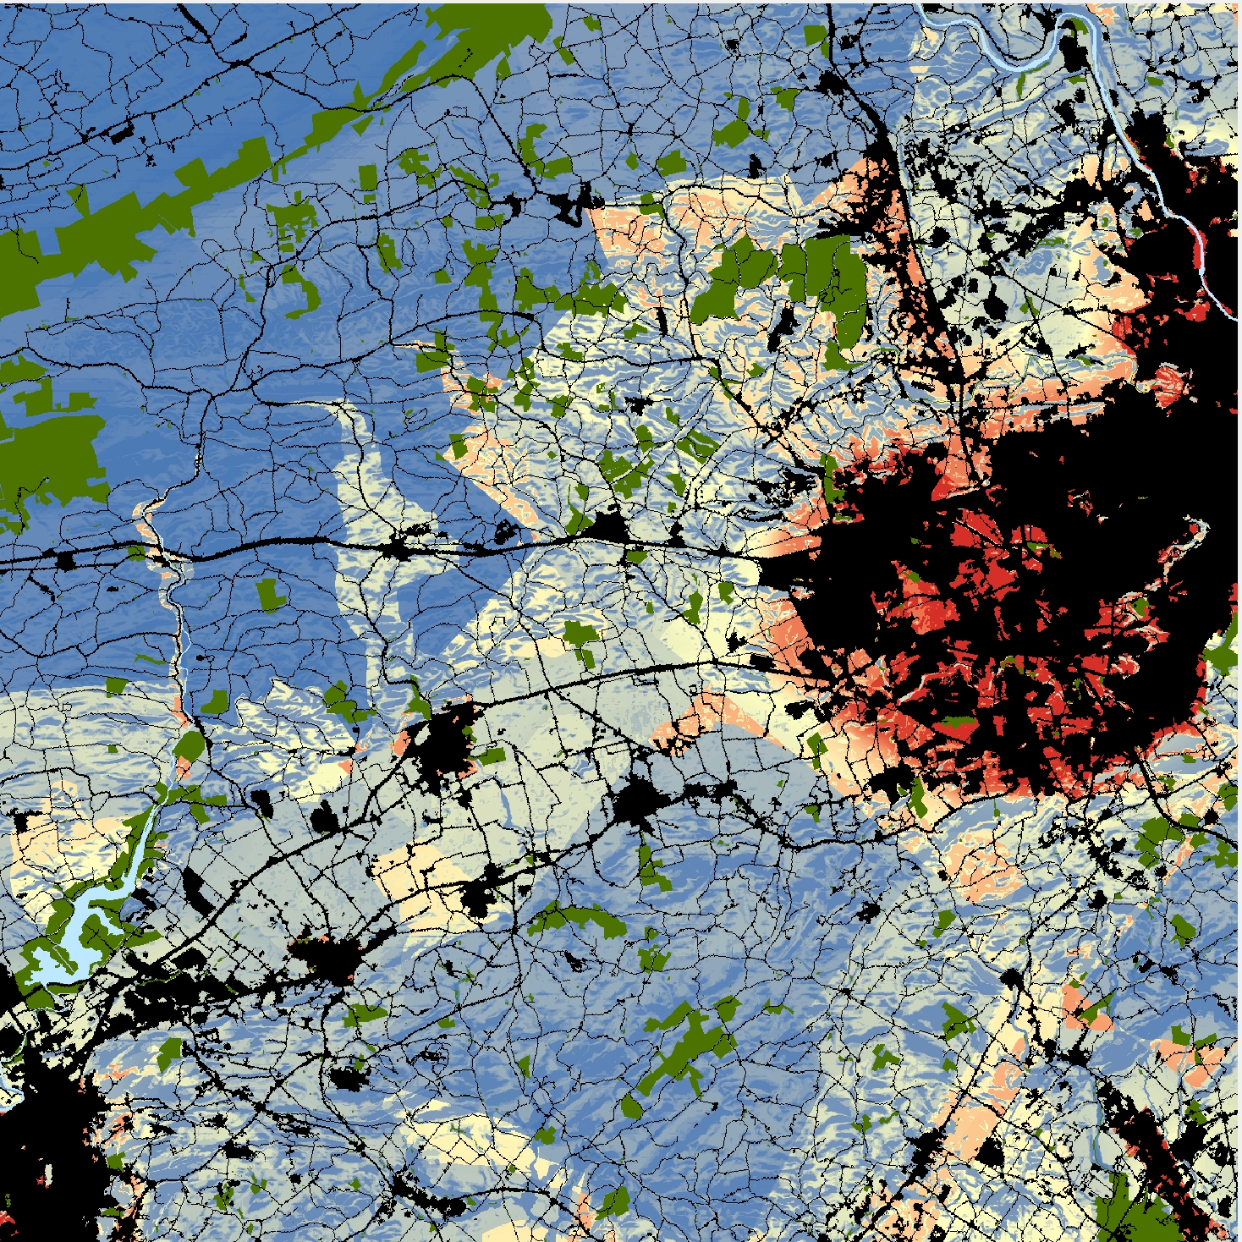
Assembling sub-models
Socio-economic
[0 – 100]
Accessibility Model
[0.5 – 1]
Physical Factors
[0.3 – 1]
Restrictions
[0.3 – 1]
Exclusions
[0 | 1]
Input to CA
Notes:
Once we have all the pieces ready, we can combine them in the final output.
Here, you can observe that the socioeconomic sub-model has a different range than the rest, and it’s equivalent to the range that SLEUTH uses.
That’s because of what I commented at the beginning of the presentation. Economy has priority over the rest of the factors in the decision process of choice.
Not all cells in the study area are allowed to be developed. We can see the exclusions here, with different colors than the gradient has. Exclusions include military land, water bodies, or areas designated for conservation purposes.
Logically, current developed cells are also removed from new development.
(click)
Here we can see in more detail how the suitability layer looks like.
The concentration of red tones surrounding towns indicates the strong influence of the urban areas.
It is also possible to distinguish corridors and the effect of some roads.
So, finally, the exclusion-attraction layer for SLEUTH is ready for begin the forecast process.
And….. that’s it.

Slide 28
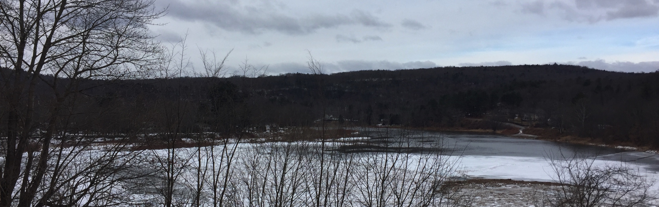




Thank you!
April 12, 2017 | US-IALE | Baltimore, MD
Presentations:
A community-driven approach to developing future land use scenarios at the river basin scale: An example from the Delaware River Basin. Antonia Price
DRB 2070: Lessons learned from basin-wide land use change forecasting. Claire Jantz
Poster:
Modeling the extent of future storm surge inundation under two sea level rise scenarios. Joshua Barth
www.drbproject.org
@ShipCLUS /ShipCLUS

