Slide 1
Governor’s Center for Local Government Services (GCLGS) Pennsylvania state data center users conference
May 2017
Rick Vilello
Deputy Secretary
Community Affairs & Development

Slide 2
agenda
Local Government in PA
GCLGS: Who We Are & What We Do
GCLGS: Programs & Services

Slide 3
Local government in pa
PA Municipalities by Type
1
957
53
93
1,453
1st Class City
2nd Class City
2nd Class A City
Town
each of
Boroughs
3rd Class
Cities
1st Class
Townships
2nd Class Townships
2,560
67
Total Municipalities
Counties

Slide 4
Local government in pa
Active Authorities by Type
Airport | 42
Business District | 27
Community Facility | 26
Economic Development | 20
Local Government Facilities | 84
Multi-purpose (Water & Sewer) | 263
Nonprofit Institutions | 60
Parking | 26
Recreation | 63
School | 25
Sewer | 595
Solid Waste | 24
Transit | 34
Water | 230
TOTAL | 1,519*
*Does not include “terminated” authorities. (As of September 2016)

Slide 5
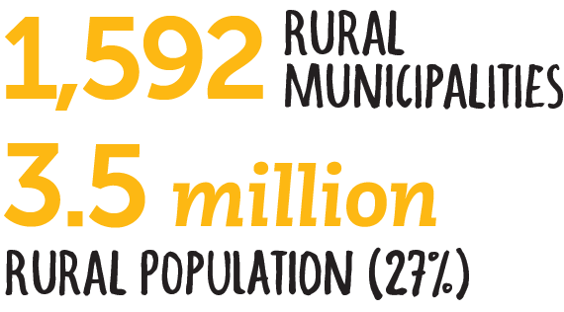
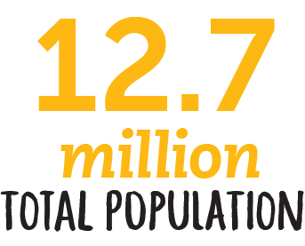
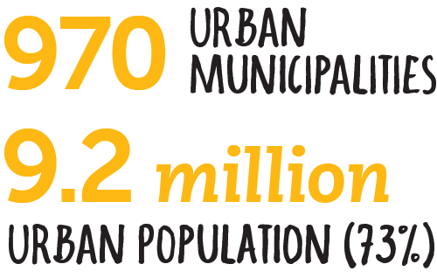
Local government in pa

Slide 6
Local government in pa
Police Departments in PA
Fire Departments in PA
Traditional . . . . . . . . . . . . . . . .966
Consolidated . . . . . . . . . . . . . 121
Contractual . . . . . . . . . . . . . . .201
TOTAL MUNICIPALITIES . . . 2,560
Paid . . . . . . . . . . . 30
Paid/Volunteer . . . 92
Volunteer . . . . . . . 1,731
TOTAL . . . . . . . . . 1,853
(As of 2016)
(As of 2016)
Local Pension Plans
Police . . . . . . . . . 956
Fire . . . . . . . . . . 83
Non-Uniformed . .2,201
TOTAL . . . . . . . . 3,240
(As of 2013)

Slide 7
Governor’s center for local government services (GCLGS): who we are and what we do

Slide 8
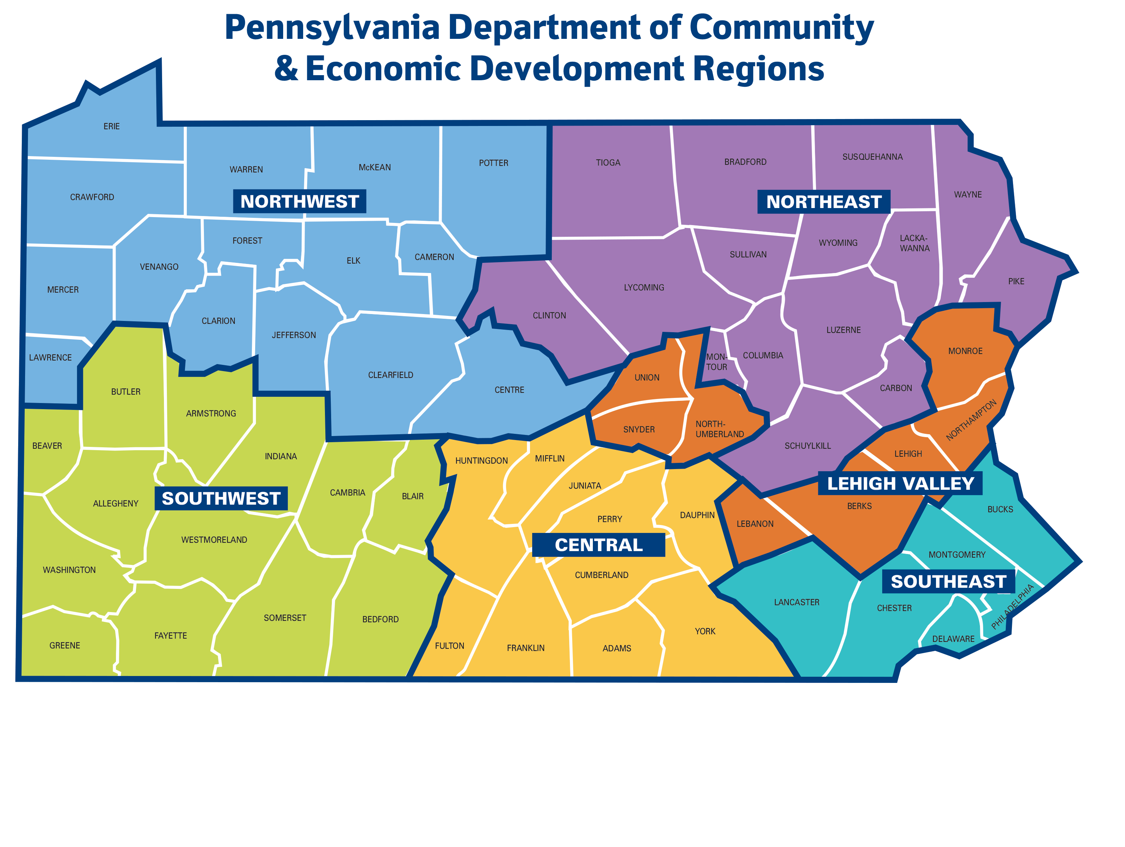
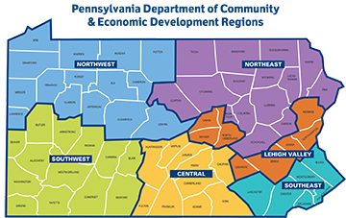
Governor’s center for local government services
Who We Are
Dennis Davin
Secretary
PA Department of
Community & Economic Development
Rick Villelo
Deputy Secretary
Community Affairs & Development
PA Department of
Community & Economic Development
The Governor’s Center for Local Government Services is an office within the PA Dept. of Community & Economic Development (DCED)
Act 58 of 1996: Formed DCED through merger of Department of Community Affairs and Department of Commerce
Regional offices throughout PA

Slide 9
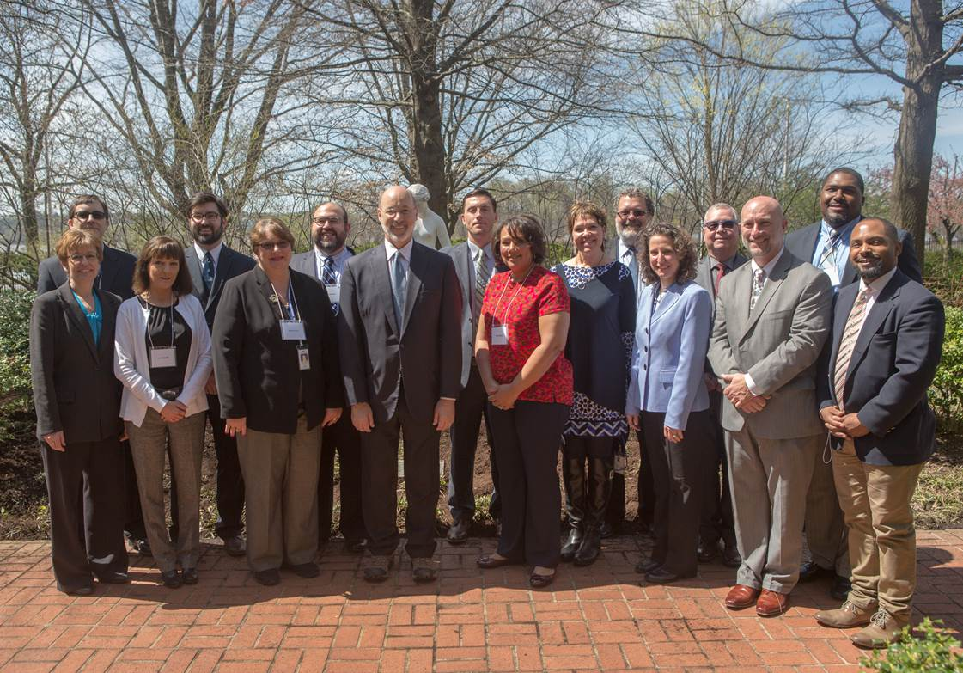
Governor’s center for local government services
Who We Are

Slide 10
Governor’s center For local government services
Who We Are
One-stop-shop for local government officials providing technical and financial assistance to:
support the performance of duties to meet everyday demands
solve problems
utilize best management practices

Slide 11
GCLGS Programs & services

Slide 12
Programs & services
Handbooks, Manuals, & Reference Guides
More than 50 publications
View and print online handbooks, manuals, and reference guides at no cost
dced.pa.gov/publications
Notes:
If you have a question, then our publications have an answer. These handbooks, manuals, and reference guides cover almost every topic pertaining to local government in PA and should be the first place to look for information. There are more than 50 publications available online at www.newPA.com/publications, and anyone can view and print these documents at no cost.

Slide 13
Programs & services
In-classroom and online training opportunities for local officials in:
local government administration
finance & accounting
planning
community & economic development
public safety
public works
recreation
tax collector qualification

Slide 14
Programs & services
PA Construction Codes Academy (PCCA)
Building Code Officials remit $4 permit fee to GCLGS (Act 13 of 2004):
fees fund the PCCA & the PA Housing Research Center
at Penn State (PHRC)
Uses e-filing system for greater transparency & efficiency
PCCA provides training and certification to:
building code officials
residential and commercial inspectors
builders, contractors, architects, engineers, & others with an interest in Uniform Construction Code

Slide 15
Programs & services
Municipal School of Local Government
Municipal School of Government
Each course is six (6) weeks in duration
Experiential exercises/assignments each week

Slide 16
Programs & services
Community Planning & Land Use
Technical and on-site assistance
Training modules and seminars
Statewide land-use reports
Work with Housing Alliance of PA for technical support
PA Blight Library
“From Blight to Bright”: a comprehensive toolkit for PA communities to mitigate blight

Slide 17
Programs & services
Municipal Statistics Office
Collects data from municipalities through e-Filing forms
Annual Audit & Financial Report
Survey of Financial Condition Form
Report of Elected & Appointed Officials
Tax Information Form
Publishes database online
Utilizes data to facilitate other functions of GCLGS
“Early Warning System” formula
Act 32 of 2008: Local Earned Income Tax (EIT) consolidated tax collection system
Notes:
Collects data from municipalities through e-Filing forms
Annual Audit & Financial Report
Survey of Financial Condition Form
Report of Elected & Appointed Officials
Tax Information Form
Publishes database online
Utilizes data to facilitate other functions of GCLGS
“Early Warning System” formula
Act 32 of 2008: Local Earned Income Tax (EIT) consolidated tax collection system

Slide 18
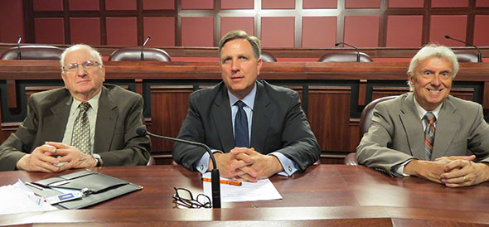
Programs & services
STEB Members L-R: Anthony “Red” Pinizzotto, Peter R. Barsz (Chair), and Daniel Guydish
Tax Equalization Division (TED)
Aggregate market values of taxable real property in each political subdivision
For each county, Common Level Ratio (CLR) = assessed value / market value
State Tax Equalization Board (STEB) members officially approve and certify the numbers reported by TED
Notes:
Collects data from municipalities through e-Filing forms
Annual Audit & Financial Report
Survey of Financial Condition Form
Report of Elected & Appointed Officials
Tax Information Form
Publishes database online
Utilizes data to facilitate other functions of GCLGS
“Early Warning System” formula
Act 32 of 2008: Local Earned Income Tax (EIT) consolidated tax collection system

Slide 19
Programs & services
Municipal Assistance Program (MAP)
Provides grant funds up to 50% of eligible costs for projects such as:
shared services
community planning
floodplain management
To apply, access DCED’s
Single Application for Assistance online at: dced.pa.gov/singleapp
Notes:
Collects data from municipalities through e-Filing forms
Annual Audit & Financial Report
Survey of Financial Condition Form
Report of Elected & Appointed Officials
Tax Information Form
Publishes database online
Utilizes data to facilitate other functions of GCLGS
“Early Warning System” formula
Act 32 of 2008: Local Earned Income Tax (EIT) consolidated tax collection system

Slide 20
Programs & services
Regional Fire & Emergency Services
Notes:
Collects data from municipalities through e-Filing forms
Annual Audit & Financial Report
Survey of Financial Condition Form
Report of Elected & Appointed Officials
Tax Information Form
Publishes database online
Utilizes data to facilitate other functions of GCLGS
“Early Warning System” formula
Act 32 of 2008: Local Earned Income Tax (EIT) consolidated tax collection system

Slide 21
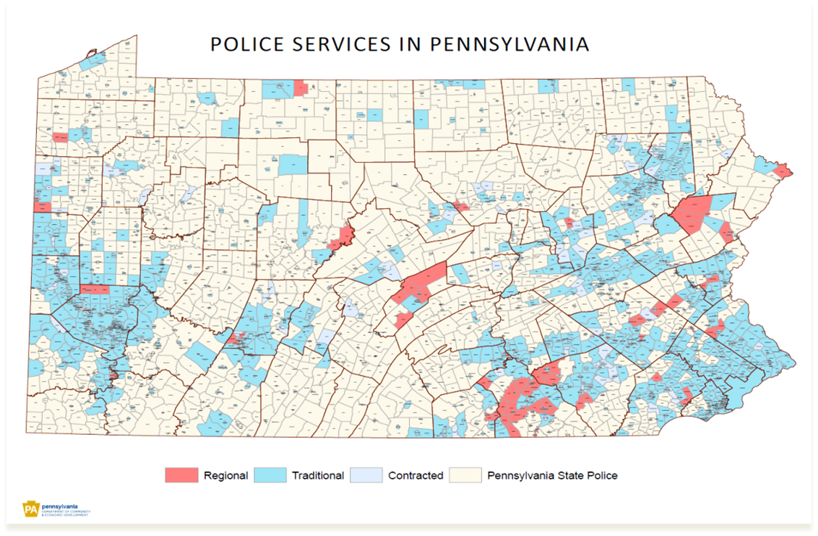
Programs & services
Regional Police Services
Notes:
The GCLGS also plays an active role in assisting municipalities interested in regionalizing their police services. Through peer consultation, the GCLGS assists in the development and implementation of an agreed-upon plan and realistic budget. The peer consultants are former police officers who work directly with the departments throughout the regionalization process.

Slide 22
Programs & services
Local Government Capital Projects Loan Program (LGCPLP)
Municipalities with population of 12,000 or less
Low-interest (2%) fixed-rate loans
Maximum loan amounts:
$50,000 for purchase of equipment
$100,000 for purchase/construction of facility
Notes:
The GCLGS also plays an active role in assisting municipalities interested in regionalizing their police services. Through peer consultation, the GCLGS assists in the development and implementation of an agreed-upon plan and realistic budget. The peer consultants are former police officers who work directly with the departments throughout the regionalization process.

Slide 23
Programs & services
Early Intervention Program (EIP)
Strategic financial management planning
50% matching grant funds; max $200,000
Supports municipalities interested in improving fiscal position
Comprehensive organizational review
Multi-year financial management plans
Implementation of desired recommended strategies and initiatives as identified in plan
Notes:
The GCLGS also plays an active role in assisting municipalities interested in regionalizing their police services. Through peer consultation, the GCLGS assists in the development and implementation of an agreed-upon plan and realistic budget. The peer consultants are former police officers who work directly with the departments throughout the regionalization process.

Slide 24
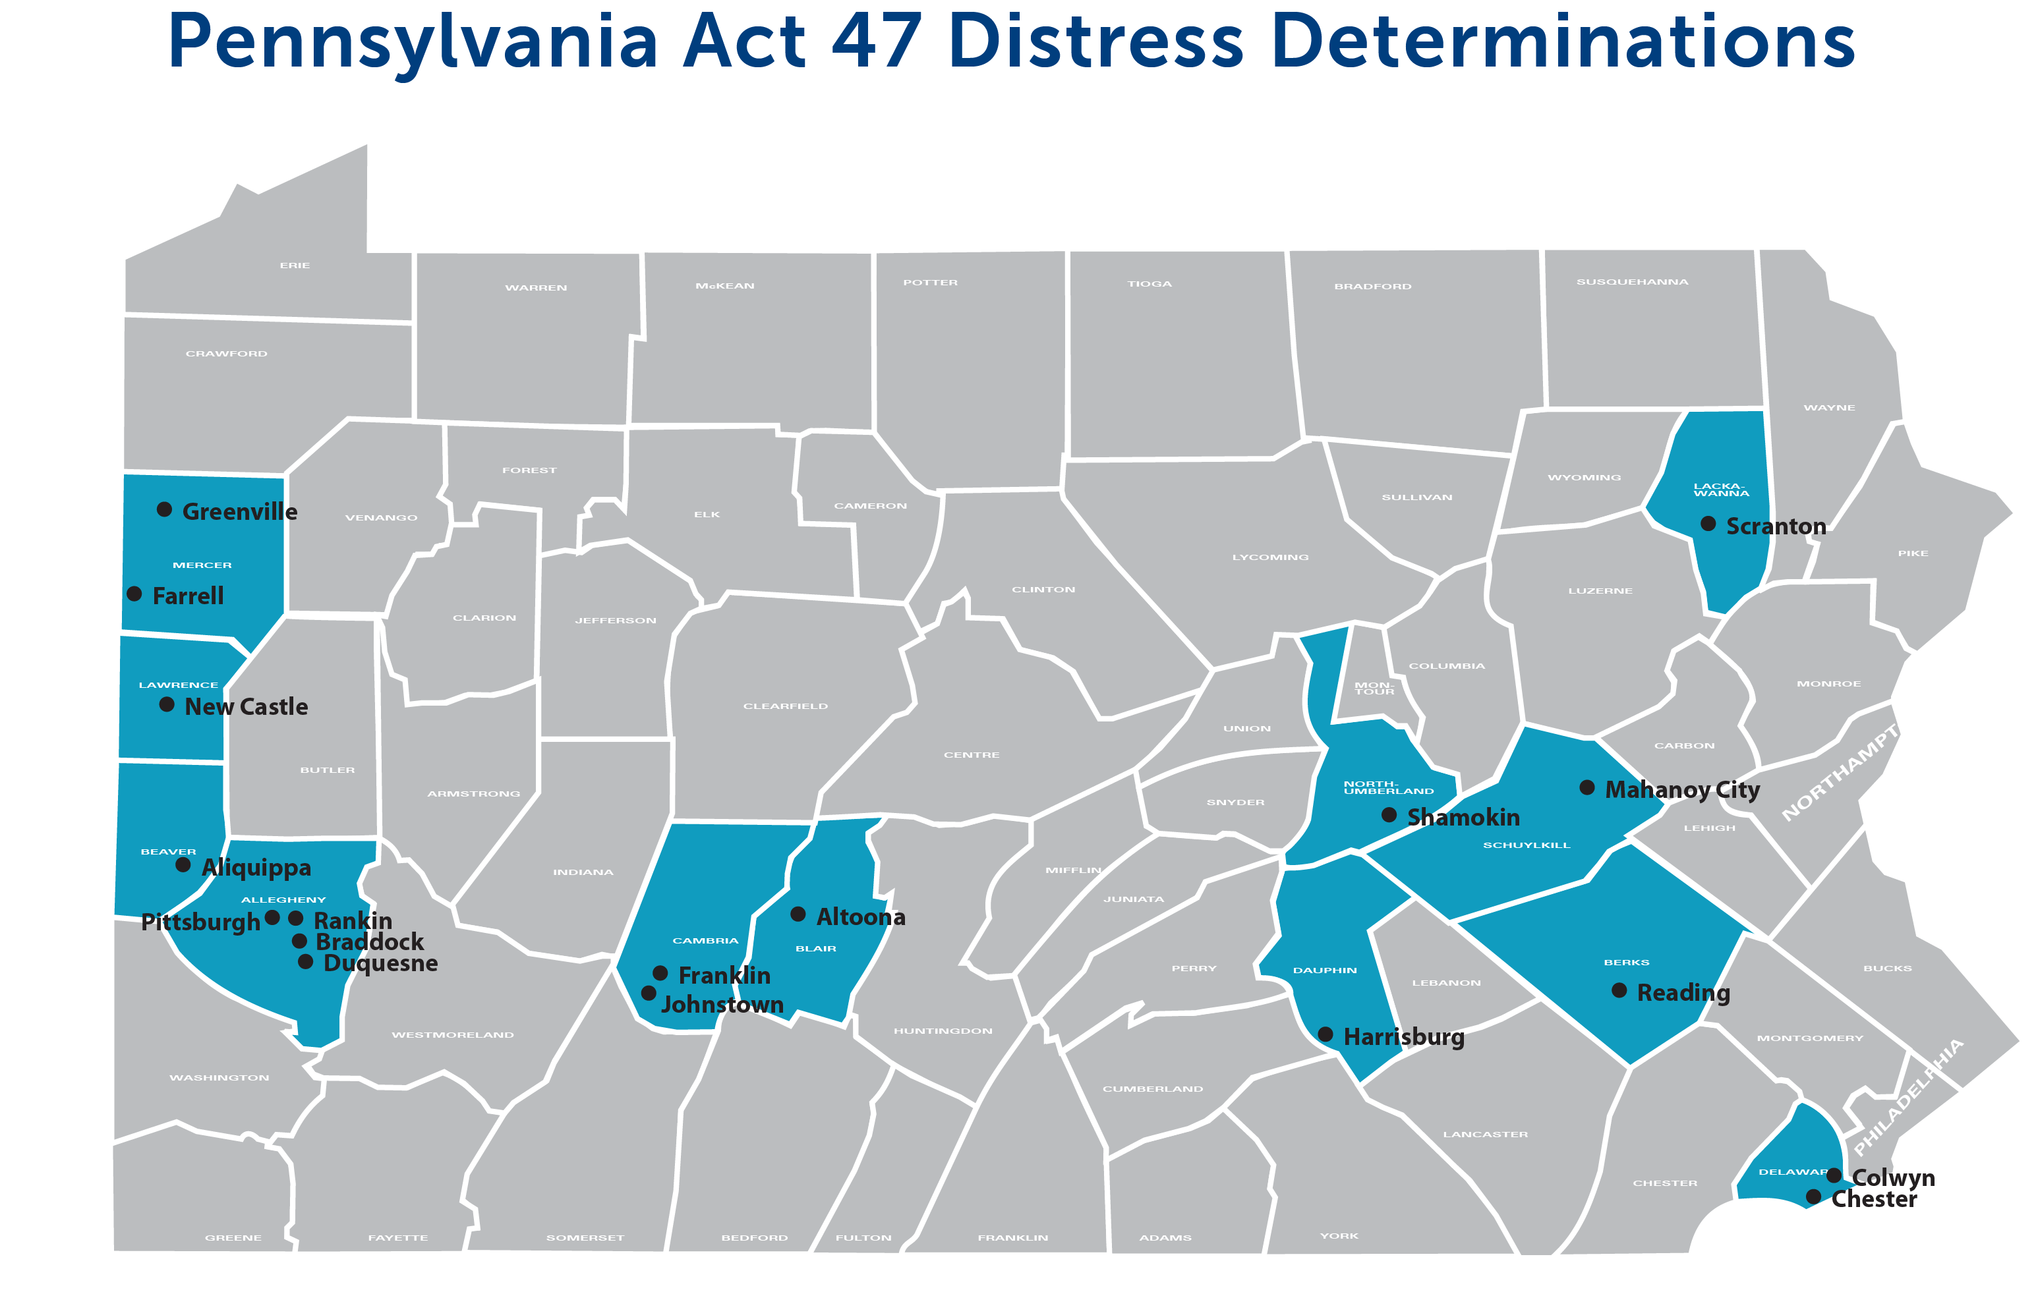
Programs & services
Act 47 of 1987: Municipalities Financial Recovery Act
Severe fiscal distress
Act 199 of 2014 amendments:
5-year time limit
Additional taxation options
Act 47 Coordinators subject to performance reviews
Disincorporation of nonviable communities
Notes:
The GCLGS also plays an active role in assisting municipalities interested in regionalizing their police services. Through peer consultation, the GCLGS assists in the development and implementation of an agreed-upon plan and realistic budget. The peer consultants are former police officers who work directly with the departments throughout the regionalization process.

Slide 25
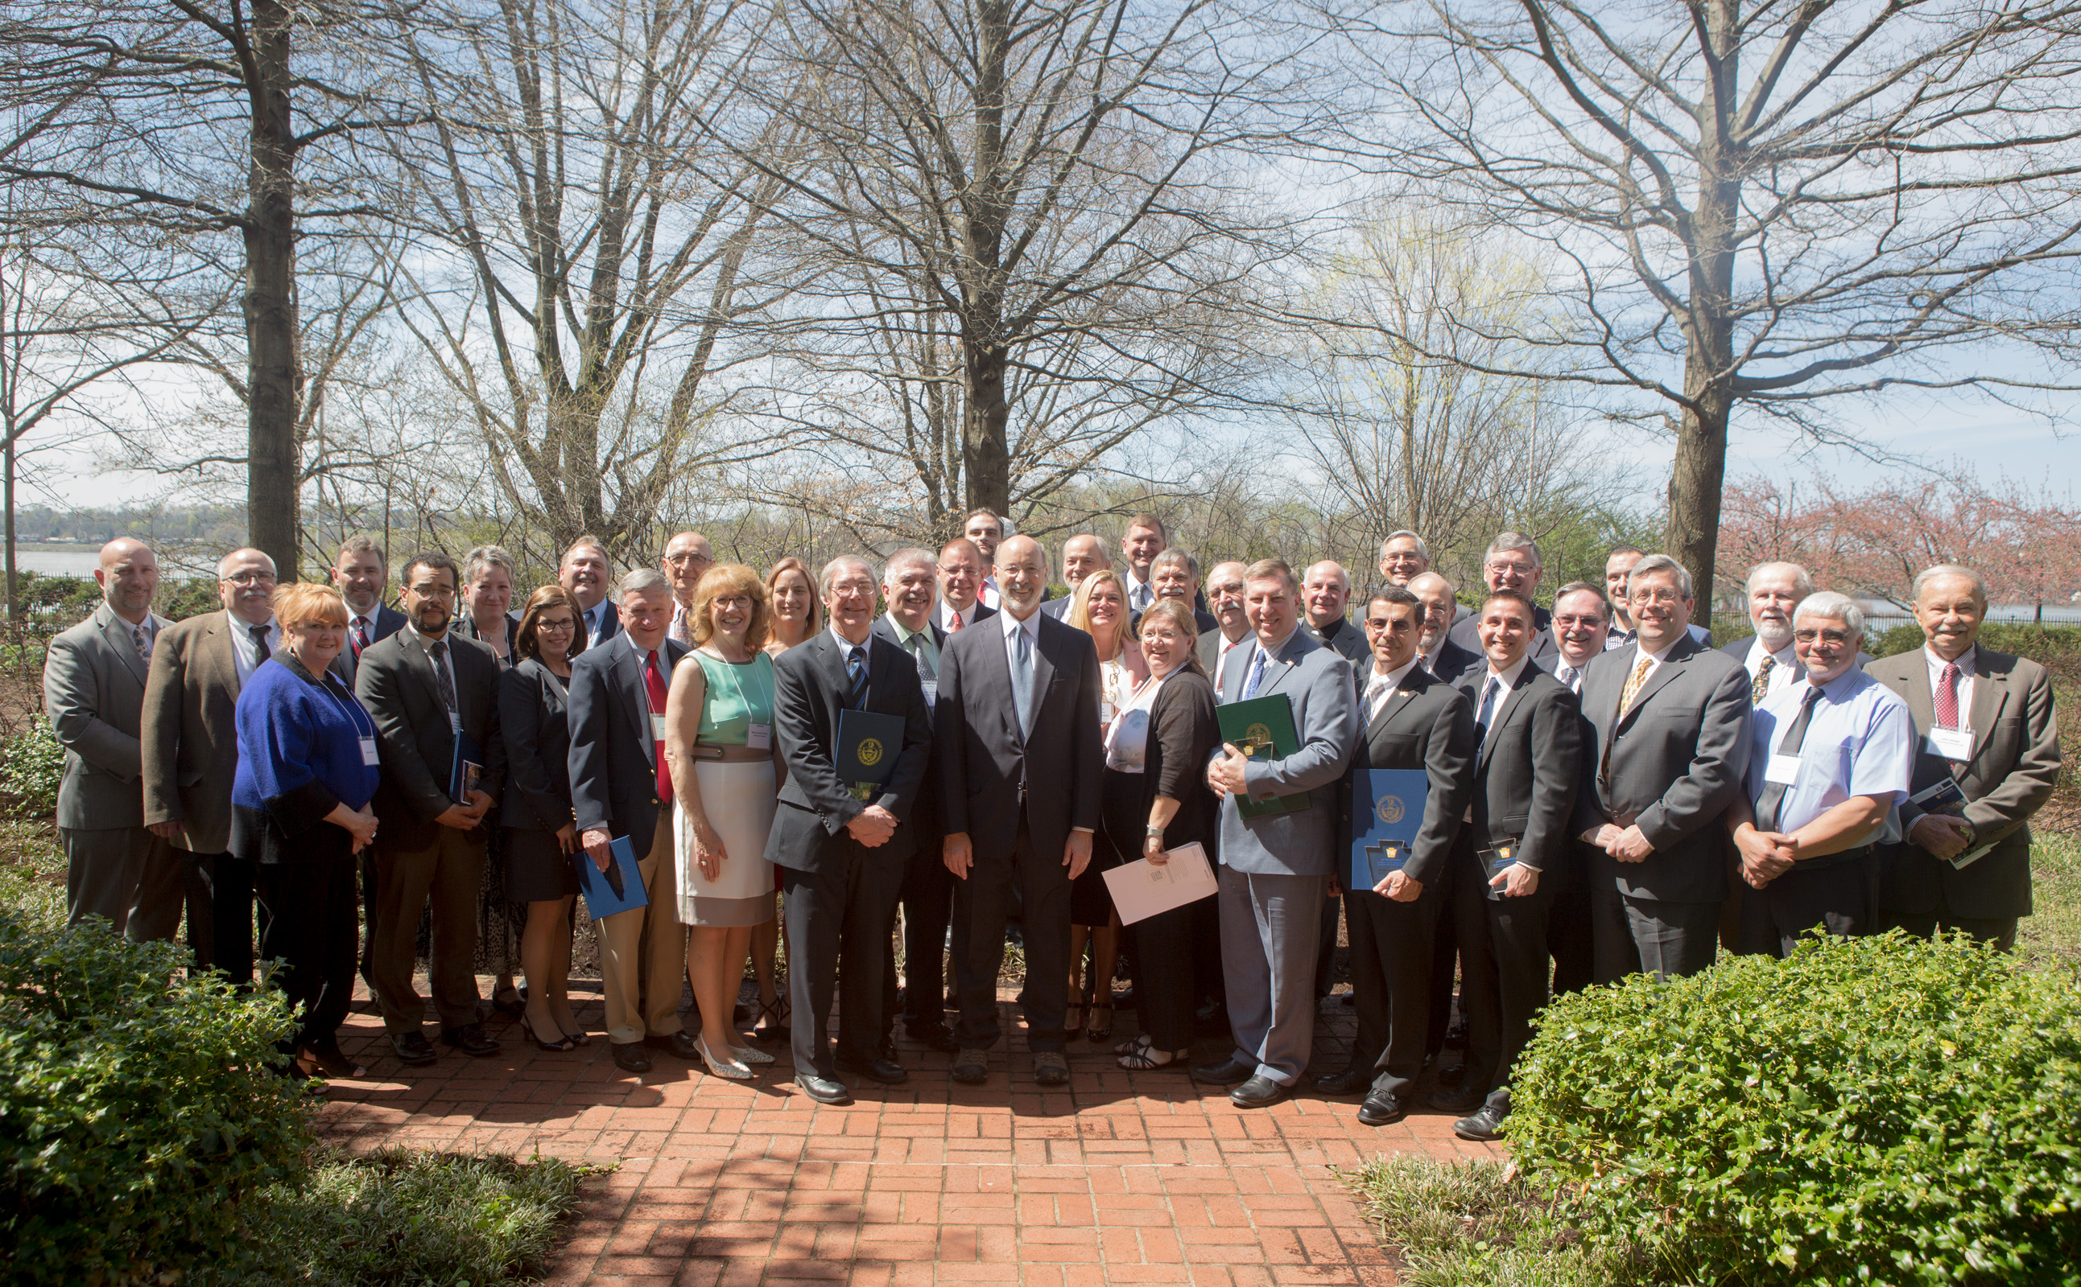
Programs & services
Local Government Day
Governor’s Awards for
Local Government Excellence
Building Community Partnerships
Responding to Adversity
Promoting Community/Economic Revitalization
Innovative Community/Governmental Initiatives
Fiscal Accountability and Best Management Practices
Innovative Planning and Sound Land Use Practices
Intergovernmental Cooperation
Information Technology
Health and Wellness Initiatives
Notes:
The GCLGS also plays an active role in assisting municipalities interested in regionalizing their police services. Through peer consultation, the GCLGS assists in the development and implementation of an agreed-upon plan and realistic budget. The peer consultants are former police officers who work directly with the departments throughout the regionalization process.

Slide 26
2020 Census

Slide 27
2020 census
Partner with Census Bureau
Technical Support
Operational Support
Promotional Support
Data User Support
Lead state entity
Support and assistance
Work with Data Center
Notes:
Local governments partnered with Census Bureau to support the decennial effort in their area for technical support, operational support, promotional support, data user support.
For Census 2000 and 2010, the Governor’s Center for Local Government Services was the lead state entity for coordinating Pennsylvania’s census efforts.
Governor’s Center was directed by Executive Order to provide administrative support and provide assistance as necessary, working in cooperation with other agencies.
In previous censuses, the Pennsylvania State Data Center worked closely with DCED in setting up state level activities to help coordinate activities that would help ensure every person in Pennsylvania was counted.

Slide 28
Governor’s center for local government services
Stay Informed
E-Newsletter
“DCED Community Corner” articles
dced.pa.gov
@PADCEDnews
Pennsylvania Department of
Community & Economic Development
PA DCED

Slide 29
Governor’s center for local government services
Questions?
Governor’s Center for Local Government Services
PA Department of Community & Economic Development
Commonwealth Keystone Building
400 North Street, 4th Floor
Harrisburg, PA 17120
Phone: 888.223.6837
dced.pa.gov

Slide 30
Rick Vilello Deputy Secretary Community Affairs & Development
717-720-7400
rvilello@pa.gov

