Slide 1
Prison Population and Prison Closures in Pennsylvania
2017 PaSDC Data User Conference
May 9, 2017
Bret Bucklen, Ph.D.
Director of Planning, Research, and Statistics

Slide 2
Outline
Overview of the PA DOC
What is the problem of “Mass Incarceration”
Pennsylvania DOC population trends
Prison closure process

Slide 3
Overview of PA DOC
Among “Top 10” largest correctional systems in the U.S.
$2.5 billion budget (approx. 6% of state general funds)
Inmate population (April 30, 2017): 48,651
25 prisons, 1 correctional boot camp, 50+ community corrections centers/facilities
15,000+ employees
Cost to house an inmate: $42,019/yr. (approx. $115/day)

Slide 4
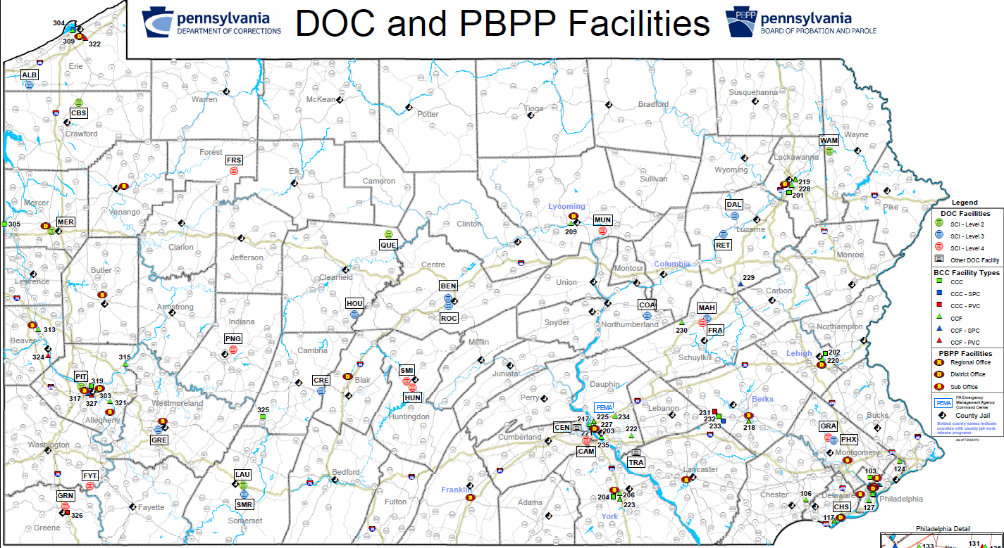
Overview of PA DOC

Slide 5
Overview of PA DOC

Slide 6
Overview of PA DOC
THREE KEY PA DOC PERFORMANCE MEASURES:
Population Reduction
Recidivism Reduction
In-Prison Violence Reduction

Slide 7
Problem of
“Mass Incarceration”
Notes:
Top Five: CA, TX, NY, NJ, GA,

Slide 8
Problem of
“Mass Incarceration”

Slide 9
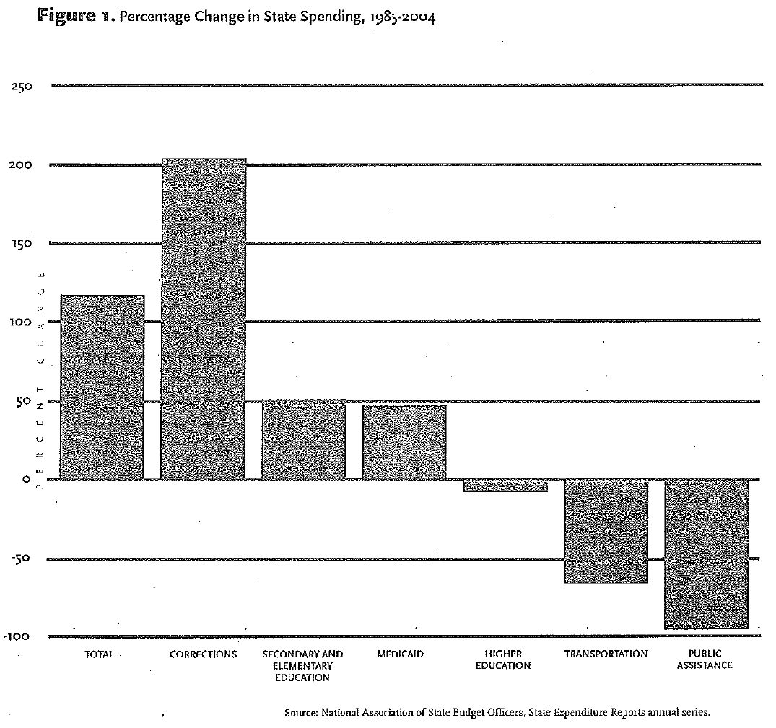
Problem of
“Mass Incarceration”

Slide 10
Problem of
“Mass Incarceration”
Consequences of Mass Incarceration:
  Fiscal
  Concentrated disadvantage and disproportionate minority impact
  Families and marriage
  Voting and political process
  Economic viability
  Community Stigma
  Weakened informal social controls
  Weakened perceived legitimacy of the criminal justice system

Slide 11
PA DOC Population Trends
THREE KEY PA DOC PERFORMANCE MEASURES:
Population Reduction
  Goal: Reduce the prison population by 2,650 inmates in the next 4 years
Recidivism Reduction
  Goal: Reduce recidivism rate by 5 percentage points in the next 4 years
In-Prison Violence Reduction
  Goal: Reduce in-prison violent incidents by 10% in the next 4 years

Slide 12
PA DOC Population Trends

Slide 13
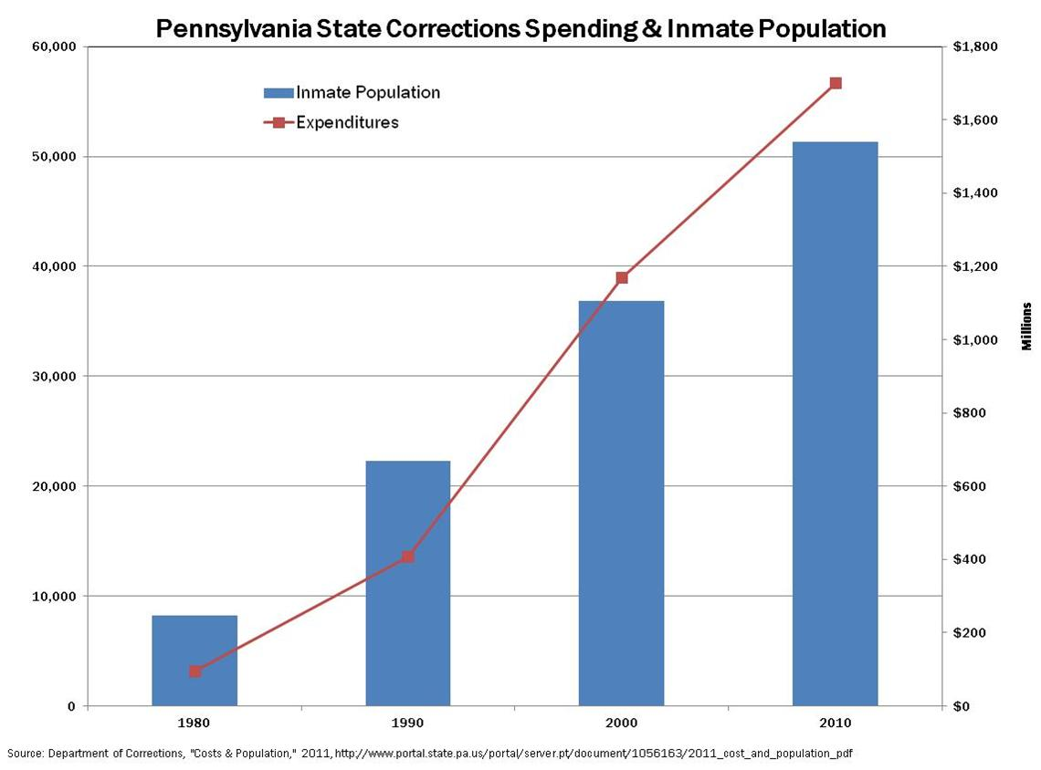
PA DOC Population Trends

Slide 14
PA DOC Population Trends

Slide 15
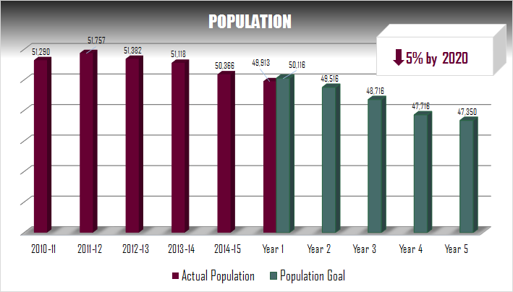
PA DOC Population Trends

Slide 16
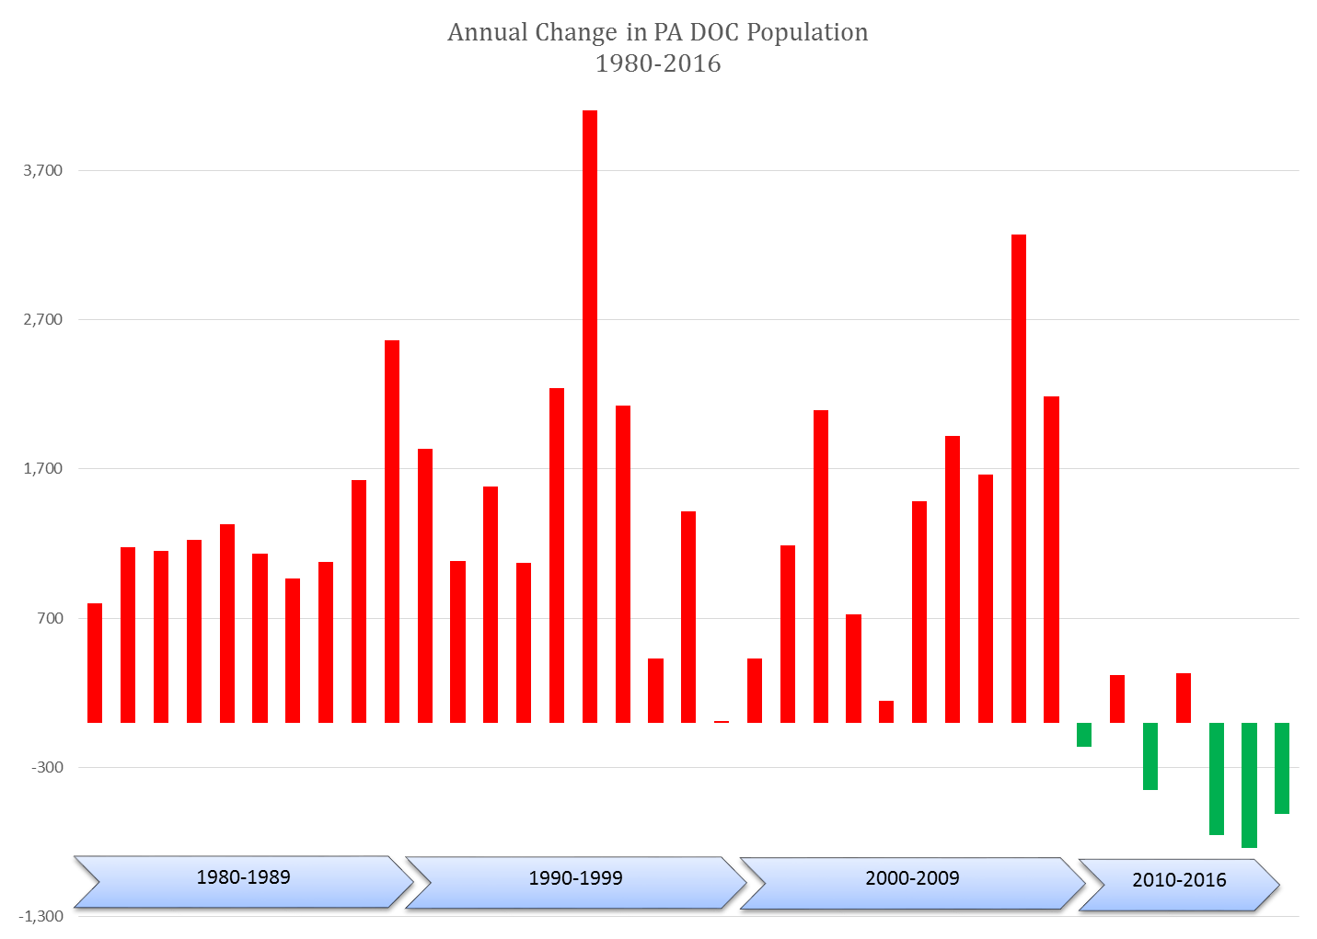
PA DOC Population Trends

Slide 17
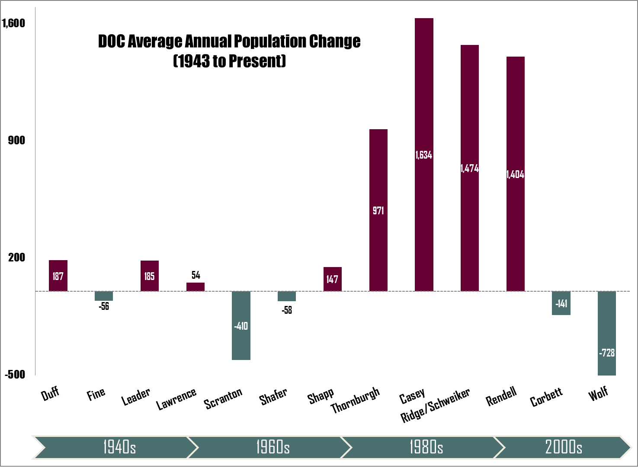
PA DOC Population Trends

Slide 18
PA DOC Population Trends

Slide 19
PA DOC Population Trends
TWO EXPLANATIONS FOR PA DOC POPULATION REDUCTION:
The Justice Reinvestment Initiative (JRI)
A Reduction in Court Admissions

Slide 20
PA DOC Population Trends
What is Justice Reinvestment?
Justice Reinvestment is a data-driven approach to reducing spending and reinvesting savings into strategies that can decrease crime and strengthen neighborhoods; it has the dual benefit of paying for itself while at the same time reducing crime and recidivism rates
Analyze drivers of the prison population
Develop evidence-based strategies for addressing drivers of population increase, in order to reduce population and lower costs
Reinvest the money saved into additional long-term proven strategies which reduce costs further and increase public safety
GOAL: LESS CRIME & LESS PUNISHMENT

Slide 21
PA DOC Population Trends
Examples of Justice Reinvestment Strategies:
Early childhood and youth intervention
Diversionary treatment programming (drug courts, etc.)
Better probation supervision
Better policing
Community support

Slide 22
PA DOC Population Trends
Since 2012, the Commonwealth of PA has reinvested approximately $4 million as a result of prison savings resulting from JRI
Reinvestment categories include:
  Innovate Policing Practices grants
  Effective County Probation Practices grants
  Diversion of “Short Min” offenders
  Community Reentry Services
  Development of a Sentencing Risk Assessment Tool

Slide 23
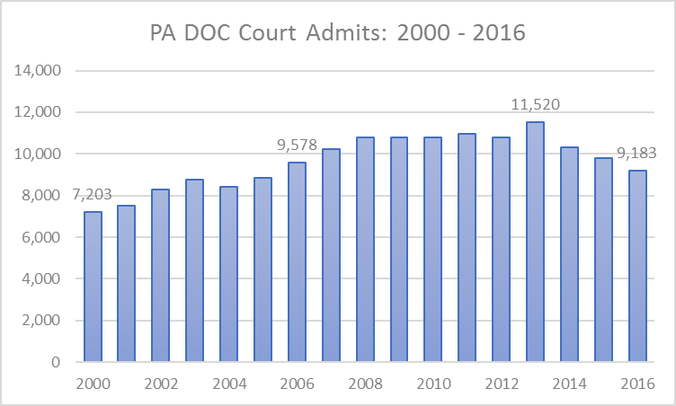
PA DOC Population Trends

Slide 24
PA DOC Population Trends
WHY ARE COURT ADMISSIONS DOWN?
Court decisions which invalidated mandatory minimum sentences
  2013 – Alleyne vs. US
  2015 – Hopkins vs. Pennsylvania
Crime continues to drop in Pennsylvania
Large PA counties are increasingly using smart crime fighting approaches, smart sentencing approaches, and diversionary/treatment programs

Slide 25
Prison Closure Process
TIMELINE
2013 – SCI Cresson and SCI Greensburg close
2013 – Prison Facility Closure Guidelines developed
December 2016 – PA DOC needs to make $160m budget cuts
January 6, 2017 – PA DOC announces prison closure process
January 23, 2017 – Legislative hearing on prison closure
January 26, 2017 – SCI Pittsburgh prison closure announced
June 30, 2017 – SCI Pittsburgh fully closed

Slide 26
Prison Closure Process
FACILITY CLOSURE GUIDELINES CONSIDERATIONS
Cost Savings
Capital projects
Programming
Facility structure
Community/economic impact
Political impact
Security impact
Impact on inmates
Impact on employees
Property options

Slide 27
Prison Closure Process
OTHER AGENCY INPUT
Department of Human Services (DHS)
Department of General Services (DGS)
Department of Labor & Industry (L&I)
Department of Community & Economic Development (DCED)
Office of Administration (OA)

Slide 28
Prison Closure Process
COMMUNICATION PROCESS
Governor’s Office
Legislators
Superintendents/Facilities
Administrative staff
All staff
Board of Probation & Parole
Unions
Inmates
Other affected agencies
Local and other stakeholders
News media
Public
SEAP

Slide 29
Prison Closure Process

Slide 30
Prison Closure Process

Slide 31
Prison Closure Process

Slide 32
Prison Closure Process

Slide 33
Prison Closure Process

Slide 34
Prison Closure Process

Slide 35
Prison Closure Process

Slide 36
Prison Closure Process

Slide 37
Prison Closure Process

Slide 38
Prison Closure Process

Slide 39
Prison Closure Process

Slide 40
Prison Closure Process

Slide 41
Prison Closure Process

Slide 42
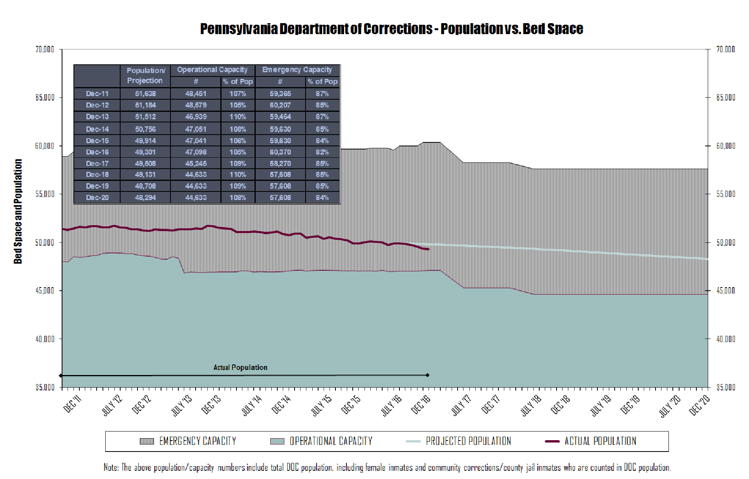

Slide 43

How Can Research Help?

