Slide 1
YorkCounts Community Indicators An Initiative of York County Community Foundation
Lise Levin, VP of Community Investment
Elyse Pollick, Community Investment Officer
The Pennsylvania Data User Conference
May 9th, 2017

Slide 2
Who We Are
Lise Levin: Lise joined York County Community Foundation as Vice President of Community Investment in June, 2015.
Elyse Pollick: Elyse joined York County Community Foundation in October, 2015.

Slide 3
What to Expect Today
Purpose of today’s presentation
Understand what the Community Foundation is.
Learn about our indicator project.
Understand how the two benefit from each other.

Slide 4
Who We Are
York County Community Foundation: We create a vibrant York County by engaging donors, providing community leadership, and investing in high-impact initiatives while building endowment for future generations.
Established in 1961
$135 million in endowed assets. Grants made from annual funds available from income from the endowment.

Slide 5
What is YorkCounts?
YorkCounts, a committee of York County Community Foundation, seeks to build a stronger York County by assessing needs, confronting critical issues, and driving for results.
YorkCounts uses indicator data to evaluate the highest-priority needs in the county and to inform its leadership, advocacy, and grant making decisions.

Slide 6
What is YorkCounts?
2001. First Community Indicators Report (ongoing, every 3 years), highlighting major community trends. Data gathered by local consultant and/or staff.
2004. Action Plan: Charting a Brighter Future for All addressing goals in three major areas – Economic Development, Education, and Community Development
2004-2009. Hundreds of community stakeholders meet in task forces addressing community challenges. David Rusk presents recommendations for a Metro York. Many initiatives accomplished, community summits held, actions taken: Truancy Prevention Initiative, Office of Workforce Development, International Baccalaureate charter school, York City fiscal crisis report, etc.

Slide 7
Indicators Project
2011. YorkCounts becomes a committee of York County Community Foundation, creating financially sustainable model to continue the work.
2015. Community Foundation decided to:
Engage outside resource for indicator data.
Solicited & evaluated proposals.
Reviewed other community’s indicators to finalize ours.
Present data only in an online format.
Update data and website annually.

Slide 8
Pennsylvania State Data Center
The PaSDC has extensive experience working with not only Census Bureau datasets but other public datasets. Over its 35 year history, the PaSDC has provided data to many agencies and businesses for various projects.
WEBSITE GOALS:
-- User friendly: click and drag
-- Clean and clear
-- Easy for users of all ability
-- Neutral. Data integrity can stand alone; no analysis

Slide 9
Why Us?
Shows us where community needs are.
Aggregated community snapshot & trendlines.
Community leadership/advocacy.
It reflects the areas in which we grant.
Resource for grantees.

Slide 10
Where We Focus
Health. Memorial Health Fund
Aging. Embracing Aging
Community and economic development. Fund for York County
Fields of interest

Slide 11
Let’s Check it Out!
http://www.yorkcounts.org

Slide 12
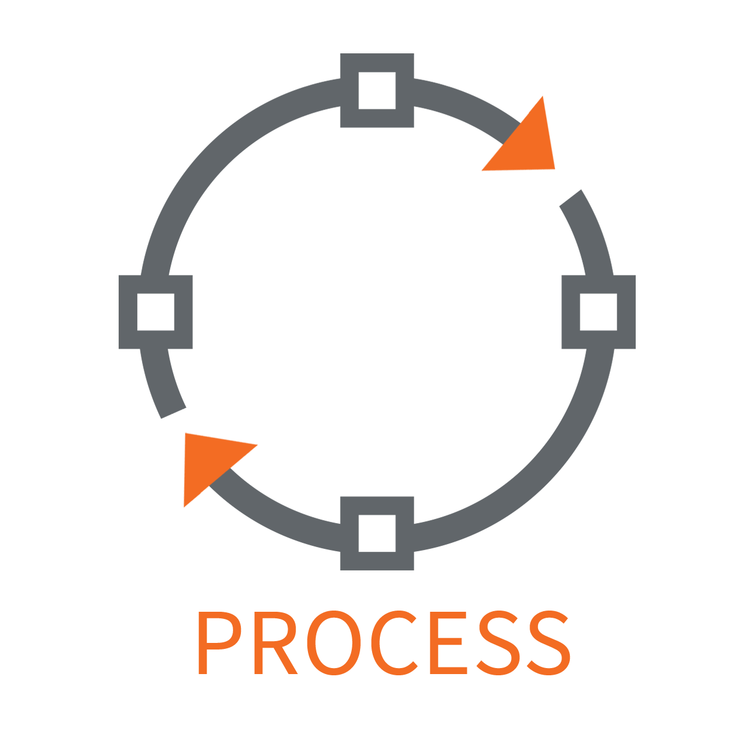
The Process
4 phases:
Pre-Data
Storing the Data
Reviewing Data
Analyzing Data

Slide 13
Analytics
Since launching the new site in July 2016:
2,329 users
13,418 pageviews
Average session duration: 3 minutes
Most viewed indicator: PSSA Results
Least viewed indicator: Contested Elections
Longest average time on an indicator: Crime Rates (2:48 average)
Who uses it?
Anecdotally
Orienting people to York
Grant seekers
Proposal writers
We hope! Decision makers
Health care professionals analyzing local social determinants of health

Slide 14
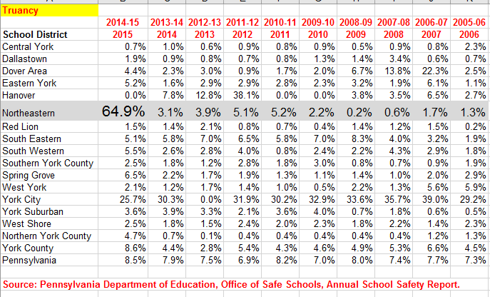
Sometimes, Data Lies
Truancy:

Slide 15
Metrics & Data
We’re getting there!
Asking grantees to perform specific outcomes in their program design
“Preferred outcomes” in competitive grant cycles

Slide 16
Where Next?
Who knows?
New indicators of community health?
New data telling us what is important – social determinants of health
Intersecting sectors – Education & Housing; Healthy aging, etc.
Data we can’t get – Is this a grant? Do we need it to inform our grant making?

Slide 17
How It All Comes Together
Leadership
Advocacy
Grant Making
High Impact
DATA =

Slide 18
2017 Potential Grant Directions & Metrics
EDUCATION: Address social determinants of educational success for underprivileged students %
Increased # of disadvantaged students stay in school; City test scores & grad rates approach State's.
DNTN & NEIGHBORHD REVITALIZATION: Expand revitalization focus to include quality of life in neighborhoods near Business Improvement District
Increased net # of businesses & residents; increased median home prices; reduced real estate tax disparity w/ neighboring municipalities.
WORKFORCE: Work w/ core partners; look for pilot projects that demonstrate newer workforce models
Increased # of disadvantaged adults are hired & retained in family sustaining jobs; workforce pipeline is streamlined and maximized.

Slide 19
Our Work: Head AND Heart

Slide 20
Questions?
Elyse Pollick
epollick@yccf.org
Lise Levin
llevin@yccf.org

