Slide 1
2020 Census
Local Update of Census Addresses Operation (LUCA)
Promotion
Notes:
Good morning/afternoon, my name is (insert NAME), from the Census Bureau’s (insert Division or Regional Office). Thank you for the opportunity to speak with you today to promote the 2020 Census Local Update of Census Addresses Operation (LUCA).

Slide 2
Agenda
The Decennial Census
2020 Census Design
Address List Maintenance 2010 - 2020
LUCA
Background
Confidentiality and Security
What’s New for LUCA
Who Can Participate
Preparation for LUCA Participation
Early Tools
Participation Methods
Product Formats (Address List & Maps)
Next Steps
Schedule
Notes:
Though the focus of most of the presentation is the 2020 LUCA operation, I will begin by providing some high level information regarding the Decennial Census, the design for the 2020 Census and the maintenance of the census address list.
I will cover the LUCA background, confidentiality and security, new aspects of 2020 LUCA, who can participate as well as numerous preparation topics including early tools, participation methods, product formats for the address list and maps, the next steps for participants and the 2020 LUCA schedule.

Slide 3
The Decennial Census
The purpose is to conduct a census of population and housing and disseminate results to the President, the States and the American People
Uses of Census data:
Apportioning representation among states as mandated by Article 1, Section 2 of the US Constitution
Drawing congressional and state legislative districts, school districts and voting precincts
Enforcing voting rights and civil rights legislation
Distributing federal dollars to states
Informing planning decisions of federal, tribal, state and local government
Informing organizational decisions (e.g., where to locate, size of market, etc.) of businesses and non-profits
Notes:
The purpose of the Decennial Census (also known as the 2020 Census this decade) is to conduct a census of population and housing and disseminate the results to the President, the States, and the American people. The United States Constitution mandates an actual count of every person residing in the United States every 10 years. The Census Bureau counts individuals within households and typically collects information about the housing structure and the housing unit.
The primary use of Decennial Census data is apportioning representation among states as mandated by Article 1, Section 2 of the United States Constitution.
Additional data uses include:
Drawing congressional and state legislative districts, school districts and voting precincts by states, tribes, and local governments
Enforcing voting rights and civil rights legislation by the Department of Justice
Distributing more than 400 billion dollars EACH YEAR in federal funding for than 1,000 programs administered by 26 federal agencies to tribal, state, and local governments. Census population figures form the basis for the allocation of significant amounts of federal funding. Missing a housing unit, and the associated population, during the decennial census may result in a missed opportunity for governments to benefit, which perpetuates until the next decennial census.
Informing the decisions of governments, businesses and non-profits regarding community and regional development, education, agriculture, energy, and environmental programs, as well as other community improvements and enhancements. Census data informs communities so they may allocate their own funding for neighborhood improvements, public health, education, transportation and much more.

Slide 4
2020 Census Design
4
Notes:
This graphic illustrates the 2020 Census Design process and why building a strong geographic foundation is so important to the success of the 2020 Census.
We must Establish Where to Count – identify all the addresses where people could live.
We must Motivate People to Respond – use the address list to send mailed materials that invite and encourage households to respond.
We must Count the Population – use the address list and maps to send our enumerators to collect interview data from nonresponding households.
We must Release Census Results – use the address list and geographic boundaries to process, tabulate, and disseminate:
Apportionment counts to the President by December 31, 2020
Redistricting data to the States by April 1, 2021
High quality data to the public
In this presentation and others you may receive throughout this year, the Census Bureau provides examples regarding the importance of LUCA participation and a successful 2020 Census that result after the “Release Census Results” section (Apportionment, Redistricting, Distributing billions in federal funding, Providing data for local analysis, etc.). While these are all valid reasons for participating in LUCA, this graphic illustrates why your LUCA participation is so fundamentally important. LUCA offers local governments the opportunity to provide their input into the address list that serves as the foundation of the entire 2020 Census Design process!
Participants in 2020 LUCA have a direct impact on the quality and completeness of the address list. Think of 2020 LUCA as a vehicle to “Get local government input” and “Establish Where to Count”.

Slide 5
Address List Maintenance 2010 - 2020
On-going Maintenance and Update
US Postal Service’s Delivery Sequence File (DSF)
Updates from tribal, state, and local government address lists and commercial address lists
Continuous identification of stability and change
Address Canvassing
Nationwide In-Office Address Canvassing
LUCA
Opportunity to review and update the Census Bureau’s address list for the 2020 Census
In-Field Address Canvassing
Annual In-Field data collection, checks, and tests
2010 Census
2020 Census
Notes:
To maintain the address list, the Census Bureau starts with a firm base from the 2010 Census. Bi-annual processing of the US Postal Service’s Delivery Sequence File (DSF), last decade’s LUCA results, the nationwide In-Field Address Canvassing that occurred in 2009 in preparation for the 2010 Census, as well as additional updates that occurred at the time of 2010 enumeration built the Census Bureau’s address list.
On-going address list maintenance and update activities not only rely on the DSF, but also on updates from tribal, state, and local government address lists and the Census Bureau’s internal work to identify areas of stability and/or areas of change.
The 2020 Census will include an Address Canvassing operation, but it will differ from previous decennial censuses. For 2020, a nationwide In-Office Address Canvassing operation will identify areas not requiring In-Field Address Canvassing. Areas of change or uncertainty identified during the In-Office operation will be included in an In-Field operation. The In-Field Address Canvassing operation leverages advancements in technology and operational improvements to make it more efficient than previous decennial canvassing operations. The Census Bureau also conducts data collection and quality checks through monthly surveys and Census Tests in advance of the decennial.
In looking at the far right portion of the slide, and as we have already discussed, LUCA provides an opportunity to review and update the Census Bureau’s address list. Therefore, LUCA serves as a component of address list maintenance leading into the 2020 Census.

Slide 6
Geographic Support System (GSS) Program
Integrated program of improved address coverage, continual spatial and feature updates, and enhanced quality assessment and measurement
Supports and maintains the geographic and cartographic infrastructure necessary for the Census Bureau’s data collection, processing, tabulation, and dissemination programs for the United States and Puerto Rico
Provides for continual updates throughout the decade to support current surveys and the 2020 Census
Notes:
<Presenter: DO NOT READ ALOUD, but if receive specific questions related to the GSS status of a county, take the information and inquire with GEO-ADCPB.>
As mentioned on the previous slide, updates from tribal, state, and local governments are part of the Census Bureau’s ongoing maintenance and update of their address list. The Census Bureau has undertaken the Geographic Support System (GSS) program in an effort to maintain the address list as well as continually research and update the address frame.
The GSS is an integrated program of improved address coverage, continual spatial and feature updates, and enhanced quality assessment and measurement. It supports and maintains the geographic and cartographic infrastructure necessary for the Census Bureau’s data collection, processing, tabulation, and dissemination programs for the United States and Puerto Rico and provides for continual updates throughout the decade to support current surveys and the 2020 Census. The program goal is to acquire address and spatial files for every census tract in the US and Puerto Rico. Since fiscal year 2011, the Census Bureau conducted research and development, acquired available files and updated their MAF/TIGER database using those acquired sources. In fiscal year 2017, the Census Bureau expects to complete a “Pass of the Nation” for the GSS program. Yearly budgetary constraints did not allow contact with all potential partners regarding the GSS program. The Census Bureau attempted to acquire data from state, county and regional agency partners, helping to streamline the GSS file acquisition process.
For fiscal year 2018 and beyond, the Census Bureau will selectively acquire and process files based on areas of change/growth, governmental entities unable to participate in LUCA and areas identified during the In-Office Address Canvassing operation. The vision after the 2020 Census concludes is to continue leveraging partners via the GSS program in order to provide continual updates in support of census surveys and future decennials.

Slide 7
LUCA Background
Authorized by the Census Address List Improvement Act of 1994 (Public Law 103-430)
Implemented in the support of the 2000 Census and refined to support the 2010 Census
Provides a voluntary opportunity for designated representatives of tribal, state and local governments to review and comment on the addresses used to conduct the decennial census
Notes:
The Census Address List Improvement Act of 1994, which became Public Law 103-430 in October 1994, authorized the Census Bureau to share its address list with governments who sign a confidentiality agreement.
First implemented in support of the 2000 Census, LUCA was later refined to support the 2010 Census.
LUCA provides a voluntary, once-a decade, opportunity to tribal, state, and local governments to review and comment on the Census Bureau's residential address list for their jurisdiction prior to the decennial census. The Census Bureau relies on a complete and accurate address list to reach every living quarters and associated population for inclusion in the census.

Slide 8
Confidentiality and Security
Information provided to/from LUCA is covered under Title 13 of the United States Code which:
Requires the Census Bureau to ensure confidential treatment of census-related information, including individual addresses and map structure points
Requires all liaisons, reviewers, and anyone with access to Title 13 materials abide by Confidentiality and Security Guidelines
Requires the Census Bureau maintain the confidentiality of all information it collects
Notes:
Title 13 of the United States Code authorizes the Census Bureau’s work and provides strong protection for the information it collects. The commitment to maintain confidentiality and security is critical in gaining, and crucial in retaining, the public’s support of their work.
LUCA participants MUST understand that information provided to/from LUCA falls under Title 13, which specifically requires the Census Bureau to ensure confidential treatment of census-related information, including individual addresses and structure coordinates. Structure coordinates identify the location of living quarters. Title 13 requires all liaisons, reviewers, and anyone with access to Title 13 materials abide by the Confidentiality and Security Guidelines and requires the Census Bureau maintain the confidentiality of all of the information that it collects.
Confidentiality and Security guidelines are included with the LUCA invitation package mailed to the Highest Elected Official in July 2017. Each participating government must designate a LUCA liaison who accepts the responsibility for protecting and safeguarding Title 13 materials. The LUCA liaison, reviewers, and anyone with access to Title 13 materials must read, understand, and agree to abide by the confidentiality and security guidelines by signing the Confidentiality Agreement form.
An internet search of both Title 13 and PL 103-430 provides additional detail.

Slide 9
What’s New for 2020 LUCA
Offers streamlined participation – Full Address List Review
Provides the digital address list in convenient standard software formats
Includes ungeocoded address records for state and county participants
Requires residential multi-unit structure identifiers (e.g., Apt 1, Unit A2, #3001, etc.)
Includes residential structure coordinates, if available
Allows participants to submit residential structure coordinates, if available
Allows participants to submit non-city style addresses with corresponding map spot
Notes:
As part of the LUCA background slide, I mentioned the refinement of 2010 LUCA, so now, it is logical to discuss “What’s New for 2020 LUCA?”
The 2020 LUCA operation offers streamlined participation through a full address list review; provides the digital address list in convenient standard software formats and includes ungeocoded addresses for state and county governments. For those of you that may be unfamiliar with the term ‘ungeocoded’, in Census terms it identifies addresses without census geography codes for the state, county, tract and block. Also new for 2020, is the requirement for multi-unit structure identifiers. This new requirement is important to mention because it may require special attention for participants that do not store individual unit information. I will mention this topic again when I discuss participant preparation.
Additionally, the 2020 LUCA materials include Census Bureau residential structure coordinates, if they are available and allows participants to submit their own residential structure coordinates to accompany their addresses/map spots. 2020 LUCA also allows participants to supply non-city style addresses, but only if corresponding map spots are also provided. The Census Bureau cannot accept PO Box information.

Slide 10
Who can participate in LUCA
Federally recognized tribes with a reservation and/or off-reservation trust land
States
Counties
Incorporated places
Cities, towns, boroughs, or villages
Townships (Minor Civil Divisions)
Notes:
Now that I have presented the LUCA background, discussed confidentiality and security as well as “what’s new”, you may be wondering who can participate? The Census Bureau’s LUCA participants are comprised of active, functioning, legal governments including:
Federally recognized tribes with a reservation and/or off reservation trust lands
States
Counties
Incorporated Places (cities, towns, boroughs, villages)
Townships (Minor Civil Divisions)
If a government lacks the resources to participate in LUCA, they can arrange for a higher level of government, such as a county or a regional organization to conduct their LUCA review. Please note, regional planning agencies and COGS are not specifically invited nor eligible to participate as a legal government entity; however, if they agree to assist local governments can designate them as a LUCA reviewer. States may enlist the assistance from their State Data Centers or specific state agencies to serve as their LUCA reviewer.

Slide 11
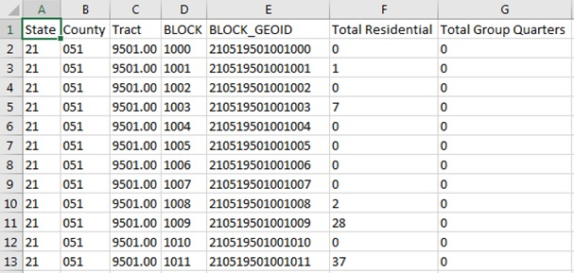
Preparation - Early Tools
2020 LUCA Address Block Count List
Provides access to an address count list which includes the count of residential addresses and group quarters by block
Notes:
The Census Bureau is excited to offer participants the opportunity to begin LUCA preparation in advance of LUCA registration. For the first time, residential address block counts are available for download on the LUCA website. These residential block counts are current as of January 2017. The Census Bureau intends to update the counts again in July 2017.
Use the “How Can I Review the Address Block Counts for My Entity” section to search and download the Address Block Count file for your government. The download is in pipe-delimited text format, but easily converts into Excel (.xlsx). The Geographic Programs Support Desk can assist with the process if necessary. I will provide their information at the end of the presentation.
This slide shows an example of the layout for the block count list which includes the geographic codes and count of residential addresses (housing units and group quarters) by census block. To prepare for LUCA, potential participants can compare the Census block count data to their local data. They can join the block count data to census block geography using a Geographic Information System (GIS) and use the results to identify areas to focus their LUCA review.
<Presenter: As time permits (or after the presentation), navigate to the LUCA website and show this section/action.>

Slide 12
Preparation - Early Tools
Census Geocoder
Takes individual addresses or file of addresses and obtains coordinates and census geography
Geocoder updates include:
Increasing the maximum number of records for batch processing from 1,000 to 10,000
Providing larger governments another means to submit addresses to be geocoded
Notes:
The Census Geocoder tool is a service that allows you to enter in an address (or upload a file of addresses) to obtain approximate coordinates and census geography based on the address ranges within the MAF/TIGER database.
Initially the Census Geocoder could only process batches of 1,000 records, but now the record limit is 10,000. If your government has more than 10,000 address records, you must divide your file into multiple files for processing. The Census Bureau will provide another means for governments to submit a larger number of addresses for geocoding without splitting into 10,000 record increments. Details are forthcoming on that process.
Geocoding a local address list using Census geocoder is another way to begin to prepare for LUCA because it standardizes local data into the format the Census Bureau needs for LUCA processing and provides the census block geocode for the records submitted in the local address list file. Participants may use the geocode information to generate their own local block count tallies for comparison to the Census Bureau’s block count file discussed on the previous slide. Participants can also generate geocodes using their own GIS, but this tool may help smaller entities or entities that do not have access to their own GIS.
<Presenter: As time permits (or after the presentation), navigate to the LUCA website and show the Geocoder tool or launch demo video if it exists.>

Slide 13
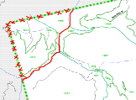
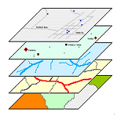
Preparation - Participation Methods
Geographic Update Partnership Software (GUPS)
Paper Format - Address List and Maps
Digital Format - Address List and Maps
Notes:
To prepare for LUCA registration, familiarity of the methods for participation is important. For 2020 LUCA, there are three methods of participation: Geographic Update Partnership Software (GUPS), Paper format and Digital format. The next few slides provide more information about these participation methods.

Slide 14
GUPS – Participation Method
Customized Geographic Information System (GIS) software for participation in 2020 LUCA
Pre-packaged to include all components
Designed for participants with no GIS experience
Allows for simple to complicated reviews and edits
Programmed with a review tool to validate LUCA edits
No internet connection required
Notes:
The Geographic Update Partnership Software, or GUPS, is a self-contained, customized GIS software tool provided by the Census Bureau for participation in a variety of Census geography programs, including 2020 LUCA. It is pre-packaged to include the Census Bureau’s address list, block count list, and TIGER partnership shapefiles. GUPS allows the participant to add external geospatial data (shapefiles, geodatabases, and imagery) for comparison and update purposes. Delivery of all data (install, address list and shapefiles) is on DVD.
Designed with the participant in mind, GUPS is user-friendly, and allows for simple to complicated LUCA reviews and edits.
Programmed with a review tool requiring the user to validate their edits before creating a submission file, GUPS ensures the file(s) submitted are valid and allows for easier processing once received by the Census Bureau.
GUPS does not require an internet connection, but one is necessary to use the imagery server.
To reiterate, other Census geography programs utilize their own custom GUPS versions, so there could be more than one GUPS version offered to you leading up to the 2020 Census depending on your role in your government. Please pay special attention to instructions for each version’s use and inquire with the Census Bureau if you have any questions.
<Presenter: DO NOT READ ALOUD, but if time permits (or after the presentation), demonstrate this software or launch demo video if it exists.>

Slide 15
GUPS screen example
NO TITLE 13 DATA DISPLAYED
Notes:
After the initial data load, the GUPS screen looks very similar to this example. There are two main toolbars at the top of the screen; the Standard Toolbar contains all the typical GIS functions; save, zoom, pan, select, etc. and the LUCA Toolbar contains all of the functions needed for performing your LUCA review; including address list toggle buttons, add/delete linear feature, and QC review tools.
Below those, you will see a map of your jurisdiction on the left, the Block Count List for your jurisdiction on the right, and the Census Address list at the bottom. Participants complete all edits, including “Adds” and “Deletes”, from within the Census Address list window. GUPS has in-line editing, as well as simple selection and “designation” buttons for designating addresses as “Out of Jurisdiction”, “Non-Residential”, or “Deletion”. Participants can also sort or filter the address list to search for a particular address, or addresses in a certain area. Lastly, next to the “Census Address List” tab, you will see a “User Address List” tab. When selected, the user can import their own address list as either editable or ‘read-only’ to assist in their review.
As an additional note, the image shown here does not show map spots because of the scale that the map is currently drawn. As you zoom into the map, more map elements are visible, including map spots, street names, and block numbers. There is no Title 13 data displayed in this example.

Slide 16
GUPS screen example
NO TITLE 13 DATA DISPLAYED
Notes:
GUPS participants can add an address by placing a map spot on the map in the location of the new address and a pop-up like this will appear.
By adding the map spot, the geocode fields (STCOU, Tract and Block) and the latitude/longitude fields pre-populate leaving only the mandatory house number and street name fields to complete. In this example, the optional ZIP Code and Address Use (Mailing, Location, Both) are included.
There is no Title 13 data displayed in this example.

Slide 17
GUPS screen example
Non-Title 13 Example
NO TITLE 13 DATA DISPLAYED
Notes:
In this last example, the participant added a road (Any Ave) as well as two new address records (using map spots). Both the address list and the map include the records. The map depicts the two new records as blue map spots.
There is no Title 13 data displayed in this example.

Slide 18
Preparation – Address List Formats
Paper
Available to governments with 6,000 or fewer addresses
Legal size (8.5” x 14”) – 6 addresses per page
Two sorts:
Street Name/House Number
Census Tract number/Block number/Street Name/House Number
Separate ‘Add Page’
Digital
Available to all governments
Excel (.xlsx) or Comma Delimited Text (.csv) format
No separate ‘Add Page’
Notes:
Now that we covered the GUPS Participation Method, the next few slides discuss the materials that comprise the Paper and Digital participation methods, so you can begin to think about which is best for your government.
The paper format address list is only available to participants with 6,000 or fewer addresses. While this may seem like a low number, more than half of the eligible governments have less than 6,000 addresses!
The address list is printed legal size (8.5 x14 inches) with only six addresses per page. There are two “sort options”: Street Name/House Number OR Census Tract number/Block number/Street Name/House Number. Each has pros and cons as it relates to a review. Consider your ability to re-sort your local list to match one of these sort options as well as whether or not geographically defining areas for your review is possible. Census Bureau staff can discuss sort options and help you choose. Additionally, a separate paper “Address List Add Page” is necessary for participants to add new or missing address records. Examples of the paper Address List and Address List Add Page are forthcoming.
The digital format address list is available to all governments. Different from 2010 LUCA, the Census Bureau is providing the 2020 LUCA digital address list in Excel (.xlsx) or Comma Delimited Text (.csv) format. A database or spreadsheet software such as Microsoft Access or Microsoft Excel is necessary to use the digital format address list. There is no need for a separate ‘Add Page” to add records. Selection of this format allows GIS users to create coordinates from the latitude/longitude values included in the address list.

Slide 19
Address List Structure
LUCA 2010 – 26 Fields
LUCA 2020 – 24 Fields
Entity ID
Line #
MAFID
Action
State
County
Tract
Block
GQ Flag
House Number
Street Name Prefix Qualifier
Street Name Prefix Direction
Street Name Prefix Type
Street Name
Street Name Suffix Type
Street Name Suffix Direction
Street Name Suffix Qualifier
Location Description or GQ Name
Apartment/Unit Number
ZIP Code
Non-city style Mailing Address
Non-city style ZIP Code
Structure Point
Latitude
Longitude
City-Style Flag
Line #
MAFID
Action
Entity ID
State
County
Tract
Block
GEO ID
GQ Flag
House Number
Street Name
Apartment/Unit #
ZIP Code
GQ Name
Facility Name
Location Description
Non-city style Mailing Address
Non-city style ZIP Code
Mapspot ID
Address Use
Latitude
Longitude
City-Style Flag
}
Notes:
Before moving onto the maps topic, please be aware the structure of the address list has changed since 2010. The Census Bureau incorporated suggestions from those programs and combined some of the fields.
The graphic illustrates the changes in the layout of the digital address list from 2010 to 2020. The most significant change was concatenating seven “Street Name” fields for 2010 into one field for 2020. In addition to two new fields, highlighted in green (GEOID and Address Use), a re-ordering of the fields also occurred.
Though most of the changes mentioned above apply to the paper address list, there are notable differences. In the paper format, the state and county fields are not separate fields; the Entity ID is along the header of each page; the Facility Name and Location Description share a field and there is no Address Use field on the address list. The Address Use field is optional and is only necessary when adding new addresses.

Slide 20
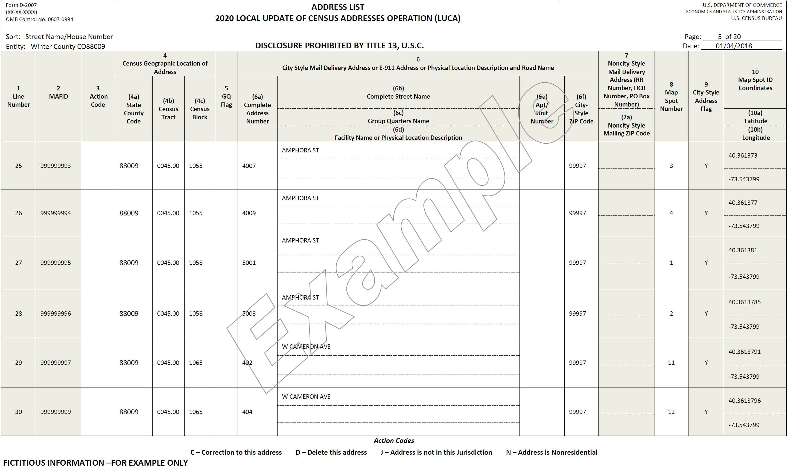
Paper - Address List
NO TITLE 13 DATA DISPLAYED
DISCLOSURE PROHIBITED BY TITLE 13, U.S.C.
Notes:
This slide shows an example of the paper format “Address List” page. Note the SIX addresses per page. The fields correlate to the fields on the ‘Address List structure’ slide, but in slightly different order. Expect a detailed discussion of this product during the LUCA Trainings later this Fall/Winter. Data shown are fictitious. There is no Title 13 data displayed in this example. This product will display the following warning, “Disclosure Prohibited by Title 13, U.S.C.” along the bottom of each page.

Slide 21
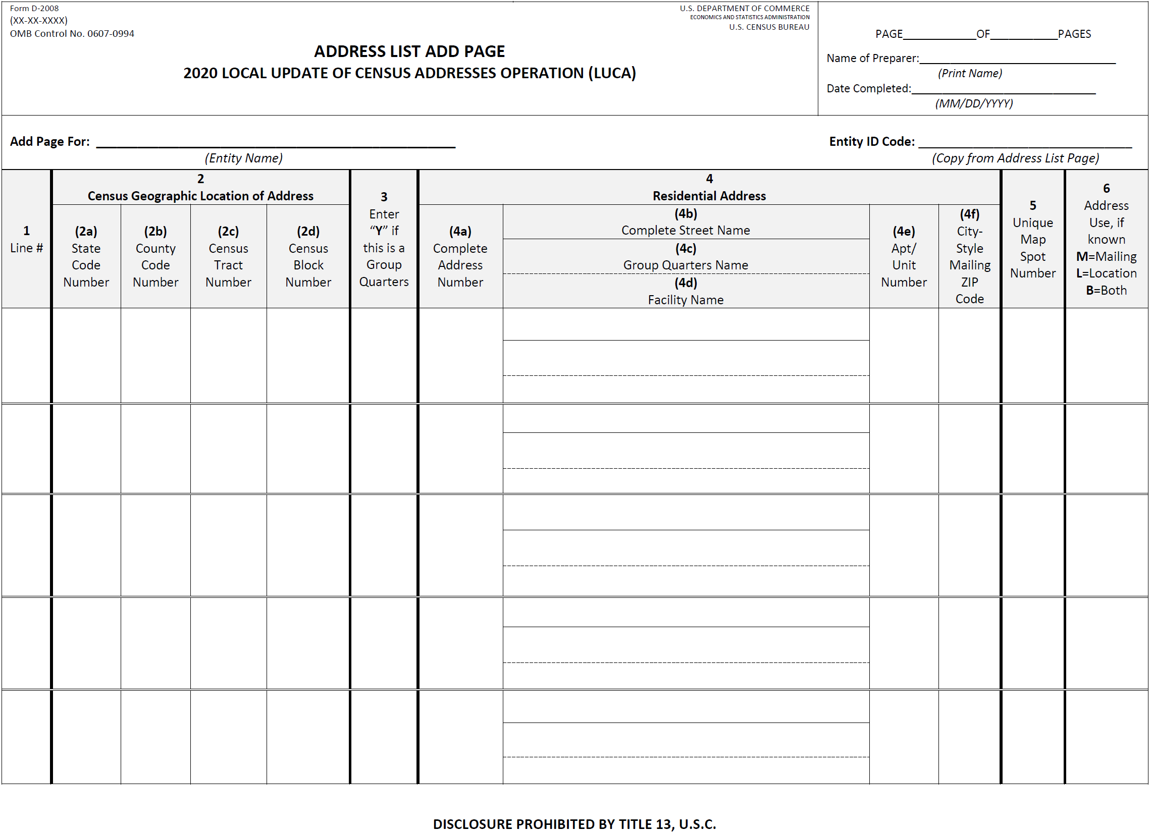
Paper – Address List Add Page
Example
Notes:
This slide shows an example of a paper format “Address List Add Page”. Paper format participants use this form to add new or missing residential address records. Expect a detailed discussion of this product during the LUCA Trainings later this Fall/Winter. This product will display the following warning, “Disclosure Prohibited by Title 13, U.S.C.” along the bottom of each page.

Slide 22
Preparation – Map Formats
Paper
Available to all governments
Two types of paper map materials:
Large format (42” x 36”) maps
DVD of Adobe small format (8.5” x 14”) census block maps
Digital
Available to all governments
TIGER partnership shapefiles (LUCA specific)
Utilize GIS software
Notes:
Both paper and digital formats are available for the LUCA maps. The paper format map is available to all governments, though there are clearly limits to their usability for larger governments that could have hundreds of large format maps and thousands of small format pdfs.
With this format, the Census Bureau provides both large format paper map(s) (custom size, 42 x 36 inches) and a DVD of Adobe PDF small format maps (legal size, 8.5 x14 inches). The small format maps contain address structure coordinates represented as map spots. Viewed by using Adobe software or printed, Title 13, U.S.C. protects these small format maps. Enforcement of confidentiality and security is required with the small format maps because they depict map spots. Participants use the small format maps for making updates. The next slide shows examples of the both large and small format maps. In addition, a large format map sample is available for viewing on the LUCA website.
The digital format map is available to all governments. The Census Bureau provides LUCA specific TIGER partnership shapefiles. Shapefiles require the use of GIS software and can be challenging to use. Please consider your jurisdiction’s GIS capabilities before selecting this map format. Address structure points are not included as part of the shapefile, but participants can create them from the latitude/longitude coordinates included on the digital address list. Please do not confuse this digital format map choice with the DVD of Adobe PDF small format maps that accompany the paper map format.
Many larger governments will choose digital format for both their address list and maps to leverage their own GIS. Smaller governments with computer expertise, but without a GIS, may prefer the digital address list and paper maps. Choosing a paper address list and TIGER partnership shapefiles would not allow for full use of GIS capabilities, but the format combination is available.

Slide 23
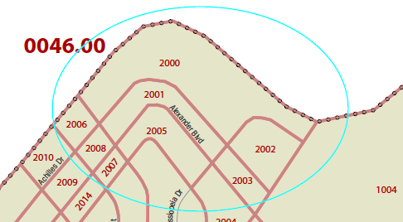
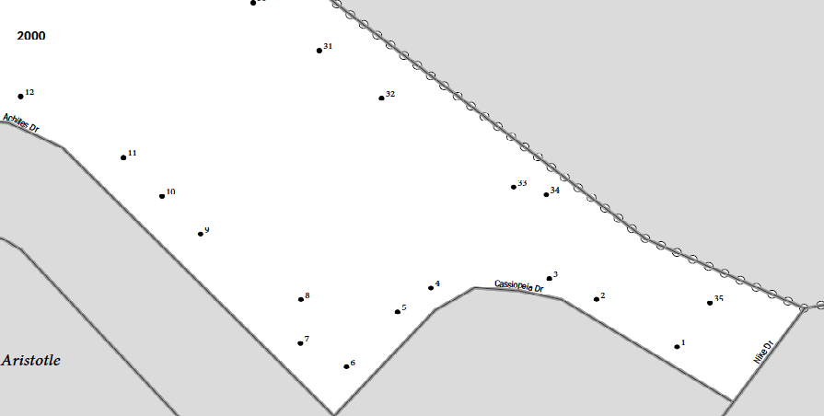
Paper – Large & Small Format Maps
NO TITLE 13 DATA DISPLAYED
FICTITIOUS INFORMATION – FOR EXAMPLE ONLY
Notes:
The image on the left is a zoomed section of a large format paper map. The census tract number on this example is 0046.00 and the block numbers (block 2000) are the four digit red numbers.
The image on the right is from one of the corresponding small format paper maps. It shows a zoomed section for block 2000. The light blue circle on the large format map example identifies block 2000. The small dots are the map spots that correspond to the individual addresses within block 2000. The map spot label does not list the actual address, but instead lists a “Map Spot Number” that corresponds to the address list’s field of the same name. Data shown are fictitious. There is no Title 13 data displayed in this example. The small format map products will display the following warning, “Disclosure Prohibited by Title 13, U.S.C.” along the bottom of each.
If you intend to register for 2020 LUCA, please plan to attend a training session to learn more details and strategies for participation. Training sessions are under development, but the Census Bureau expects them to begin later this year, in October 2017. These sessions provide instructions regarding the use of the 2020 LUCA address list and map products.

Slide 24
Preparation – Next Steps (Participant)
Prepare (now!)
Register to participate (July 2017)
Attend a training workshop (Fall/Winter 2017)
In-person workshops
Self-training aids and Webinars available online
Conduct your LUCA review (Feb-April 2018)
120 calendar days upon receipt of materials to complete review
Notes:
Eligible governments should begin preparing now to determine their available resources.
Do you have an address list (E911, appraisal district/assessment records, water/utility records, building permits, etc.)?
Does your address list source have multi-unit structure identifiers (Apt 1, Unit A2, #3001, etc.)?
Does it contain both residential and commercial information? Can you distinguish the types?
How much time can your staff devote to conducting a LUCA review?
If a complete review of the address list is improbable, identify your government’s high priority areas. Consider areas where the Census Bureau’s block count list contradicts your knowledge or your local block counts, areas where multi-unit are concentrated, areas of new development, areas around your boundary, etc. and plan to focus the LUCA review on those areas.
Do you want to designate (or collaborate with) a higher-level government or regional planning agency to assist with the review? Begin outreach to those higher-level groups.
The Census Bureau suggests entities begin to answer these questions and preparing to participate now, because the July 2017, 2020 LUCA Invitation mailing distributes the registration materials. If you know your registration status (Participate or Not), please complete and return the form as soon as possible to exclude your government from LUCA registration follow-up activities. Beginning in October 2017, LUCA training workshops begin. Both in-person workshops and webinars, along with self-training documents, are under-development. If you choose to register, please plan to attend a training or self-train. In February 2018, the 2020 LUCA materials begin shipping to participants. Upon receipt, participants have 120 calendar days to conduct their review and update the Census Bureau’s Address List.

Slide 25
Preparation - 2020 LUCA Schedule
✓
✓
Notes:
Before closing, it is important to discuss the LUCA schedule as another preparation aspect of 2020 LUCA. Keeping the schedule in mind prepares you for upcoming tasks and actions.
January 2017 – Advance Notice mailing conducted
The purpose of the Advance Notice mailing was to bring awareness to 2020 LUCA and its schedule so governments could begin preparing to participate. The Census Bureau asked contacts to review the LUCA Information Guide and to confirm/correct their contact information. The Census Bureau sent a large number of Advance Notice materials in order to build a solid courtesy copy base for the Invitation Mailing scheduled for July 2017. Nearly 83,000 contacts were shipped the Advance Notice mailing which covered just over 40,000 governments and organizations.
March 2017 – LUCA promotional presentations begin
The six regional offices manage the scheduling of these presentations. Expect email invitations to webinars with some classroom presentations as well. Direct questions regarding the LUCA promotional presentations to the GEO 2020 LUCA email and/or toll-free number provided on the next slide.
July 2017 – LUCA Invitation mailing (which includes registration materials) conducted
October 2017 – LUCA training workshops begin
December 15, 2017 – Deadline for LUCA registration
February - April 2018 – LUCA materials begin to ship to participants. Participants begin their review and have 120 calendar days to complete.
February - September 2018 – Census Bureau processing of LUCA submissions begins.
August - September 2019 – Census Bureau delivers LUCA feedback to participants (the Appeals process is still under development, but tentatively scheduled to begin in October 2019 with a very short review timeframe)
April 1, 2020 is CENSUS DAY!

Slide 26
Questions about 2020 LUCA?
Visit our 2020 LUCA website: https://www.census.gov/geo/partnerships/luca.html
Contact us:
Via telephone: 1-844-344-0169
Via Email: GEO.2020.LUCA@census.gov
Notes:
I have presented a significant amount of information today. Please note the information on this slide. These are the resources available from the Census Bureau to communicate your 2020 LUCA related questions.
The LUCA website is the best resource to “self-serve” information. It includes the link to the Address Block Count files, the link to the Census Geocoder, the LUCA Flyer, the LUCA Information Guide and a LUCA sample large format paper map. It will include training webinars and additional materials in the future. The Census Bureau anticipates posting the schedule of the LUCA trainings to the website.
If you are unable to find information on the LUCA website or have specific questions about LUCA, please use the Geographic Programs Support Desk telephone number and/or the GEO 2020 LUCA email address listed on this slide to contact the Census Bureau. The support desk offers a variety of levels of support Monday-Friday from 8AM – 8PM (Eastern), closed on Federal Holidays. Thank you for your attention and the opportunity to speak with you today.
<Presenter: DO NOT READ ALOUD, but as mentioned in previous slides, if time allows and demo videos regarding Address Block Count files, Census Geocoder or GUPS are available (on the LUCA website or otherwise) you may choose to launch them or offer attendees the option of staying late.>

Slide 27
Connect with Us
Sign up for and manage alerts at https://public.govdelivery.com/accounts/USCENSUS/subscriber/new
More information on the 2020 Census Memorandum Series:
http://www.census.gov/programs-surveys/decennial-census/2020-census/planning-management/memo-series.html
More information on the 2020 Census:
http://www.census.gov/2020Census
More information on the American Community Survey:
http://www.census.gov/programs-surveys/acs/
facebook.com/uscensusbureau
twitter.com/uscensusbureau
youtube.com/user/uscensusbureau
instagram.com/uscensusbureau
pinterest.com/uscensusbureau
27
Notes:
For those of you using social media, please feel free to ‘connect with us’ via these social media sites.

