Slide 1
2020 Census Briefing
Tuesday, May 9, 2017
PA State Data Center
Data Users Conference

Slide 2
Why We Do a Census
Article 1, Section 2 of the US Constitution
  The actual Enumeration shall be made within three Years after the first Meeting of the Congress of the United States, and within every subsequent Term of ten Years, in such Manner as they shall by Law direct.
Key Purpose is Apportioning the U.S. House of Representatives.
Census Day – April 1 in the year ending in zero (0)

Slide 3
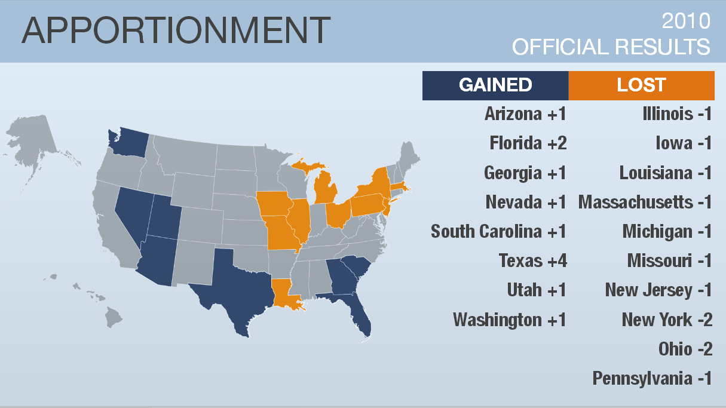

Slide 4
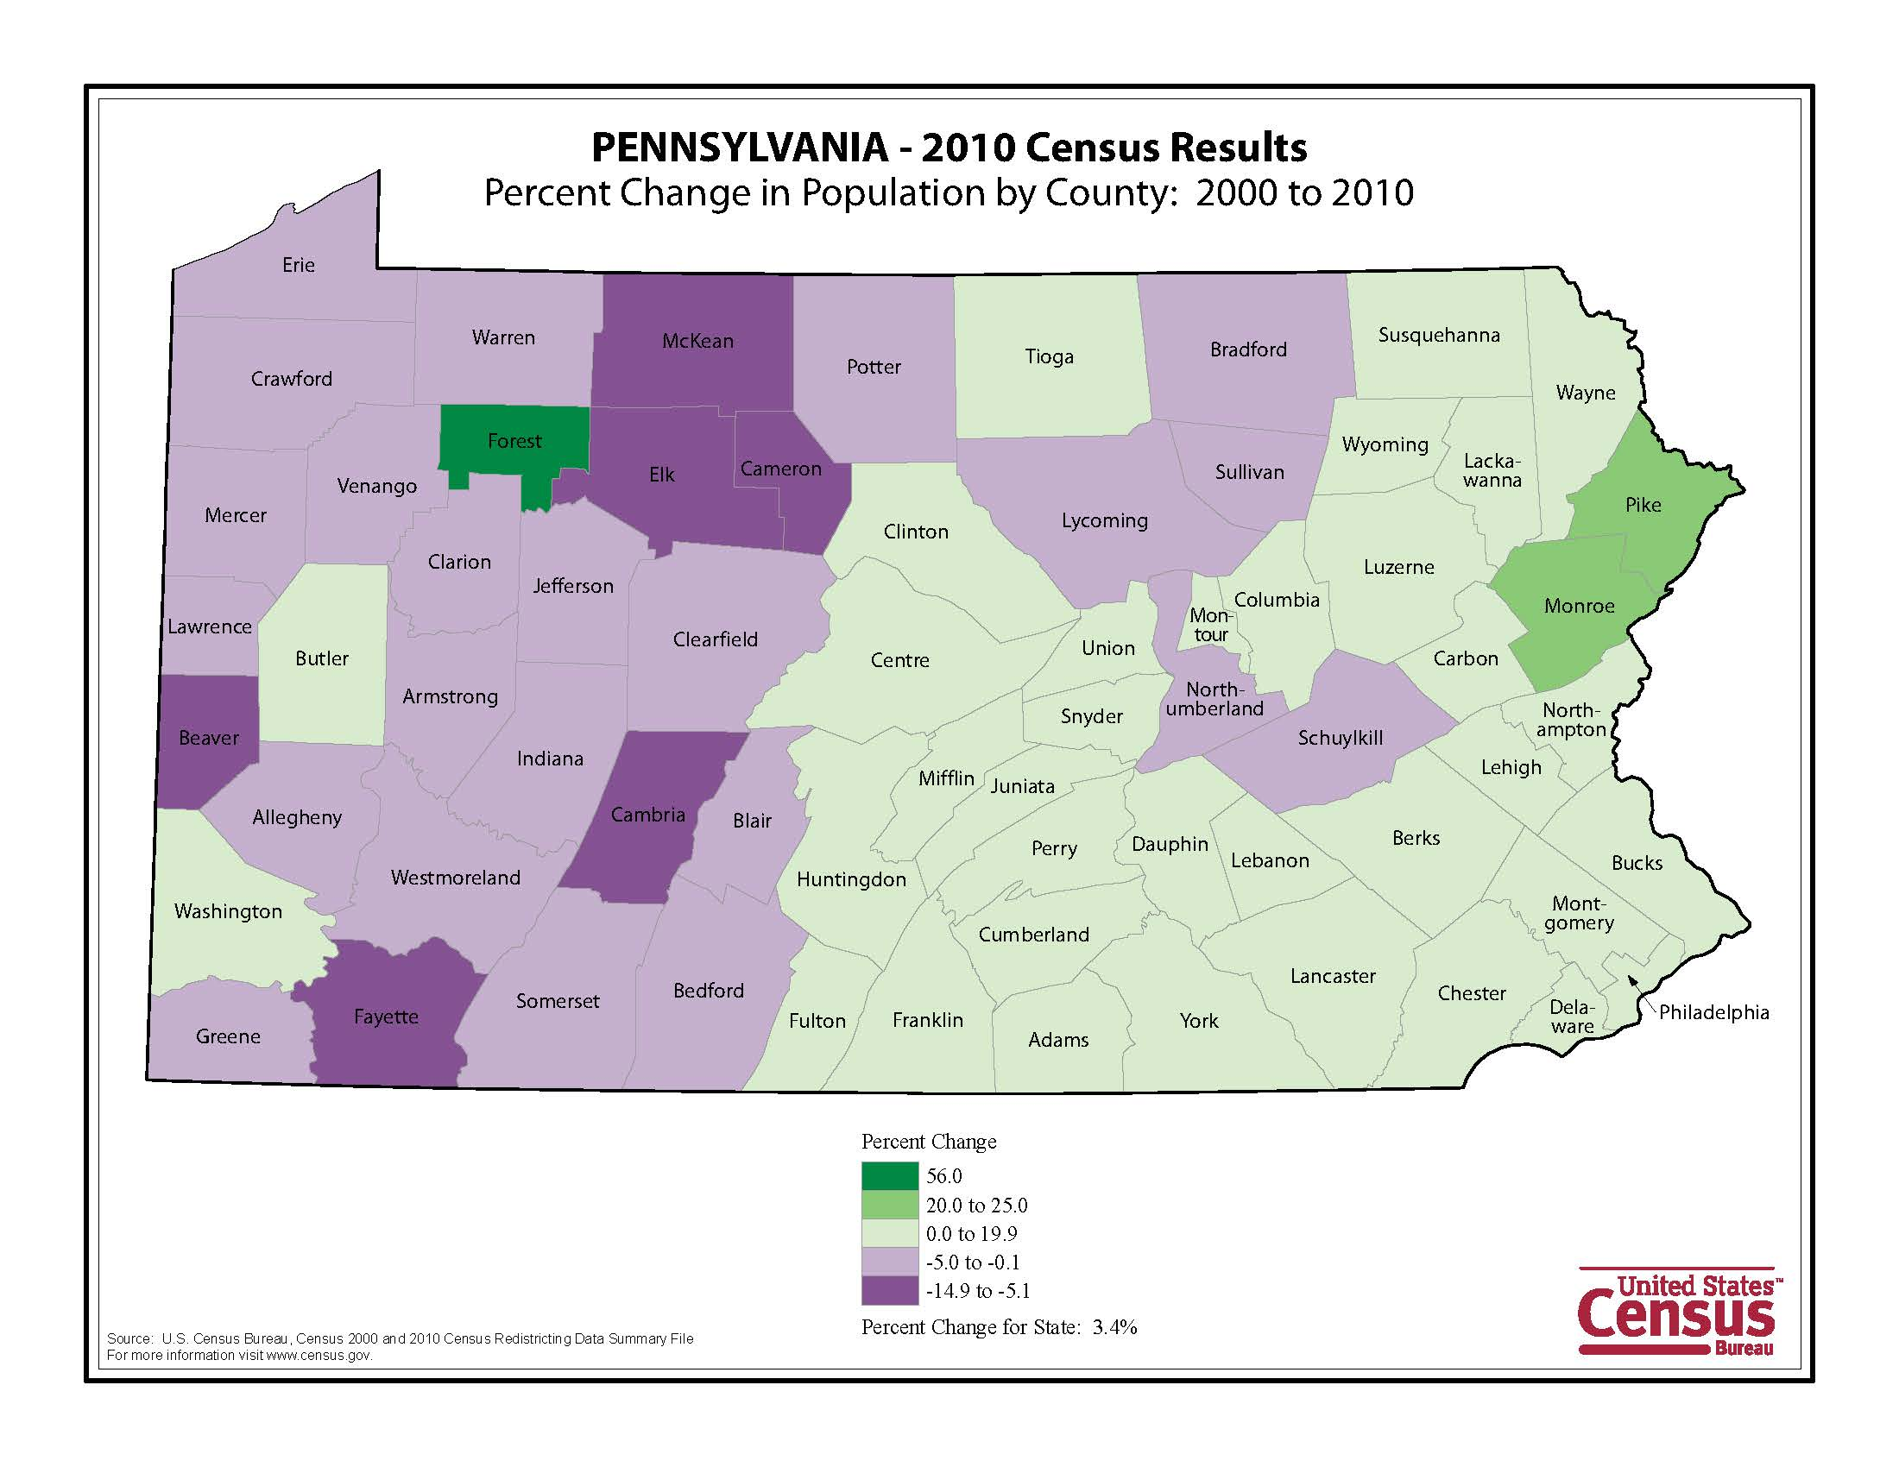

Slide 5
Also About Fairness…
Fundamental element of Federal legislation
Some examples:
  Voting Rights (Voting Rights Act)
  Civil Rights
    Title VI
    Title IX
    Americans with Disabilities Act
    Age Discrimination Act
  Fair Housing Act

Slide 6
And About Funding
Program | Amount (Billions)
Medicaid | $214.0
Highway Planning and Construction | $37.4
TANF | $17.0
Section 8 Housing Choice Vouchers | $15.6
Title I Grants to Local Education Agencies | $13.9
IDEA Part B | $11.0
Federal Transit Formula Grants Programs | $8.2
Head Start | $6.9
CHIP | $6.0
CDBG and Neighborhood Stabilization Program | $4.9
Source: “Formula Grants” Government Accountability Office, December 2009

Slide 7
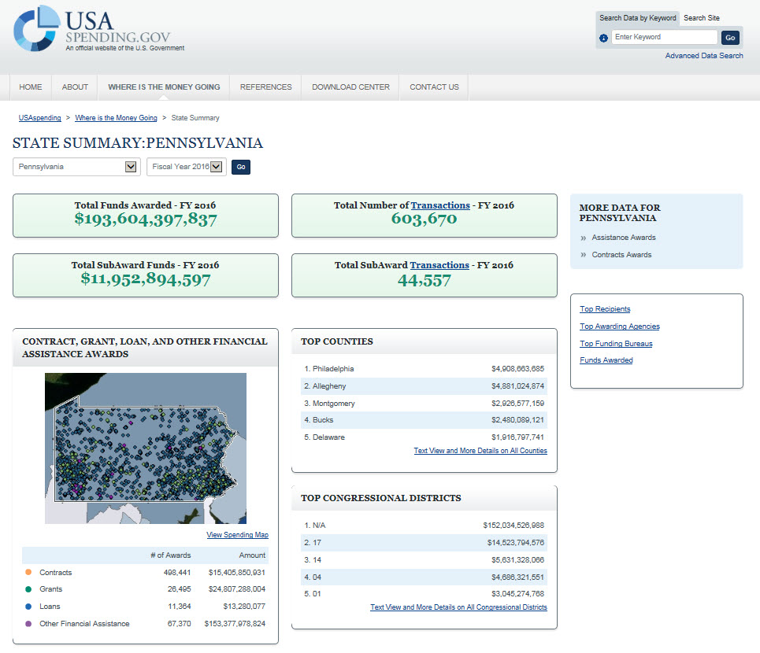

Slide 8
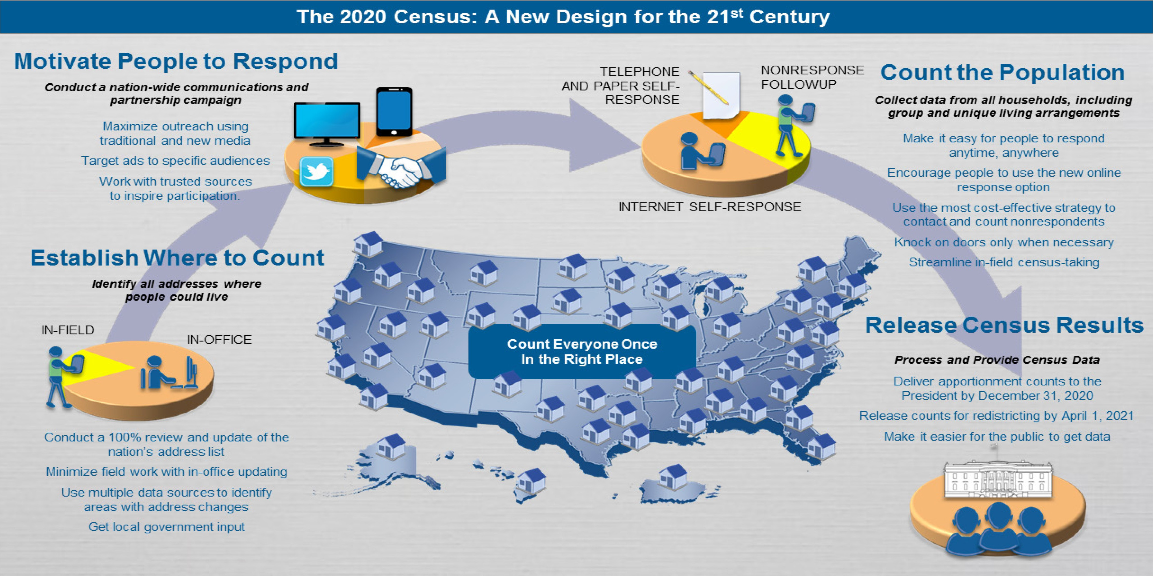
The 2020 Census
Count Everyone, Only Once, in the Right Place
Notes:
Our goal for every Census is to COUNT EVERYONE, ONLY ONCE, AND IN THE RIGHT PLACE. However, the plans for the 2020 Census, as they stand today, are different than those implemented in past censuses.
Starting down in the bottom left corner, we are planning to conduct the address canvassing operation using both an in-office and in-field approach. Instead of conducting a 100 % review in the field as we’ve done in the past, we will conduct an in-office address canvassing operation first –minimizing field work required. This is made possible by imagery technology, multiple data sources for address updates– such as post office address files and local government address updates.
Moving around to the right… to Motivating People to respond.. We will continue to use traditional media sources like TV, Radio and Newspaper to promote the 2020 Census and encourage participation, as well as Trusted Voices/Partners in the community– but now we can also use new technologies and media sources that will help us to expand our reach and target specific ads to specific audiences.
Moving to the right again… to How we Count the Population… Plans currently call for additional response options that will make it easier for people to respond –any where any time. In 2010 most people received the form in the mail and could self-respond by sending the form back – then we had in person f/u for non-responders. The current plan calls for 3 convenient self response options -internet response, phone response (both in multiple languages) and also the traditional mail response, minimizing the need for costly in-person follow up. *Stress current plans being tested.
Finally, as always, Apportionment counts will be released– December 31st 2020
Counts for redistricting April 1, 2021
But it will be much easier for the public to access the data

Slide 9
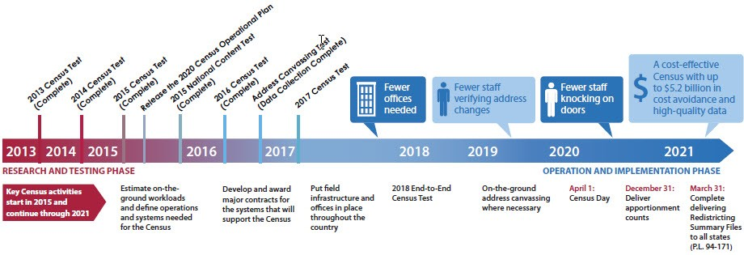
Program Updates
Current Updates
Key Activities:
Making Key Decisions: Continuously make timely decisions based on research and evidence
Award Key Contracts: Continue to award key contracts for the 2020 Census
2017 Census Test: Nationwide self-response test that includes Internet self-response, Real-Time Non-ID response and processing, and the deploying of applications in the Cloud
Residence Criteria: Proposed criteria in June 2016 and final criteria in 2017
Topics to Congress: Title 13 requires the Census Bureau deliver to Congress subjects for the decennial census program by March 31, 2017, and questions by March 31, 2018
Operational Readiness
2020 Census Operational Plan 2.0
Local Update of Census Addresses (LUCA)
Field Infrastructure: Space, Decennial Logistics Management, Training, Recruiting, and Onboarding
2018 End-to-End Census Test

Slide 10
Program Updates
Schedule
Milestone | Date
Begin 2020 Census Program | November 18, 2011 | ✓
Deliver 2020 Census Operational Plan | September 30, 2015 | ✓
Federal Register Notice of Proposed Residence Criteria and Residence Situations for the 2020 Census | June 30, 2016 | ✓
Conduct the Second Round of Tribal Consultations | September – November 2016 | ✓
Begin Local Update of Census Addresses (LUCA) Program (including Appeals Process) | January 2017 | ✓
Deliver 2020 Census Topics to Congress | March 28, 2017 | ✓
Conduct the Block Boundary Suggestion Program | December 2015 – May 2017
Deliver 2020 Census Questions to Congress | By March 31, 2018
2020 Census Day | April 1, 2020
Deliver Apportionment Counts to the President | By December 31, 2020
Complete Delivery of Redistricting Counts to the States | By March 31, 2021
Complete 2020 Census Program | September 29, 2023

Slide 11

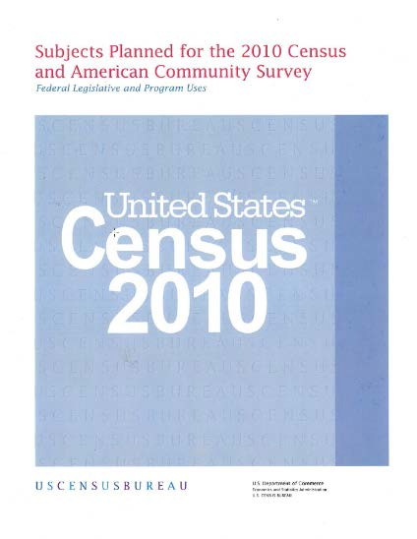
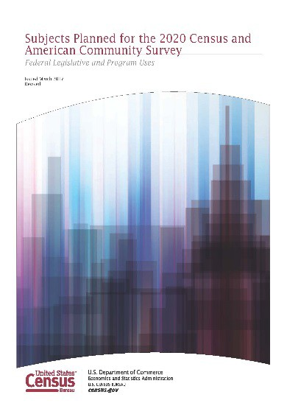
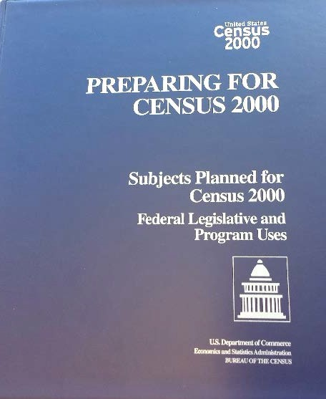
Program Updates
2020 Census Subjects
Title 13 requires that the U.S. Census Bureau deliver to Congress:
Subjects proposed for the decennial census program by March 31, 2017, delivered March 28, 2017
Questions proposed for the decennial census program by March 31, 2018
The Census Bureau submitted subjects planned for the Decennial Census Program, including:
2020 Census Subjects
  No new subjects (same set proposed for 2010 Census)
American Community Survey (ACS) Subjects
  No new subjects (same set asked on current survey)
2020 Island Area Censuses Subjects
  No new subjects
  Four subjects not on the ACS, but included on 2010 Island Areas Census

Slide 12
Goals for the 2020 Census
Count Everyone, Only Once, in the Right Place
Maintain Quality
Reduce Costs
4 Areas of Innovation
  Efficiency in Building an Address List
  Easier Ways to Respond
  Better Use of Information We Already Have
  More Efficient Field Operations

Slide 13
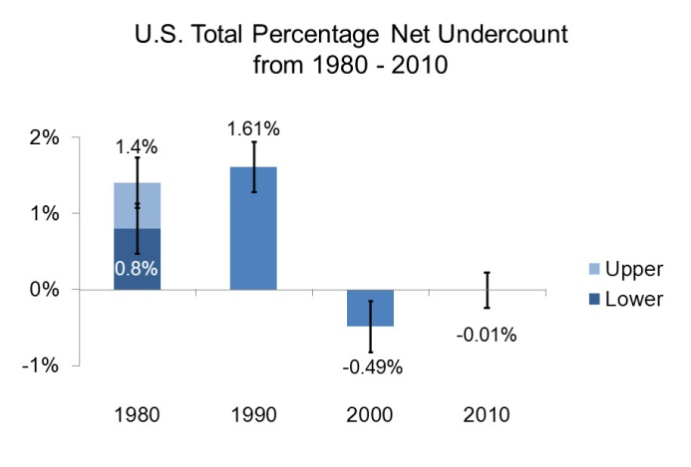
Maintain Quality - The 2010 Census
A Very Good “Net” Census

Slide 14




Geographic Partnership Opportunities
2020 Census
Boundary and Annexation Survey
Social
Local Update of Census Addresses
Geographic Support System
Participant Statistical Areas Program
NEW Tool: GUPS
Geographic Update Participant Software
Notes:
Let’s move now to the Geographic Partnership Opportunities available for 2020. I’ll provide a high-level overview to help you plan as we move toward Census 2020. While there are other partnership programs such as the Boundary Quality Assessment Review, the BAS, LUCA, and GSS offer opportunities to directly improve the geographic framework for taking the census. The PSAP allows participants to suggest the data tabulation framework.
Most of our partnership programs offer in-person training, on-line webinars, and other resources.

Slide 15
Local Update of Census Addresses
LUCA
What is It?
A once-a-decade-opportunity for eligible governments to review their address list that will be used to conduct the Decennial Census
Why Should Governments Participate?
To ensure that the Census Bureau has a complete and accurate address list for the jurisdiction for the 2020 Census
Note: If an address is not included in the census, for whatever reason, we cannot add it (and the population associated with it) after the census has been completed. The apportionment counts are based on the census figures delivered to the President by December 31, 2020.
Social
Notes:
The Local Update of Censuses Addresses is available to governments under Public Law 103-430. It allows the Census Bureau to share our Title-13 address list with local government officials who agree to sign a confidentiality agreement.
Why Participate? Probably the most important thing to know about LUCA is that if an address is not included in the census, for whatever reason, we can not go back and add it in (or the population associated with that housing unit) after the census has been completed.
By law, we must deliver the apportionment counts to the President by December 31, 2020, and we cannot change those counts once they have been finalized.

Slide 16
Local Update of Census Addresses
LUCA Schedule
 | Date | Activity
ü | January 2017 | Advance Notice mailed to HEOs and other governmental unit contacts Housing unit counts by block available for governments
ü | March 1 | Deadline for BAS response (1st Deadline)
 | March-December 2017 | LUCA Promotional Workshops
 | July 2017 | LUCA Invitation and Registration Materials mailed to HEOs
 | October 2017 | LUCA Technical Workshops begin
 | December 15 2017 | Deadline for LUCA Registration
 | February-April 2018 | Participants review and update the Census Bureau’s address list (120 day review period from receipt of materials)
 | August-September 2019 | Census Bureau delivers LUCA participant feedback
 | April 1, 2020 | 2020 Census Day
Social
Notes:
Instruction: Walk through each line of the schedule on the slide.
LUCA promotional workshops will be available via webinar given by our regional geography staff, as well as through self-paced on-line learning tools available on the web.
DO not read: For your information only, in case someone asks:
LUCA Appeals: October 2019

Slide 17
Participant Statistical Areas Program
PSAP
What is It?
Opportunity for invited participants, including American Indian tribes, to review and update Census Tracts, Block Groups, and Census Designated Places (CDPs) in advance of 2020 Census Data tabulation and publication.
How to Participate?
Census Bureau invites former 2010 PSAP participants and solicits new partners where there were no 2010 participants for a geographic area.
Social

Slide 18


Participant Statistical Areas Program
PSAP
Schedule
Participation Options
Social
Date | Activity
Spring 2017 | Participant Statistical Areas Program announcement
Late 2018 | PSAP delineation/review
Late 2019 | PSAP Verification
GUPS (Geographic Update Partnership Software )
Paper Map Option for Tribal Participants
Notes:
Walk through the timeline.
All particpants are REQUIRED to use our GUPS, with the exception of Tribal participants, who have the option of using paper.

Slide 19

United States Postal Service and Census Bureau Partnership
Partnership Approach
USPS-Census Bureau areas of cooperation are organized into the categories included in the diagram below.
MAILING AND DELIVERY SERVICES: Continuously improving the current approach and processes for mailing services (e.g. Print contract verbiage, mail flow schedule, holiday mailer)
Mail
DATA PRODUCTS AND SERVICES: Data that the partnership
utilizes and shares
WORKFORCE SERVICES: Exploring all possibilities for using shared labor to create innovative models and solutions by utilizing new resources
Cross-cutting
Data
Workforce
CROSS-CUTTING: Initiatives supporting the working group structure and the development of a long term governance model, mapping partnership processes, and capturing institutional knowledge

Slide 20
United States Postal Service and Census Bureau Partnership
Ongoing Activities
USPS-Census Bureau are cooperating on ongoing activities in each of the enterprise areas.
D ATA
•Update the Master Address File with new addresses from the Delivery Sequence File
•Utilize the “Undeliverable as Addressed” data for
MAIL
•Exploring the use of “Every Door Direct Mail” to deliver postcards announcing our recruiting campaign and Internet Response option
•Track disposition of paper questionnaires in the mail stream by using postal tracing
W ORK F OR CE
the 2018 End-to-End Census Test to remove cases from Nonresponse Followup
•Use of carrier route data to improve address geocoding in the Master Address File
•Collaborate on hiring temporary Census Bureau field workers for the 2018 End-to-End Census Test; utilizes established USPS process for Onboarding
•Pilot testing the use of Postal Carriers as Enumerators

Slide 21
United States Postal Service and Census Bureau Partnership
2018 End-to-End Census Test Activities
Enumeration Pilot
A pilot would test the use of postal carriers as enumerators as part of Nonresponse Followup.
Interactive Kiosk
Interactive kiosks could be enabled in Post Offices to allow customers to fill out their Census questionnaire.
Onboarding
Collecting application materials and fingerprints for temporary field staff.
Community Engagement
A marketing and outreach campaign could place signage, flyers, and other materials in Post Offices to encourage response.
Informed Delivery
A subscription service where customers receive a preview of their mail via email; allows for interaction with some mail content via barcode or similar technology

Slide 22
Optimizing Self Response
Operational Testing in 2017
Internet Self-Response
First test using ECaSE platform
Languages available: English and Spanish
Census Questionnaire Assistance
First test to utilize Census Questionnaire Assistance contracted solution
Interactive Voice Response system active
Live agents taking responses by phone
Languages supported: English, Spanish, Chinese (Mandarin, Cantonese), Vietnamese, Korean, Russian, and Arabic
Paper Data Capture
Testing new paper control processes
Testing new check-out procedure

Slide 23
Administrative Records Research and Planning
Administrative Records Data Sources
Vacancy Determination
United States Postal Service Information
  USPS Undeliverable-as-Addressed (UAA) reasons for census mailings made around April 1
    Vacant
    No Such Number, No Such Street
    Others
  Delivery Sequence File
Other Sources
  Internal Revenue Service (IRS) 1040 filings
  IRS 1099 information returns
Centers for Medicare and Medicaid Services Medicare Enrollment database
Indian Health Service Patient Database
Third-party Veterans Service Group of Illinois (VSGI) files

Slide 24
Administrative Records Research and Planning
Identifying Administrative Records Occupied Units
Can we reduce contacts for 101 Main Street?
Build a roster from administrative record sources
Check that multiple sources indicate the family lives at an address
Use statistical models to evaluate the roster
Decision for 101 Main Street

Slide 25
2018 End to End Census Test
Nonresponse Followup Universe
NRFU Universe
Nonresponding Addresses after multiple attempts for self-response
Field Data Collection
Late self responses Completed cases
Early NRFU
Administrative Records Vacant/Delete
Response Validation Reverse Check-ins Field Verification
* Spring Delivery Sequence File
Administrative Records Occupied
In-field Adds
Selected NRFU Reinterview cases
------------------------------------------
Telephone Data Collection
Coverage Improvement
Completed telephone cases
* Addresses not previously in the enumeration universe.

Slide 26
2018 End-to-End Census Test
Nonresponse Followup – Field Data Collection Contact Strategy
Administrative Records modeling determines initial contact strategies
  Vacant/Delete: Removed from nonresponse followup workload
  Occupied: Receives one contact attempt
  No Determination: Receives maximum of 6 contact attempts
Nonresponding addresses become proxy eligible when:
  Third contact attempt at census address is unsuccessful
  Enumerator observes a unit is vacant or not a housing unit
  Supervisor determines a case should be proxy eligible or proxy required
  Maximum daily limit of three proxy attempts
Contact strategies for multiunits
  Interview building manager to remove vacant units from nonresponse followup workload
  Same enumerator assigned manager interviews for all multiunits in a Basic Collection Unit
Non-ID Field Verification cases receive one attempt
Self-responding vacant cases receive one attempt
Response Validation Re-collect cases receive maximum of three contact attempts

Slide 27
2018 End-to-End Census Test
Nonresponse Followup – Multiunit Manager Visits
Purpose: Resolution of occupancy status for units at multiunit structures via an interview with a ‘manager’ Process:
Grouping of nonresponding addresses within a multiunit
Enumerator attempts contact with ‘manager’
Addresses by ‘manager’ as vacant or nonexistent are designated as such and are not subject to additional contact attempts
Addresses identified by manager as ‘occupied’ or left undetermined will be assigned for contact attempts by an enumerator to collect response data
2016 Census Test Findings:
Manager visits successfully identified the occupancy status of nonresponding units, thus reducing enumerator attempts to resolve vacant units
2018 End-to-End Census Test:
Increase in the number of units at a Basic Street Address that triggers a eligibility for a manager visit
Maximum of two manager visit attempts before assigning nonresponding units for enumeration attempts

Slide 28
2018 End-to-End Census Test
Nonresponse Followup – Field Verification
Purpose: To verify the existence of addresses resulting from Non-ID self-responses that could be assigned to a Census Basic Collection Unit (BCU) or block and identified as new to the Master Address File
Process:
Non ID self-response received
Address completes Non ID processing including automated matching and/or clerical processing
Identify “new” geocoded MAF addresses for field work – Field Verification (FV) workload
FV cases added to the NRFU workload
Enumerator attempts to locate the FV address and capture status
No capture of response data
No use of Notice of Visit correspondence

Slide 29
2020 Census Language Program
Overview
Identify ways to reduce language barriers for respondents of Limited English Proficiency (LEP)
Determine the optimal level of support in non-English languages for LEP households completing the 2020 Census
Optimize the non-English content of questionnaires and associated non-questionnaire materials across data collection modes and operations
Ensure cultural relevancy and meaningful translation of 2020 Census questionnaires and associated non- questionnaire materials

Slide 30
Innovations for 2020
Translation Memory (TM)
Computer program that helps translators compare new text to previously translated text to increase their consistency, quality, and efficiency
Automatically searches all previously translated text and provides matches to translators
Increases style and terminology standardization
Saves translators time researching previous translations and facilitate version control
Not to be confused with online machine translation engines

Slide 31

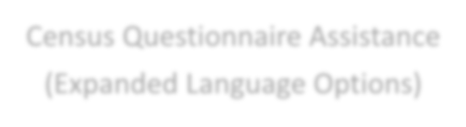





2020 Census Language Program
Then and Now: Planned Changes for 2020
2010
2020
Internet Instrument
Paper Questionnaires
Paper Questionnaires
Telephone Questionnaire Assistance (Limited Language Options)
Census Questionnaire Assistance (Expanded Language Options)
Field Materials
Field Materials
Language Assistance Guides (Paper)
Field Enumeration Instrument
“It’s Easy” Videos (via Comcast)
Language Assistance Guides (Paper and Internet)
Language Identification Flashcard
Language Identification Flashcard

Slide 32
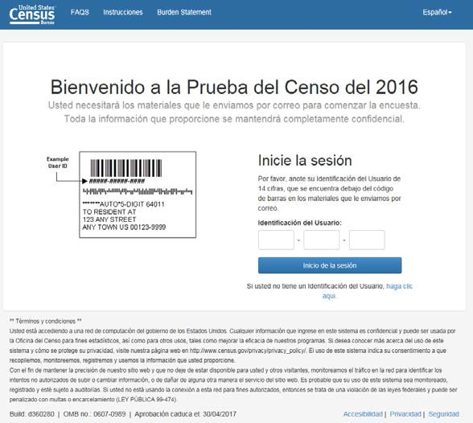
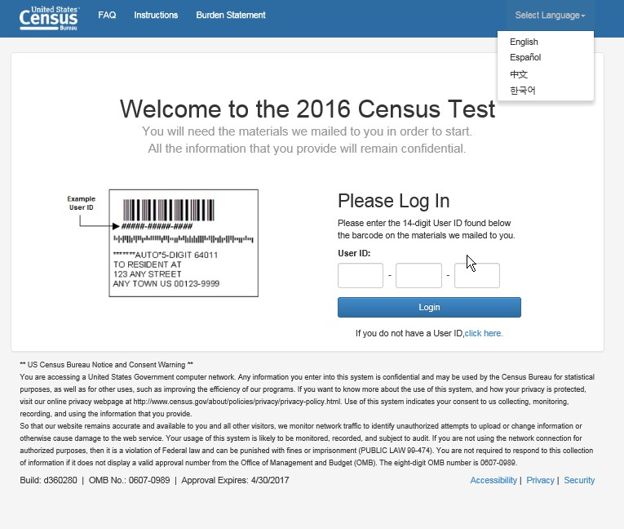
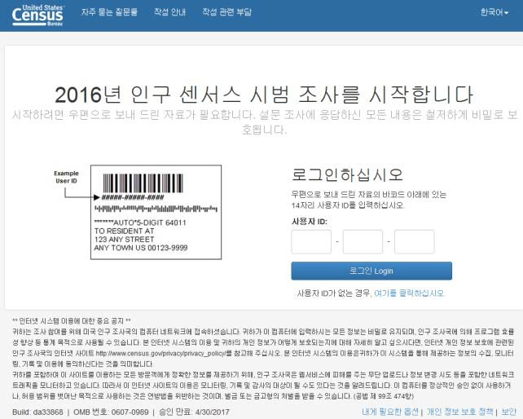
Examples of Instruments/Materials Planned for 2020
Internet Self-Response: Non-English Response Options
Example: 2016 Census Test non-English internet questionnaire

Slide 33
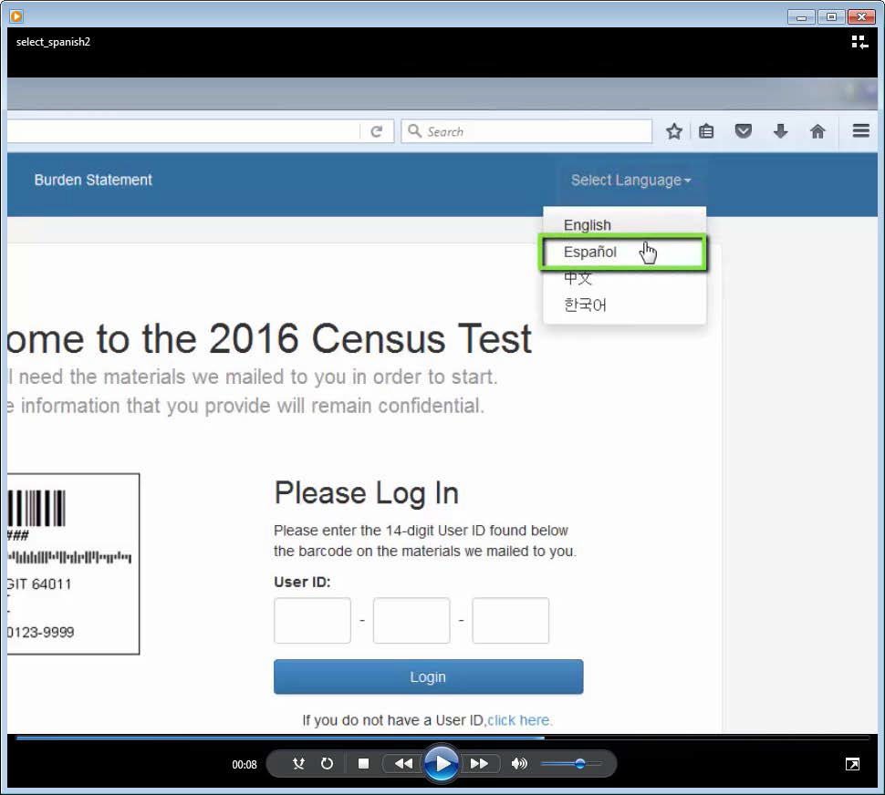
Examples of Instruments/Materials Planned for 2020
Video Language Assistance Guides
Assist non-English speaking respondents on filling out the Internet questionnaire
Examples of video content:
  What are the questions and why
  Why participation in important
  How to select the language
  How to log in
  How to navigate
  How to submit
Available via the internet
Also used during partnership and communications events
Conceptual Example of Video Language Assistance Guide

Slide 34
Examples of Instruments/Materials Planned for 2020
Paper Language Assistance Guides
Assist non-English speaking respondents who prefer the paper questionnaires or do not have easy access to the Internet
Show English questionnaire
  Highlight English text
  Provide translated text with highlighted English text
Printed copies available for partnership and communications

Slide 35
High Level Field Operations
Address Canvassing (about 25% of country)
Group Quarters
  Many ops from nursing homes to homeless shelters
Update Enumerate
  List housing units & attempt to get data
Non Response Follow-Up
  Visit housing units that did not respond
Coverage Measurement
  Measure accuracy of Census
Notes:
Here are the 34 operations for the 2020 Census.

Slide 36
Key Dates
Now – 2019
Jan 2018
Mid 2019
Fall 2019
Mid 2019
Early 2020
March 23, 2020
April 1
Mid May 2020
August 2020
December 31, 2020
In Office Address Canvass
Regional Census Center Opens
Early Area Census Offices Open
Address Canvassing – select areas
Area Census Offices Open
Group Quarters Start
Self Response & Update Enumerate Start
CENSUS DAY
Non-Response Follow-up Starts
Data Collection Complete
Counts Delivered to President

Slide 37
Reasons We Miss People
We don’t have an address
  We can’t send a form
  If we get a response, we can’t “match” them to the ground
We can’t get a response
  We have an address, but we can’t determine occupancy
We get a partial response
  Children
  Multiple Families
  Unrelated individuals
People don’t want to be count
  Children
  Multiple Families
  Unrelated individuals

Slide 38
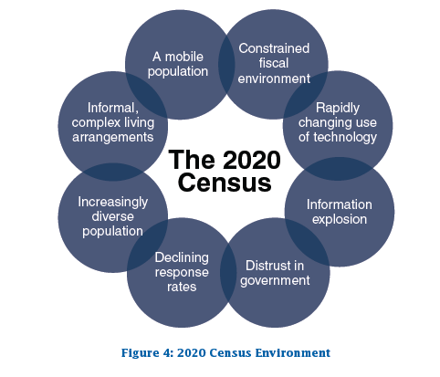
2020 Census Environment

Slide 39
Community Partnership and Engagement Program
The Environment
Growing concerns about privacy and cybersecurity
Growing terrorist fear
Charged political environment
Growing diversity in our nation’s population
Deepening distrust of government
Notes:
We have a big challenge to get an accurate count including, people who do not understand the census, who don’t trust it and who are hard to locate. So we work with you to communicate that the census is safe, easy and very important

Slide 40
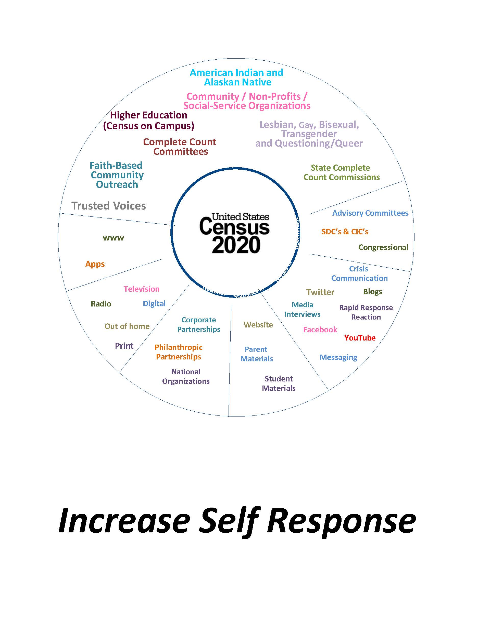

Slide 41
Community Partnership and Engagement Program
Complete Count Committees
Educate and Motivate Residents to Respond
Tell Your Census Story (Local Uses of Census Data)
What’s In It For Me?
  Medical, playgrounds, senior centers, food stores, etc.
Notes:
We have a big challenge to get an accurate count including, people who do not understand the census, who don’t trust it and who are hard to locate. So we work with you to communicate that the census is safe, easy and very important

Slide 42
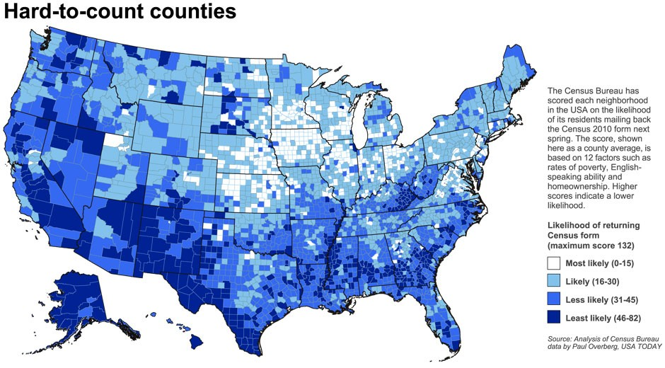
Community Partnership and Engagement Program
Targeted Outreach to Hard-to-Count Populations
Support through community leaders
Raise census awareness among HTC populations
Overcome community fears through awareness, education, motivation,
and community events

Slide 43
Community Partnership and Engagement Program
Partnership Methods
Complete Count Committees
Tribal Government Liaison Program
Targeted Outreach to Hard-to-Count populations
Language Support Program
Faith Based Organizations
Statistics in Schools
Social Media Outreach
60
Notes:
The Census Bureau can not do this job alone. We rely on tens of thousands of partners who help us get the word out.

Slide 44
Community Partnership and Engagement Program
Complete Count Commission
HIGHEST LEVEL PARTNERSHIP
Develop partnerships at the highest levels within each state
State Complete Count Commission may be codified and grounded in law, if desired
PURPOSE
Act as 2020 Decennial Champion for the State by providing leadership and support for 2020 Census
Provide “trusted voices” to act as Census Ambassadors
Provide authoritative and knowledgeable contact point to meet goal of timely, accurate and cost-effective Census count
GOALS AND OBJECTIVES
Monitor Census participation to target outreach efforts and support
Focus attention on low response rate areas
Marshall financial and staffing resources to support Complete Count Commission goals
Promote the formation of Complete Count Committees at the county and municipal levels, with support from the Census Bureau

Slide 45
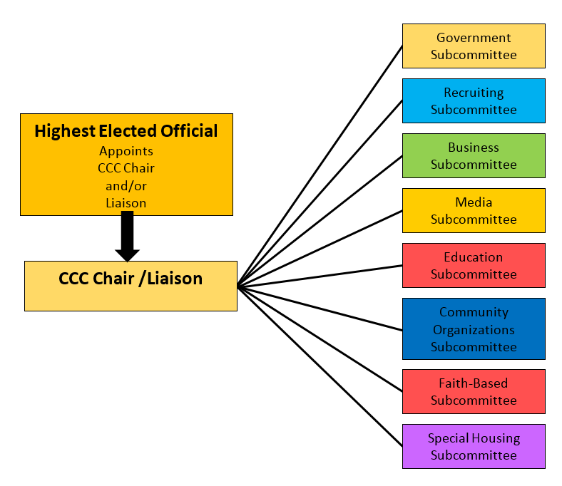
Complete Count Committee
Notes:
This chart is an example of a successful Complete Count Committee structure in previous decennial censuses.
The committees can be shaped to reflect important components of your community and should be built around community segments where maximum outreach can be reached
More examples of committees can include Universities/Colleges, Foundations, Social Media, Re-entry Programs, Judicial and Health just to name a few
The committee and its subcommittees should be a reflection of your community

Slide 46
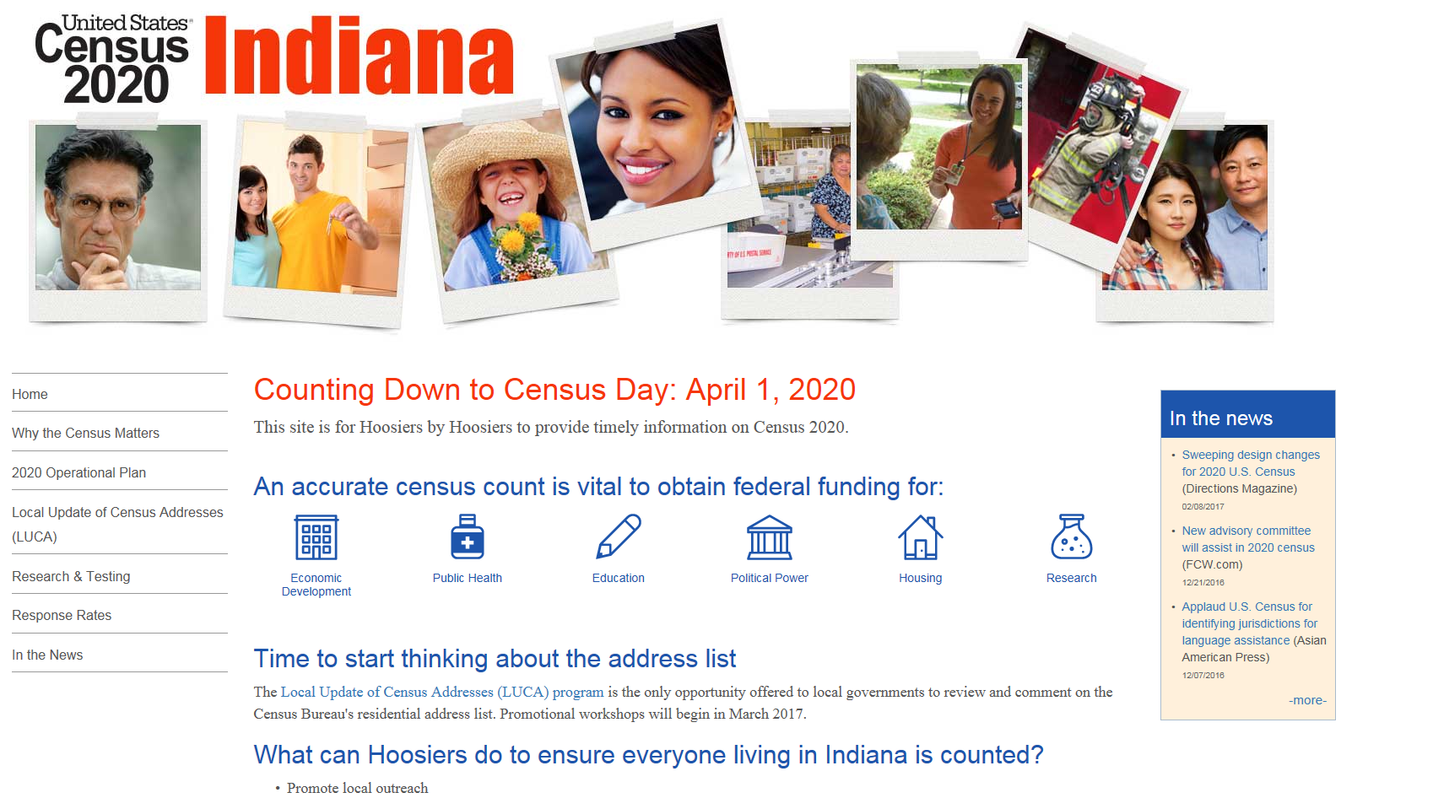


Slide 47
2020 Census Partnerships
What to do next
Encourage Local Governments to participate in LUCA
Join Complete Count Committee
Participate in the Statistical Areas Review
Encourage use of Statistics in Schools
Promote job opportunities

Slide 48
Questions

