Slide 1
Data-Driven Approaches in Criminal Justice Research
Jonathan Lee, Ph.D.
School of Public Affairs
Penn State Harrisburg

Slide 2
Juvenile Delinquency
Survey
Criminology
Violent Crime
Crime Records
Arrest / Force Use
Police Reports
Policing
Community Policing / Public Relations
Survey / Crime Records
Hot Spot Policing
Crime Records
Court
Pre-trial
Court Records
Corrections
Probation and Parole
Parole data

Slide 3
Negative Labeling
Family Attachment
Delinquent
Values
Delinquent
Peer
Association
General Delinquency

Slide 4
Variables | Metric Slope | Error Variance | Reliability Coefficient
Negative Labeling |  |  | 0.879
Friends agree that you break rules | 1.00^{b} | 0.199
Friends agree that you get into trouble | 0.888 | 0.153
Parents agree that you break rules | 0.895 | 0.258
Parents agree that you get into trouble | 0.850 | 0.191
Family Attachment |  |  | 0.827
I feel close to my family | 1.00^{b} | 0.102
My family is willing to listen if I have a problem | 0.863 | 0.210
I feel like an outsider in my familyª | 0.971 | 0.178
My family doesn't take much interest in my problemª | 0.893 | 0.149
Delinquent Values |  |  | 0.752
How wrong is it to cheat on school tests? | 1.00^{b} | 0.191
How wrong is it to purposely damage others’ property? | 0.534 | 0.055
How wrong is it to steal something worth <$50? | 0.935 | 0.104
How wrong is it to hit/threaten someone without any reason? | 0.612 | 0.095

Slide 5
 |  | Wave III |  |  |  |  | Wave IV |  |  |  |  | Wave V
 |  | Negative Labeling | Family Attachment | Delinquent Values | Delinquent Peers | General Delinquency | Negative Labeling | Family Attachment | Delinquent Values | Delinquent Peers | General Delinquency | Delinquent Peers | General Delinquency
 | Age | -0.002 | 0.002 | -0.003** | -0.010** | 0.005 | -0.004* | -0.001 | -0.004** | -0.009** | -0.012 | -0.001 | 0.004
Wave II | Negative Labeling | (0.562**) | -0.015 | -0.045** | 0.302** | 1.076**
 | Family Attachment |  | (0.757**) |  | -0.128** | 0.255*
 | Delinquent Values |  |  | (0.702**) | 0.393** | 1.282**
Wave III | Delinquent Peers | 0.291** | -0.018 | 0.138** |  | 0.093** |  |  |  | (0.621**) | 0.143*
 | General Delinquency | 0.080** | -0.021** | 0.020** | 0.093** |  |  |  |  | 0.037** | (0.700**)
 | Negative Labeling |  | -0.029** | 0.018** |  |  | (0.536**) | -0.031* | -0.008 | -0.005 | 0.175**
 | Family Attachment | -0.029** |  | -0.007** |  |  |  | (0.731**) |  | -0.102 ** | -0.103
 | Delinquent Values | 0.018** | -0.007** |  |  |  |  |  | (0.680**) | 0.014 | 0.153
Wave IV | Delinquent Peers |  |  |  |  |  | 0.126** | -0.028 | 0.073** |  | 0.070** | (0.588**) | 0.193**
 | General Delinquency |  |  |  |  |  | 0.058** | -0.012** | 0.005 | 0.070** |  | 0.041** | (0.687**)
 | Negative Labeling |  |  |  |  |  |  | -0.028** | 0.009** |  |  | 0.056** | 0.188**
 | Family Attachment |  |  |  |  |  | -0.028** |  | -0.009** |  |  | 0.026
 | Delinquent Values |  |  |  |  |  | 0.009** | -0.009** |  |  |  | 0.148** | 0.277**

Slide 6
HGLM for Use of Nonlethal Force (N_{incident-level} = 8,597; N_{community-level} = 56).
 |  | Coefficient | SE | Odds ratio
Incident-level | Community-level
White (Intercept) | Intercept (γ₀₀) | -1.520*** | 0.137 | 0.219
 | % White (γ₀₁) | -0.009** | 0.003 | 0.992
 | Violence rate (γ₀₂) | 0.013* | 0.006 | 1.013
Black | Intercept (γ₁₀) | 0.271* | 0.132 | 1.32
 | % Black (γ₁₁) | -0.001 | 0.003 | 0.999
 | Violence rate (γ₁₂) | -0.025*** | 0.007 | 0.975
Hispanic | Intercept (γ₂₀) | 0.199 | 0.117 | 1.220
 | % Hispanic (γ₂₁) | 0.006 | 0.003 | 1.001
 | Violence rate (γ₂₂) | -0.021*** | 0.006 | 0.979
Age | (γ₃₀) | -0.019*** | 0.003 | 0.981
Residence | (γ₄₀) | -1.177*** | 0.152 | 0.308
Nighttime | (γ₅₀) | -0.080 | 0.082 | 1.083
Perceived danger | (γ₆₀) | -0.107 | 0.072 | 0.899
Noncompliance | (γ₇₀) | 1.24*** | 0.099 | 3.445
Part I offense | Intercept (γ₈₀) | -0.330*** | 0.073 | 0.719
 | Violence rate (γ₈₁) | 0.006* | 0.002 | 1.006

Slide 7
Negative Contact with Police
Social Distance
Demographics
Individual Attitude toward the Police
Negative Media Reports
Victimization

Slide 8
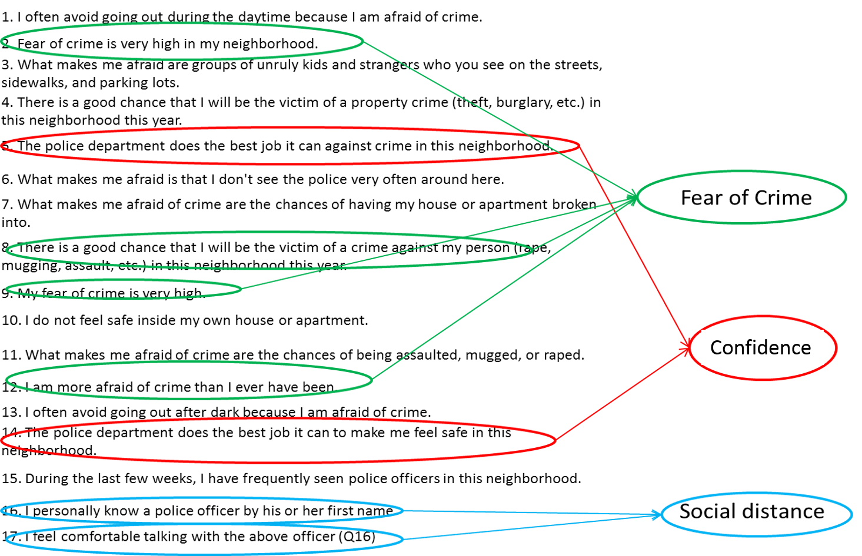

Slide 9
Base Model
 | Negative Contact | Negative Vicarious Contact | Media Exposure | Victimization | Confidence in the Police
Minority | 0.345* | 1.974** | 0.758** | 0.010 | -0.659*
Male | 0.409** | 0.526 | 0.206 | 0.012 | -0.179
Age Group | 0.010 | -0.222 | 0.049 | 0.001 | 0.062
Negative Contacts |  |  |  |  | -0.503**
Neg' Vicarious Contact |  |  |  |  | -0.096**
Media Exposure |  |  |  |  | -0.370**
Victimization |  |  |  |  | -0.232

Slide 10
Full Model
 | Social Distance | Negative Contact | Negative Vicarious Contact | Media Exposure | Victimization | Confidence in the Police
Minority | 0.628* | 0.345* | 1.974** | 0.758** | 0.010 | -0.546
Male | -0.109 | 0.409** | 0.526 | 0.206 | 0.012 | -0.206
Age Group | 0.008 | 0.010 | -0.222 | 0.049 | 0.001 | 0.061
Negative Contacts |  |  |  |  |  | -0.467**
Neg' Vicarious Contact |  |  |  |  |  | -0.107**
Media Exposure |  |  |  |  |  | -0.368**
Victimization |  |  |  |  |  | -0.256
Social Distance |  |  |  |  |  | -0.168**

Slide 11
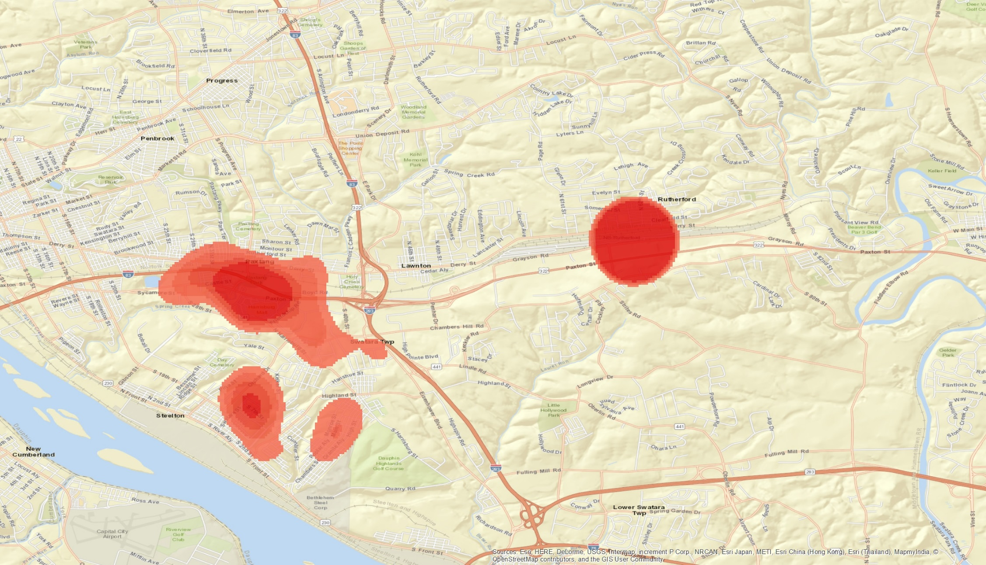
Community Policing: Pre-test
Rut2
Pax0
Len1
Law3
Cha4
Tri5

Slide 12
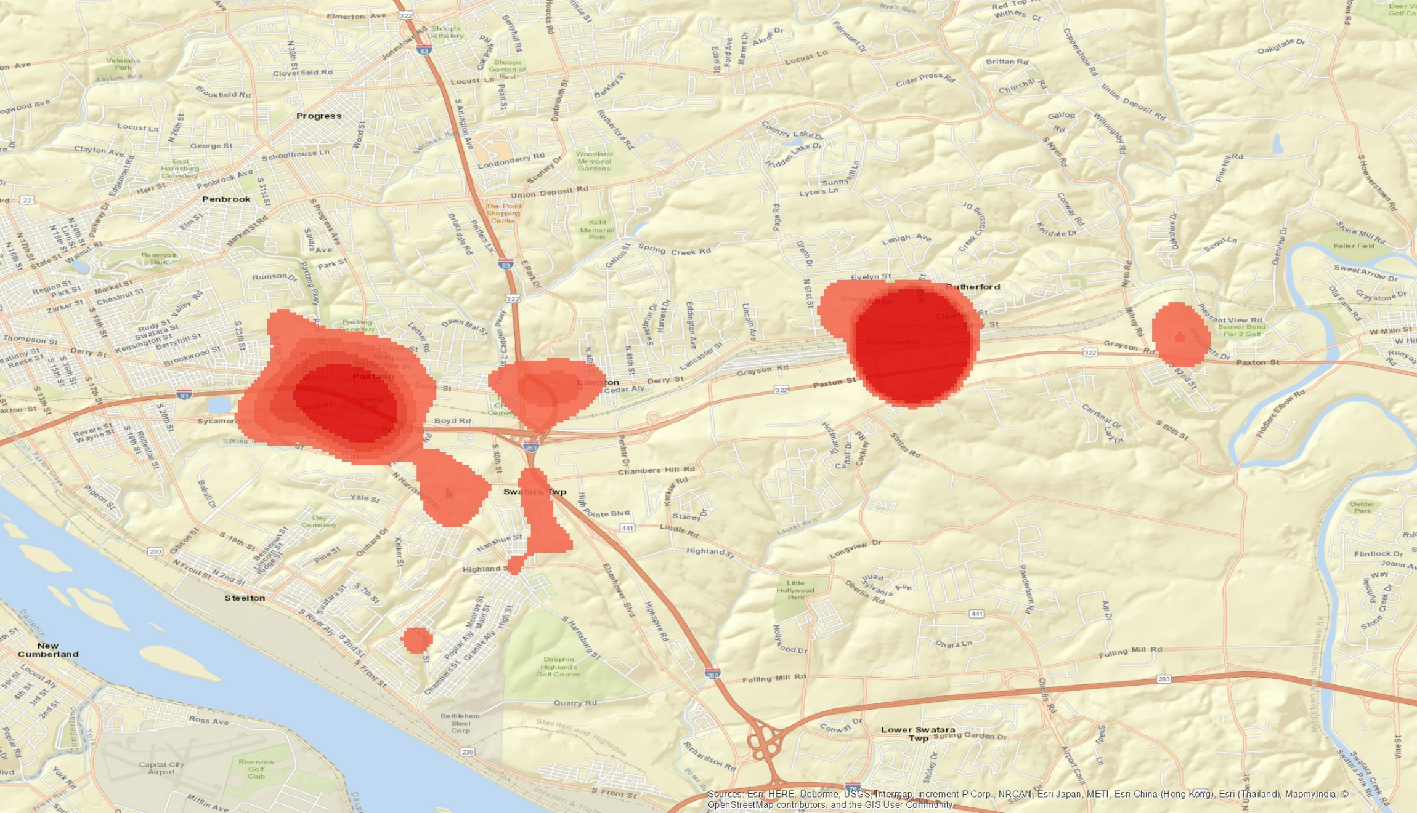
Community Policing: In Progress
Rut2
Pax0
Len1
Law3
Cha4
Tri5

Slide 13
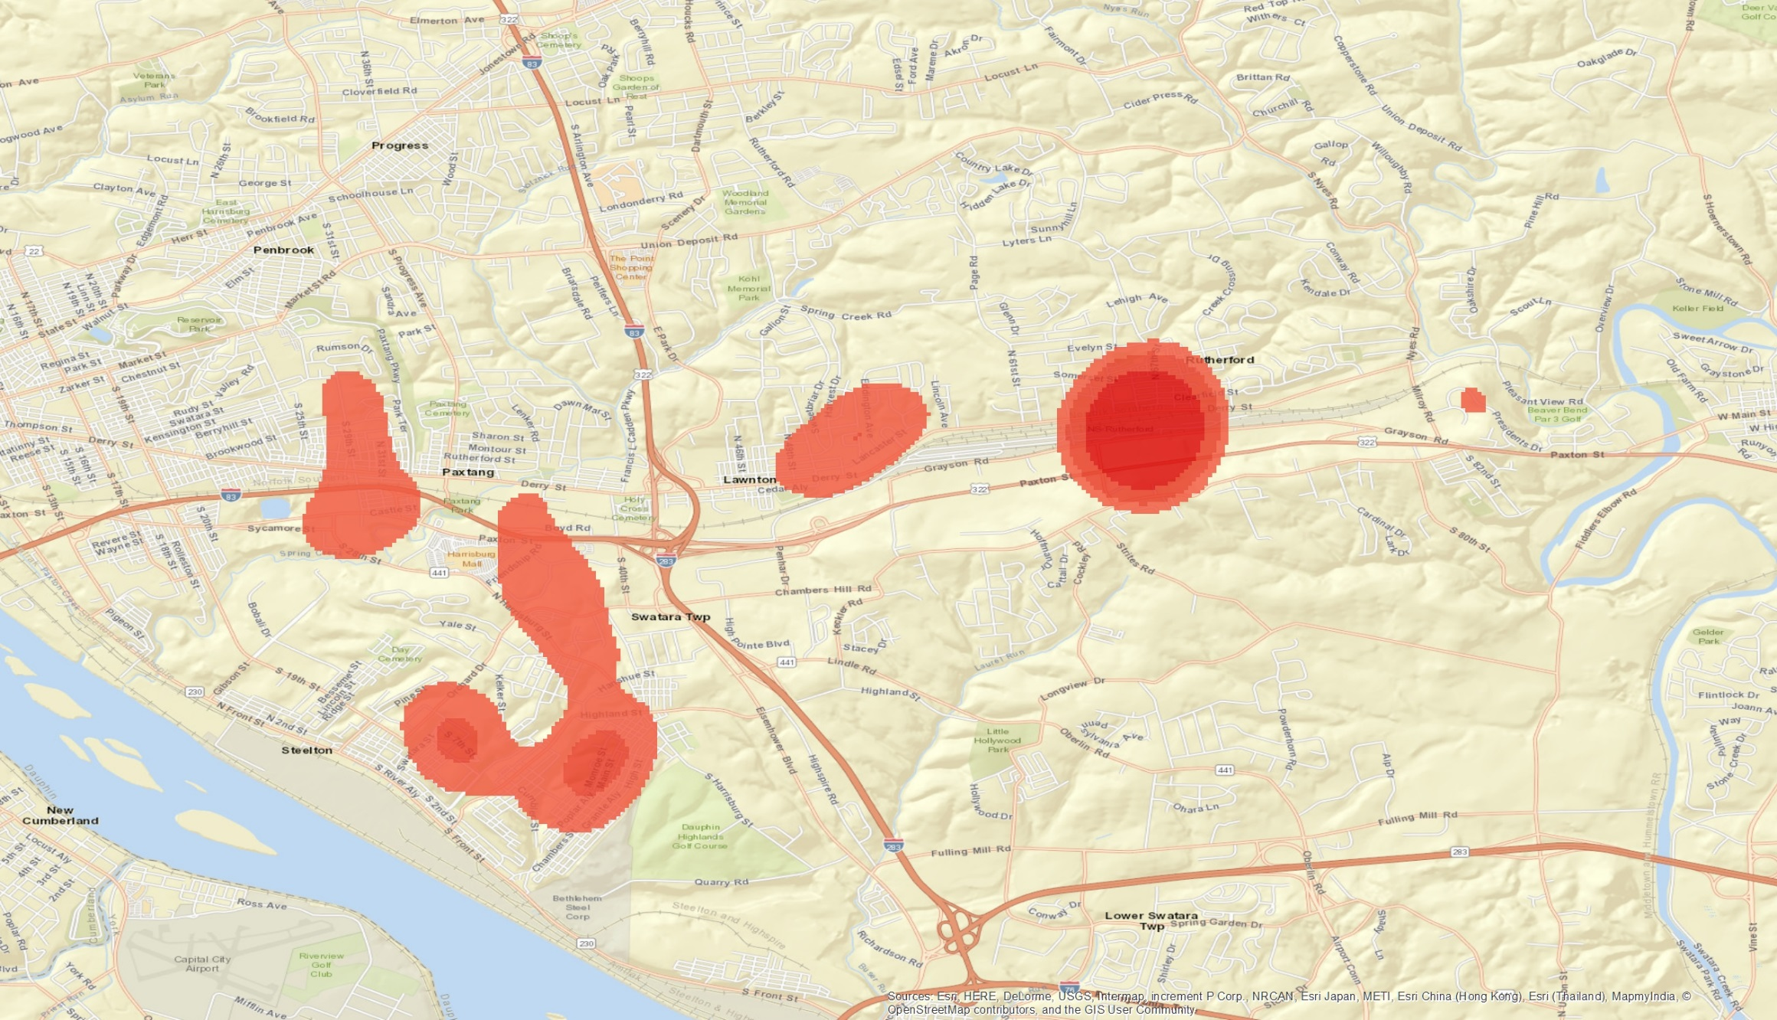
Community Policing: Post
Rut2
Pax0
Len1
Law3
Cha4
Tri5

Slide 14
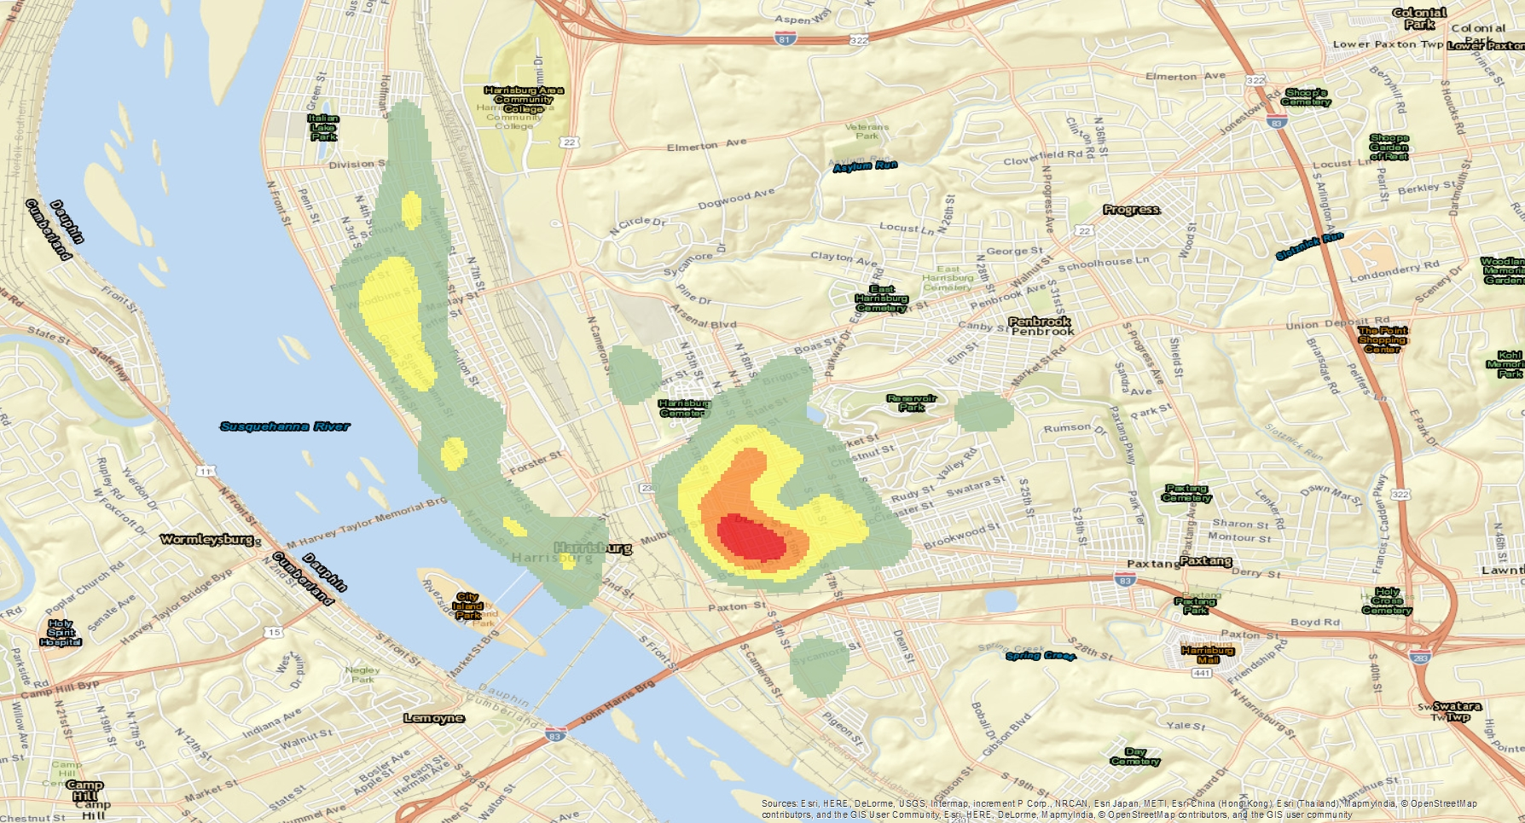
Pre-saturation

Slide 15
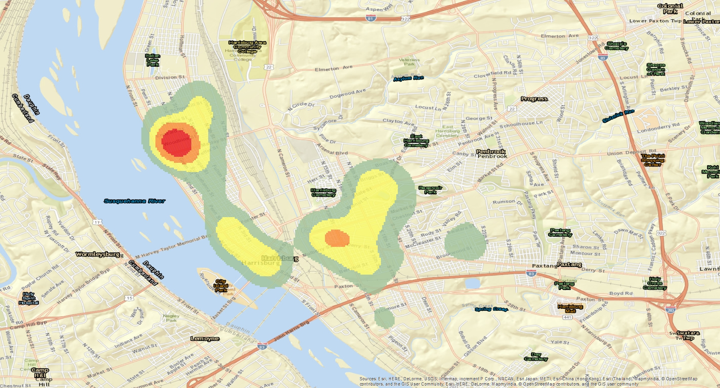
Post-saturation

Slide 16
Current Projects
PA Board of Probation and Parole
Gender-Specific Parole Program
Dauphin County DA’s Office
Crime Mapping and Analytics
Harrisburg Police Bureau
Controlled Test for Surveillance Camera Operation
Dauphin County Criminal Justice Advisory Board
Pre-trial Assessment
PA Commission on Crime and Delinquency
PA Youth Survey (PAYS)

