Slide 1
iCount: A Call for AAPI Data Disaggregation
GOVERNOR’S ADVISORY COMMISSION ON ASIAN PACIFIC AMERICAN AFFAIRS

Slide 2
Governor’s Advisory Commission on Asian Pacific American Affairs
The Governor’s Advisory Commission on Asian Pacific American Affairs
Swearing – In Ceremony
Pennsylvania Governor’s Residence | Harrisburg, PA | November 18, 2015

Slide 3
The Governor's Advisory Commission on Asian Pacific American Affairs serves as the Commonwealth’s advocate agency for the Asian American and Pacific Islander (AAPI) communities. Our mission is to ensure that state government is accessible and accountable to the AAPI communities in Pennsylvania.

Slide 4
“Pennsylvania (will) continue to build on its rich history of accepting immigrants and refugees from around the world.”
- Governor Tom Wolf
http://wesa.fm/post/essential-pittsburgh-conversation-governor-wolf#stream/0

Slide 5
The Governor’s Advisory Commission on Asian Pacific American Affairs
Civil Rights Task Force hosts a Community Forum on Islamophobia
Al-Aqsa Mosque | Philadelphia, PA | April 9, 2016

Slide 6
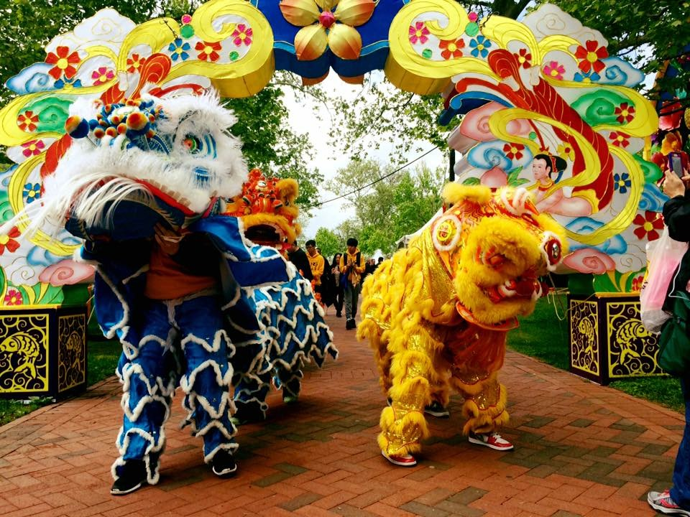
Title VI of the Civil Rights Act of 1964 protects people against which forms of discrimination?
The Governor’s Advisory Commission on Asian Pacific American Affairs co-sponsors the Pan Asian Association of Greater Philadelphia’s 10th Annual Asian Pacific American Heritage Festival
Franklin Square Park | Philadelphia, PA | May 7, 2016

Slide 7
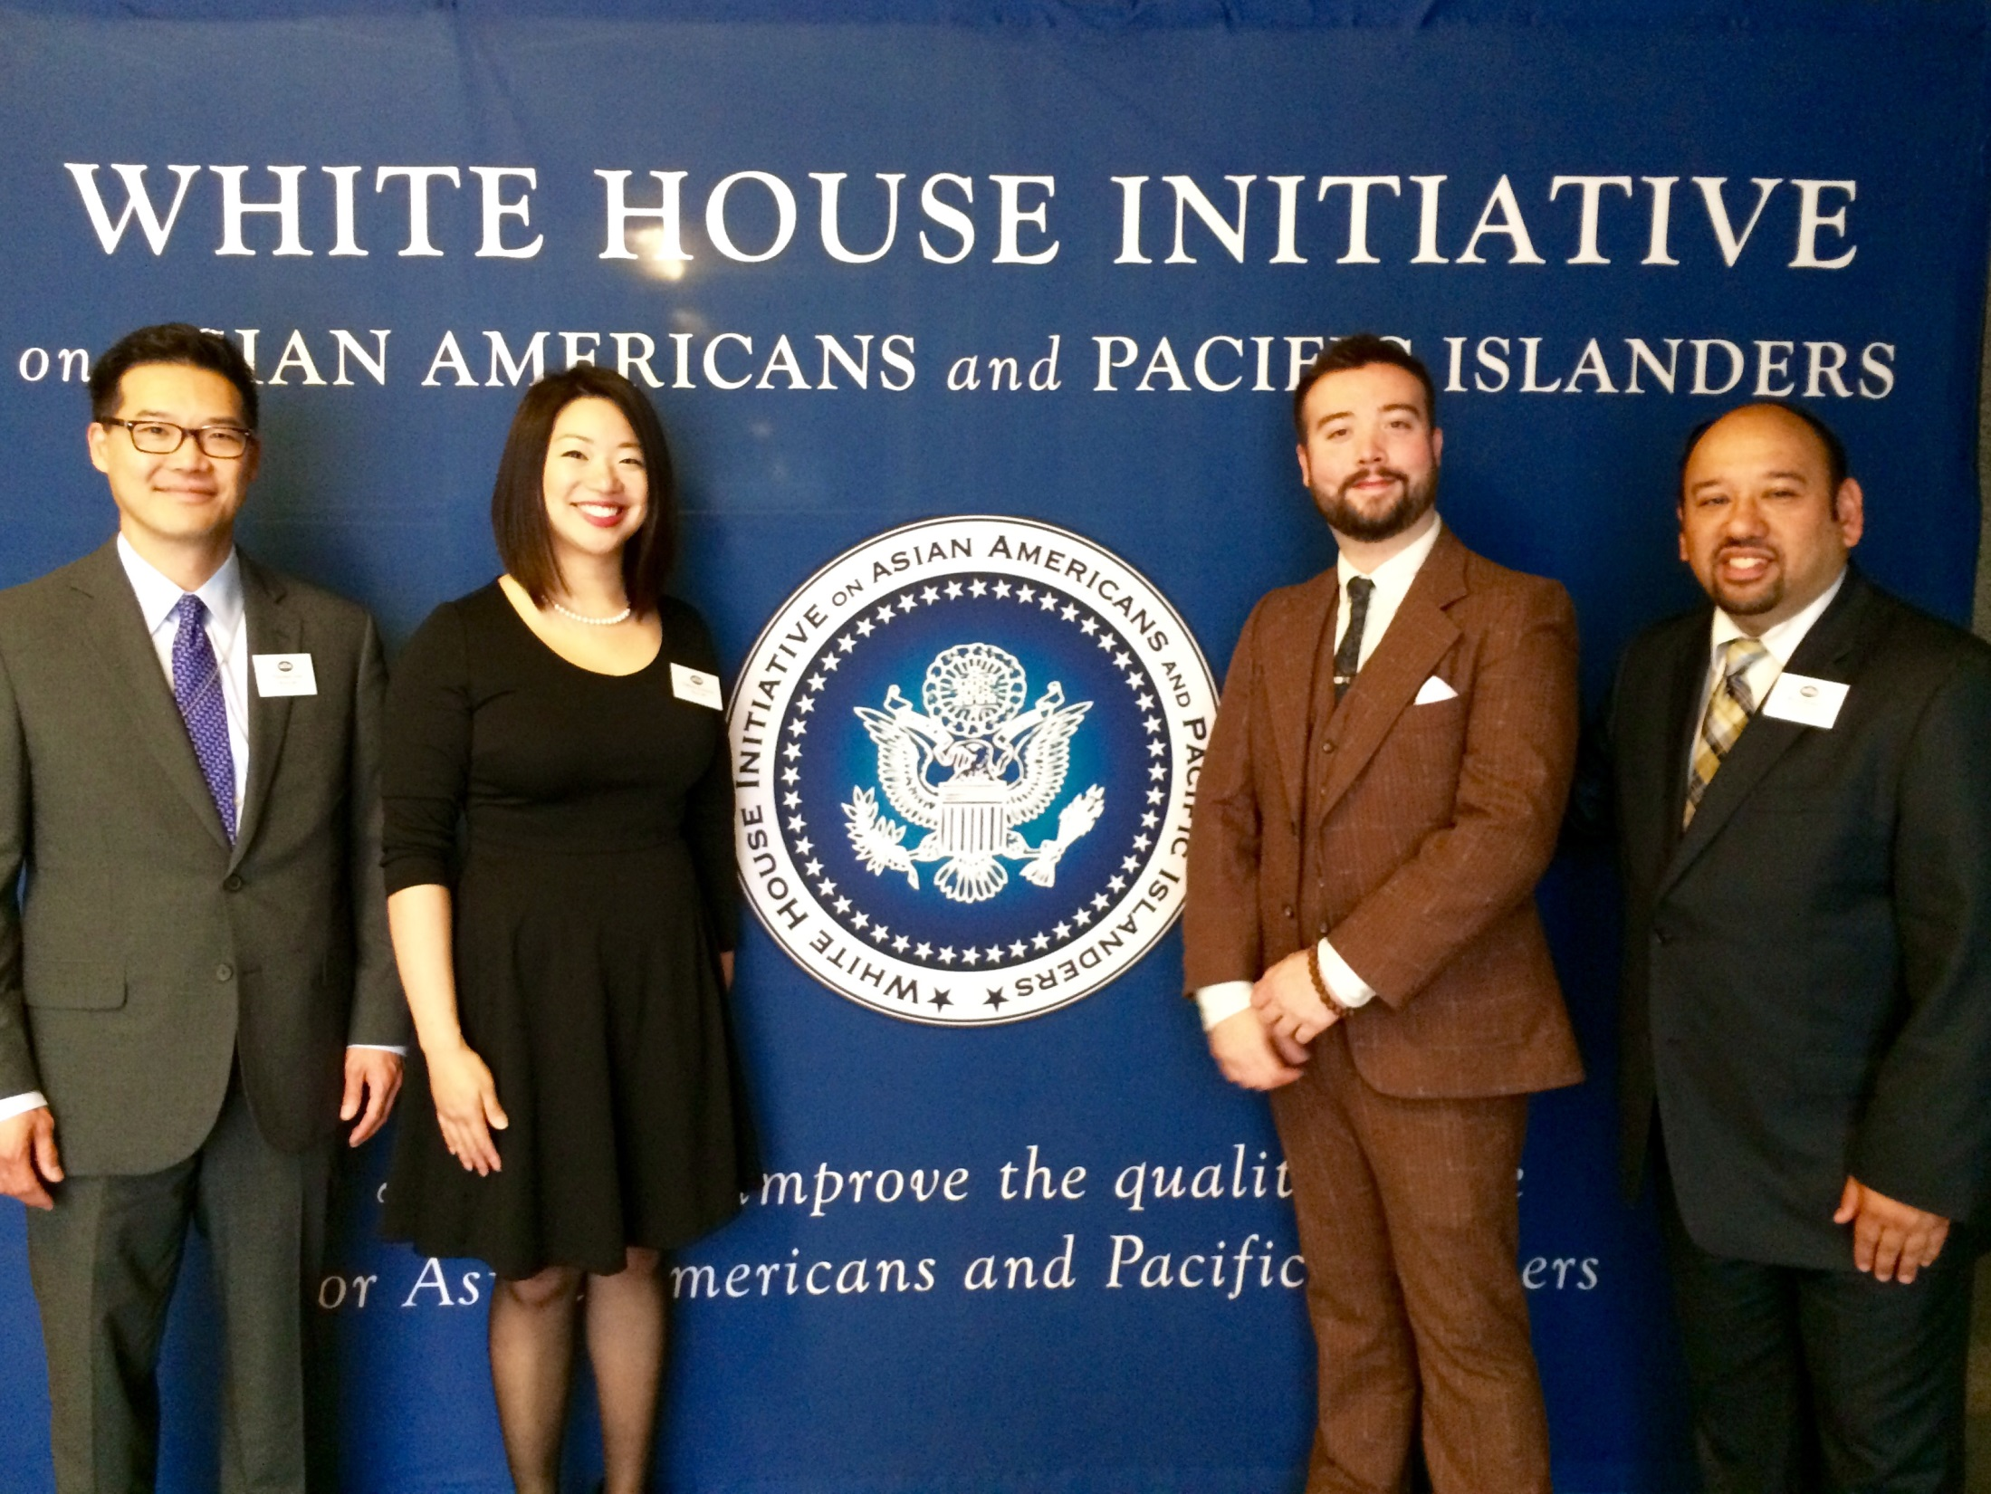
Title VI of the Civil Rights Act of 1964 protects people against which forms of discrimination?
The Governor’s Advisory Commission on Asian Pacific American Affairs attending the White House Initiative on Asian Americans and Pacific Islanders annual convening
Eisenhower Executive Offices | Washington DC | May 5, 2016

Slide 8
Asian Americans are the fastest growing racial group in the United States

Slide 9
According to 2012 Census data, how many Asian Americans & Pacific Islanders (AAPIs)
live in the United States?
6.2 million
10.2 million
C. 18.2 million
D. 28.2 million

Slide 10
How many AAPIs currently live in Pennsylvania?
215,000
875,000
C. 38,000
D. 435,000

Slide 11
The city of Philadelphia has nearly 110,000 Asian Americans and over 3,100 Native Hawaiians and Pacific Islanders (NHPI).

Slide 12
Who do you think is considered AAPI?
Take a couple minutes to write down a list of ethnicities that you believe fall under the umbrella of Asian American and Pacific Islander….
http://www.wegrowours.com/tag/questions/

Slide 13
U.S. Census Bureau Definitions
“Asian” refers to a person having origins in any of the original peoples of the Far East, Southeast Asia, or the Indian subcontinent, including, for example, Cambodia, China, India, Japan, Korea, Malaysia, Pakistan, the Philippine Islands, Thailand, and Vietnam. It includes people who indicated their race(s) as “Asian” or reported entries such as “Asian Indian,” “Chinese,” “Filipino,” “Korean,” “Japanese,” “Vietnamese,” and “Other Asian” or provided other detailed Asian responses.
Overview of Race And Hispanic Origin: 2010
http://www.census.gov/prod/cen2010/briefs/c2010br-02.pdf

Slide 14
U.S. Census Bureau Definitions
“Native Hawaiian or Other Pacific Islander” refers to a person having origins in any of the original peoples of Hawaii, Guam, Samoa, or other Pacific Islands. It includes people who indicated their race(s) as “Pacific Islander” or reported entries such as “Native Hawaiian,” “Guamanian or Chamorro,” “Samoan,” and “Other Pacific Islander” or provided other detailed Pacific Islander responses.
Overview of Race And Hispanic Origin: 2010
http://www.census.gov/prod/cen2010/briefs/c2010br-02.pdf

Slide 15
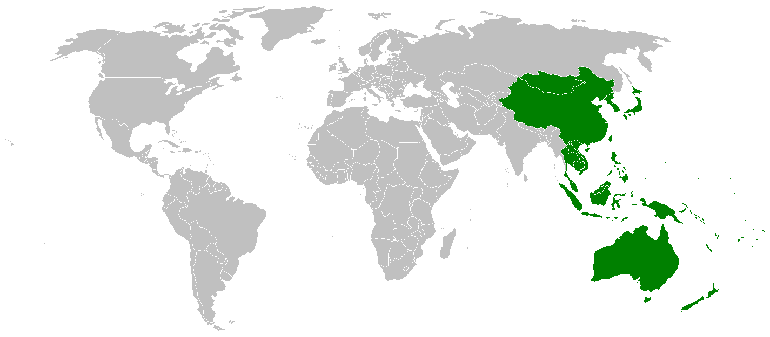
Asia & the Pacific Islands

Slide 16
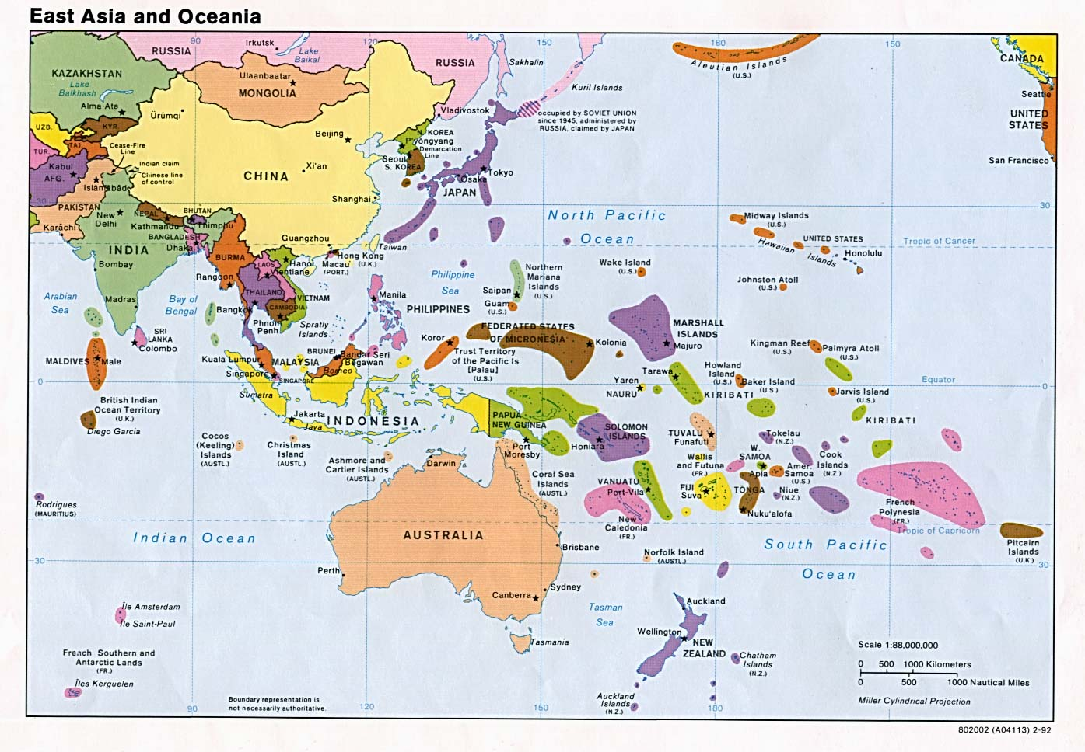

Slide 17
City of Philadelphia Demographics
In the city of Philadelphia Asian Americans comprise 7% of the population and NHPI make up 0.2%
The largest Asian American ethnic group in Philadelphia are Chinese Americans with a population of nearly 33,000
They are followed in size by Indian Americans - 20,809
Vietnamese Americans– 16,268
Cambodians Americans– 9,912
37% of Burmese Americans, 33% of Cambodian Americans, and 31% of Bangladeshi Americans are youth.
Youth make up a higher proportion of the Burmese American population than any other racial or ethnic group in Philadelphia
Among Asian American ethnic groups, the Bangladeshi American population grew the fastest, more than quadrupling between 2000 and 2010
Other communities that saw substantial growth :
Indonesians (270%)
Sri Lankans (161%)
Pakistani Americans (145%)
U.S. Census Bureau, 2010 Census SF1, Tables PCT7 and PCT10: 2010 Census SF2, Table PCT1

Slide 18
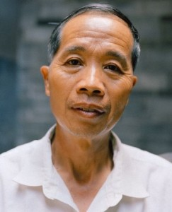
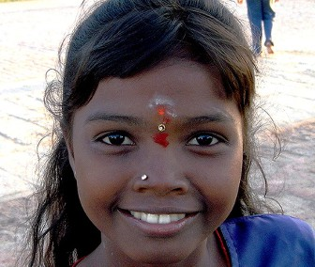
The AAPI Mosaic
Chinese
Asian Indian
Fijian
http://www.china-mike.com/chinese-culture/understanding-chinese-mind/in-out-groups/
http://realhistoryww.com/world_history/ancient/China_2.htm
http://whatkarensees.blogspot.com/2011/11/beautiful-fijian-woman.html

Slide 19
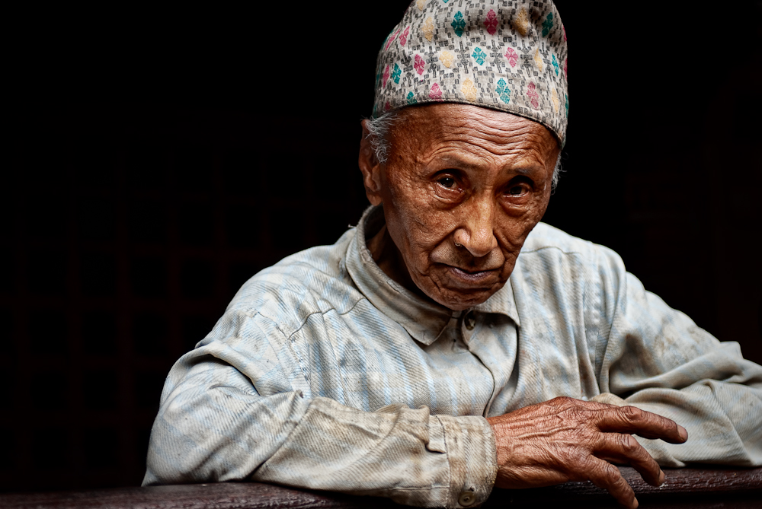
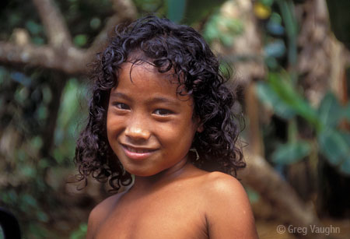
Nepali
Vietnamese
Indonesian
Micronesian

Slide 20
What is the
Model Minority Myth?

Slide 21
What does this picture show?

Slide 22
The Model Minority Myth is…
It is the stereotype and perception that all AAPI’s have a higher degree of socioeconomic success. This success is measured in income, education, low crime rate and high family stability. The model minority myth has been greatly influenced by immigration trends and policy.

Slide 23
Let’s take a look back through history…

Slide 24
Chinese Exclusion Act 1882
The Chinese Exclusion Act of 1882 was a federal law signed by President Chester A. Arthur on May 6, 1882.
It was the first law implemented to prevent a specific ethnic group from immigrating to the United States.
Although the Chinese composed only .002 percent of the nation’s population
The Chinese Exclusion Act was repealed in 1943, Chinese remained ineligible for citizenship until that time
http://www.history.com/topics/chinese-exclusion-act

Slide 25
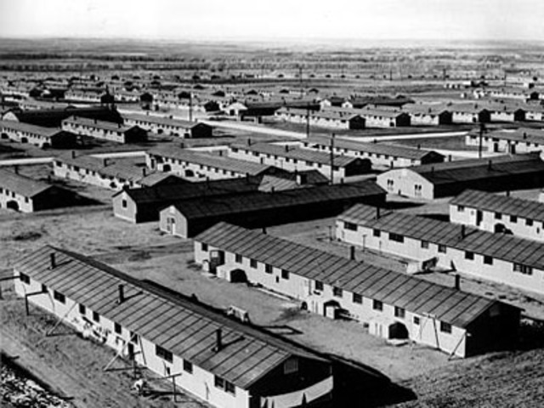
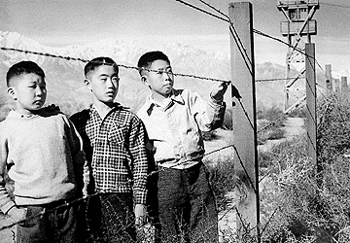
WWII & Japanese Incarceration
On February 19, 1942, President Franklin Roosevelt signed Executive Order 9066
120,000 Japanese men, women, and children, many of whom were U.S. Citizens - were packed onto trains like cattle, and transporte to military bases where, though innocent of any crime, they were guarded at the point of a gun for the duration of the war.
https://www.mtholyoke.edu/~matsu22k/classweb/index3.html
http://www.timetoast.com/timelines/japanese-internment-camps-history-jacob-and-drew-period-3

Slide 26
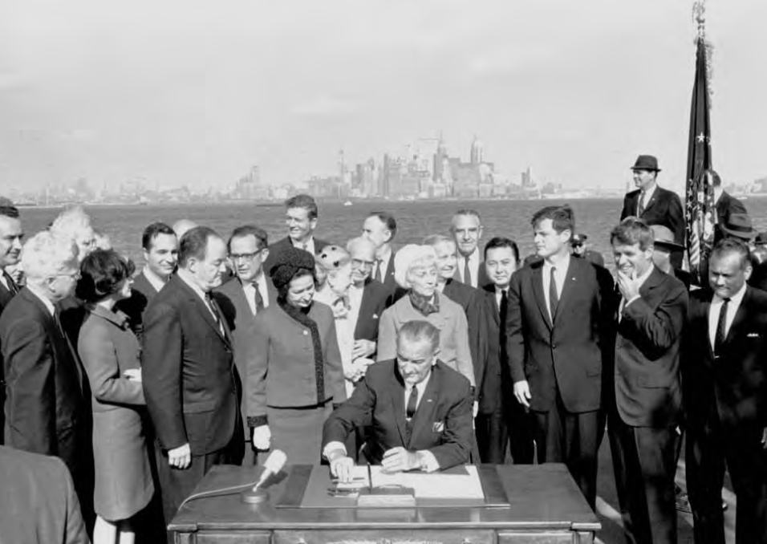
Immigration and Nationality Act of 1965
President Lyndon B. Johnson signing the Immigration and Nationality Act
Base of the Statue of Liberty| New York City, NY | 1965
(Lyndon B. Johnson Library Collection/Yoichi R. Okamoto)

Slide 27
Immigration and Nationality Act of 1965
Previous laws restricted immigration from Asian and African countries
These laws also gave preference to immigrants from Northern and Western European countries over Southern and Eastern European countries.
A major catalyst for the new legislation was the opposition to racially discriminatory laws arising from the Civil Rights era.
Michigan’s Democratic Senator Philip Hart, one of the sponsors of the law declared that the effort to maintain the American creed required an American immigration policy become more consistent with democratic moral and ethical principles.

Slide 28
Vietnamese Refugees & Fort Indian Town Gap
On April 30,1975, Saigon the Capital of South Vietnam was captured by North Vietnamese forces.
In desperation hundreds of thousands of asylum-seekers fled Vietnam
22,000 of these refugees journeys brought them to Fort Indiantown Gap – one of four military posts in the U.S. that were temporarily used as refugee resettlement centers
http://www.pennlive.com/midstate/index.ssf/2015/04/40_years_later_former_vietname_1.html

Slide 29
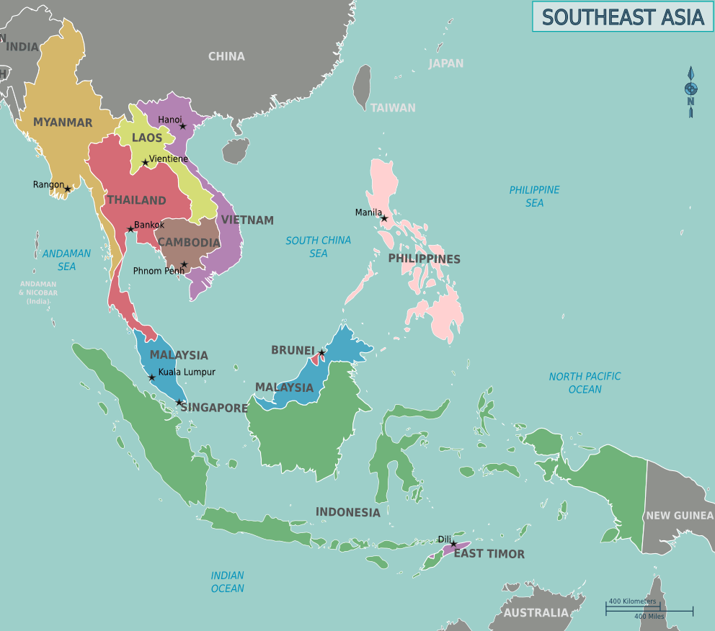

Slide 30
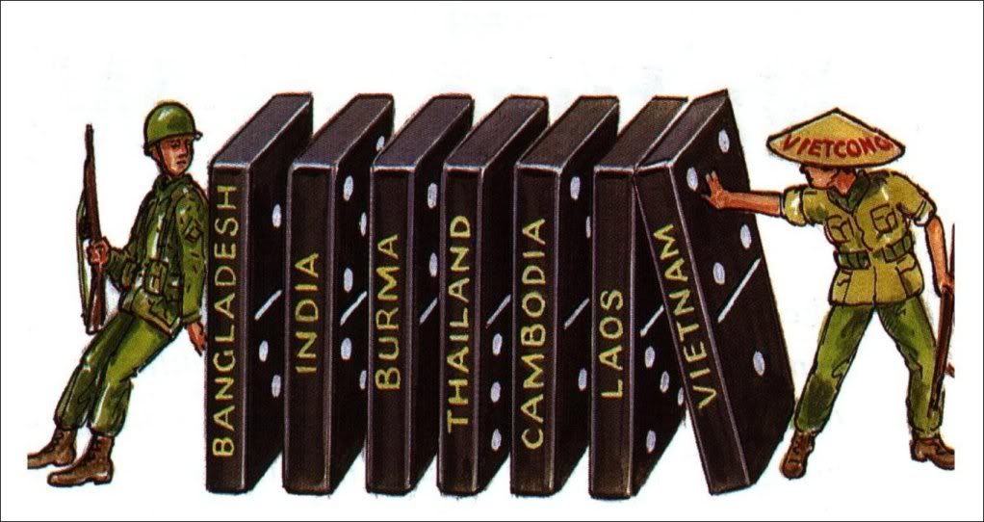
Domino Theory
http://irongangsta.blogspot.com/

Slide 31
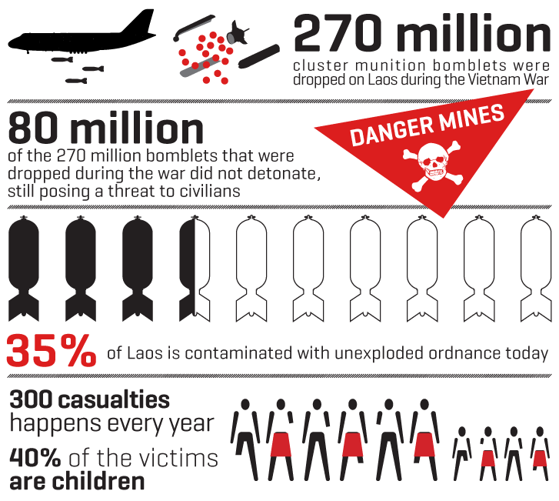
https://www.danchurchaid.org/news/news/mine-awareness-day-the-vietnam-war-is-still-claiming-victims

Slide 32
Why is it harmful?
This stereotype polishes over the myriad of difficulties that the AAPI community faces including but not limited to: poverty, mental illness, health disparities, language access and violence.

Slide 33
In Philadelphia, 48% of Vietnamese Americans and 52% of Cambodian American adults are less likely to have a high school diploma or GED than all other racial and ethnic groups. Nationally post-9/11 Muslim American students
K-12 have seen a dramatic increase in bullying.

Slide 34
“
“The model minority myth chooses to highlight the successful immigrant examples and brush aside the high rates of poverty.”
“
“To address this problem, it is vital to address not only the consistent collection of disaggregated data, but also its reporting and accessibility.”
- Jo-Ann Yoo
Executive Director of the Asian American Federation

Slide 35
The Challenges
There are three major areas that present frequent challenges when providing disaggregated data
Data Collection
Data Analysis & Evaluation
Data access and dissemination
https://sites.ed.gov/aapi/files/2013/03/WHIAAPI-Best-Practices-for-Disaggregation-of-Federal-Data-on-AAPIs.pdf

Slide 36
Best Practices to Overcome Data Collection Challenges
Conduct outreach activities with AAPI community organizations, advocates, and respected leaders to encourage AAPI participation.
Oversample the AAPI population to ensure adequate AAPI representation.
Develop a language assistance program to account for limited English proficiency in the AAPI community.
https://sites.ed.gov/aapi/files/2013/03/WHIAAPI-Best-Practices-for-Disaggregation-of-Federal-Data-on-AAPIs.pdf

Slide 37
Best Practices for Data Analysis & Evaluation
Pool multiple months or years of survey data together and combine samples when working with a dataset that has a small AAPI sample.
Produce analytic results for disaggregated AAPIs when reliable estimates are available in order to better show the similarities and differences within the population.
Review AAPI data carefully to ensure that the data are suitable for publication.
Create a variety of data products that will communicate important findings and trends to different audiences.
https://sites.ed.gov/aapi/files/2013/03/WHIAAPI-Best-Practices-for-Disaggregation-of-Federal-Data-on-AAPIs.pdf

Slide 38
Best Practices for Data Analysis & Evaluation
Collect information on detailed ethnicities with an adequate set of separate ethnic checkbox response categories that reflect the diversity within the community and/or write-in/type-in areas in the survey instrument.
Collect AAPI data using multiple modes, considering that the AAPI community is diverse and may not be as responsive to surveys in one particular mode of data collection and may require culturally and linguistically appropriate approaches.
https://sites.ed.gov/aapi/files/2013/03/WHIAAPI-Best-Practices-for-Disaggregation-of-Federal-Data-on-AAPIs.pdf

Slide 39
Best Practices for Data Access & Dissemination
Partner with AAPI communities in access to and dissemination of data to ensure these approaches are relevant and usable for target audiences.
Provide materials to assist data users in working with data and datasets, release public use files, and arrange special access for researchers who require analysis of full microdata to make datasets more accessible to a wider range of data users.
Make high-quality microdata and analytic results available as widely as practicable as soon as possible after data collection—in as much detail as possible—while maintaining survey participant confidentiality.
https://sites.ed.gov/aapi/files/2013/03/WHIAAPI-Best-Practices-for-Disaggregation-of-Federal-Data-on-AAPIs.pdf

Slide 40
Best Practices for Data Access & Dissemination
Use a variety of vehicles to share data-related announcements and information (webinars, press releases, blogs, factsheets, etc.) and ensure that these are distributed to ethnic media, community organizations, Asian/Pacific Islander studies departments, and federal statistical advisory groups.
Partner with communities to develop data releases that are culturally and linguistically appropriate, so that they reach the intended audiences.
https://sites.ed.gov/aapi/files/2013/03/WHIAAPI-Best-Practices-for-Disaggregation-of-Federal-Data-on-AAPIs.pdf

Slide 41
DATA.GOV/AAPI
ONLY 1 IN 7 NATIVE HAWAIIANS & PACIFIC ISLANDERS HAS A COLLEGE DEGREE OR HIGHER.

Slide 42
Top 10 Languages in Pennsylvania (2010)
According to the PA Department of Education more than 200 different languages are spoken by the English Language Learner (ELL) population.
The top 10 languages spoken in Pennsylvania make up 85 percent of total languages and include:
Spanish
Vietnamese
Chinese
Arabic
Russian
Korean
Khmer
Gujarati
French
Creole & Pidgins
http://www.pattan.net/category/Educational%20Initiatives/English%20Language%20Learners%20(ELL)/page/What_are_PAs_Languages.html

Slide 43
Resources
Asian Americans Advancing Justice
2013 a Community of Contrasts Report for Boston, New York, and Philadelphia
White House Initiative on Asian American and Pacific Islanders Interagency Working Group
Best Practices for the Disaggregation of Federal Data on Asian Americans and Pacific Islanders

Slide 44
THANK YOU
If you have any additional questions you can reach me at:
tlawson@pa.gov

