Slide 1
The 2017 Economic Census
2017 Pennsylvania Data User Conference
May 9, 2017
Presented by:
Andrew W. Hait
U.S. Census Bureau

Slide 2
Monthly and Quarterly Data
Leading Economic Indicators, like the M3 and Monthly Retail Trade
Annual Data
Annual Survey of Manufactures
County Business Patterns
Quinquennial and Other Data
Economic Census
Survey of Business Owners and Other Related Programs
Detail Shown
Timeliness

Slide 3
Economic Census
Done on the years ending in “2” and “7”
Covers employer businesses in the U.S.
Covers businesses in all NAICS sectors except:
Agriculture
Public Sector
Other selected exclusions (see census.gov/econ/census/help/naics_other_classification_systems/codes_not_covered.html)
Notes:
Employer Establishments
Businesses with 1+ employees (file IRS form 941)
Nonemployer Establishments
Businesses with no paid employees (independent contractors) (usually File IRS form 1040 Schedule C)
Make up 75% of all businesses in the US but < 4% of receipts/revenue
Covered by the Nonemployer Statistics program only
Establishment - A store, warehouse, factory, or other type of business at a single physical location
Company (or firm) – One or more establishments under common ownership or control

Slide 4
The Econ Census Offers…
Over 200 unique industry statistics
National-, state-, metro-, county-, place-, and ZIP Code-level data (varies by sector)
Industry detail: 2- thru 6-digit NAICS codes
Additional cross-tabs, including:
Business employment and sales size
Taxable and tax exempt business
Very accurate
Notes:
Even though only publish down to place, geocode to block & tract to assign place and for other purposes.
Only publish to place primarily for disclosure reasons.
NASS = National Agricultural Statistics Service

Slide 5
2017 Economic Census Content and Tools
Notes:
Good morning! I’m Kari Klinedinst from the Respondent Management and Promotion Branch. Andy was kind enough to give me the majority of his presentation this morning. And so far he’s on time! This could be a first! I want to talk to you about our ongoing efforts to promote response to the 2017 Economic Census and how you all can help us support these initiatives.

Slide 6
Content Changes
NAICS updates – See the NAICS web site (http://www.census.gov/eos/www/naics/ ), including the Federal Register Notices (http://www.census.gov/eos/www/naics/federal_register_notices/fedregister.html )
Increased implementation of North American Product Classification System (NAPCS)
Geography – Boundary and other changes
New dissemination system

Slide 7
2017 NAICS – Selected Changes
Split Crude Petroleum Extraction and Natural Gas Extraction
Combine Household Cooking, Refrigerator/Freezer, Laundry, and Other Major Appliances
Combine Department Stores and part of Discount Department Stores
Combine Warehouse Clubs and Supercenters with other part of Discount Department Stores
Combine Electronic Shopping, Electronic Auctions, and Mail-Order Houses
Breakout Nanotechnology R&D

Slide 8
2017 Economic Census Response
Notes:
Good morning! I’m Kari Klinedinst from the Respondent Management and Promotion Branch. Andy was kind enough to give me the majority of his presentation this morning. And so far he’s on time! This could be a first! I want to talk to you about our ongoing efforts to promote response to the 2017 Economic Census and how you all can help us support these initiatives.

Slide 9
What’s New for 2017?
Directorate initiative for 100% online response
Respondent Portal – Users create individual accounts
New Reporting Tool
Later mailing & due date
Notes:
First of all, we have a number of changes in store for the collection of the 2017 Economic Census. I don’t expect you to be experts on these changes, but rather wanted to give you an idea of some of the ways we are adapting with technology and to better serve businesses.
-No longer an option to report on paper. An electronic response is required. We have piloted this effort on a number of our annual surveys and it has been successful.
-Individuals, not the company, will need to create an account with the Census Bureau to respond. We used to send a username and password in our letter to companies. This will no longer be the case. We will now direct them to a website where an individual will create a personal account with their email and own unique password. Once logged in, they will then use the one-time use authentication code we mailed the company to link their account with the survey. This is Respondent Portal being rolled out to all of our business surveys over the next 18 months. This means that if someone is responsible for multiple surveys, they will use this portal to access all the surveys they are responsible for completing and see them all in one place.
-No more downloadable software for large businesses – it will be an online program. Businesses will still have the option to export the requested data items into an Excel spreadsheet that they can populate and then upload back into the program to submit.
-We’ve listened to businesses and are changing when we mail the survey and it’s due date to be a little later in the year. This is to give them more time to do their year end work, but still be early enough in the year that the statistics produced can be timely. I have a slide for this new time frame later in the presentation.

Slide 10
Response Promotion Strategy
Notes:
As the part of the Economic Census Promotion and Outreach team, it is our responsibility how to best prepare businesses to receive this survey. Over the past several months, we have been working with our contractor to develop a communications plan that outlines our strategies and tactics. As you can see in the chart here, we have three primary means.
In blue – you see our Account Manager program. This consists of Census Bureau staff who are assigned to the largest businesses in the US to be their personal help for completing the Economic Census. They will guide them through the response process and answer any questions they might have.
In green, you see the ways we reach the all the other businesses who are receiving the Economic Census. The only direct communication we have with them is our official correspondence – letters and then follow up calls (but no one would be upset if EVERYONE responded so we didn’t have to call them.)
In red you see the ways that the Census Bureau reaches all US Businesses with over all awareness efforts such as social media, PR, awareness campaigns, and government relations to name a few.
****ANGELO this wording will have to change for DDS*****
But take a look at that box in the middle of the slide. That represents you. The box is what we call intermediaries - all the various organizations that influence and impact businesses such as trade associations, chambers of commerce, and trade publications. We know your State Data Centers are a trusted voice to businesses and business associations in your areas. By working with you – attending your conferences, providing you with materials, asking for you to promote us on your website – that is how we can not only raise awareness of this survey to businesses, but also promote response for those that will receive the Econ Census.
We are currently developing a suite of materials for you and other intermediaries can begin using late summer to start getting the word out on our behalf. I’d like to give you a sneak peak of a few slides from a power point. These are still drafts but it will give you an idea of the direction we are going.

Slide 11
Monthly
and Quarterly
Surveys
Annual Surveys
Economic Census – Every 5 years
Census Bureau Surveys
Census Bureau Economic Surveys are a key source for official statistics companies can use:
Monthly and Quarterly are small sample surveys that provide the most TIMELY data available
Annual surveys have larger samples and provide the most up-to-date TREND data available
Every 5 years, the Economic Census measures all businesses and provides the most COMPREHENSIVE data available
Theses surveys set the standard for U.S. economic statistics, and are fueled by the data provided by individual businesses
Notes:
We’ve heard in research with both businesses and trade associations that less is more. We love Andy and all his details into the methodology, but that is not what motivates a business to respond. Methodology and details are definitely needed, but businesses don’t have the time for long explanations and want to know “What’s in it for me?”
You remember how Andy had a slide at the beginning that gave a brief overview of the range of surveys we have? Well here’s an updated version.
*walk through slide*
It’s very high level but it demonstrates that the Economic Census is part of an entire set of surveys, each serving their own purpose.

Slide 12
Using Census Bureau Statistics
When it was time for James to open his second restaurant, he used U.S. Census Bureau statistics to help pick the location
With industry trends and ZIP Code level data, he identified a downtown spot with high potential to grow his business
Where did these statistics come from?
They came from James’ restaurant and all the other businesses who reported their information in Census Bureau surveys
Together, their responses fueled the local, state, and national economic statistics used for planning and decision-making
Notes:
*walk through slide*
Businesses want to know that the time they are taking to complete the survey serves a purpose. Small businesses can see themselves in James. Even if they aren’t the ones using the data, they want to know that someone is. It’s not just another government request that then goes into a black hole.

Slide 13
Economic Census Response Steps
1. READ LETTER:
Official letter from the Census Bureau with company’s authentication code arrives late January 2018. Save this letter.
2. GO TO WEBSITE:
www.report.census.gov
3. CREATE ACCOUNT:
Similar to other online accounts with email username, password, and security questions. Set up account on first visit.
4. SIGN IN:
Enter authentication code from official letter to unlock company’s Economic Census survey.
5. PREPARE TO REPORT:
Print out census questions as a worksheet or download spreadsheet for multiple locations. Delegate others to assist.
6. INPUT DATA:
Enter company data via online reporting screens or multi-unit spreadsheet upload. Review and confirm responses.
7. SUBMIT RESPONSE:
Due March 15, 2018. Submission receipt and copy of completed response can be saved electronically and printed out.
8. SEE THE RESULTS:
www.census.gov/EconomicCensus Visit to see where survey data goes and how to use Census statistics.
Notes:
I’m not going to read through all these steps with you but this slide incorporates what we’ve learned through our focus group efforts with businesses. They won’t take the time to read details, but will scan for highlights. That’s why we have the high level steps on the left, with further information on the right if they want to take the time to read more.

Slide 14
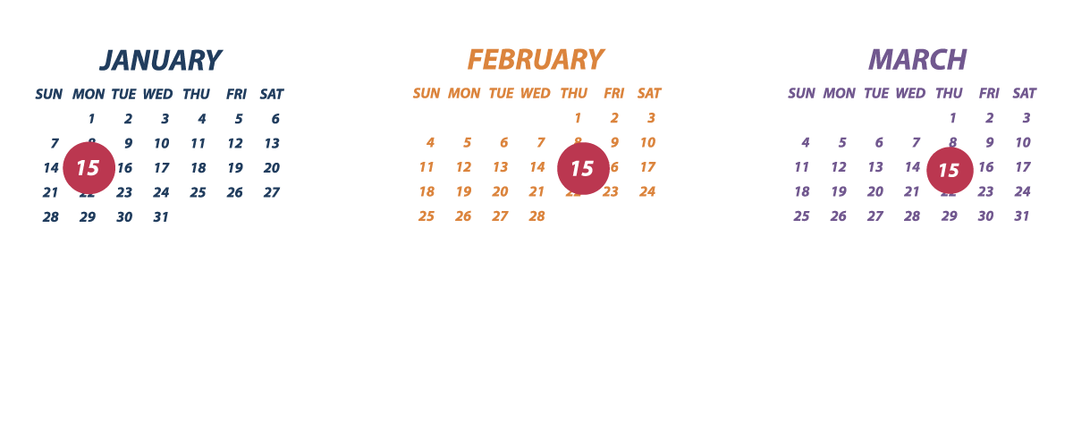
Economic Census Timing– 3 Dates to Remember
Communications from Census to inform membership will be provided
Full suite of promotional materials will be available Summer 2017
Notes:
And finally, our 15-15-15 slide. The new due date for the Economic Census is March 15, 2018. As we meet with business organizeations, we want them to think about the 15th of the month as Economic Census related. We will launch the program on January 15, host a webinar on February 15, and then it is due on March 15.
I do want to take a quick side bar and say that webinar isn’t set in stone yet, so please don’t communicate that information yet.

Slide 15
What You Can Do
Spread the word!
Disseminate promotional and informational items that we provide to you
Coming June 2017
Stay connected
Notes:
Use meetings and events as opportunities to communicate with potential respondents
We will provide messaging & materials for you to use to reach out to local stakeholders. As I mentioned, a power point and other items are curtently in debelopemtn and will be ready for you to use in June.
My contact information is at the end of this presentation, so please give me any feedback. And I will be reaching out to all of you through the appropriate channels with any updates and materials in the months ahead. You are all vital to the success of the Economic Census. Thank you for all the work you do.

Slide 16
Summary
Census is not just the Decennial Census… we provide a wealth of business data that can help users understand their local economy
Lots of changes coming for the 2017 EC
Garbage In = Garbage Out… we need your help to promote response
An Andy Story…

Slide 17
Questions

Slide 18
Thank You! Contact me at: andrew.w.hait@census.gov (301)763-6747

