Slide 1
GIS in Pennsylvania State Corrections
Pennsylvania Department of Corrections, Bureau of Planning, Research, and Statistics (PRS)
Contact:
Joseph Hafer
(jhafer@pa.gov)

Slide 2
So What
What we use – software
What we have – data
What we produce – maps and apps

Slide 3
Software
Data extraction and manipulation
Microsoft Access and Excel
Mapping
ESRI Products
ArcGIS Desktop Basic (v 10.4.1)
ArcGIS Online
Geocoding – ESRI and/or U.S. Census Bureau
Minimal users – limited to PRS staff
Notes:
Data is being entered into our data warehouses throughout sites in Pennsylvania. We extract data from our data warehouses through ODBC connections in MS Access and manipulate that data in access and excel. We use ESRI products for all of our GIS work. We are currently running version 10.4.1. Many organizations that use ESRI products have individuals using GIS in the field. We don’t use it for those purposes. Our use is limited to staff of PRS and mostly for data visualization purposes. We don’t have an individual whose sole job is working with GIS. So we utilize a concurrent license for ArcGIS desktop, and we have the minimal 5 named users for ArcGIS Online.

Slide 4
Data
Inmate/Parolee Demographics
Gender, age, race, type of offense, level of risk, etc.
Geospatial Data:
PA Legislative Districts (PennDot)
Inmate/parolee addresses
Committing County

Slide 5
Data
Inmate/parolee address data:
Collected at intake/classification
Inmate “Legal Address”
Inmate “Notify Address”
address1, address2, city, state, zip
NOT verified
address = “mom’s house”, “Harrisburg CCC”
Philadelphia = Phi, Phil, Phila, Philal, Phily, Philly, Phla, Phialdelphia, Philaedlphia
80-90% match w/ cleaning
Notes:
We have two sources of inmate addresses that are both collected at intake into our system: legal address and notify address. They both consist of 5 fields. Unfortunately, none of the address data is verified, so it can be quite a mess. For example…. While not complete, we tend to rely on zip code when using address data for geographic regions. Because of the messiness of the data, geocoding our address data can be quite challenging and time consuming. But we can usually get around 90% of the records geocoded with some intense data cleanup.

Slide 6
Data
Committing County
68 values: 67 counties and Out-of-state
Clean and easy to use
Proxy for county of residence, NOT the same as county of residence
Notes:
We use the ESRI geocoding service when we have available credits, and we also use the free batch online geocoder from the US Census bureau.
In addition to address, we frequently use committing county as the spatial determinant for a record.

Slide 7
Data
Committing County
Proxy for county of residence, NOT the same as county of residence
2 years of releases (2014-2015)
Allegheny County (Pittsburgh)
3,859 legal or notify zip code
2,458 Allegheny committing county – 64%
Philadelphia County (Philadelphia)
10,639 legal or notify zip code
7,567 Philadelphia committing county – 71%
1,861 MontCo, DelCo, BucksCo – 89%
Notes:
To illustrate how committing county can differ from county of residence…

Slide 8
Maps
Facility Location
Choropleth
Spatial Analysis
Online Interactive
Notes:
There are four basic types of maps that we do. The majority of work we do with GIS is to assist with data visualization, so most of the maps are static choropleth maps that are used in different reports or are based on different data requests, both internal at DOC and external to DOC.

Slide 9
Facility Location Maps
Notes:
We also produce static facility location maps. These are usually statewide maps and are used for internally and externally.

Slide 10
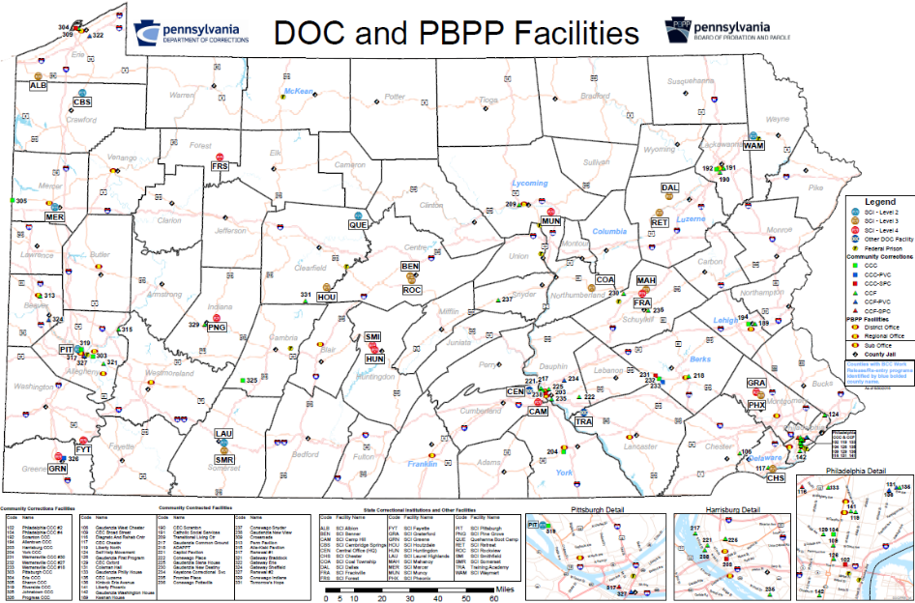
Notes:
This is our “most popular” internal map. It provides SCI locations, community corrections center locations, state parole office locations, and county jail locations. These maps are usually printed out in 2 feet by 3 feet and hung in executive staff offices for quick reference.

Slide 11
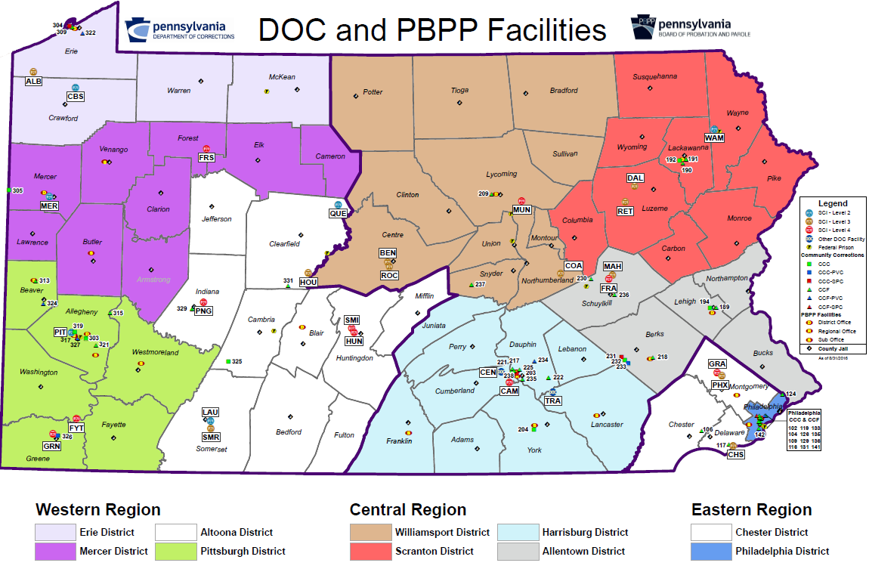
Notes:
There are many versions of the previous facility location map, this being one of them. It takes away the underlying road base map and breaks the state into the 3 DOC Regions as well as the 10 smaller PBPP districts.

Slide 12
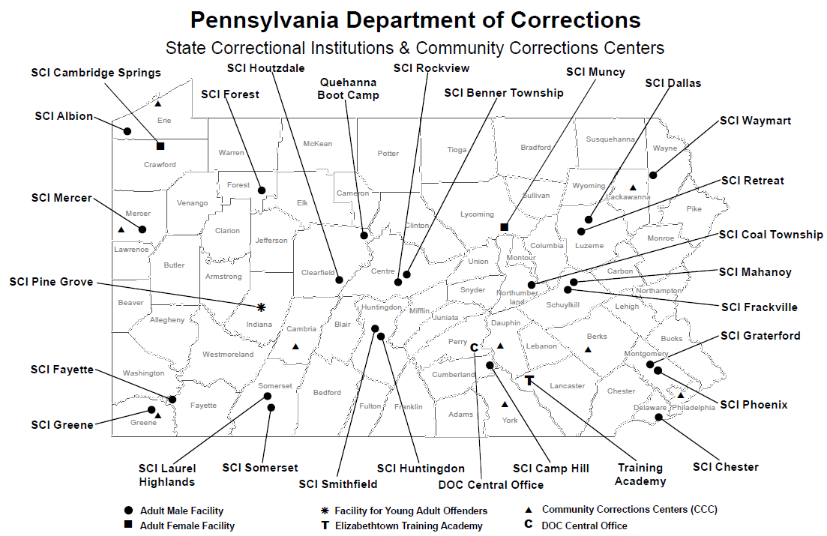
Notes:
This is a map created for our Human Resources Office for us at job fairs and recruitment events. Very basic, shows where people employed by the DOC can work.

Slide 13
Choropleth Maps
Notes:
Static choropleth maps are those that we complete the most. The majority are completed based on a request from executive staff or from an outside data or media request. Many times these maps are a one-and-done event. But we do include updated choropleth maps in annual reports that we complete.

Slide 14
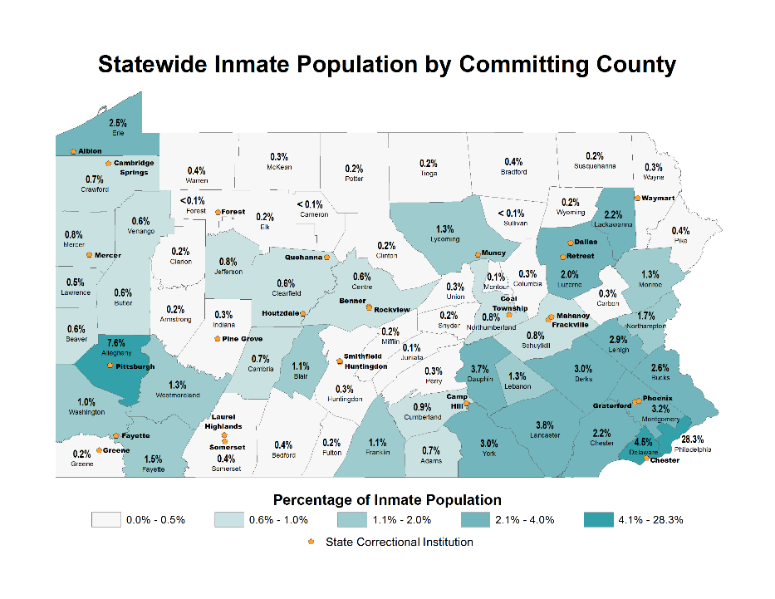
Notes:
A map that used our current inmate population and broke it into percentage of total inmate population by committing county. A map like this doesn’t change frequently. It coincides with population levels and urban/rural areas. For example, the majority of dark green counties are in the southeast part of the state, which is the most heavily populated area of the state.

Slide 15
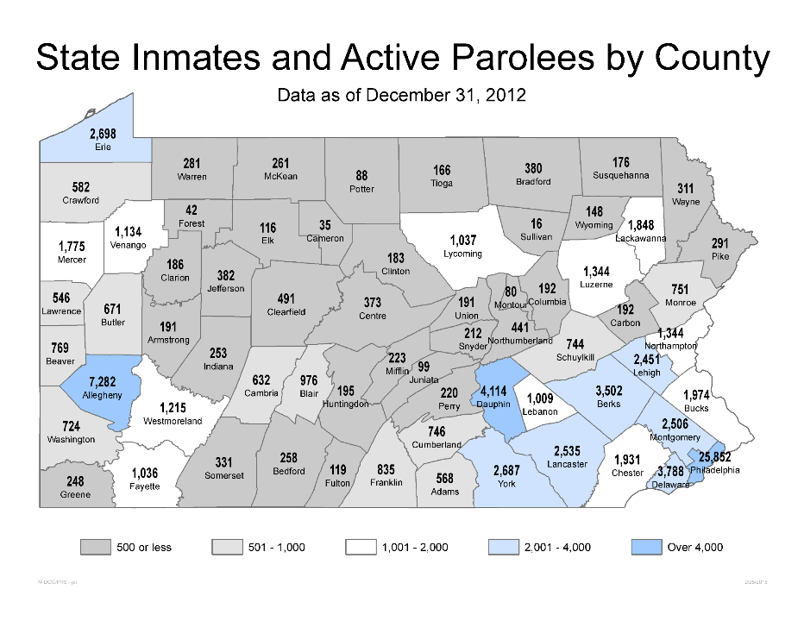
Notes:
Again, a static map based on population at a given time. This map includes parolees in the count.

Slide 16
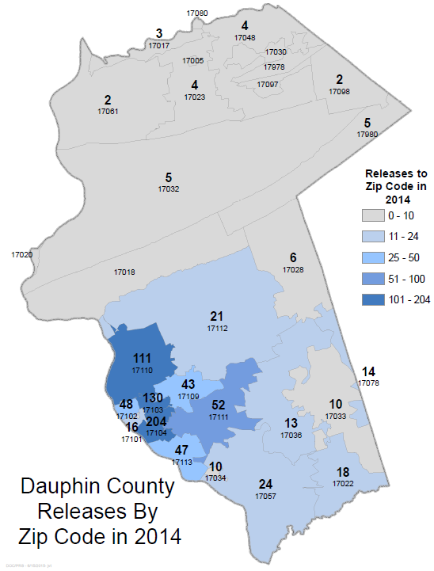
Notes:
An example of a static choropleth map by a specific Pennsylvania county based on zip codes.
This is the number of releases by Dauphin county zip code in 2014.

Slide 17
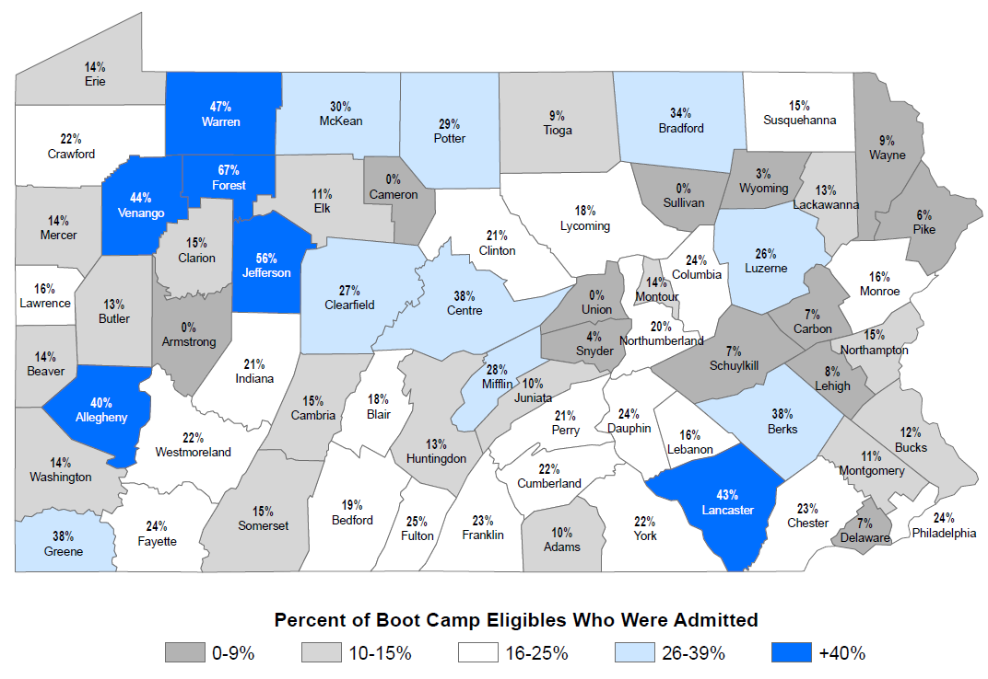
SCI Admissions Eligible for Boot Camp & Actual Admits
Notes:
This is an example of a map that we completed for inclusion in a publically available report of our Boot Camp program. It displays that some counties are much more active in sentencing individuals who are eligible to the Boot camp program.

Slide 18
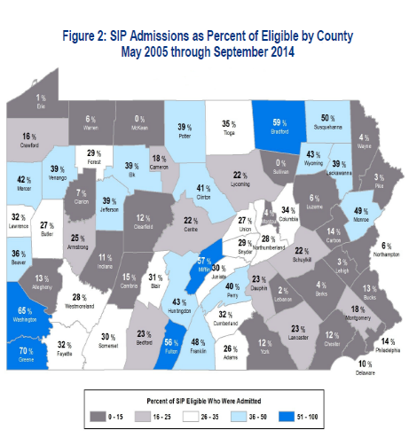
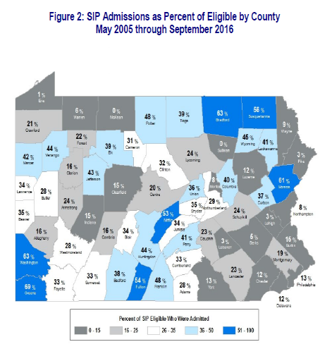
2015 State Intermediate Punishment (SIP) Report
2017 State Intermediate Punishment (SIP) Report
http://www.cor.pa.gov/About%20Us/Statistics/Pages/Reports.aspx
Notes:
This is another example of a map that is in one of our publically available bi-annual reports, this being a report of the State Intermediate Punishment (SIP) program. This is similar to the Boot Camp map in that it shows which counties are more open to alternative sentencing. Both maps include all SIP cases from the inception of the program in May 2005 and end with the prior September of the year of the report. The two maps together allow us to see how some counties have increased their utilization of the SIP program. Clearly some judges are more open to the program than others. Or maybe some judges just aren’t aware of the program. This gives our SIP treatment staff a tool for outreach.

Slide 19
Spatial analysis maps
Notes:
We also use GIS for some basic spatial analysis tasks, but less frequently. These projects tend to take more time and we don’t have staff dedicated solely for GIS work. So these projects are usually undertaken only when we have the time, or when we receive an order from executive staff regarding a specific analysis, which is infrequent.

Slide 20
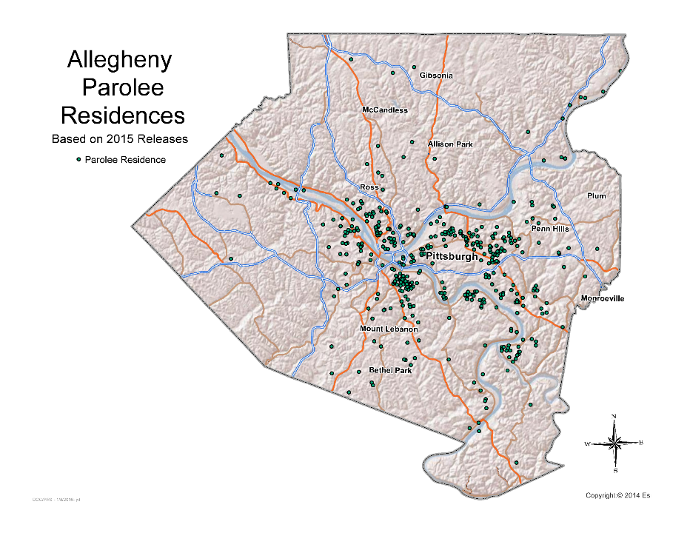
Notes:
In the past we have done some analyses of where parolees are going and where parole violators are coming back from. This is just a point map of parolee residences upon release from an SCI.

Slide 21
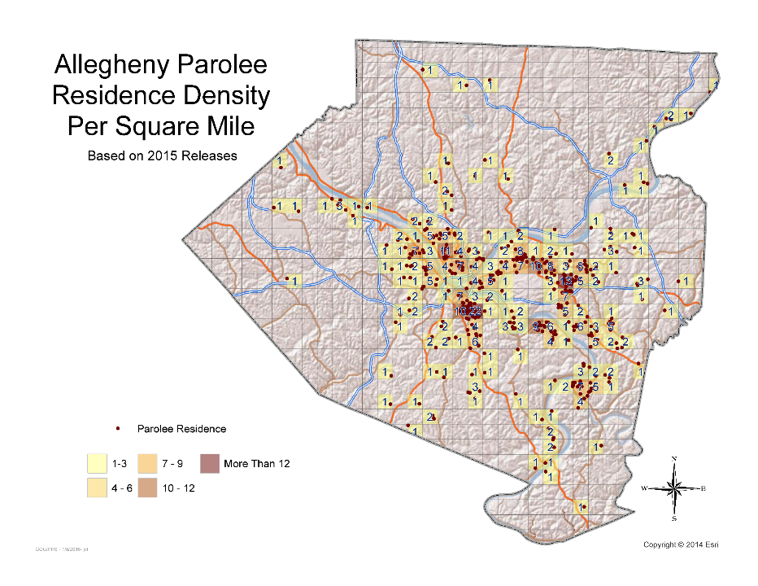
Notes:
This is the prior map but broken down into square mile cells using the fishnet tool in ArcGIS.

Slide 22
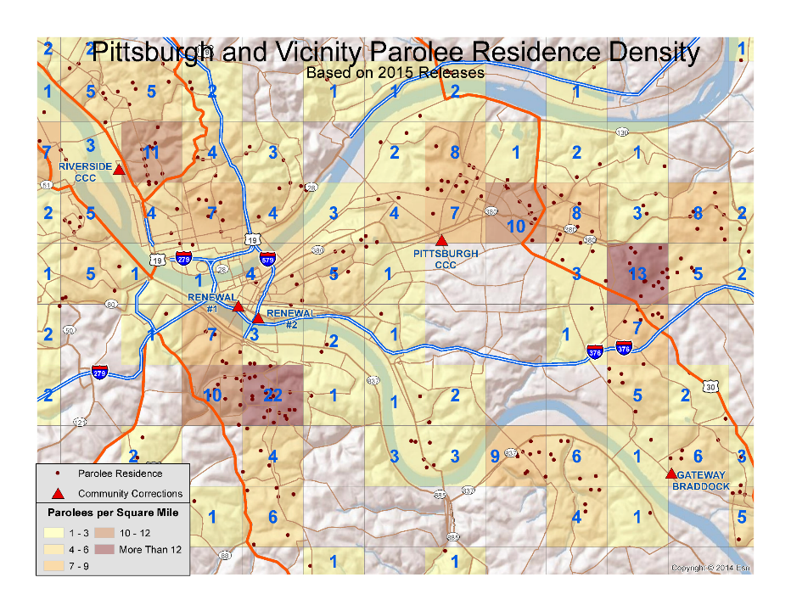
Notes:
This is the same as the previous map, but with a much closer look at the Pittsburgh area. It also adds in the locations of our community corrections centers located in Pittsburgh.

Slide 23
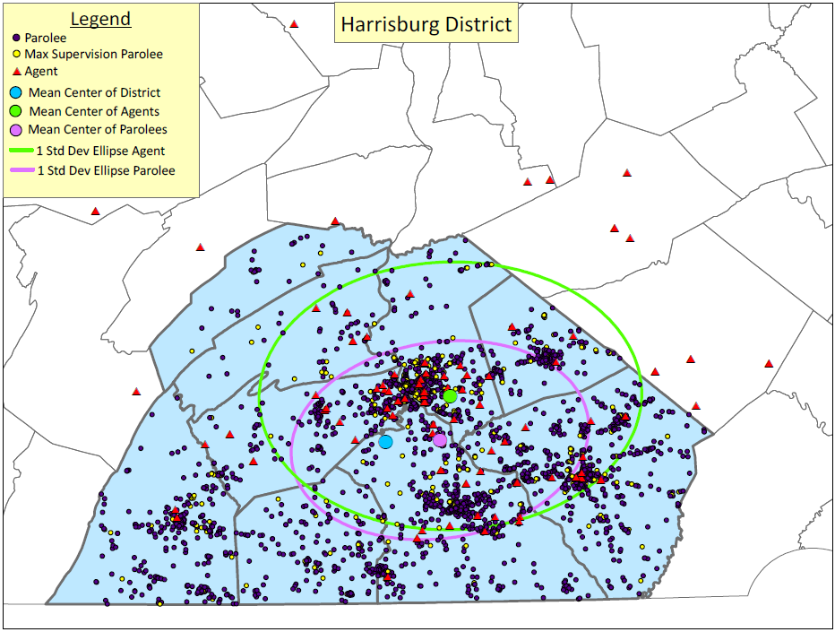

Slide 24
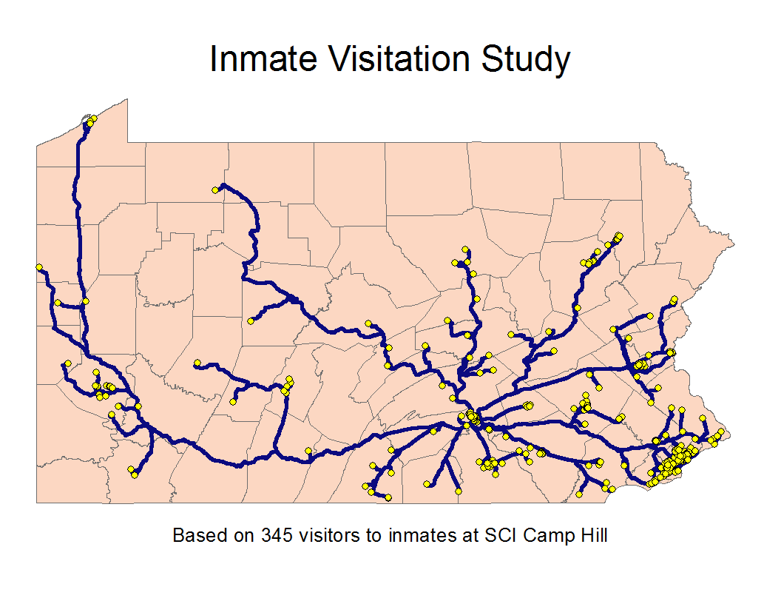
Notes:
We have also used ArcGIS software to assist with a visitation analysis, and if visitation impacts recidivism. Visitors must provide address data, so we were able to use that for drive-time analyses using the ArcGIS Network Analyst extension. We measured visitors by drive distance and drive time. This is showing one of the maps of visitors coming to SCI Camp Hill.

Slide 25
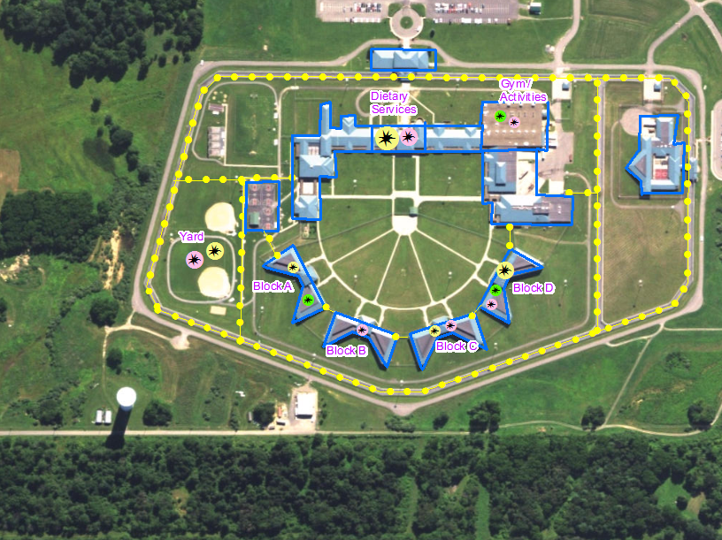
Mapping Misconducts and Fights in SCIs
Notes:
We have also done some georeferencing of our institutions. Doing so has given us the opportunity to display our assault and fighting data as from a spatial perspective. This map isn’t actually one of our institutions, it’s just a similar example of what one of the products looked like. (This is actually Allenwood Federal prison with hand drawn fences and buildings, and made up assault data, in case someone asks)

Slide 26
Online Interactive Maps – www.cor.pa.gov
Notes:
And lastly, we have a few online maps hosted through ArcGIS Online that the public can access. All the maps are available through our public website.

Slide 27
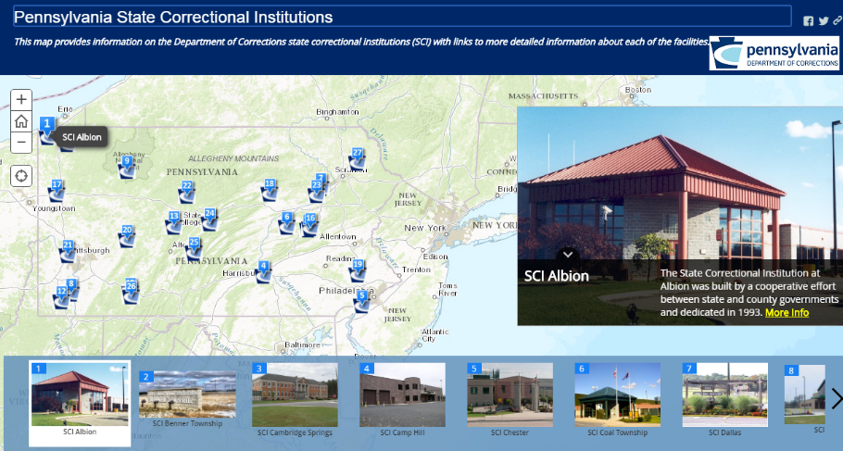
http://arcg.is/1OQngwP
Notes:
This is a story map of our SCIs. It is our most popular map by far, and the first story map we posted. It was built using ESRI Story Map Tour template. It includes a picture of each SCI, usually of the front entrance, and provides a link to each SCIs homepage. On the homepages people can access basic information about each SCI – size, population type, programming available, driving directions, SCI leadership, contact information, etc.
According to the number of views tracked by ArcGIS Online, this map has gotten 445,348 views since it was created on 11/21/14. Which is about 15,900 views per month.

Slide 28
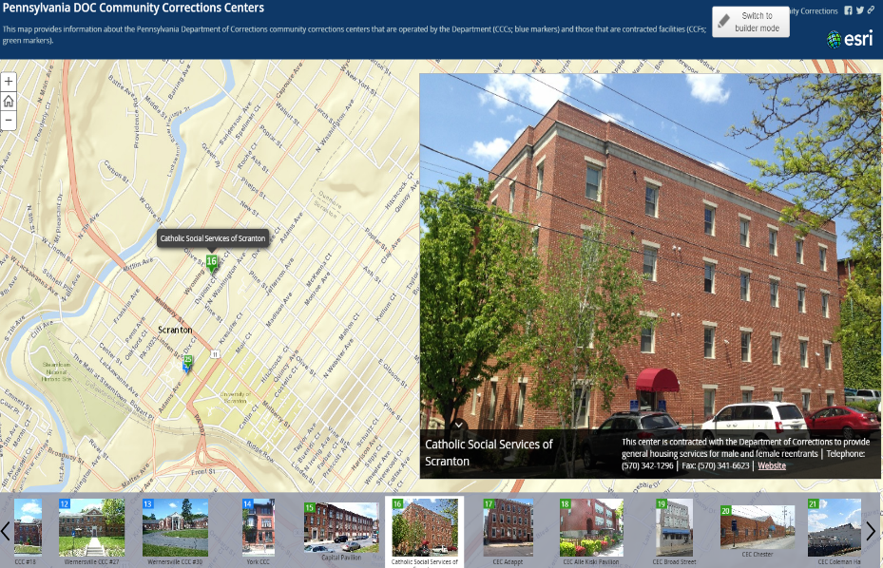
http://arcg.is/1YhNr1L
Notes:
We also have a similar story map of our community corrections centers. These are both state run and contracted sites. There is basic information about the type of center – what services is provides and what gender does it serve – and basic contact information. It also has a link to the website of the contracted agency if available.
This was created just last June, and is more “hidden” in our website, but has gotten 1,450 views since posted.

Slide 29
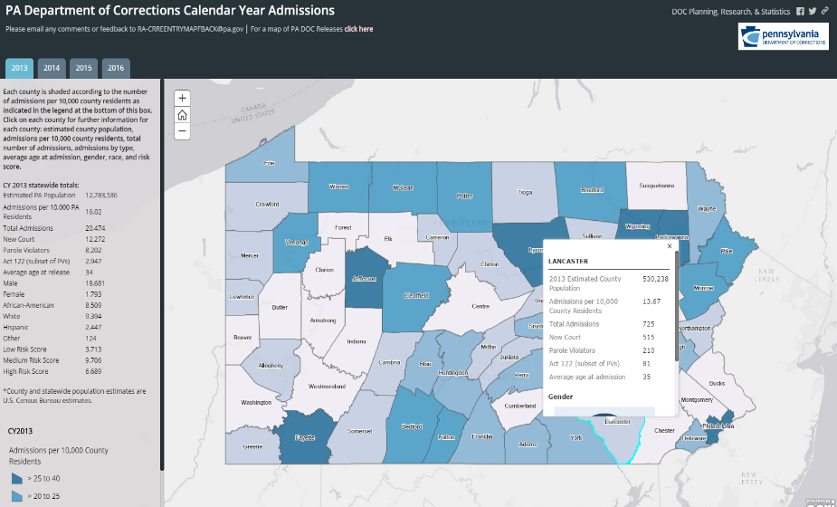
http://arcg.is/2a4J8Sm
Notes:
This was completed using the Story Map Series Tabbed Layout. It provides SCI admission data by county. The counties are shaded based on SCI admissions per 10,000 county residents. The box on the left provides a statewide perspective. And there are also popups when you click on each county that provide the same information but at a county level. We have four years of data tabbed out for these maps.
This map and the releases map were both released last June and July and both average 700-800 views per month.

Slide 30
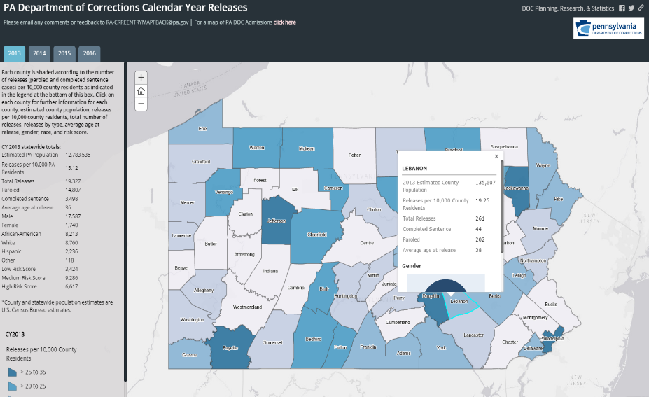
http://arcg.is/1YpMtk7
Notes:
This is the same map as the admissions map, but completed with release data.

Slide 31
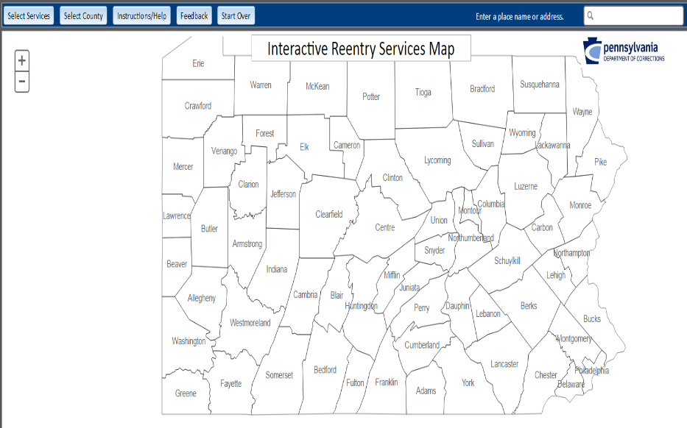
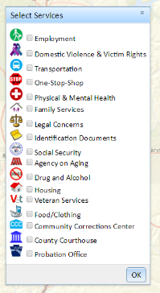
http://reentrymap.cor.pa.gov/
Notes:
And lastly we have an Interactive Reentry Services Map. This map actually isn’t hosted through ArcGIS online and was created through an outside contractor. By clicking on a particular county you’re prompted to select particular reentry services that you’re interested in finding.

Slide 32
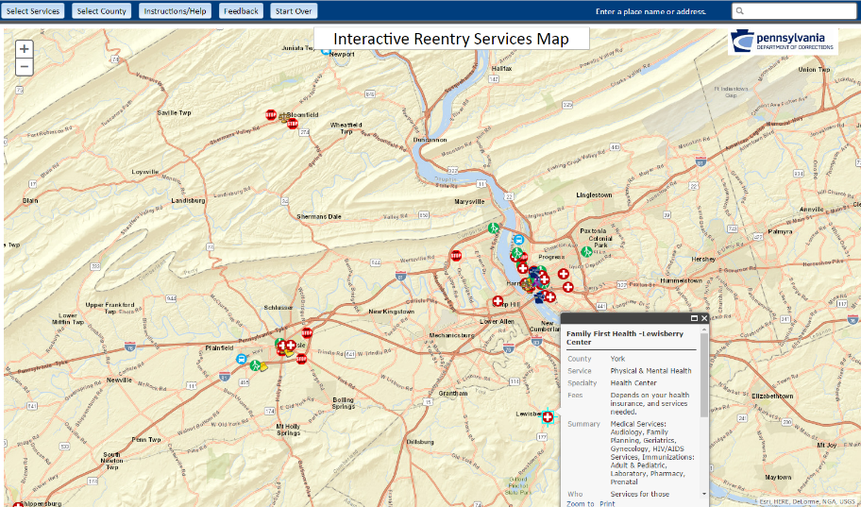
http://reentrymap.cor.pa.gov/
Notes:
Here is an example of the reentry services in Dauphin county. There is a popup for each service with basic information on the business and contact information.

Slide 33
What is Next?
Parole address data and districts
Parole violations and recidivism
Notes:
Future uses
DOC and PBPP consolidation presents new opportunities.
Parole address data instead of DOC data.
Looking for closest address to release for a better idea of where people are actually going and where they lived when they violated.
Improve services available.
Consolidation presented an opportunity to look at more accurate data.
Parole violations and recidivisim

