Slide 1
Enhancing Public Health with GIS and Informatics
2017 Pennsylvania Data User Conference
Penn State Harrisburg
Paul Dioguardo
Bureau of Informatics and Information Technology
Division of Health Informatics
Data Warehouse Team
May 9, 2017

Slide 2
Enhancing Public Health Through GIS and Informatics
Overview
GIS Users
Software
Data
Enterprise Data Warehouse
and Informatics
Services
Maps and Applications
Questions

Slide 3
Overview
GIS is used by various Health Department Bureaus for geocoding, mapping, and spatial analysis of health data, facilities and related issues, in support of these goals:
Promote healthy lifestyles, prevent injury and disease, and to assure the safe delivery of quality health care for all Commonwealth citizens
Successfully reduce the number of serious illnesses, injuries and deaths due to major health threats; tobacco-related diseases; infectious disease; and accidental injuries.
Planning and coordinating health resources throughout the Commonwealth
Licensing and regulating a variety of health facilities
Driving public health policies and program decisions
Improve and streamline government effectiveness
Become a more data-driven organization
Provide useful information to the public
The use of GIS is supported by a group within the Division of Health Informatics

Slide 4
Health GIS Users
Policy Office
Communicable Diseases
District Offices
Family Health
Facility Licensure and Certification
Health Promotion and Risk Reduction
Health Statistics and Registries
Informatics and Information Technology
Epidemiology
Managed Care
Public Health Preparedness
Quality Assurance
Women Infants and Children

Slide 5
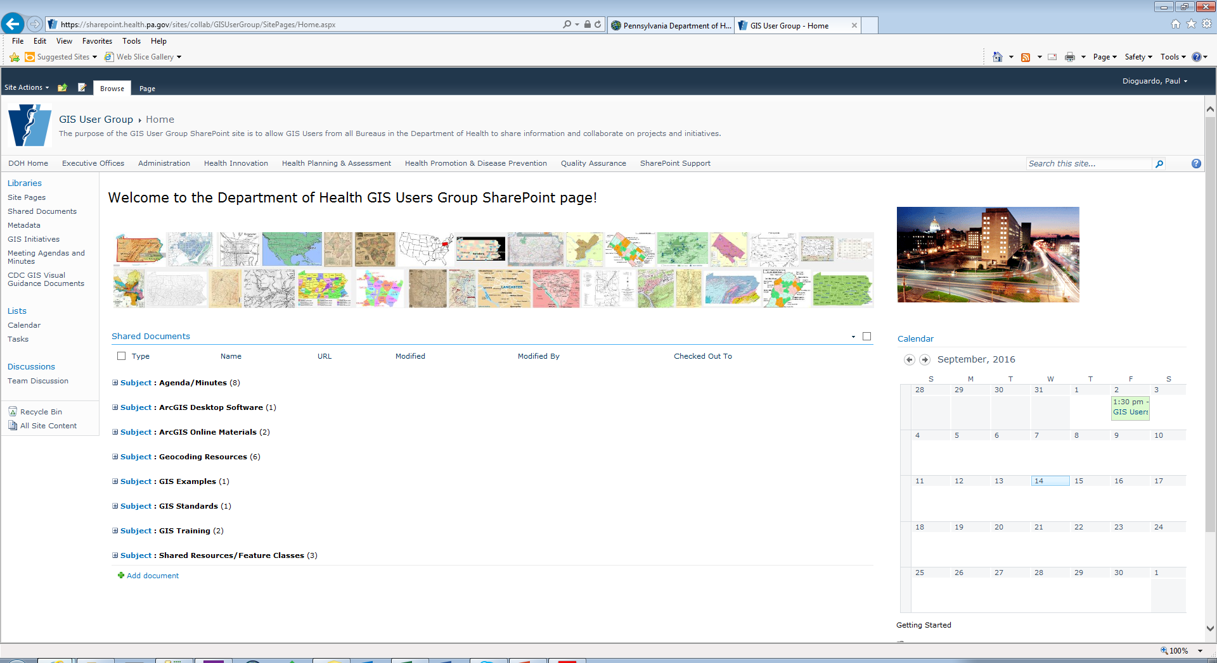
GIS User Group
The purpose of the Pa. Department of Health GIS Users Group is to form collaborative relationships and share expertise relative to automated geocoding, spatial analysis, computer mapping of health data and other geographic information services. DOH staff who attend have interests in epidemiology, public health, statistics, health services, cartography and more.

Slide 6
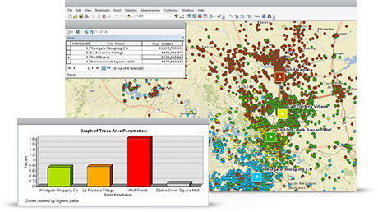
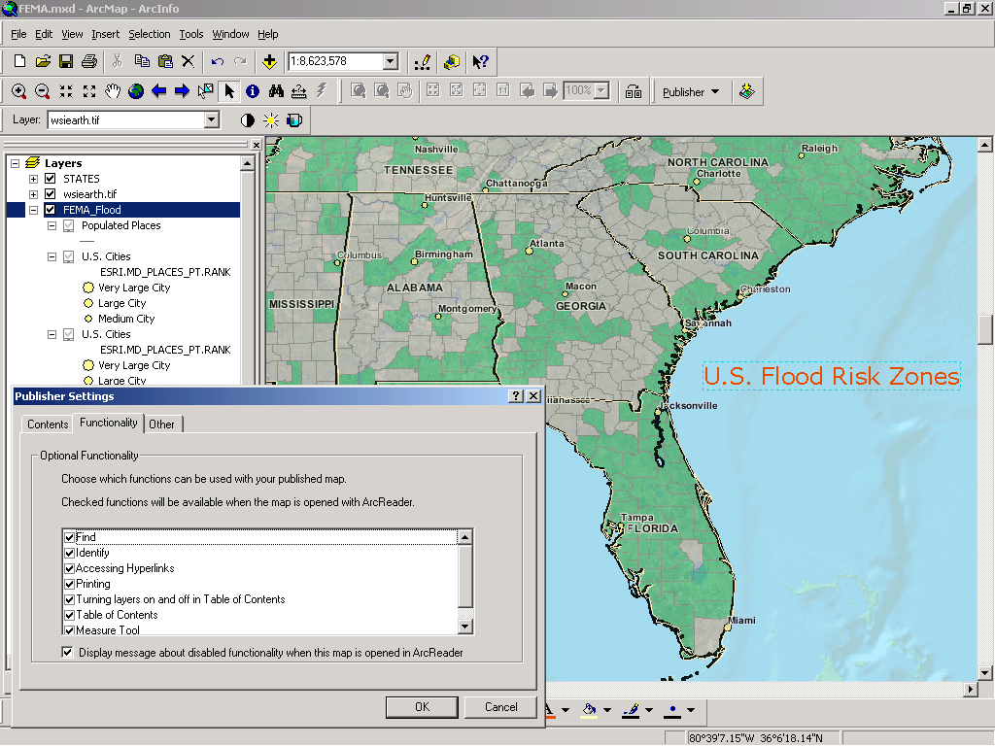
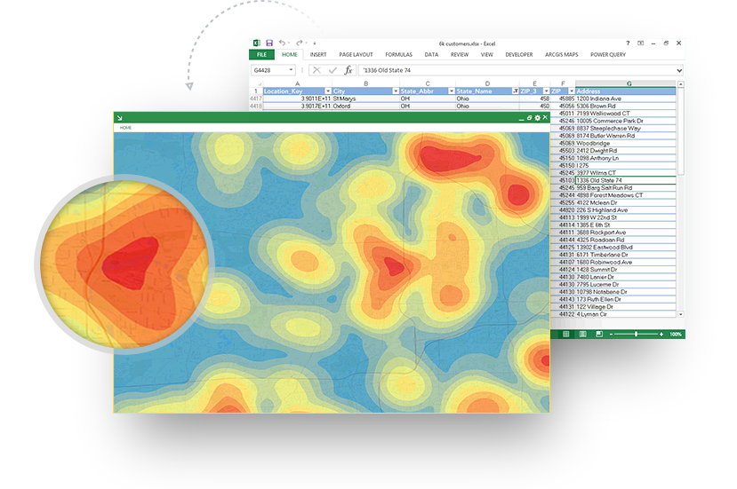
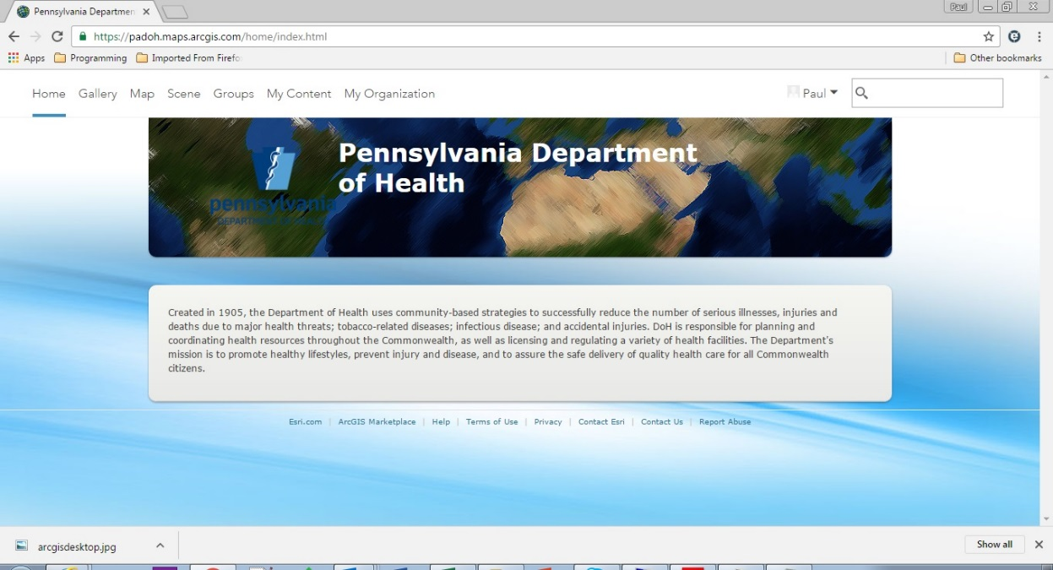
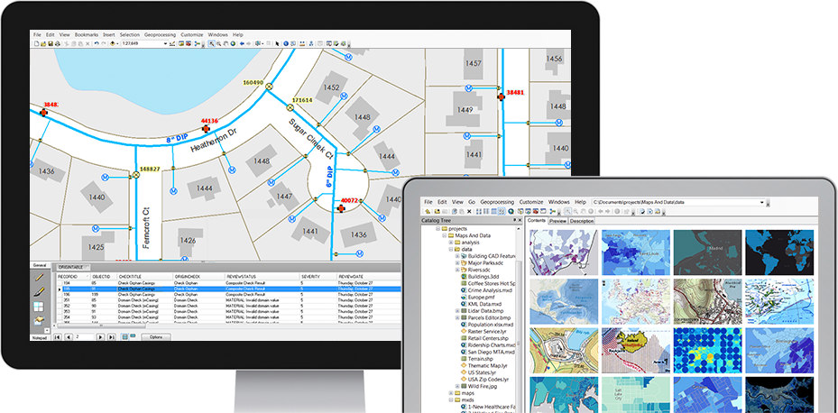
GIS Software
ArcGIS Desktop
ArcGIS Publisher
Maps for Office
ArcGIS Online
ArcGIS Server
https://padoh.maps.arcgis.com

Slide 7
Data
Health and Related Facilities
Registries and Statistics: Births, Deaths, Fetal Deaths, Cancer
Diseases
Hospitalizations
National Electronic Disease Surveillance System (NEDSS)
EpiCenter
Laboratory Information Management System (LIMS)
Women, Infants and Children (WIC)
Enterprise Data Warehouse (EDW)
And more …

Slide 8
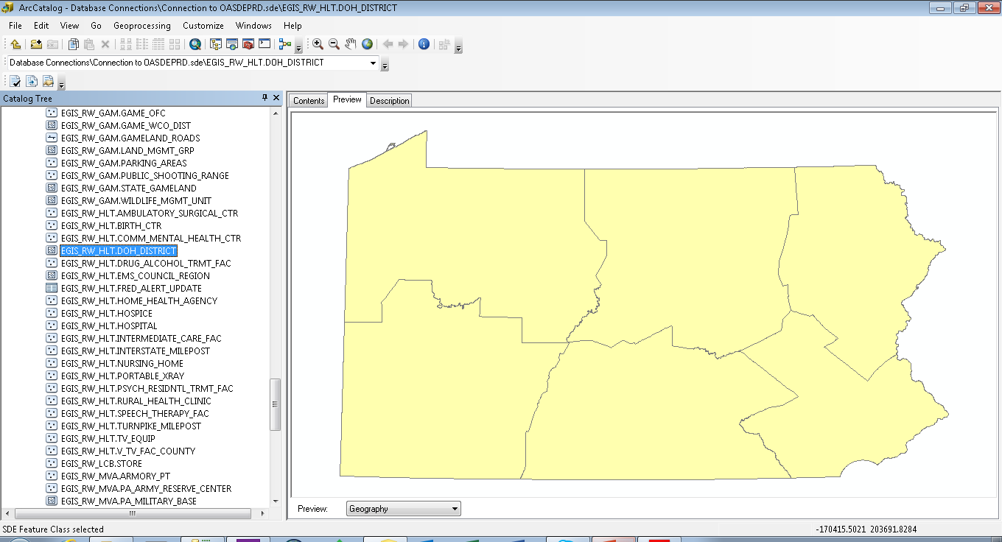
Commonwealth Geodatabase

Slide 9
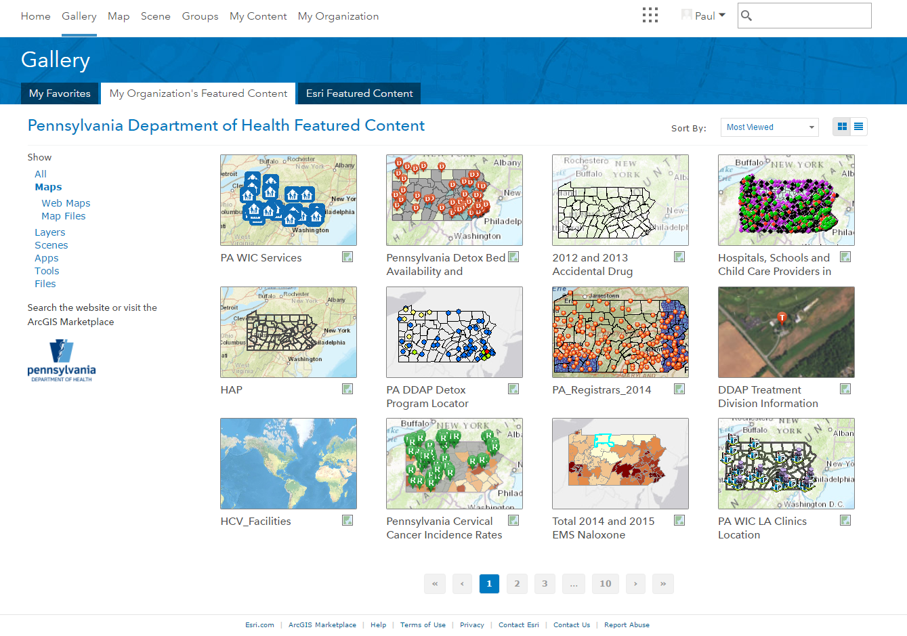
ArcGIS Online Data, Maps and Apps

Slide 10
Data (partial list)
Hospitals
Ambulatory Surgery Centers
Nursing Homes
Birth Centers
Community Mental Health Centers
Hospices
Intermediate Care facilities
Physical Speech Therapy Facilities
Portable Xray
Psychiatric Residential Treatment Facilities
Rural Health Clinics
Health Assessments
Radon Concentrations
Arsenic in Groundwater
Air Quality
Behavioral Risk Factor Surveillance System (BRFSS)
County Health Profiles
Prescription Drug Monitoring
Medical Marijuana
Marcellus Shale Related Complaints
Birth Defects
Births
Cancer Incidence
Carbon Monoxide Poisoning Mortality
Childhood Cancer Incidence
Childhood Lead Poisoning
Children Less Than Age 5 Living in Poverty
Communicable Diseases (Other than STD)
Deaths
Drinking Water Quality
Hospitalizations
Housing by Year Built
Infant Deaths
Poison Control Call Center Data
Population
Reported Pregnancies
Reproductive Health Outcomes
Sexually Transmitted Diseases (STDs)

Slide 11
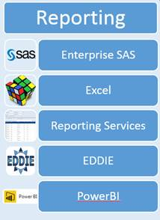
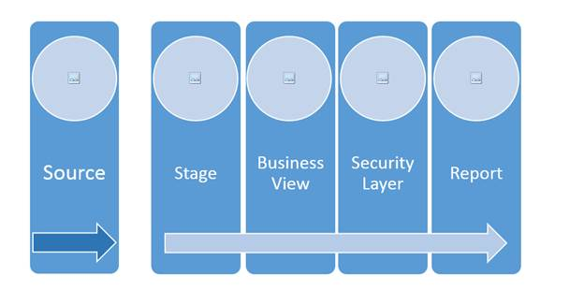
Enterprise Data Warehouse and Informatics Implementation
Government that Works initiative
Department of Health Strategic Plan
Increasing demand for high quality health data and statistics
Enterprise data warehouse system (EDW) project
Enterprise Data Dissemination Informatics Exchange (EDDIE)
EDW, Business Intelligence, Informatics and GIS tools

Slide 12
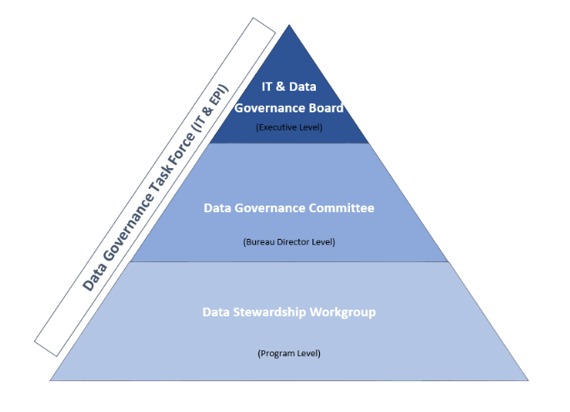
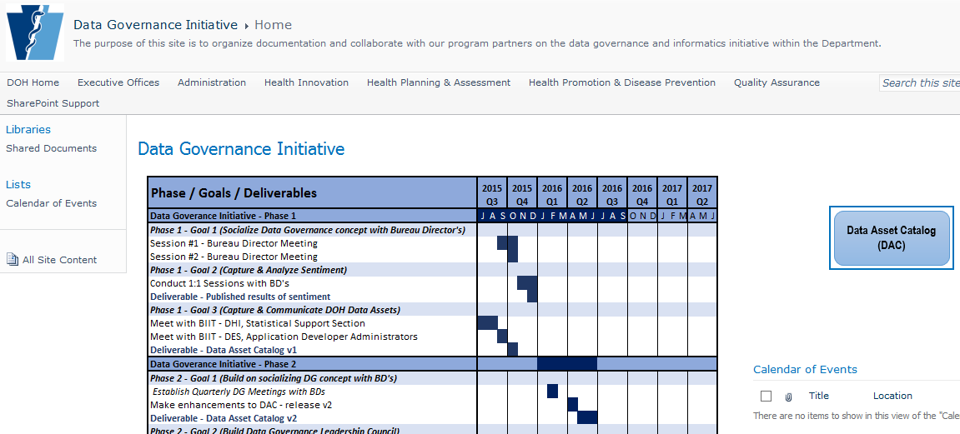
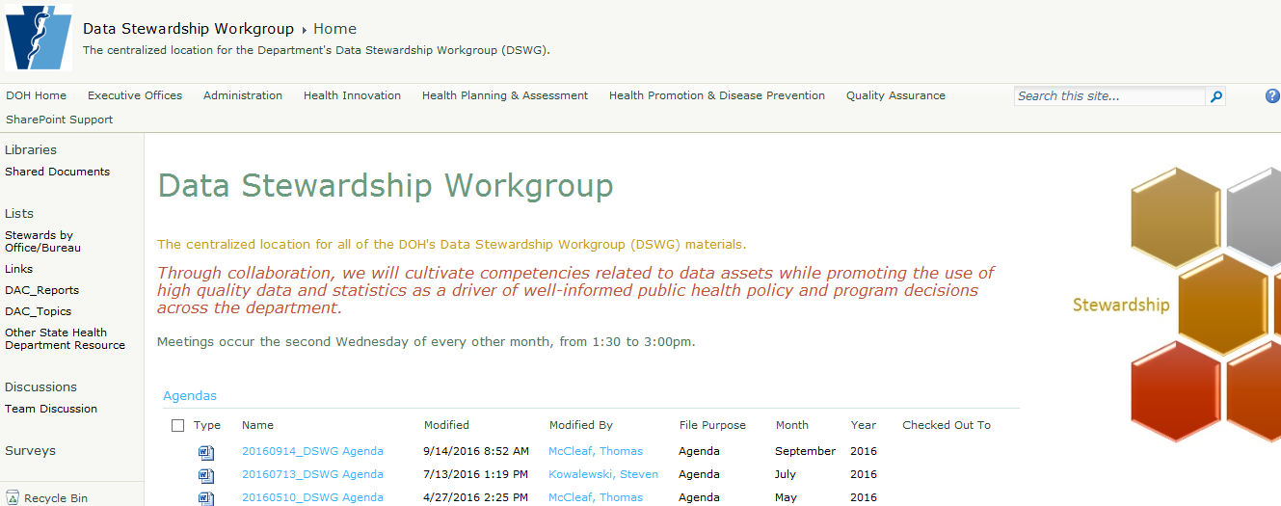
PA DOH Informatics Vision
“A Governed Architecture and Technology aligned with privacy, policy and governance imperatives to enable a single source of trusted information for cross functionality instrumental to PA DOH goals”
Data Governance
Data Stewardship

Slide 13
GIS and Informatics Services
Geocoding (Births, Deaths, Fetal Deaths, Diseases)
Rooftop Geocoding of Health Facilities
Disease and other health issues mapping (choropleth vs point)
Creation of static or printable maps for reports displaying health statistics
Creation of interactive maps that allow the end user to make choices
Assistance provided to other program area staff using GIS software
Examples of interactive maps created for program areas:
Birth and Death Registrars
Hepatitis Patient Services
Confirmed Tuberculosis Cases and Health Centers
Cervical Cancer and Dental Shortage Areas
Hospital, Schools and Child Care Providers
Health Assessments, Radon, Arsenic

Slide 14
Maps and Apps

Slide 15
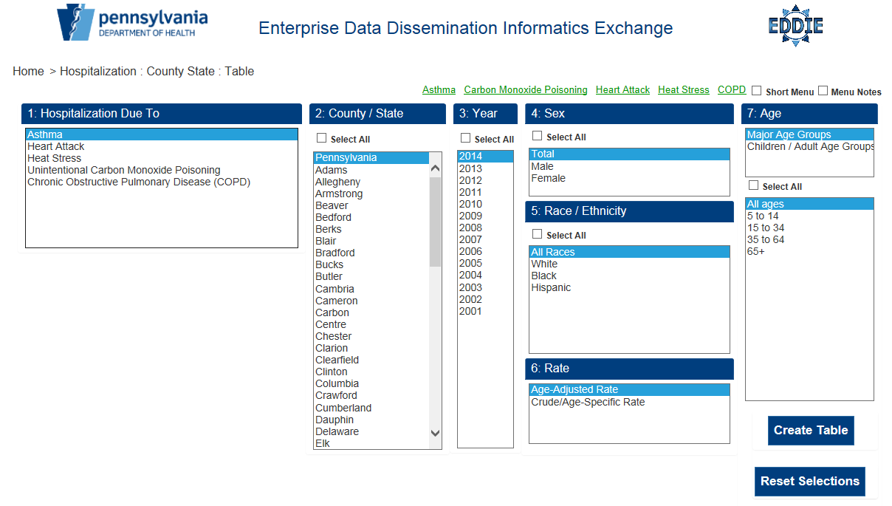
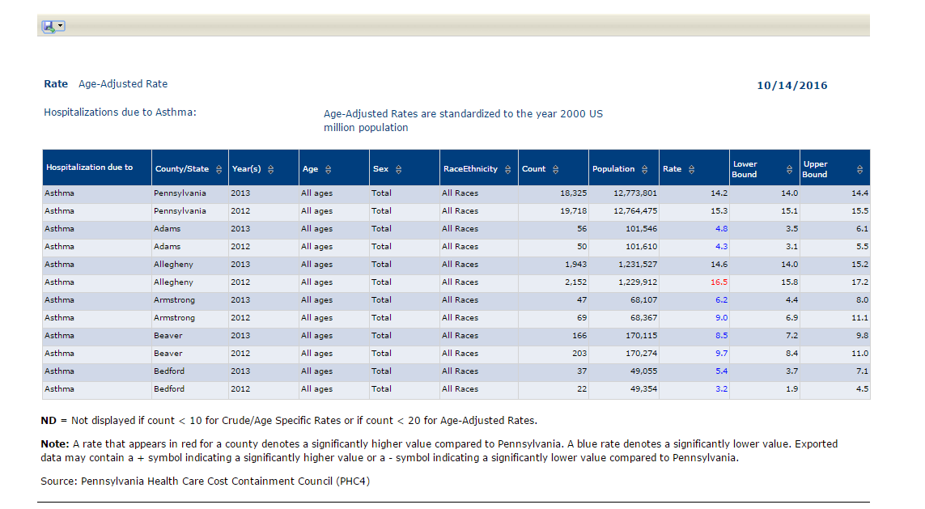
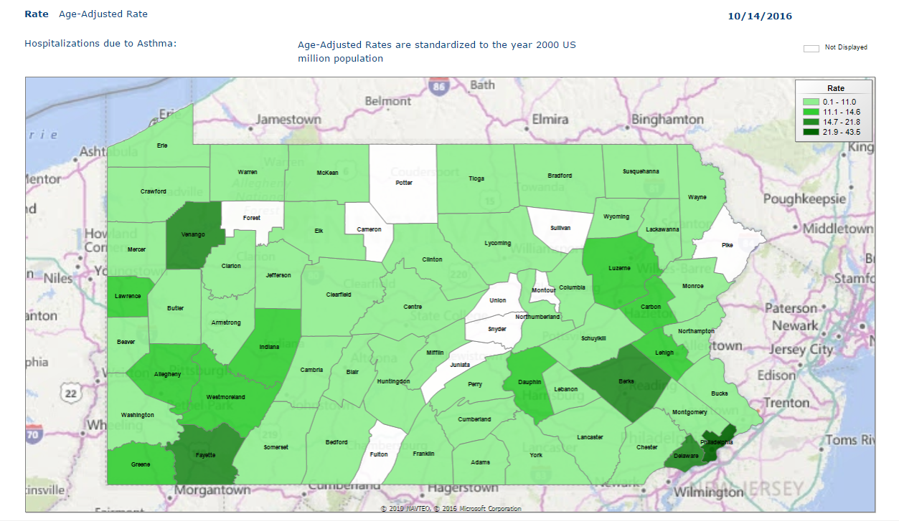
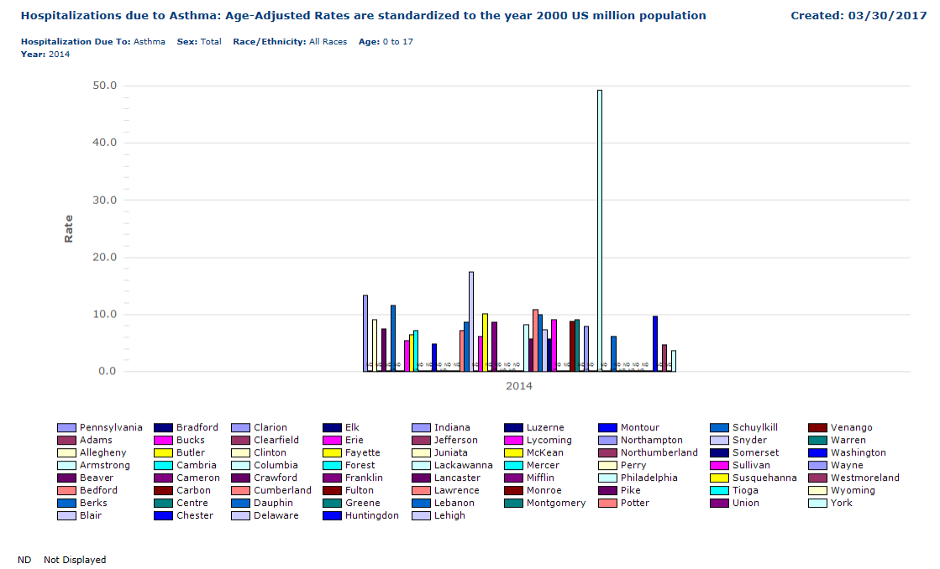

Slide 16
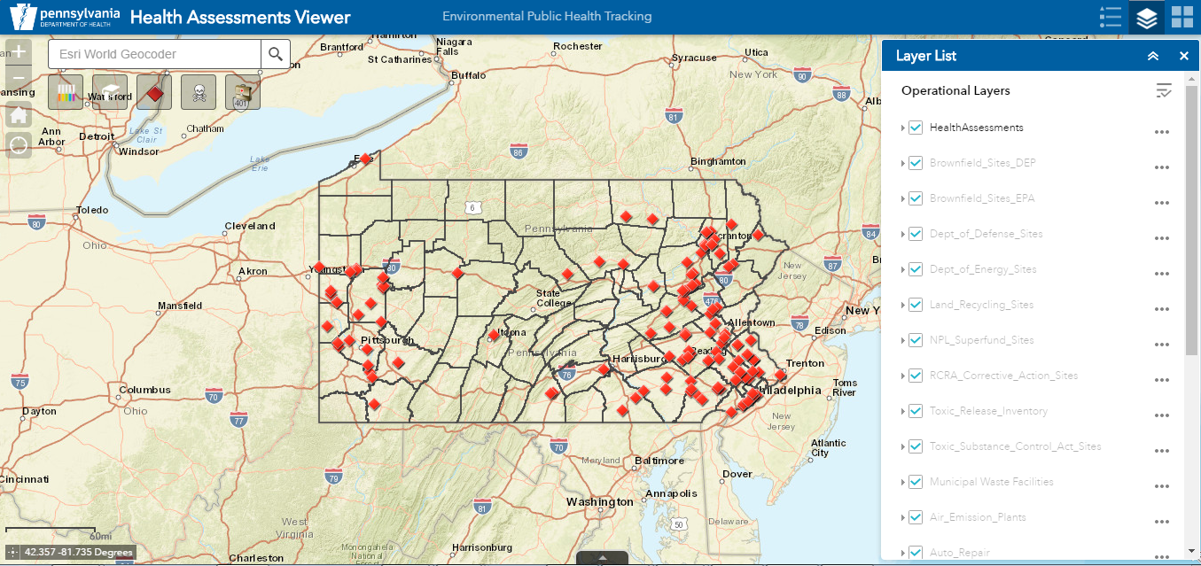
Health Assessments Viewer Application
Health Assessment evaluations determine if the site is a public health risk, if people are being exposed to harmful substances and, if so, to stop or reduce the exposure
The HAP Viewer application displays Health Assessment (HA) locations, along with document links and allows searches on HA sites by site name, chemicals found and by disease risk.
Additional layers depict contaminated areas or potential environmentally hazardous sites and facilities containing harmful substances
Used for easy access to and search of documents and locations, for follow-up investigations to address concerns about toxic hazards and public health consequences of environmental contamination

Slide 17
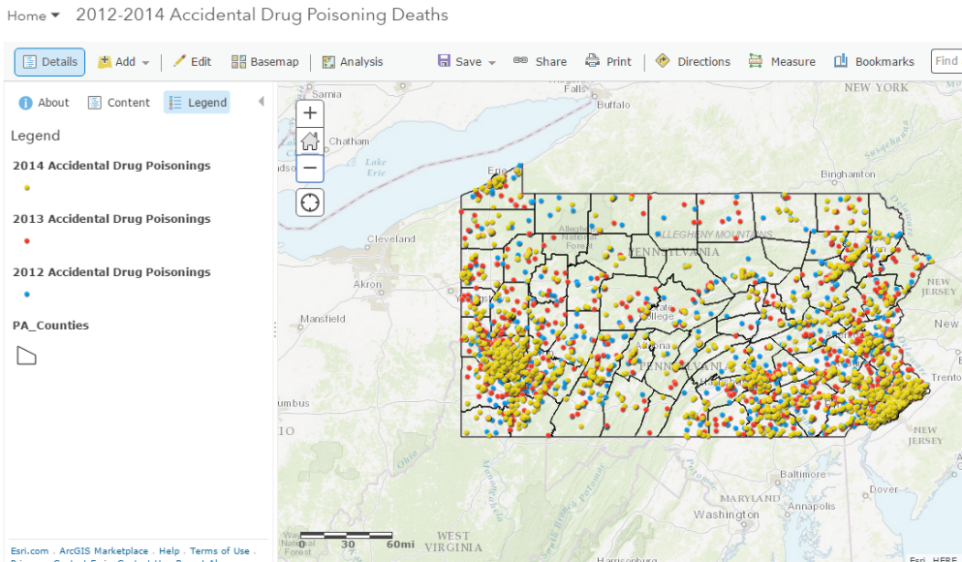
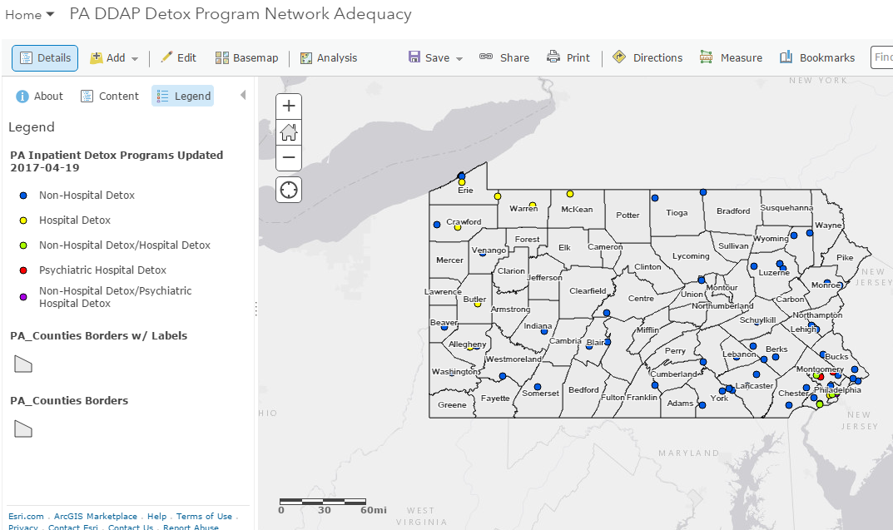
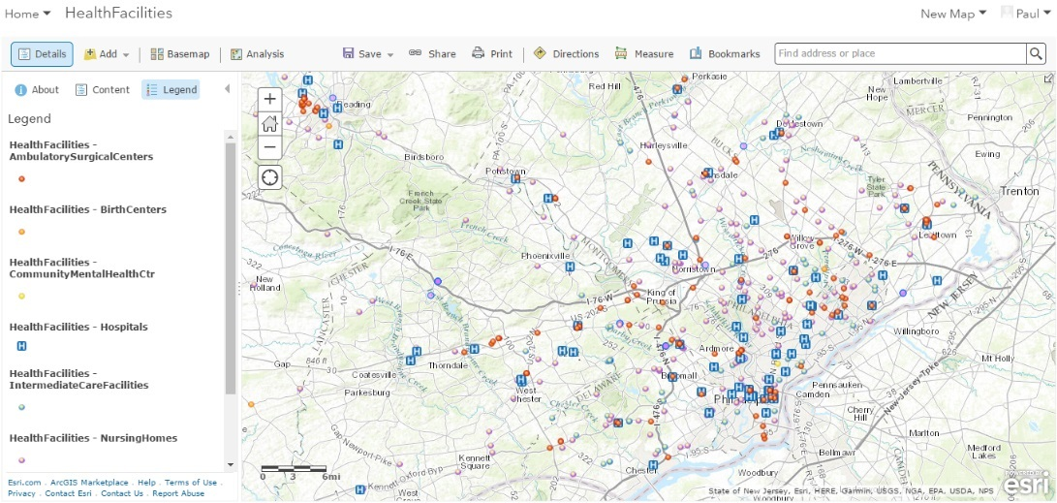
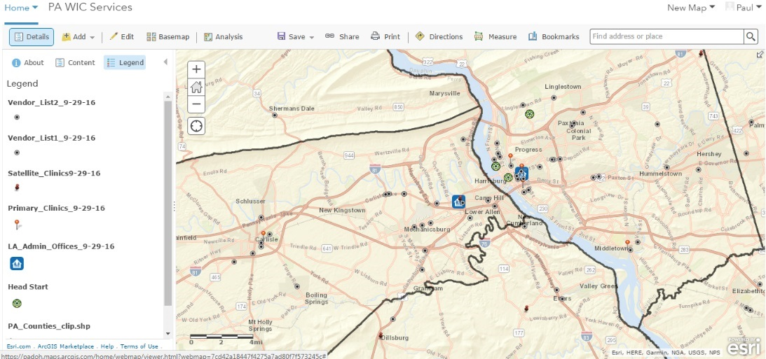
Maps and Apps
Accidental Drug Poisoning Deaths
In-Patient Detox Programs
Health Facilities
WIC Services

Slide 18
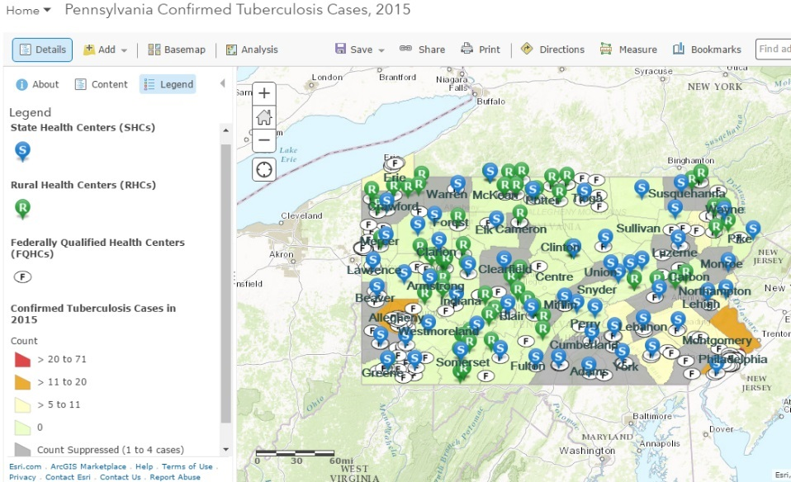
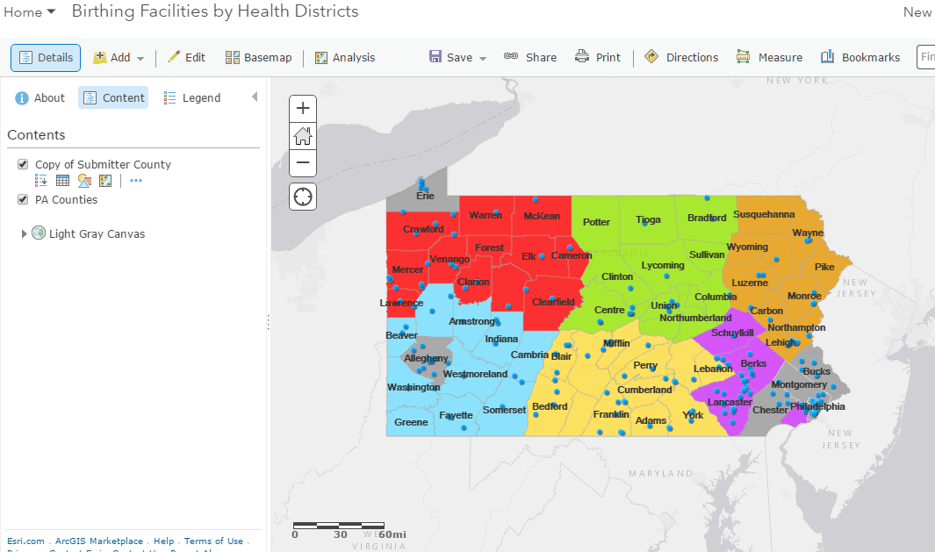
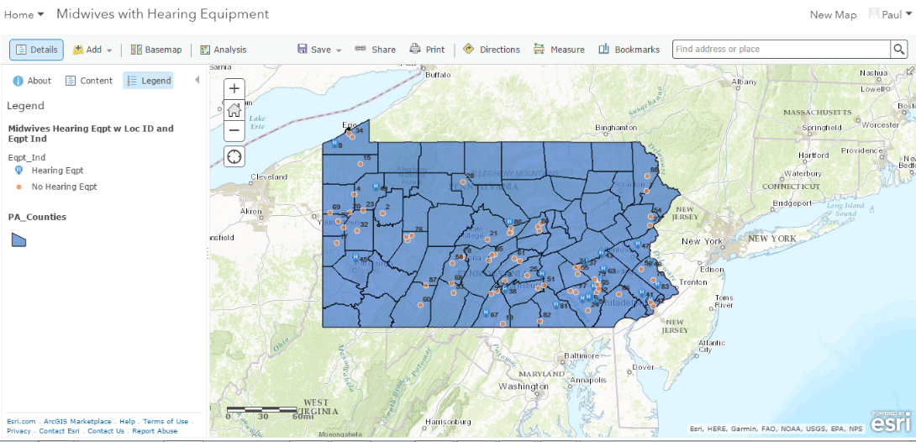
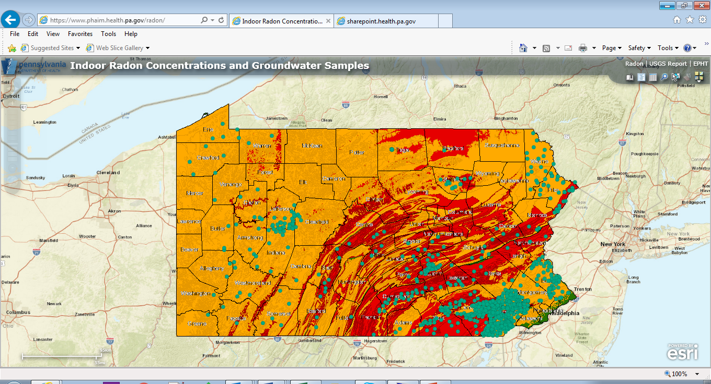
Maps and Apps
Tuberculosis Cases
Birthing Facilities
Midwives with Hearing Equipment
Groundwater and Indoor Radon

Slide 19
Thank You
Paul Dioguardo
PA DOH BIIT
717-836-3516
pdioguardo@pa.gov
Questions

