Slide 1
CEDSCI for State Data Center (SDC) Affiliates
Ally Burleson-Gibson, MS
Center for Enterprise Dissemination and Services and Consumer Innovation (CEDSCI)
U.S. Census Bureau
Notes:
Good morning/afternoon. Thank you for the opportunity to speak to you today about the Center for Enterprise Dissemination Services and Consumer Innovation, or CEDSCI.

Slide 2
In Today’s Session
CEDSCI Background and History of Data Dissemination on Census.gov
Dissemination Platform Preview - Data.census.gov
Upcoming Features
What would you like to see moving forward?
Notes:
In this session, I will provide an overview of the CEDSCI program, and look back at Data Dissemination on Census.gov
We will talk a little bit about the Data.census.gov platform, including upcoming features to be incorporated in the platform.
And, last, you’ll have an opportunity to be interactive as we talk about the things that you could like to see included in the data platform moving forward.
Let’s get started!

Slide 3
Data Dissemination Journey
Optimize:
Continue to enhance based on feedback
2015 CEDSCI Platform was Initiated
Data Dissemination Task Force Initiated
Personalize:
Deliver personalized experiences
Improve:
Leverage existing investments
Make data driven decisions to continuously improve
Level of Maturity
Strategize:
Map your journey
Digitize:
Provide content online
Build online relationships through tailored experiences that drive repeat visits
Identify and use existing data dissemination investments and resources
Create the roadmap to the future state of dissemination
Provide content via Census.gov
CEDSCI Established
Notes:
The Census Bureau has a long history of both collecting and disseminating data for the nation. This slide will provide a bit of background on our Data Dissemination Journey over just a couple of decades…starting back in 1994 when we launched Census.gov. Providing content online really changed the way the Bureau looked at it’s data and how our customers were accessing and using it. Today – we’ll be focusing on digital data dissemination and how we disseminate data on census.gov.
So almost 20 years after launching census.gov, in 2013, the Census Bureau began to look closely at our bureau-wide approach to data dissemination. At that time, the Data Dissemination Task Force found that there were a disparate set of data dissemination tools (about 40-50 of them), and a variety of programs across the bureau disseminating data in different ways.
From there we started to strategize and to determine what was working well and what could be improved upon.
Naturally, we want to keep things that really help data users access the information in the ways they want and need to use the data, but we also want to work toward making data more easily accessible overall.
So, in an attempt to create a streamlined approach and platform, the Center for Enterprise Dissemination Services and Consumer Innovation (or CEDSCI) was created, and development of the new data dissemination platform began in 2015.
And, as you can see, as we are moving forward, we will continue to leverage existing resources – keeping aspects of the tools that currently work well and that help to provide you with the data you need in the ways that you want it.
We are also working toward an integrated search and census.gov experience, that will allow for personalized experiences for all data users.
And, last, we will continue to build on customer feedback as we develop both the new data dissemination platform, and as we continue to optimize Census.gov.

Slide 4
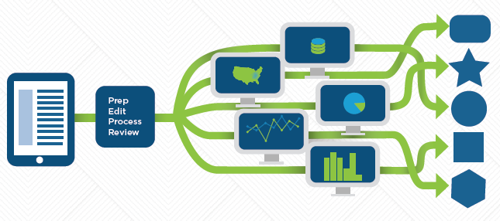
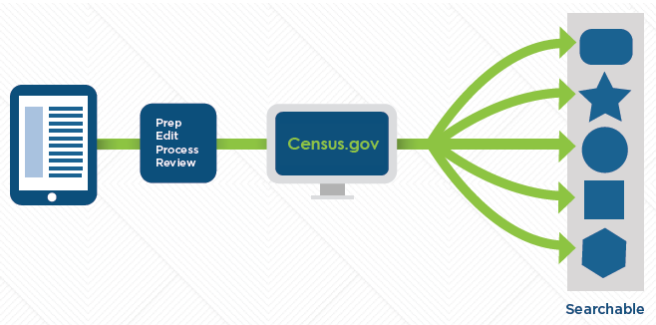
Center for Enterprise Dissemination Services and Customer Innovation (CEDSCI)
BEFORE
Role of the program:
Centralize and standardize metadata, data, and software
Create a customer-oriented platform for easy access to Census Bureau data
Move dissemination from duplicative tools to streamlined, efficient platform
AFTER
Notes:
What is CEDSCI?
CEDSCI is the Center for Enterprise Dissemination Services and Customer Innovation and is the program responsible for creating the new data dissemination platform that will ultimately be known simply as Census.gov.
The CEDSCI program is working to:
Develop a single, integrated data dissemination platform on Census.gov, where users get all data, reports, and web content
Increase visibility and usability of Census Bureau data to improve the customer experience
Enable more efficient and standard dissemination operations within the Census Bureau
Why? Several data dissemination tools use their own databases, infrastructure, and software, which causes internal duplication and degrades the customer experience.
Of course, with many different offices and programs, it’s not only up to CEDSCI staff to create the platform. We also are also collaborating with programs from around the Bureau to make sure we’re moving from our “before” situation of many disparate data tools to our “after” where we have one seamless approach to access our content.

Slide 5
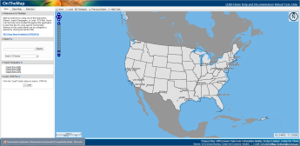
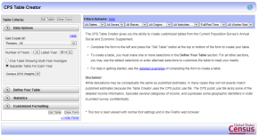
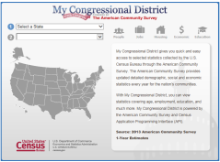
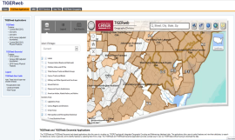
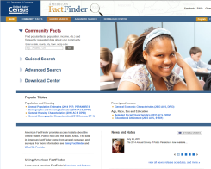
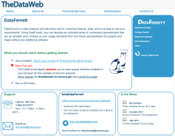
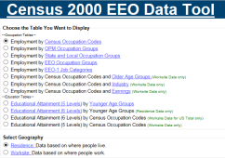
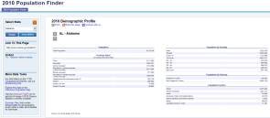
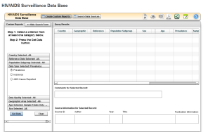
From Many Dissemination Systems
Notes:
Here, and in the next slide, you can get a quick visual of what we’re moving from, and where we’re headed.
Basically, we are moving from many systems, including:
- More than 40 data tools currently on Census.gov
- Over 100 applications prepare and release data
- Lack of standardization and consistency across dissemination processes
- Complexity for users to find data and create insights…

Slide 6
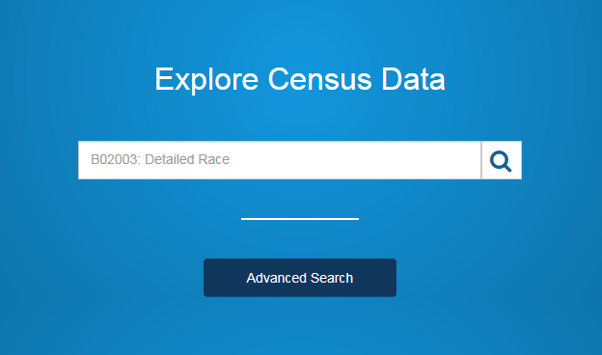
To One Dissemination Platform
** Preview available at data.census.gov**
Notes:
To one standardize search capability for accessing all of our data….
This slides shows you the current iteration of the single search bar on data.census.gov.
As you can see, we are moving from many disparate tools and access points for our data, to once simple search functionality.
The Agile approach used for the development of Data.census.gov means that you will continue to see releases in iterative stages over the next several months.
As we continue to develop platform capabilities and incorporate further data sets, we will continue releasing new iterations of the tool and will continue to depend upon user feedback – like yours – to let us know how things are working!

Slide 7
What Does this Mean for Users?
Google-like search for both data and Census.gov content
A clean, componentized interface
No need to find the right tool before searching for data
Easy access to data with graphic presentations
Advanced searches by topics, table ID, etc.
Notes:
As we are changing the search platform through which all data and content will flow, we will obviously be working on the back-end to ensure that the infrastructure is in place to support such an endeavor.
But, what does this mean for data users?
First, it means a simple, Google-like search bar for plain language and intuitive searching. This single search bar will link users to both data and Census.gov directly, without need to navigate to various tools before finding the desired data.
It means a clean, componentized search functionality, drawing from metadata rather than being hard-coded. This provides flexibility so the platform will respond to user searches directly, and without impact other aspects of the site since results will come directly from metadata.
It also means easy access to data in different formats, including tables, mapping services, visualizations, and the data API.
And, don’t worry, if you’re only interested in specific topics or detailed tables, we will provide an advanced search function so that you’re able to get to the data you want directly.
Next, let’s take a look at some of the features that you may see in the next releases.

Slide 8
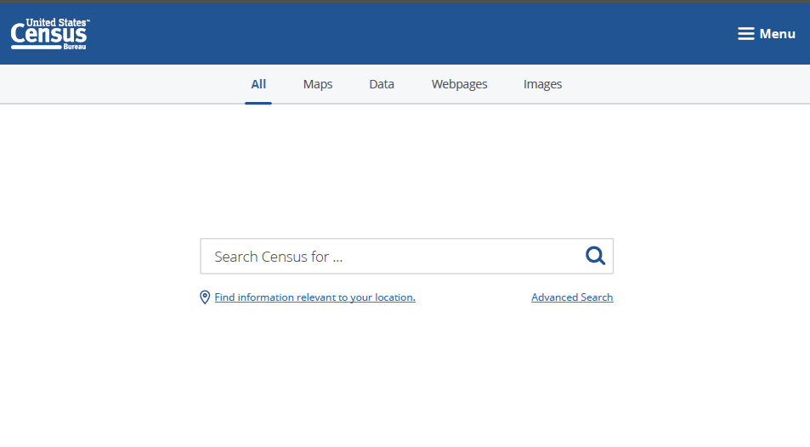
Upcoming Features: Single Search
Notes:
Here you see the single search, with navigation topics across the top, including:
All (to provide a quick view of tables, maps, websites, and images)
Maps
Data
Webpages
Images
You also see a couple of links below the search bar.
On the left you see an option to “Find information relevant to your location.”
And, on the right is the link for Advance Search.

Slide 9
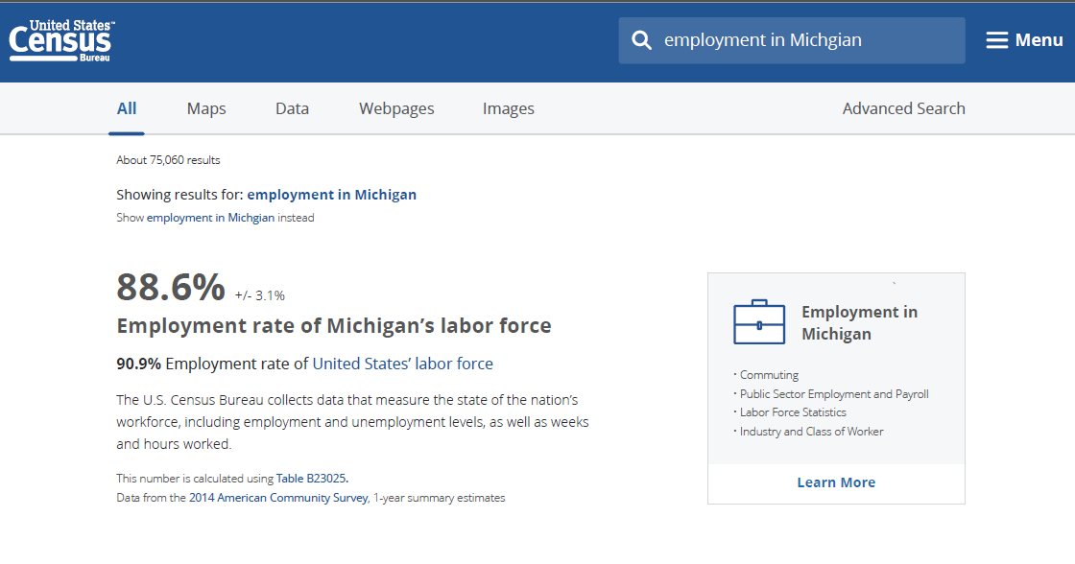
Upcoming Features: All Search Results

Slide 10
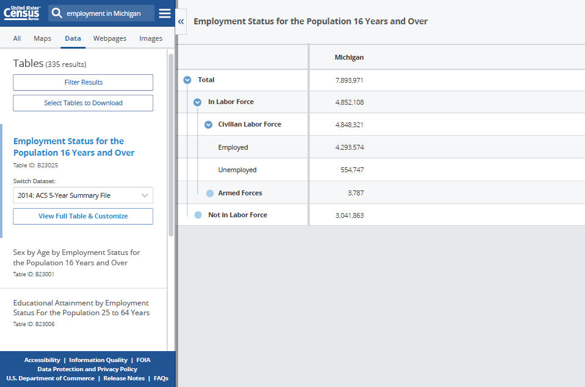
Upcoming Features: Table Results

Slide 11
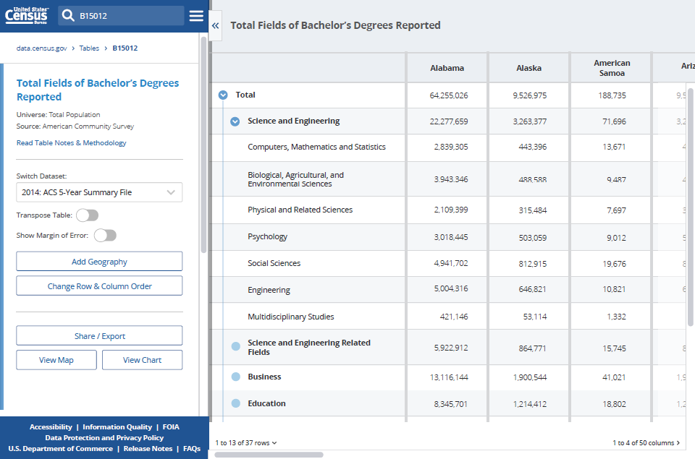
Upcoming Features: Full Table View

Slide 12
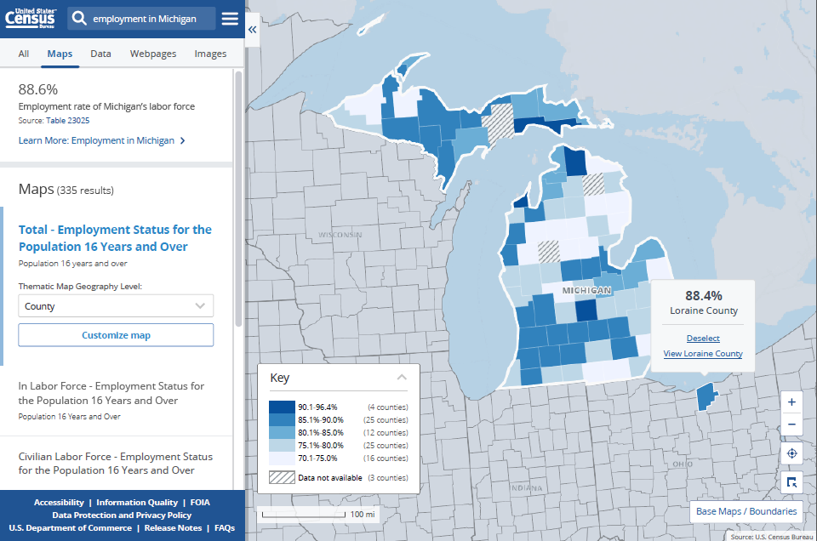
Upcoming Features: Thematic Map

Slide 13
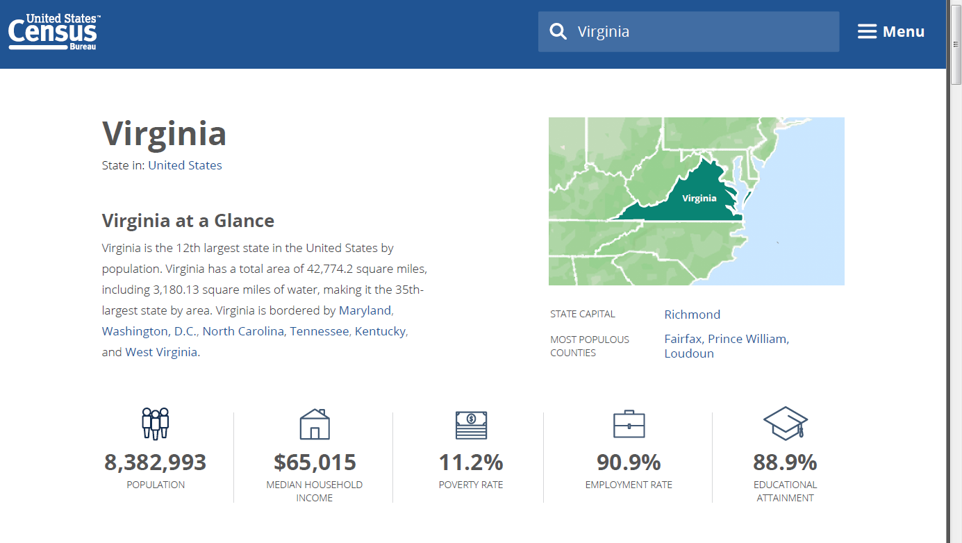
Upcoming Features: Geo Desktop

Slide 14
What would you like to see in the platform?
For the next few minutes, consider what you have seen in the slides for potential upcoming features.
What did you like?
What didn’t you like?
Is there anything missing?
Are there features you want to be sure we add?

Slide 15
What would you like to see in the platform?
Then, please tell us what you’d like to see, related to:
File formats – for download, presentation, etc.
Data sets – are there datasets we should be sure to include?
Data aggregation – is this something you’re interested in? By geographic region or by other methods?
Other – what else would you like to see? Dynamic maps, visualizations, tabulation capabilities, etc.? We need your ideas!
Notes:
Now I’m going to give you an opportunity to let us know what you would like to see in the Census Bureau’s new data platform. There are a few specific things we’d like you to tell us about. Please use the post-its on your tables to note your thoughts, and then place them on the corresponding easel papers on the wall.
Are there particular file formats that are particularly useful to you? Right now we offer a lot of our data in Excel, CSV, and PDF formats. What else would you like to see? And, how are you using the data – for download, for presentation, for analysis??
Which data sets do you use most? Which do you want to be sure we include in the platform moving forward? Are there datasets on census.gov that you use that are not available in American FactFinder (if you use that?)? Are there related data sets that you frequently used paired with Census Bureau data, for example from BLS, or other agencies?
Is data aggregation important to you? If so, how would you like to be able to aggregate data? By geography – for example, for planning commissions or area agencies on aging? Or, would you like to aggregate data by groups – for example, looking at different characteristics by different race or ethnic groups? Are there other ways you might use data aggregation?
Are there other functionalities, datasets, or capabilities you would like to see? Are you creating visualizations? Are you using your data in SAS, SPSS or other statistical package software? If there are other things that could make the data or the platform more useful to you, now is your change to let us know!

Slide 16
Remember, the Future of Census Bureau Data Dissemination Depends on You!
BEFORE
Visit data.census.gov and provide your feedback!
Don’t forget:
This is an early preview; phased releases will continue as we test, develop, and incorporate feedback.
For official Census Bureau data, continue to use the tools available on Census.gov.
AFTER
Notes:
Since we debuted the preview of data.census.gov in September 2016, we have received some feedback, but now we are really ready to ramp up the volume of feedback we’re getting.
We encourage you to visit the site and check out some of the current capabilities, but knowing that we will continue to evolve the platform incrementally. Then, be sure to offer your feedback, so we can learn from you about what might work best for getting our data out to the public in a more user-friendly, intuitive way!
Thank you in advance for checking it out and letting us know what you think!

Slide 17
Questions or Feedback? Please contact me!
Ally Burleson-Gibson
External Communications, CEDSCI,
U.S. Census Bureau
allyson.r.burleson.gibson@census.gov
301-763-6306
Notes:
We will continue to update the Data.census.gov site throughout the year and we will be offering webinars as we continue to release new functionalities on the platform.
If you have questions or feedback as we’re continuing the development, please feel free to contact me.
Thank you!

