Slide 1
Community Impacts of Marcellus Shale Development:
A Research Update
Kathy Brasier, PhD
Dept. of Ag Econ & Rural Sociology
Penn State University
Pennsylvania State Data Center
User Conference
September 15, 2010
Grantville, PA

Slide 2
Objectives
Describe natural gas within national energy context
Provide background on Marcellus Shale
Describe results of on-going research and outreach
Future work / data needs

Slide 3
1. Introductions
We’re going to be together a while, so tell me:
  Name
  Home county
  Your top 2 data or information needs related to Marcellus

Slide 4
2. Energy Sources and Use
Setting the Context for Marcellus

Slide 5
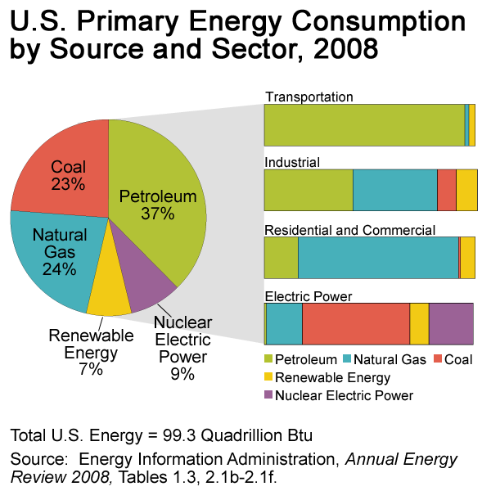
Energy Sources and Use in the US
Natural gas provides about ¼ of energy sources
Primarily used for residential, industrial sectors
Source: Energy Information Administration

Slide 6
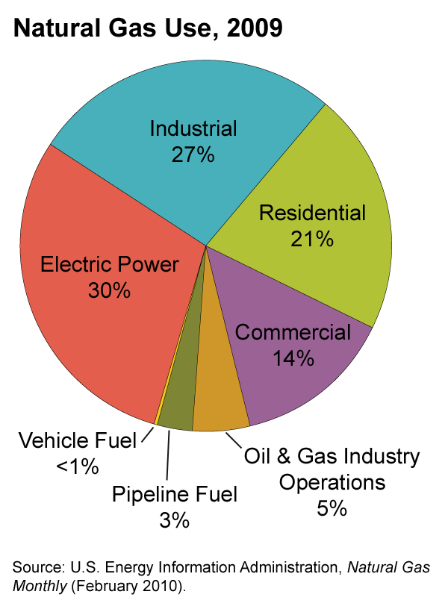
Natural Gas
Natural gas is used to produce steel, glass, paper, clothing, brick, and electricity.
It is raw material for products such as paints, fertilizer, plastics, antifreeze, dyes, photographic film, medicines, and explosives.
Slightly more than half of the homes in the United States use natural gas as their main heating fuel.
Natural gas is also used in homes to fuel stoves, water heaters, clothes dryers, and other household appliances.
Source: Energy Information Administration

Slide 7
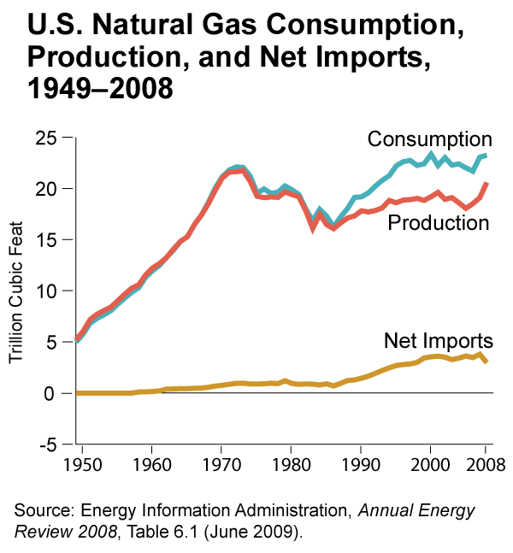
Most natural gas consumed in US is produced in US
Largest source of foreign natural gas is piped in from Canada (11.5% of consumption)
Largest foreign source of LNG is Trinidad and Tobago (1.5% of consumption)
Source: Energy Information Administration
Notes:
In comparison, 57% of petroleum comes from foreign sources. Of this, 45% comes from the western hemisphere (north, central, south america). 22% from Africa and 21% from persian gulf.
What should be the balance between fossil fuels and alternative energy sources?
What should be the balance between domestic and foreign energy sources?
Can the increased production from Marcellus Shale be used domestically, especially near where produced?
What is role of Marcellus (and other unconventional resources) in environmental policy and debates (including climate change)?

Slide 8
3. Why Care
About Marcellus Shale?

Slide 9
Why Care About Marcellus Shale?
Scale of this is BIG
It is happening now, and is accelerating
Resource-based economic development; when it’s gone, it’s gone
Will be significant impacts
  economic – if can keep dollars local
  social impact – but for whom? How distributed?
  environmental impact – but where? For whom?
There will be “winners” and “losers” – people, species, communities, ecosystems
Notes:
I’ve heard companies say that won’t be at full activity until 2012

Slide 10
4. Background on Marcellus Shale
Scale, Technology, Location, drivers

Slide 11
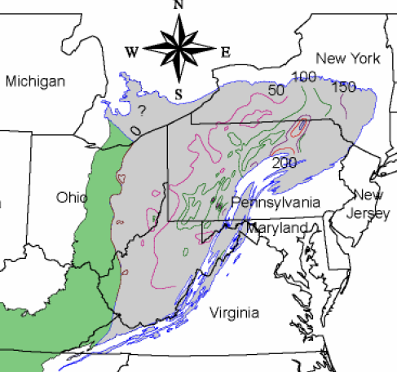
Background on Marcellus Shale
34 million acres in size, multi-state
Several million acres leased
Multiple companies drilling in region – consolidation, globalization
$2 Billion invested in Appl’n. basin in 2008
11

Slide 12
Acceleration of Activity
Monthly Average Number of Permits and Wells
 | Permits issued | Wells drilled
2008 |  | 16
2009 | 165 | 64
2010 | 246 | 117
Source: PA DEP (http://www.dep.state.pa.us)

Slide 13
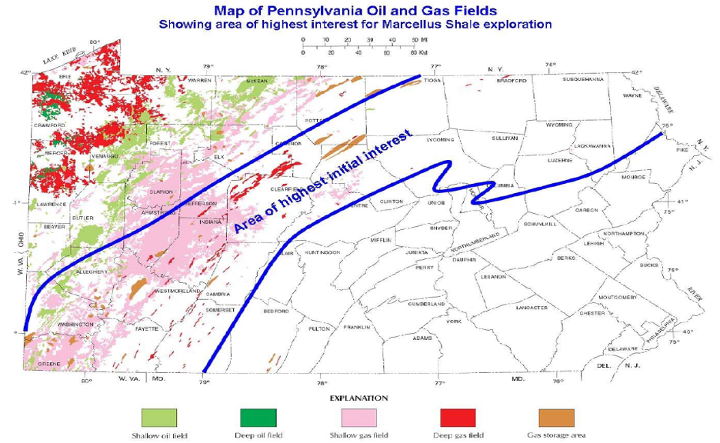
Where is the Interest?
Notes:
Yet company interest in drilling falls in a swath through the middle of PA- the thickness of the Marcellus layer declines as you go further northwest – a thicker layer means any single well accesses more Shale, so its more cost effective

Slide 14
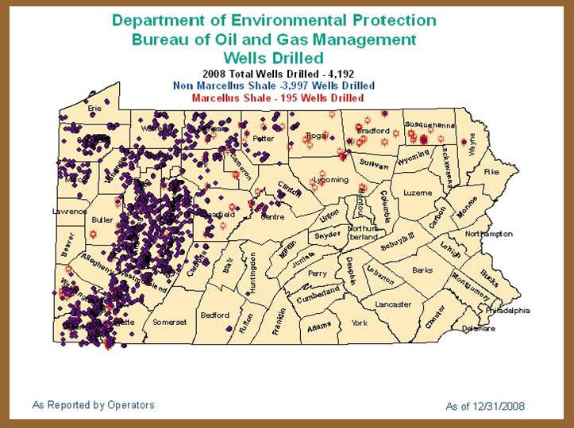
Wells Drilled 2008
Notes:
Marcellus is 5% of all wells drilled

Slide 15
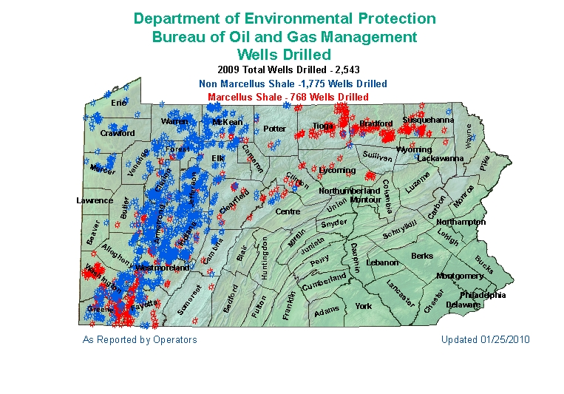
Wells Drilled 2009
Notes:
Marcellus is 30% of all wells drilled

Slide 16
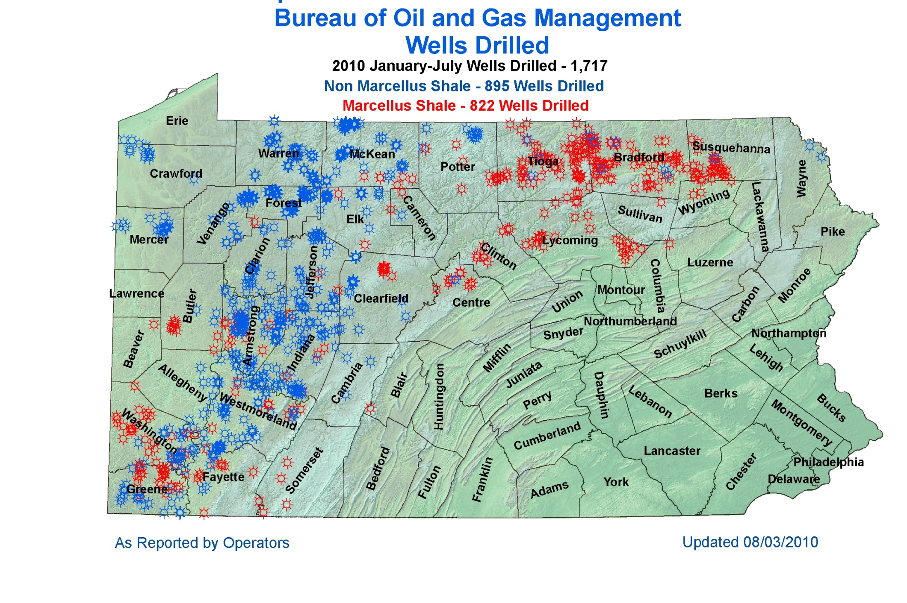
Wells Drilled 2010 to Date
Source: PA DEP (http://www.dep.state.pa.us)
Notes:
Marcellus is 41% of all wells drilled

Slide 17
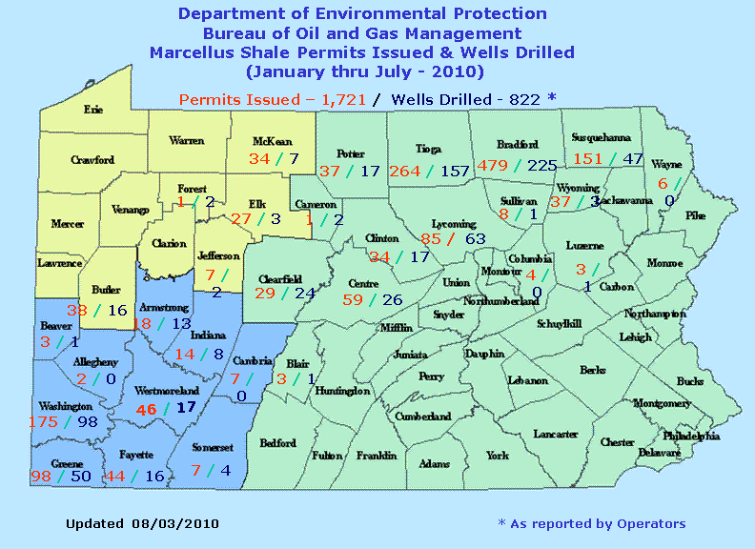

Slide 18
Three Phases of Natural Gas Development
Development Phase (Short Lived/Labor Intensive)
  Well-pad and Access Road Construction
  Pipeline Construction
  Drilling of the Well
  Fracturing of the Well
  Reclaiming Some Disturbance
Production Phase (Long lived/Small & Steady Labor Force)
  Trucking Water and condensate from Well Site
  Monitoring Production
  Occasional Well Work-Overs (partially re-drill/re-frac)
Reclamation Phase
  Dismantle and Reclaim well-sites
Source: Jacquet
Notes:
When thinking about the economic and employment impact of natural gas, its vital to keep in mind the varying labor needs throughout the phases of natural gas production.
There are three distinct phases, which very different labor requirements:
Length of time unknown – because play is so large, different parts of state will be in different stages at different times

Slide 19
Jonah/Anticline Fields Direct Workforce
Graph: Ecosystem Research Group/Jacquet
Notes:
This slide illustrates how employment needs vary, based upon the phases of development. During the drilling and pipeline building process, lots of jobs are created. But once all the wells are drilled, the ‘surge’ of employment passes. There are a steady number of jobs (typically well paying ones), but not at the same level as early.
This variation in employment needs creates planning questions/issues- how ensure enough housing for the ‘boom’ time, without over building so you have too many during the later stages?

Slide 20
5. Economic Impacts

Slide 21
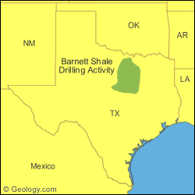
Economic Impacts from Other States
Texas (Barnett)
  Development started in 2001
  Predominantly urban area
  Impacts (Perryman Group)
    $11 billion in annual output (9.3% of total regional output)
    111,131 jobs (10.4% of total employment)
    Provides some stability to Fort Worth area’s economy

Slide 22
Barnett -Which Industries Benefit?
Share of Annual Impact on Business Activity, 2008
Business Sector | Personal income | Employment
Crude Petroleum & Natural Gas | 20% | 6%
Retail Trade | 17% | 28%
New Construction | 10% | 10%
Maintenance & repair | 7% | 6%
Business services | 6% | 4%
Health services | 6% | 6%
Eating & drinking places | 5% | 15%
Transportation | 4% | 3%
Notes:
Important to notice here:
Natural gas benefits ALL of the economy, not just the gas sector. ALL gain.
And compare the ‘personal income’ to ‘employment’ – when income % is higher than employment %, it means the jobs are very good paying compared to the average ; when income% is lower than employment%, it means the jobs aren’t very good paying (but they’re still jobs!)

Slide 23
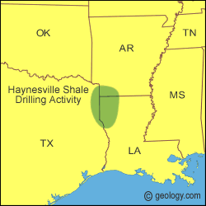
Economic Impacts from Other States
Louisiana (Haynesville)
  Drilling began in 2006
  Impacts (Louisiana Dept of Natural Resources)
    $4.5 billion in annual expenditures
    Nearly $3.9 billion in household earnings
      $3.1 billion in lease payments
      $94 million in royalty payments
    Increase of 32,742 jobs
    Provides some economic stability to the region
Notes:
By end of 2008, 102 drilling rigs were active in the play
Source for drilling rig data: LA DNR economic impact report
Important to note that since most of this is LEASING income, it isn’t sustainable. In their analysis, they did treat the leasing income as wealth (so assumed only 5% spent a year), so the employment effects are spread over years even though the leasing payments will slow or stop. They’re still in the process of ramping up drilling activity, so gas employment will increase.

Slide 24
Direct Economic Impacts: Local Economy
Direct employment
  Drilling each Marcellus well requires:
    More than 410 individuals
    Almost 150 different occupations
    11.5 full time direct jobs
  Once drilled, each well generates 0.17 long-term full-time jobs
Multiplier effects
Caveats:
  Who will take these jobs?
  What happens when drilling is complete?
Source: MSETC/CPWDCWorkforce Needs Assessment 2009 http://www.pct.edu/msetc/

Slide 25
Direct Economic Impacts: Royalties
Royalties
  Example: $2.25 million over lifetime of well, assuming:
    Production of ~4.5 bcf
    Mineral right owner gets minimum 12.5%
    Gas sold for $4 mcf
  Decreases significantly after 15-20 years
Caveats:
  Will it be spent locally?
  How to manage ‘windfall’ income’?
Source: MSETC/CPWDCWorkforce Needs Assessment 2009 http://www.pct.edu/msetc/

Slide 26
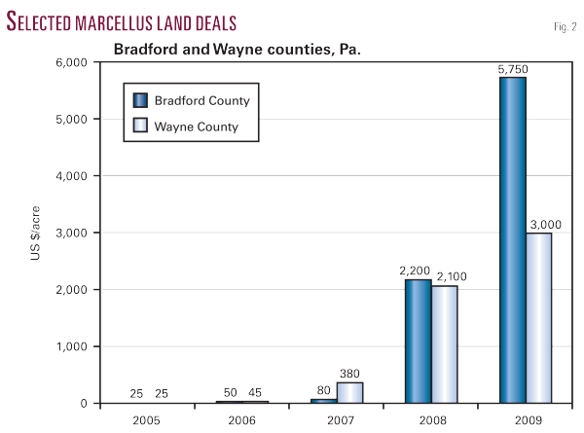
Direct Economic Impacts: Lease Payments
Source: Stephen Bull, Oil and Gas Journal
Notes:
Leasing process – separation of rights – histories in different parts of state

Slide 27
6. Community Impacts Research Update

Slide 28
Research Projects and Questions
Research goals
  Establish ‘pre-boom’ conditions for longitudinal study
  Document early impacts
  Identify objects ‘at risk’ from development
  Understand context of risk perceptions (trust, extractive history)
  Identify individual and collective responses to risk
  Describe impacts on families, children
  Understand community resiliency
Projects/methods
  8 Case Study counties
  Household survey
  Task force interviews
  Family interviews (planned)

Slide 29
‘Boomtowns’: Community Impacts Literature
Western energy development, largely in 1970s, 1980s
‘Social disruption’: direct & significant influence of rapid population growth and change
  Housing
  Public Services
  Culture, quality of life
  Social problems (crime, mental health)
  Conflict
  Disruption of family, community relationships
But also adaptation, recovery over time

Slide 30
‘Boomtowns’: Community Impacts Literature
But….
  Experience of rapid growth depends on demographics, social position
  Unequal distribution of benefits/costs
Unfolds in stages:
  Boom-Bust-Recovery
  Enthusiasm-Uncertainty-Panic-Adaptation
Experiences, reactions, winners/losers different at each stage
  Important decisions made in early stages based on anticipation and expectations of impacts

Slide 31
Community Impacts in Early Stages of Marcellus
Case studies of counties in PA (7), NY (1)
  Washington, PA
  Lycoming, PA
  Bradford, PA
  Steuben, NY
  Greene, PA
  Westmoreland, PA
  Susquehanna, PA
  Lackawanna, PA

Slide 32
Economic Impacts
Jobs, jobs, jobs (expected)
Effects on other sectors
  Industry hiring away technical and regulatory expertise
    Gaps in local expertise and capacity
    Gaps in regulatory authorities
  Competition
    For workers in related industries (construction, heavy equipment, welding, etc.)
    For raw materials (road building)
  Workforce education challenges and opportunities
    Re-training current local workers
    Training future local workers
  Agriculture
    Save it or kill it?

Slide 33
Wealth Generation
Millions of dollars to date in lease payments
Royalties will be spread over 20+ years
Financial management
  Philanthropic giving to communities? Lasting impact?
  Family wealth transfer planning?
Public entities with leases/wells
  Lasting impact rather than short term problem solving?
  DCNR and leasing
Split estates in western PA
Notes:
At one recent signing meeting in Bradford County, about a half billion dollars in leasing checks were handed out.

Slide 34
Physical Infrastructure & Land Use
Transportation and roads
  Heavy truck traffic on rural roads – public safety concerns
  Road damage and maintenance – experiences vary
Land use planning
  Relatively little local control
  Communication with industry about siting roads, wells and pipelines to avoid identified areas
Population growth
  Where? How much? What type of people? For how long?
  Associated with industry or with general economic growth?
Housing
  How much do we need now and after the boom?
  Affordability?

Slide 35
Social Infrastructure
Indirect effects
  Some strain on social services
    Example: affordable housing
  Small increases in school populations
Direct effects
  Some increase in criminal justice issues
    Warrants from other states
    Substance abuse, disorderly conduct

Slide 36
Social Stratification and Inequality
Economic divisions
  Haves vs have-nots
  Cost of living
Social divisions
  Long-time vs new residents
  Rural vs urban
  North and west vs south and east
  Privileging of land-based livelihoods
Seen in:
  Statewide discussion of severance tax
  Local discussions about water resources, public land, etc.

Slide 37
Population Growth and Change
Diversity of workers and their families
  Racial
  Cultural
  Linguistic
Issue for service providers, school districts, local government, nonprofits
How to track?

Slide 38
Community Relations
Quality of life
  Residents choose to live in these places because of attachment to that place and its amenities
    What if those amenities change?
    What if newcomers change ‘feel’ of community?
Conflict
  Neighbor conflict over leasing, drilling activities
  Community conflict over public leasing decisions, allocation of public resources
  Potential for conflict because of cultural differences
Trust
  Very low in industry, state government, state regulators
  Concerns related to both competence/capacity and motives/integrity

Slide 39
Tracking Newspaper Coverage

Slide 40
Community Context: Newspaper Coverage

Slide 41
Newspaper Coverage

Slide 42
Household Survey

Slide 43
Household Surveys: Preliminary Results
Sample of 6000 households in 21 PA counties and 8 NY counties
Conducted Oct. 2009 – March 2010
1918 out of 5479 valid surveys returned (35%)
Question topics:
  Community satisfaction
  Social capital
  Community attachment
  Environmental attitudes
  MS knowledge, experience, leasing, employment
  Perceptions of risk re: MS
  Expectations for community impacts from MS
  Demographics

Slide 44
Household Survey: Marcellus Knowledge
 | ‘none’ or ‘very little’ knowledge | ‘some but not much’ knowledge | ‘a good bit’ or ‘a great deal’ of knowledge
Environmental impacts | 38% | 31% | 34%
Impacts on water | 41% | 27% | 32%
Economic impacts | 43% | 29% | 28%
Social impacts | 45% | 31% | 24%
Gas drilling practices | 59% | 24% | 17%
Leasing | 63% | 23% | 15%
Impacts on local govt | 65% | 24% | 12%
Gas-related jobs or job-training opps | 68% | 22% | 10%
Govt regulations | 71% | 19% | 10%
39% were aware of wells or pipelines within 10 mi of home

Slide 45
Household Survey: Information
Contribution to knowledge from: | At least ‘some’
Media | 61.6%
Neighbors, friends, relatives | 47.0%
Internet | 30.1%
Natural gas industry | 22.8%
Landowner groups | 21.5%
Environmental regulatory agencies | 20.3%
Extension | 19.1%

Slide 46
Household Survey: Expectations
 | Get better | Stay same | Get worse | Don’t know
Good jobs | 42% | 34% | 2% | 23%
Job training | 30% | 43% | 4% | 23%
Roads/streets | 10% | 42% | 31% | 17%
Affordable housing | 9% | 51% | 20% | 20%
Recreation | 5% | 58% | 16% | 22%
Neighborliness | 4% | 65% | 10% | 21%
Natural environment | 4% | 30% | 48% | 18%
Drinking water | 3% | 33% | 41% | 23%
Crime/violence | 3% | 52% | 23% | 21%
Overall quality of life | 14% | 48% | 19% | 20%
Overall cost of living | 9% | 42% | 28% | 21%

Slide 47
Household Survey: Leasing Experience
44% (825) own land in Marcellus region
20% (382) own mineral rights
10% (183) have signed a lease
1% (26) have had drilling or pipeline on land they own
Consider signing?
Yes, I have already signed a lease | 10%
Yes, I have not signed, but would consider it | 24%
No, I would not consider it | 27%
Don’t know | 40%

Slide 48
Household Survey: Leasing Experience
Of those who had signed a lease (183):
  49% satisfied, 26% dissatisfied with terms
  45% had not received royalty or lease payments
  Of those who had received payments, 71% were satisfied
Of those who have had drilling or pipe laying on their property (26):
  68% were satisfied, 32% dissatisfied

Slide 49
Household Survey: Institutional Trust

Slide 50
Household Survey: Attitudes

Slide 51
Household Survey: Attitudes

Slide 52
Data Wish List
Tracking of:
  Population growth and change
  Demographic characteristics of new residents
  Workers (permanent, temporary)
  Income change
  Housing
  Land use change
  Changes in community interactions (volunteering, cross-cultural interaction)
  Opinion polling (especially in reaction to major events)
  Companies, businesses
  And …..

Slide 53
Acknowledgements
Research presented here comes from multiple projects, with colleagues from Penn State, Cornell, and Wilkes Universities:
Matt Filteau
Tim kelsey
Diane Mclaughlin
Rich Stedman
Stephan Goetz
Bunny willits
Whitney prose
Jeffrey jacquet
Ted alter
Teri ooms

Slide 54
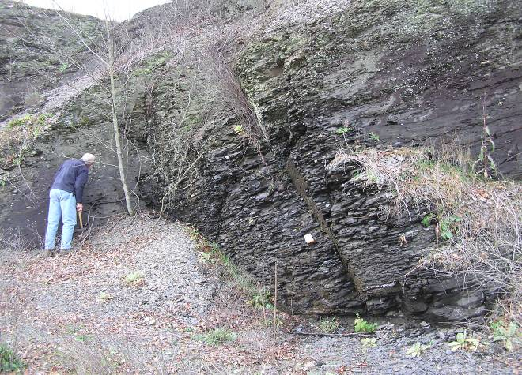
Marcellus Shale – Route 54 near Washingtonville, PA
Notes:
The shale does appear at the surface in some parts of the state.
Its important to note that the shale is hard, and that the gas is bound up directly in the rock- there are NOT broad caverns underground holding the gas, and you simply put a hole in and suck it out. Rather the gas is tightly bound up in the rock.
This has implications for how the wells are drilled and the process for extracting the gas. The hydro fracing is the method the companies use the force open the rock to get the gas–
Fracing uses 1-6 million gallons of water under thousands of PSI to force open natural fractures in the shale. Sand or other fine grained additive in the water is forced into the fractures, holding them open after the water is extracted.

Slide 55
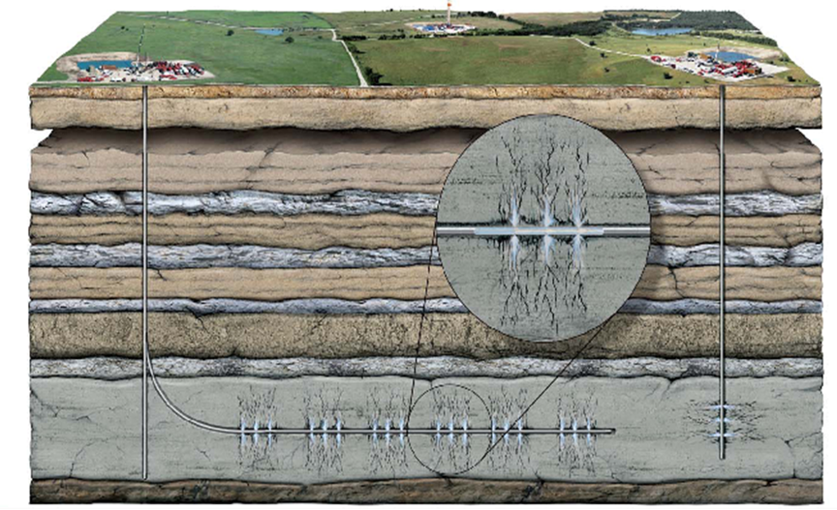
Vertical vs. Horizontal Drilling
Source: Chief Oil and Gas
Notes:
This is an illustration of the difference between vertical and horizontal wells. Note that the vertical well (on the right) only accesses a relatively small amount of Shale- limiting the amount of gas it can extract.
A horizontal well instead can run horizontally 5,000 or more feet – accessing shale throughout this length. The fracing process allows extracting gas throughout the length. This makes a single well much more cost effective.
Several implications:
Since a horizontal well can access much more shale than a vertical well, you need many fewer wells to develop a gas field. This means less surface impact
a horizontal well goes one direction underground– it is common in Texas for companies to put several horizontal wells on a single pad, with each going a different direction like spokes on a wheel. Theoretically one wellsite could thus cover a two mile + area (5,000+ feet in both directions)

Slide 56
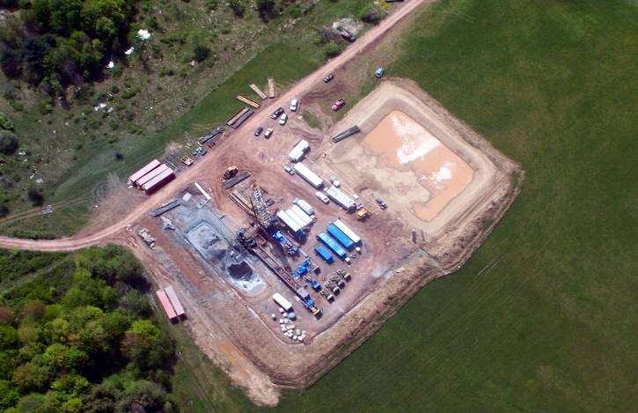
Well Site
Notes:
Here’s a photo of a wells site during the drilling operation. Several things to note:
The drilling rig rising up from the center of the site
The cuttings pool to the lower left of the rig- this is where rock cuttings from the rig are dumped.

Slide 57
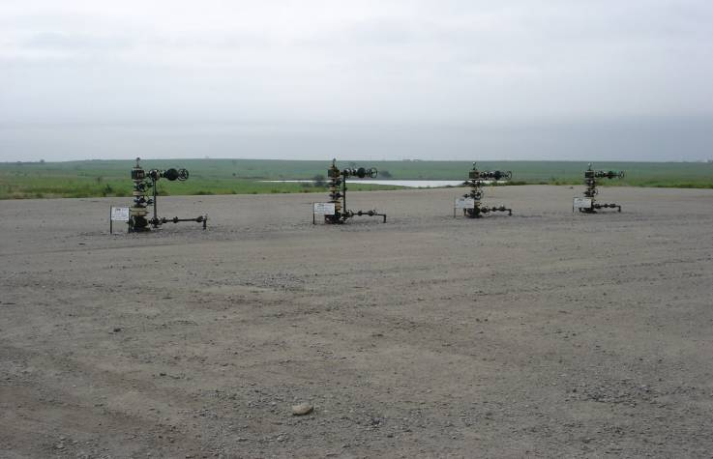
Can be Multiple Wells per Pad
Notes:
Here’s an example of four wells on a single site. This photo is from Texas- and this is what a completed and operating well looks like.

Slide 58
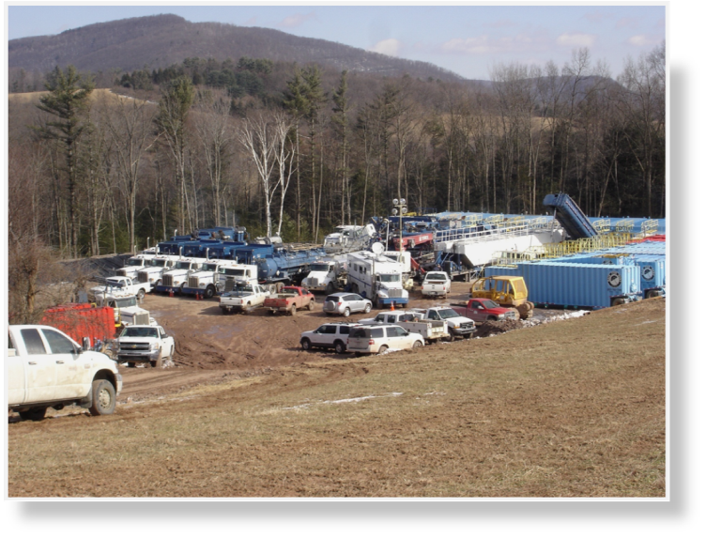
Heavy Equipment Intense
Notes:
Here’s a wellsite during the fracing operation. The wellhead is in the center of the vehicles
The blue trailers on the right hold water
The RV in the center is the command center
The squarish trailer to our right of the RV holds sand
The blue trucks on the left are water (and possibly pumps – its hard to tell at this distance)

Slide 59
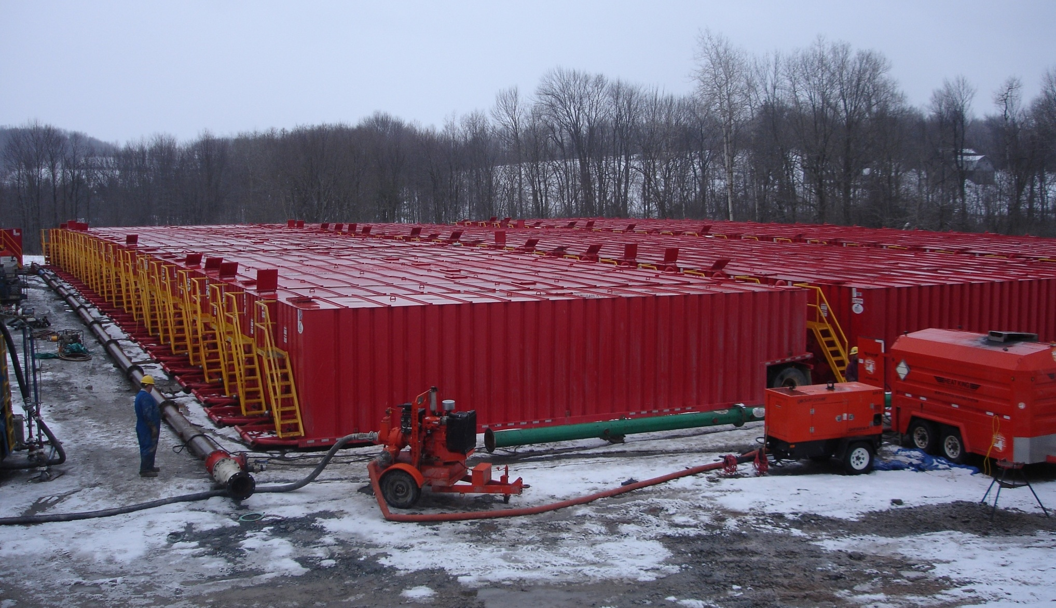
Fracing – water trucks
Notes:
Another view of a frac operation, showing all the water trailers.

Slide 60
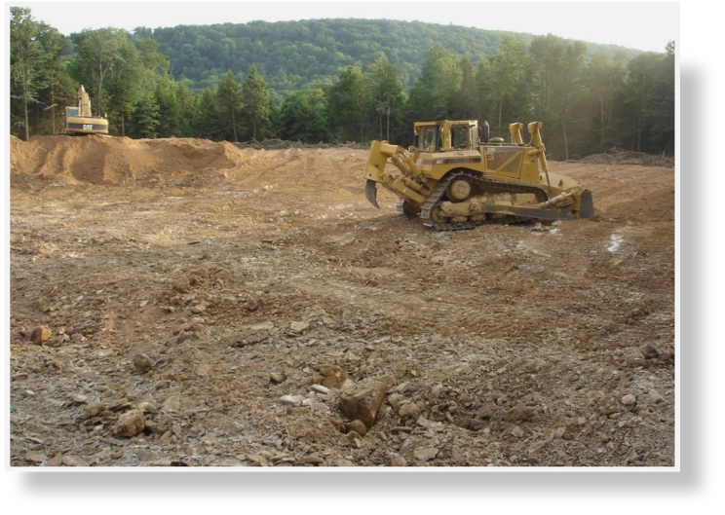
Larger Well Sites Needed
Typically about 5 acres
But can have multiple horizontal wells on same site
Less surface disturbance than vertical wells
Notes:
Because of the water requirements for fracing, the size of the wellpad is larger than required for the more typical shallow gas wells we’ve had in Pennsylvania. Typical well pad for Marcellus is around 5 acres.

Slide 61
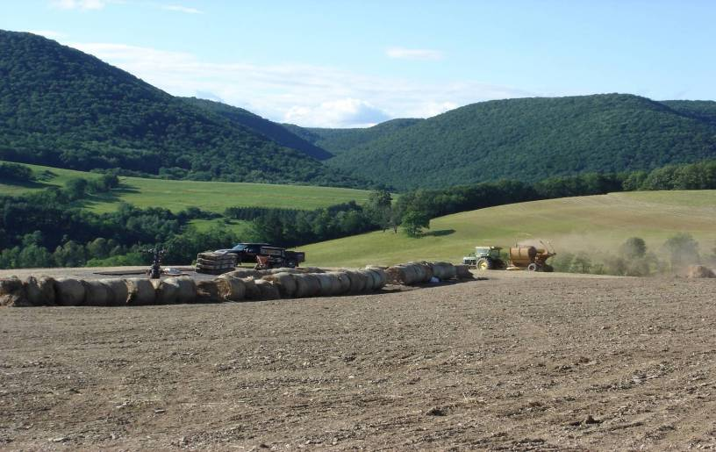
Start of Site Restoration
Notes:
After a well is completed and connected to a collecting pipeline, the site is restored as much as possible to its original condition. This well site is in Lycoming County, and was just completed when this photo was taken.

Slide 62
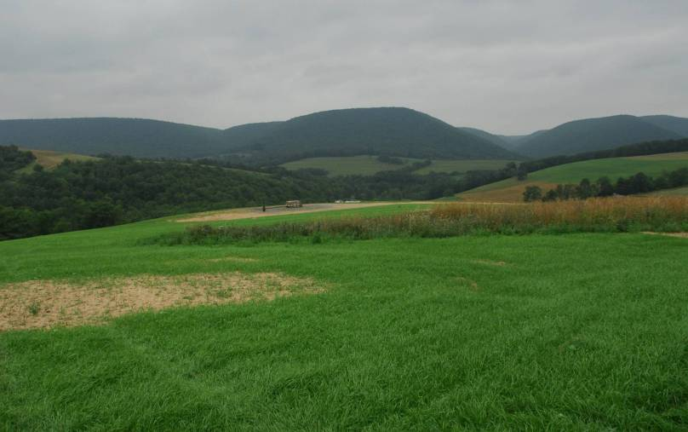
Four Weeks Later
Notes:
This is the same site four weeks later.

Slide 63
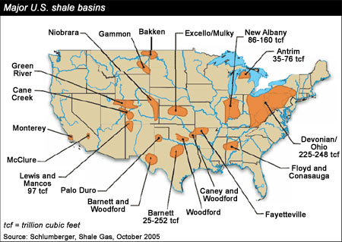
Notes:
Marcellus is the largest (known) unconventional gas play in the world, and it's right in your backyard

Slide 64
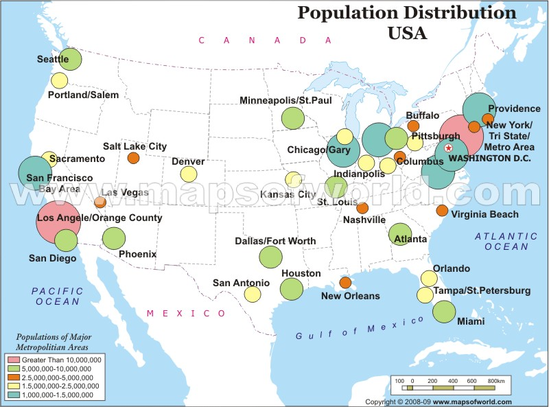
Proximity of Population to Natural Gas Production

Slide 65
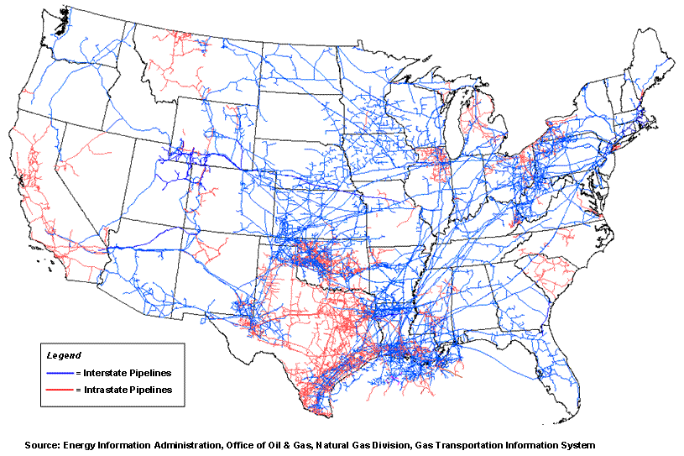
Pipeline Infrastructure

Slide 66
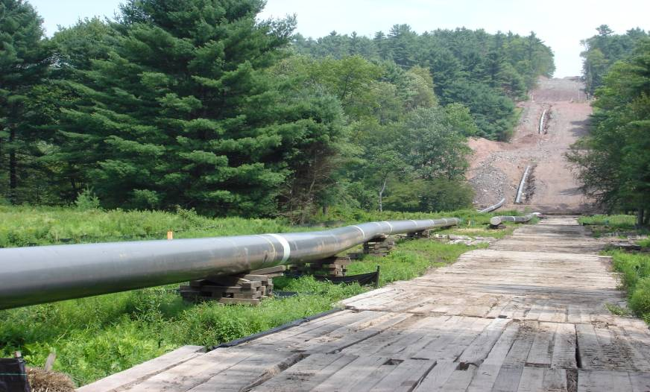
Pipeline Infrastructure
66
Notes:
Another impact of natural gas are the pipelines- a well is worthless unless there is a means to get the gas to market- and for natural gas, this means pipeline. This photo is a construction photo of a pipeline- it’ll be buried underground (yet the clearcut remains afterwards).
(in case there are questions, the timber on the ground in the foreground is there because the ground was somewhat wet and they wanted to minimize soil compaction)

